Slide 1
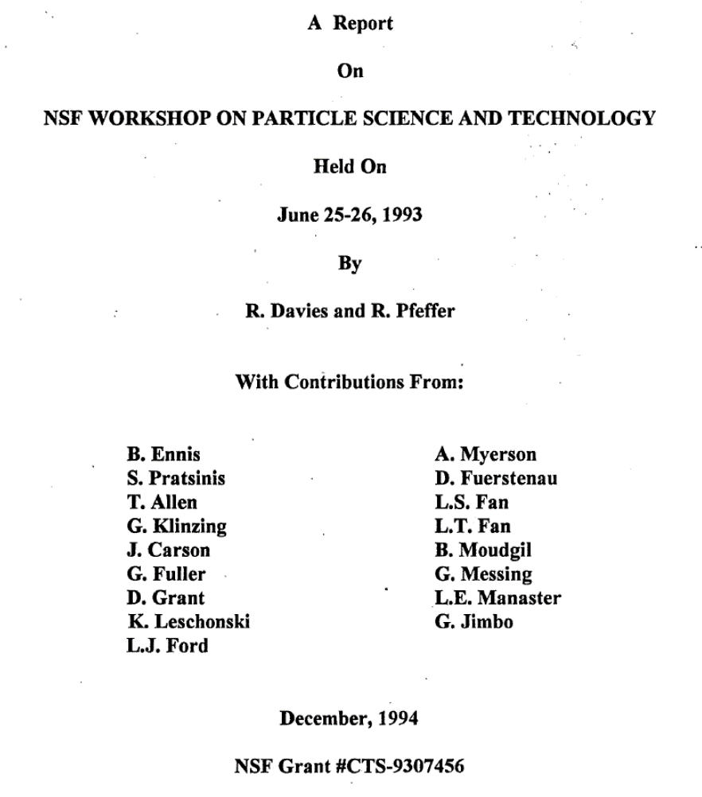

Slide 2
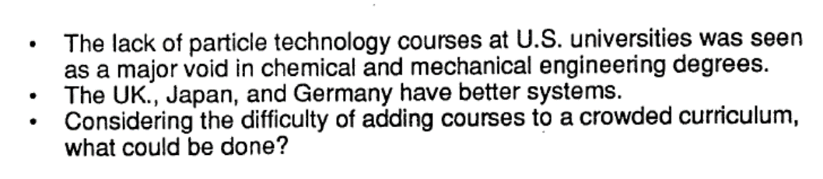
Particle Technology Education - 1993

Slide 3
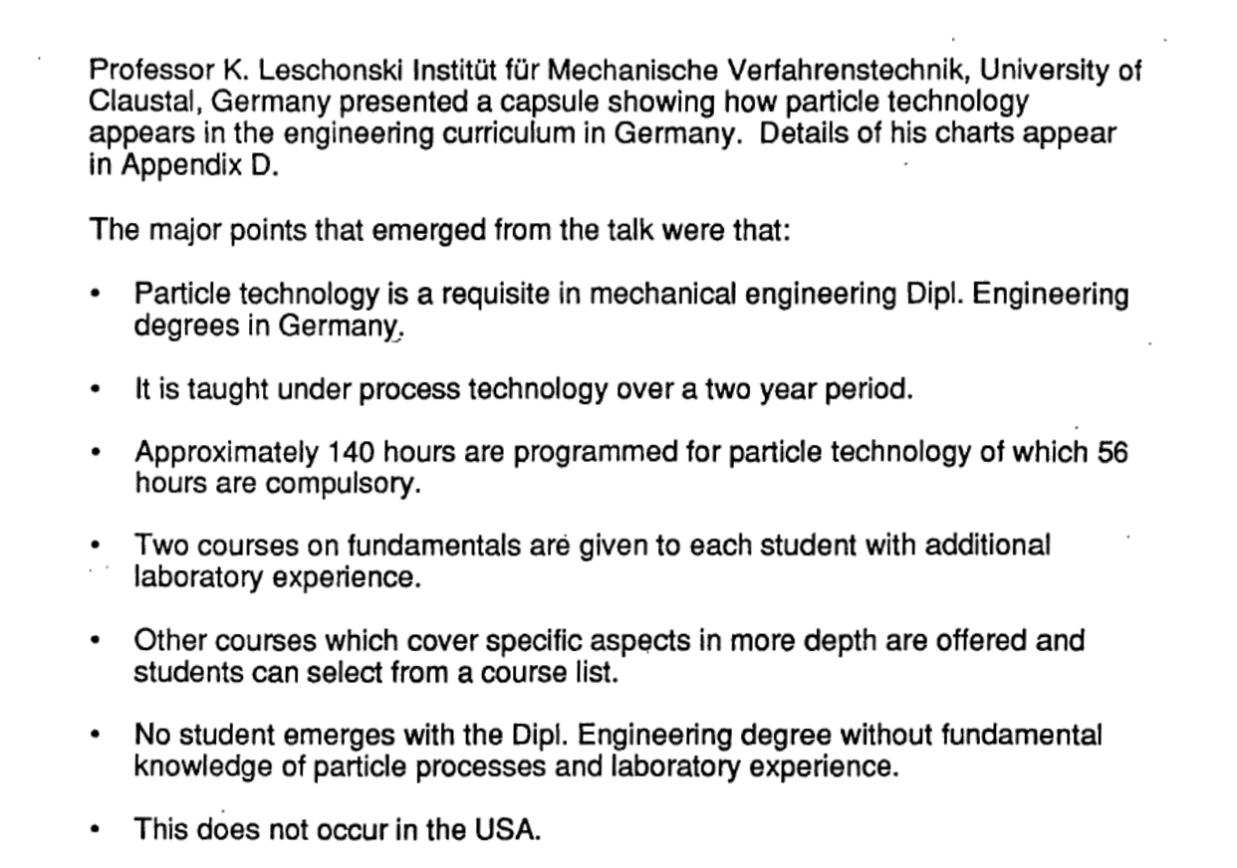
The German Model - 1993

Slide 4
The Path Forward - 1993

