Slide 1
Breakout I – Industry Needs
Green Group
Notes:
Note: Go to “Slide Show” tab and check “Use Rehearsed Timings” if this is to be shown as an automated loop.

Slide 2
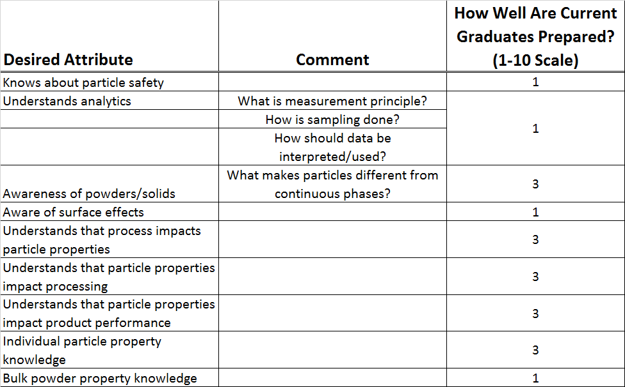
Desired Attributes & Assessment - I

Slide 3
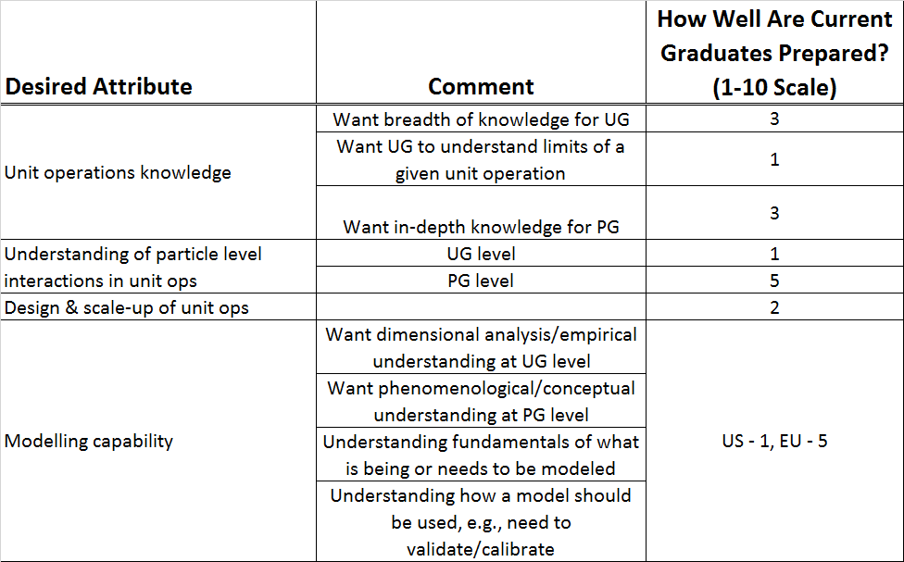
Desired Attributes & Assessment - II

Slide 4
Historical Trend in Preparation
Since 10 years ago: no change
Since 25 years ago:
Fundamental understanding: regressed
Breadth of knowledge: improved
Ability to use models: improved

