Slide 1
Particle Technology Education in North America
Bert Diemer
University of Delaware
Professor of Practice &
Co-Director, MEPT Program
Notes:
Note: Go to “Slide Show” tab and check “Use Rehearsed Timings” if this is to be shown as an automated loop.

Slide 2
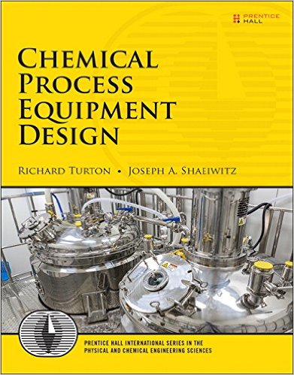
Introduction
Point of view:
US-centric
Chemical Engineering-centric
A quote:
From 3/29/17 promotion letter:
“By the time undergraduates have worked through this material, they will be able… to design most equipment in a typical chemical plant that processes gases and/or liquids.”

Slide 3
Assessment Methodology
Assess key US institutions for Particle Technology research
Identify
In-depth review of 2016 AIChE Annual Meeting PTF Programming
Examine curricula and course catalogs
Internet searches on key words
Review offerings of AIChE Academy

Slide 4
Universities for In-Depth Discussion
8 from PTF Programming Analysis
4 Represented at this Conference
Purdue – Carl Wassgren
Colorado – Christine Hrenya
Rutgers – Alberto Cuitiño
NJIT – Rajesh Dave
4 Others:
Florida
MIT
Penn State
Iowa State
Add Delaware
159 ABET Accredited
121 PhD Granting
On Karl Jacob’s preliminary list

Slide 5
MIT
5 Courses
1 survey course
Pharmaceutical Engineering
Specific industry focus
Undergrad and grad sections meet together
Covers particle processing unit operations
Others
Structure of Soft Matter (undergrad/grad)
Colloid & Surfactant Science (grad only)
Crystallization Science & Technology (grad only)
Introduction to Interfacial Phenomena (grad only)

Slide 6
Florida
1 Undergraduate Course
Fluid & Solid Operations
“Solids” = Fixed & Fluidized Beds
5 Graduate Level Courses
Offered by Particle Engineering Research Center (PERC)
Particle Science & Technology (Survey)
Interfacial Phenomena I & II
Applied Colloid & Interface Chemistry for Engineers
Topics in Colloid Science

Slide 7
Iowa State & Penn State
Iowa State
Surface & Colloid Chemistry (undergrad/grad)
Special Topics – Crystallization (grad only)
Special Topics – Surfaces (grad only)
Penn State
No indentifiable Particle Technology courses

Slide 8
Rack Up
Summary of 4 assessed:
Only 2/4 survey the field
Well-covered at graduate level
Colloids
Interfaces
Surfaces
Crystallization
Rest of Jacob list:
Several courses, maybe a survey, maybe different coverage
Akron, IIT, Michigan, Mississippi State, Ohio State
CCNY offers a suite of courses
Expect this view to be modified by comments from:
Purdue, Colorado, Rutgers, NJIT

Slide 9
University of Delaware ME in Particle Technology
1 Year Professional Masters Degree Program - In its 3rd year!
Courses Open to Advanced Undergrads
Fall Semester (12 credits)
Spring Semester (12 credits)
Particle Kinetics
Particle Transport
Particle Properties
Math for Particle Systems
Particle Unit Ops
Particle Product Engineering
2 Electives
Colloids, Mixing, Statistics
Also offer Intro to Particle Tech (survey)
Summer Semester (6 credits) – Industrial Internship

Slide 10
Internet Search
University of Minnesota
Kansas State
Particle Technology Lab
Mechanical Eng Dept
Offers courses:
Aerosol/Particle Engr
Cleanroom Tech & Particle Monitoring
Aerosol Measurement Lab
Adv. Aerosol/Particle Engr.
HVAC System Design
Dept of Grain Science & Industry
Degree program in Milling Science & Management
Principles of Milling w Lab
Material Handling
Milling Science I & II w Labs
Pneumatic Conveying
Cereal Food Plant Design

Slide 11
AIChE Academy
Offerings
Short Courses (Classroom or Online)
Webinars, Demos, Conference Talks
25% of Entries in Two Areas Reference Particles/Powders
Areas:
Chemials & Materials (1600 of 7000)
Chemical Engineering Practice (6000 of 22000)
Majority are Conference Talks
4 Classroom Courses (Mirrored by 4 Online Courses)
Crystallization, Powder Flow, Pneumatic Conveying, Characterization
11 Webinars
Characterization, Drying, Fluidized Beds, Bulk Powder Storage & Flow, Intro to Particle Tech, Bulk Solids vs Liquid, Crystal Nucleation & Growth, Crystal Engineering for Size & Shape, Hydroclones, Dust Explosions, Intro to Population Balance Modeling
Topics Complement University Offerings

Slide 12
2017 Summer School for ChE Faculty
Diemer/Michaels propose workshop
Proposed Title: Creating and Teaching a Particle Technology Curriculum in the Chemical Engineering Paradigm
Goals: Establish the need for elements of Particle Technology in the education of Chemical Engineers, and stimulate thinking regarding how aspects of Particle Technology may be incorporated into undergraduate and graduate Chemical Engineering programs.
Response:
“We are not able to justify including your session in the program. Hardly any of our participants expressed interest in attending a session on this topic.”

Slide 13
Conclusions
1993 NSF Report: “The lack of particle technology courses at US universities was seen as a major void in chemical and mechanical engineering degrees.”
Changes since are incremental and evolutionary, not revolutionary
US academia taken broadly has little interest in change
Much is left to be learned on the job or via short courses

Slide 14
Backup Slides

Slide 15
Particle Technology Research
2016 AIChE Annual Meeting
53 PTF Sessions
Programming Area Number | Programming Area Name | Number of Sessions
3 | Plenary/Award/Poster | 3
3A | Particle Production & Characterization | 13
3B | Fluidization & Fluid-Particle Systems | 10
3C | Solids Flow, Handling & Processing | 12
3D | Nanoparticles | 12
3E | Energetics | 3

Slide 16
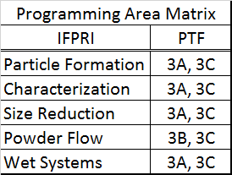
Comments
Particle technology research level is significant:
PTF is 1 of 22 programming areas (5%)
PTF Sessions were 7% of 789 total
Cross product of IFPRI and PTF programming areas:
Nanoparticles (3D) and Energetics (3E) are their own communities
PTF Areas 3A & 3C play
across all IFPRI Areas

Slide 17
Institutions Represented
63 Universities
58 US-ABET ChE Accredited (36%)
55 US-ChE PhD Granting (45%)
4 Canadian
1 US-Non-PhD Granting
0 Mexican
Schools only represented in 3D = 27 (43%)
Schools only represented in 3E = 1
Schools represented in more than one of 3A/3B/3C = 8
Targets for in-depth analysis

Slide 18
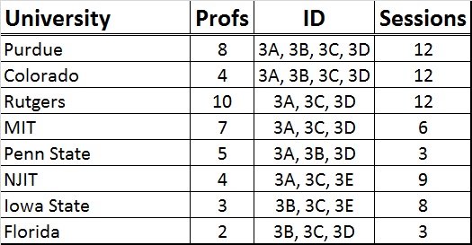
8 Universities at 2016 AIChE

Slide 19
Thomas Baron Award Winners
2016 – Rodney Fox – Iowa State
2015 – Hamid Arastoopour - Illinois IT
2014 – Jennifer Curtis – Florida
2013 – Norm Wagner – Delaware
2012 – Jim Litster – Purdue
2011 – Roger Bonnecaze – Texas-Austin
2010 – Tony Ladd – Florida
2009 – Al Weimer – Colorado
2008 – Dilhan Kaylon – Stevens
2007 – John Grace – British Columbia

