Slide 1
Current State of Particle Technology Education
Asia-Pacific, Japan
Hidehiro Kamiya
Dean, Graduate school of Bio-Applications and systems Engineering,
Dean, Institute of Global Innovation Research
Professor, Institute of Engineering
Tokyo University of Agriculture and Technology, TUAT
Koganei, Tokyo 184-8588, Japan

Slide 2
Outline of this talk
Education in Japanese university, undergraduate education
  Kyoto University
  Tokyo University of Agriculture and Technology
Industrial education program by APPIE with Society of Powder Technology, Japan
Collaboration for education program with ASEAN countries
  Malaysia
  Indonesia

Slide 3
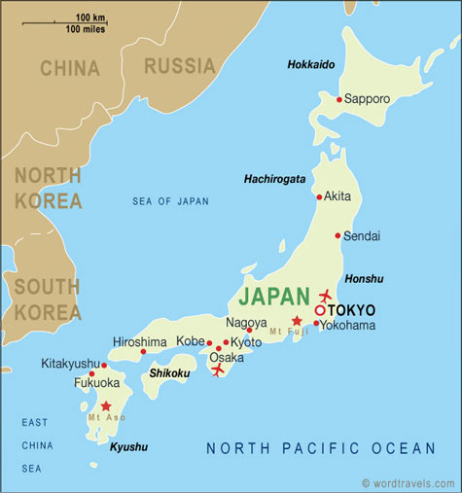
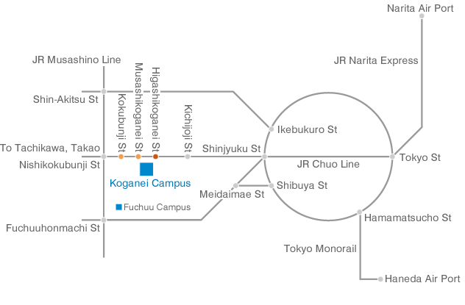
Powder and particle technology laboratory in Japan
Tokyo University of Agriculture and Technology TUAT, Faculty of Engineering
Graduate school of Bio-Applications and Systems Engineering, BASE（Koganei Campus）
Hokkaido University
Kitami Institute of Technology
Muroran Institute of Technology
Toyama University
Tohoku University
Kanazawa University
Waseda University
KOgakuin University
Soka university
Okayama University
Chuo University
University of Tokyo
HIroshima University
Kyushu University
Nagoya Institute of Technology
Kyoto University
Osaka University
TUAT, Faculty of Agriculture
（Fuchu Campus）
Yokoyama National University
Tokyo area
Kagoshima University

Slide 4
Course syllabus
Dept. of Chemical Engineering, Kyoto University
“Fine particle technology” for 3rd year student, undergraduate course
Item
number of lecture
Introduction of fine particle technology 1
Particle properties and characterization 4
Particles behavior in gas phase 5
Particles behavior in liquid phase 4
Conclusion 1
Position of particle technology in chemical process
Size distribution, mechanical properties, electric and photonic behavior, surface interaction. Introduction of characterization methods.
Particle formation, grinding process, aerosol process, deposition on wall, aggregation and dispersion
Particle-particle interaction in liquid, Fundamentals of aggregation and dispertion process, filtration and separation process

Slide 5
Course syllabus
Dept. of Chemical Engineering, Kyoto University
“Chemical reaction Engineering II” for 3rd year student, undergraduate course
Item
number of lecture
Gas-solid reaction and reactor design 3.5
Solid catalyst reaction and reactor design 3.5
Overall reaction rate calculation by using unreacted core model, reactor design and application for coal combustion and gasification
Estimation of effectiveness factor of catalyst reaction, fixed and fluidized bed reactor design
“Transport phenomena” for 3rd year student, undergraduate course
Heat transfer and diffusion on solid surface 3

Slide 6
For under graduate students in Department of Chemical Engineering, TUAT
“Particulate Process Technology”
Fundamentals of Powder and particles science and technology will be introduced. Some applications in the field of energy and environmental, material production process will be discussed based on fundamentals.
Chapter 1. Particle properties
/ Size and size distribution, shape, micro-structure, surface behavior, surface area
/ Particles dynamics, Brownian motion, sedimentation behavior, interaction between particles
/ Characterization, size distribution, surface area
/ Packing structure, pore size distribution
Chapter 2. Fundamentals of powder technology
/ Powder bed statics model, strength (Rumpf’s model), stress distribution (Janssen’s theory)
/ Filtration, dust collection, pressure drop (Kozeny-Carman model)
Chapter 3. Powder, particle design, and control of powder process
/ Particle preparation process, grinding, chemical and physical process

Slide 7


Collaboration between industry and academia for powder and particle technology education in Japan
Industry side
Academic side
Regular members (included industry) | 575
Student members | 151
Corporate members | 294
Others(Library,overseas,honorable) | 113
Total | 1,133
Association of Powder Process Industry and Engineering, JAPAN
Academia collaborate with industries
History of APPIE
History SPTJ
1971 The Council of Powder Process Industry was founded as an informal organization in Nagoya
1974 APPIE, the name of organization was changed.
1976 First exhibition “POWTEX, Tokyo”
1981 A legal corporation approved by MITI, Japan.
1956 Foundation of the Research Association of Powder Technology
1964 Publication of Journal of the Research Association of Powder Technology, Japan (biannualy)
1972 The International Symposium on Powder Technology Kyotoj

Slide 8
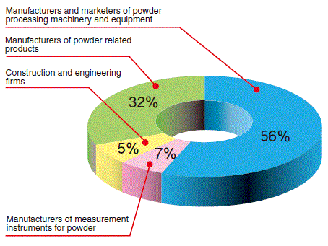
APPIE’s members

Slide 9
APPIE operating organization

Slide 10
Technical center of powder technology
Education division activity
3 levels education program organized on every year.
Special seminar for professional engineers and researchers
18 technical groups are supporting special seminar in various fields
2 or 3 professors are supported as a coordinator in each technical group
Each group consists of 30 to 60 industrial members
Cultivation seminar for Powder Technology Engineer
Introductory basic class seminar
3 times / year, 2 days seminar
Lecture by professors

Slide 11
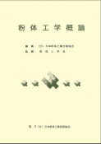
Examples of seminar
Introductory basic seminar
(2 days course, 3 times / year)
Cultivation seminar for Powder Technology Engineer
Introduction of powder and particle behavior
Size and density or particles
Mechanical properties of particles
Particle behavior in gas phase
Particle behavior in liquid phase
Particle motion in fluid
Examples of 2017’s course
August 22-23, 2017
Measurement and control
September 21-22, 2017
Classification and Sieving
November 21-22, 2017
Particle modification
Text book, “Introduction of powder technology”

Slide 12
Professional course are organized by technical groups
Advanced subjects in each technical group’s field are lectured by famous professors.
In each group, 2-3 coordinators (academic), 5-10 organizer (industry), 30-70 industry members are joining.
Unit operation Technical group
Project oriented technical group
Powder Handling
Comminution
Classification and Sieving
Drying
Dust collection
Mixing, Kneading and Forming
Granulation
Measurement and control
Wet process
Transportation
Clean technology
Environmental, Energy and Fluidization
Crystallization
14. Fine powder Nano-technology
15. Battery Manufacturing Technology
16. Recycling and Reclamation
17. Food Process Technology
18. Particle Modification Technology
Special technical committees in APPIE
Nanoparticle safety
Nanoparticles application

Slide 13




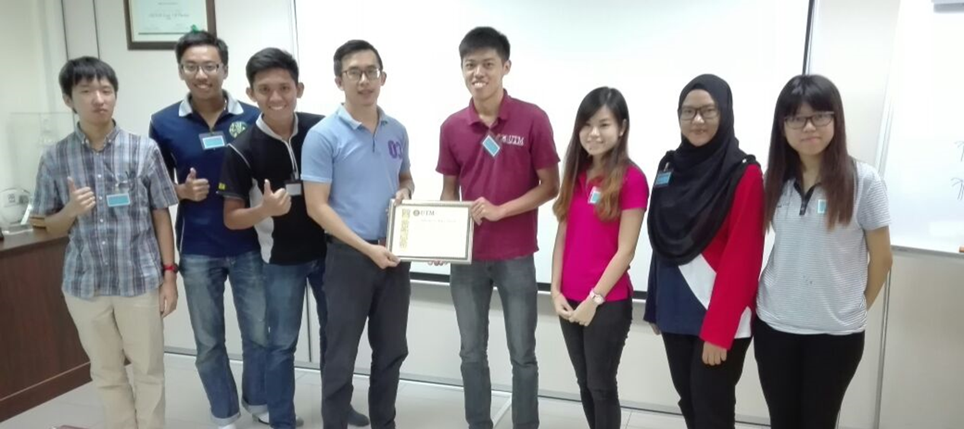
Powder Technology Education with ASEAN Countries
AIMS : ASEAN International Mobility for Students Program
Thailand
Malaysia
Indonesia
ASEAN International Mobility for Students Program (AIMS Program) is a government supported multilateral educational program in the ASEAN region, launched in 2010 by coordinated efforts of Malaysia-Indonesia-Thailand and in 2013 current members include Vietnam, the Philippines, Brunei ( Total : 12 universities in ASEAN ) and Japan
Chemical engineering course, the most active students are joining from ASEAN and Japan side.
Japanese students visit in Malaysia factory

Slide 14
2017 AIMS Program Course List (Faculty of Engineering, TUAT)

Slide 15
Topics for Research Internship in TUAT (AIMS Program 2017)

Slide 16
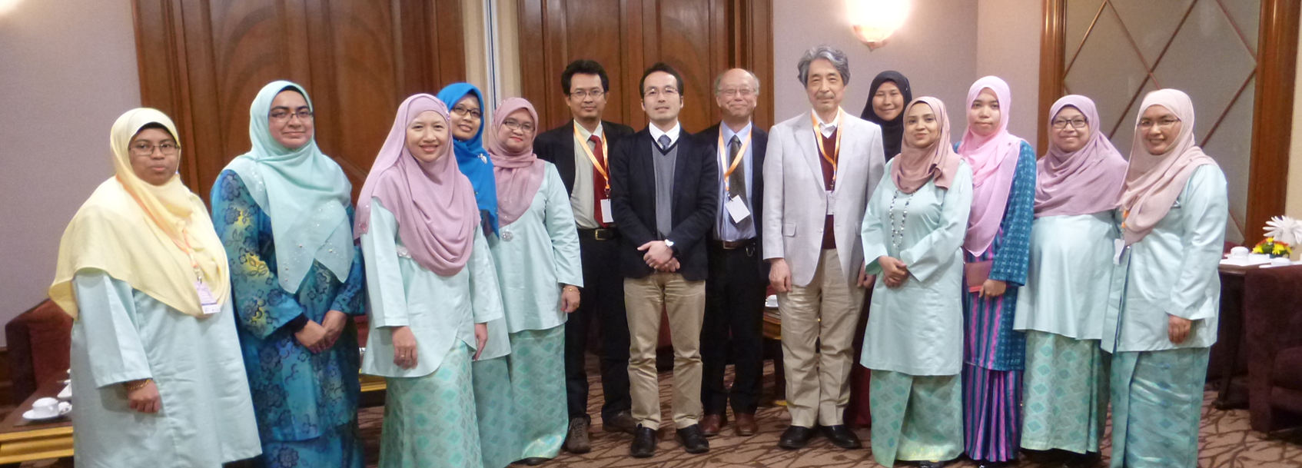
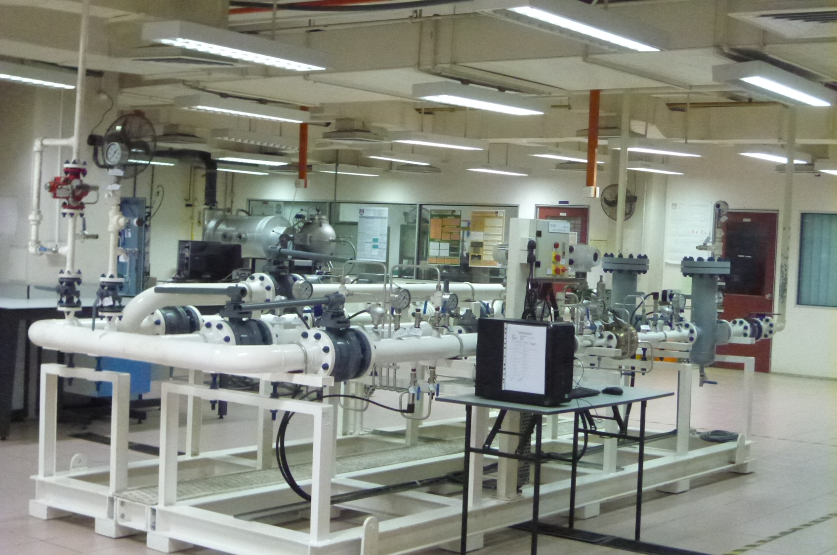
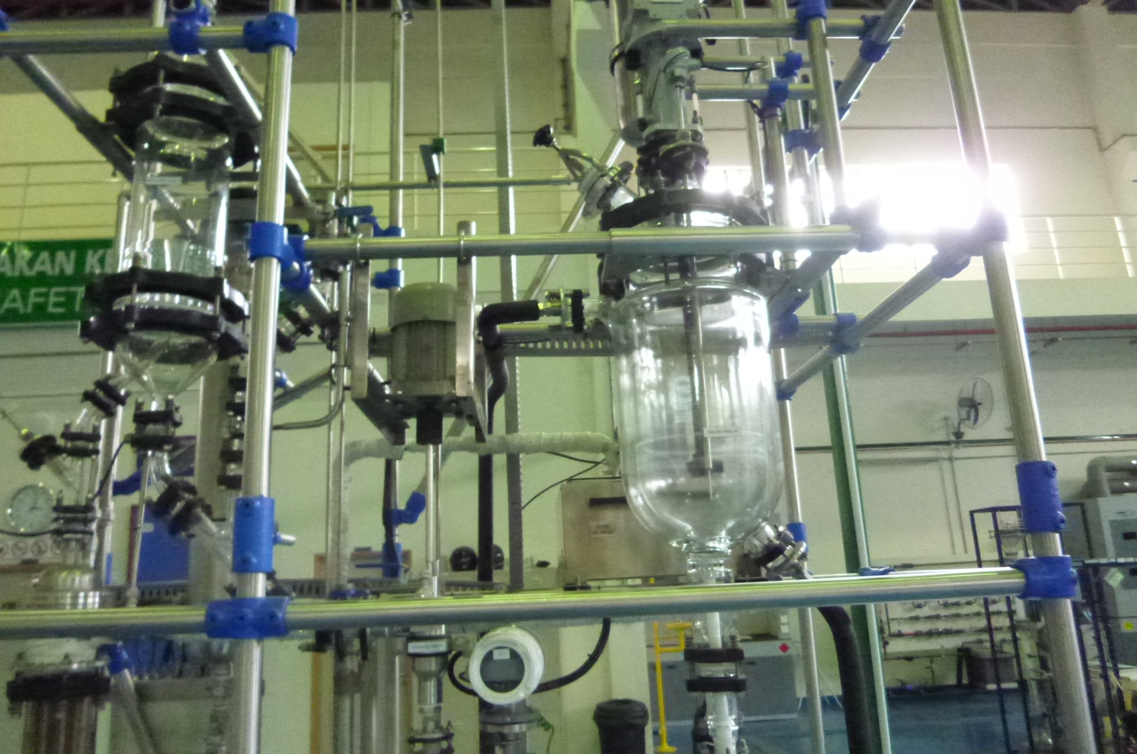
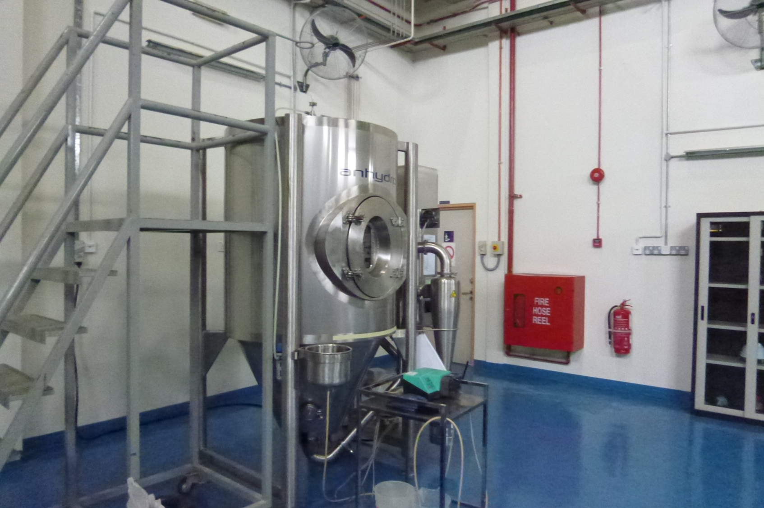
Development of collaboration with Malaysia university
University Technology Mara , UTM
Fluid systems and reactor
Young lectures in Mara
Crystallization
Spray drier
High level equipment for undergraduate student’s education

Slide 17
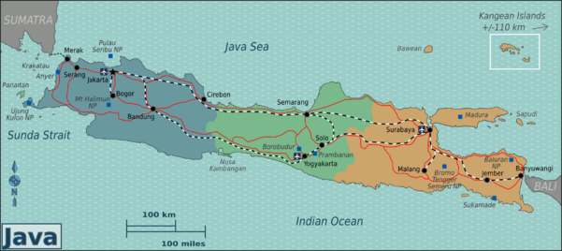
Japan Powder Tech Forum in Indonesia
2012, 2013, 2015, 2017
← 2017: 4th Forum with 1st Indonesian Powder Conf.
← 2015: 3rd Forum with Physics Conf.
← 2012: 1st Forum.
2013: 2nd Forum
with Nanotech. Sympo.
Map: wikitravel.org

Slide 18
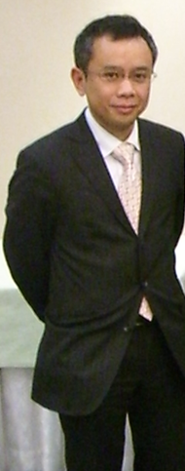
Why Particle/Powder Tech. in Indonesia ?
Population : around 250 million (World’s No.4)
“The country of the future”: The Economist (2016)
Future market is large
Rich of mineral (besides gas and oil)
Only a few R&D players (around 10-15 in 5 groups) in particle technology
A lot of users of particle technology
Dr. Wuled Lenggoro,
Associate Professor
TUAT
Hiroshima Univ. (1998-2006)
TUAT from 2007
19 years in Japan, supervising “key players” on Particle Technology in Indonesia

Slide 19

Proyeksi Jumlah Mahasiswa 3 Bidang Ilmu 2030
Indonesia needs more engineering graduates in future
2009, 2014, 2030
ENGINEERING AGRICULTURE SCIENCE

Slide 20
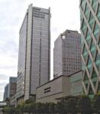
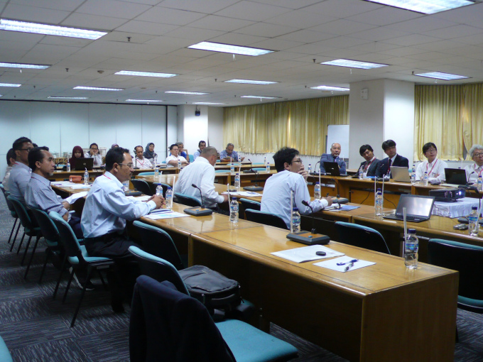
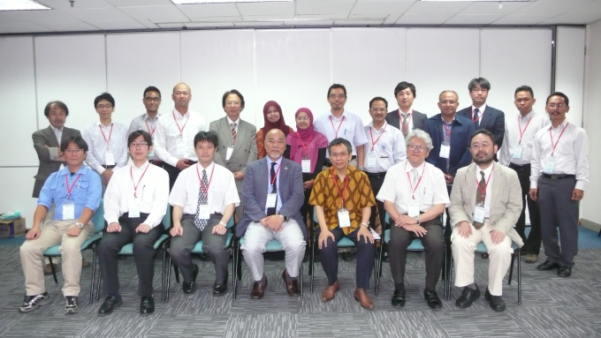
1st Japan Powder Tech Forum in Jakarta 2012
Opening: (T. Matsuyama, Prof. Soka U.)
Nikkiso Co. Ltd. (Mr. K. Satou)
Ohkawara Kakohki Co. Ltd.
(M. Ohkawara, CEO and H. Tomita)
Makino Mfg Co.,Ltd. (T. Makino, CEO)
NIMS (Dr. T. Suzuki)
AIST (Dr. N. Aya)
TUAT (Dr. W. Lengggoro)
Without talk: Dr. S. Endo, Japan Cokes
* Co-Hosted by the Agency for the Assessment and Application of Technology (BPPT: Badan Pengkajian dan Penerapan Teknologi, Indonesia) and co-operated by JETRO Jakarta Office

Slide 21
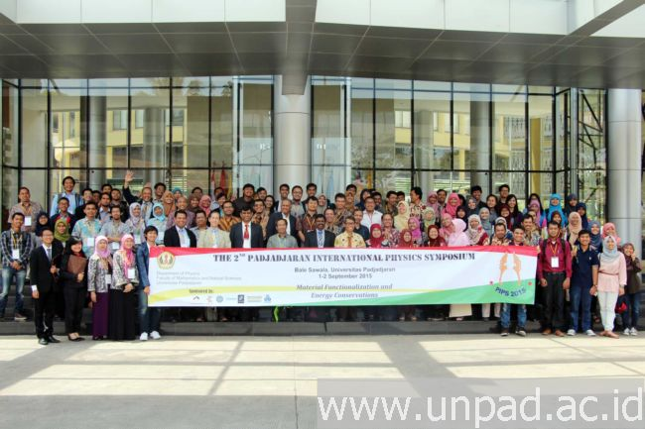
3rd Japan Powder Tech Forum in Indonesia
(within PIPS 2015, Univ. Padjajaran, Bandung)

Slide 22
Education method for innovative young students
New Team LEAD approach

Slide 23
Conclusion
In Asia area, powder and particle technology education are important to develop each country.
Especially, ASEAN area need more engineering graduates in future.

Slide 25
Example :
Request to powder technology education from one company
Powder handling
  Fundamentals of powder and particle behavior
  Powder bed strength (shear test) and dynamics
Powder flow
  Flow in hopper
  Pressure drop of powder bed, Darcy Eq., Kozeny-Carman Eq.
  Fixed bed, Fluidized bed, Moving bed
Solid reaction
  Non-reacted core model of solid particle
  Heat and mass transfer on particle surface

Slide 26
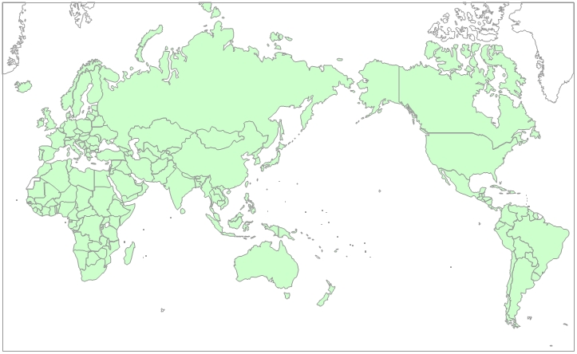
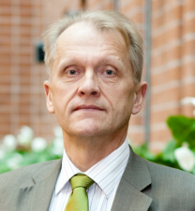
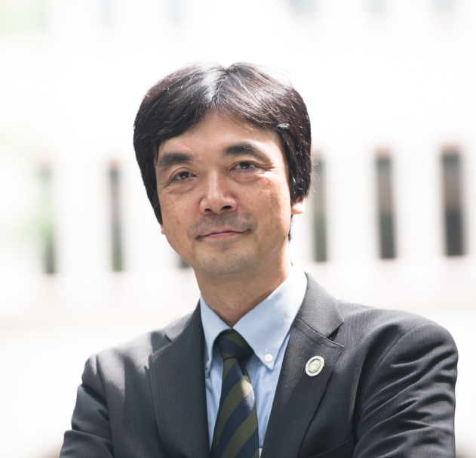
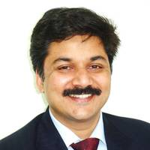
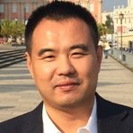
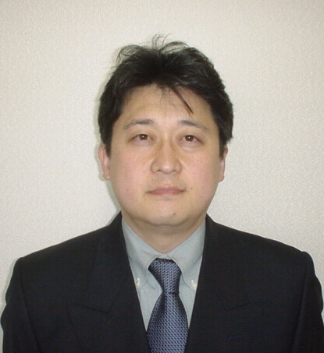

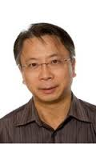
International network for Graduate students exchange by GIR
Prof. E. Kauppinen
Aalto Univ., Finland
Prof. Chiba
Prof. S. Muther
Keln Univ. Germany
Prof. Z. Tong
South East Univ., China
Prof. Nagasawa
Prof. Rashid
Malaysia Institute Tech., Malaysia
Prof. Aibing Yu
Monash Univ. Australia

Slide 27


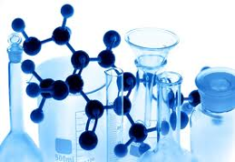


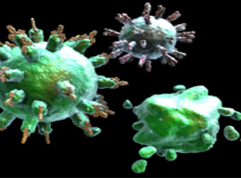


Innovation Leaders with Professional
Sense and Skills for Green-Clean Food Productions
T U A T
Promotion of Professional Sense and
Skills of Leading Research
D3
Collaborative Activities with Top Class International Organizations
D2
Excellent Skills for Innovation
D1
Communication with Real World
D0
Higher Human Caliber
PreD
Motivation for Advanced Learning

Slide 28
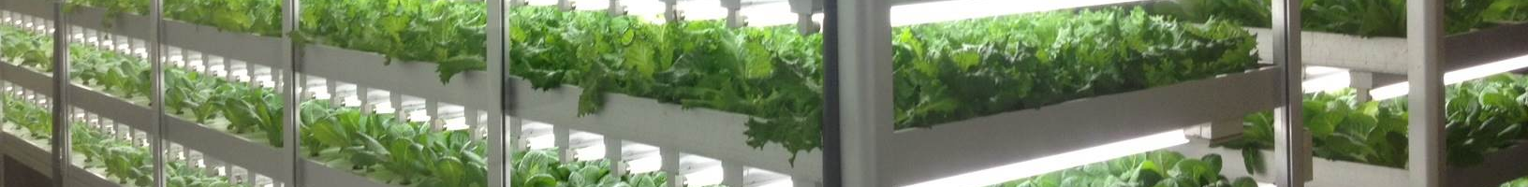
An example of Innovative challenge for The kingdom of Saudi Arabia, produced by our TUAT students
APPROACH
INTRODUCTION
CONCLUSION
BUSINESS
METHOD
・Poor water resources
・Dependence on oil
Severe environmental limitation
&
Remarkable population growth
Difference of ”Food” arise
Notes:
Does everybody know a country called Saudi Arabia? This country located in the Middle East, west Asia is the country which lacks in water resources as everybody imagine. The life of the nation is guaranteed with abundant oil capital now. However we think this country with severe environment and a problem of the population growth will receive the influence of the difference of the food most in the future.
サウジアラビアという国を皆さんはご存知でしょうか。中東・西アジアに位置するこの国は、皆さんのイメージする通り水資源に乏しい国です。現在は潤沢な石油資本で国民の生活は保障されています。しかし厳しい環境的な制約と人口増加の問題を抱えるこの国こそが、将来，「食」の格差の影響をもっとも受けると考えられるでしょう。

Slide 29
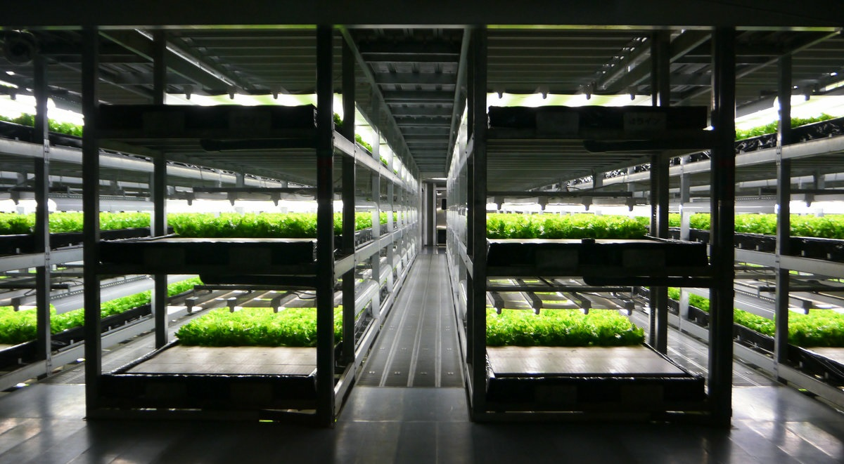
Plant Factory
APPROACH
INTRODUCTION
CONCLUSION
BUSINESS
METHOD
Environmental control in the closed space
Effective production
Notes:
Then, we paid attention to a indoor type of a plant factory as approach which enables to save water resources. And It can produce foods effectively by controlling the enclosed environment.
そこで、私たちは水資源を有効利用できる生産方法として植物工場に着目しました。植物工場は閉鎖空間で環境を制御し、より効率的な生産が可能となっています．

Slide 30
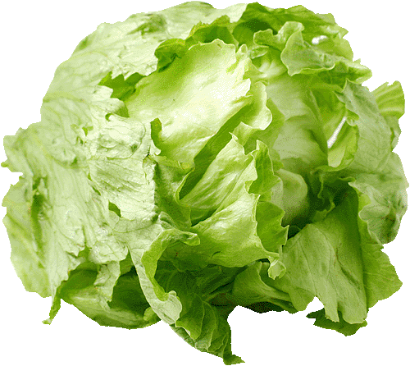
Plant Factory
APPROACH
INTRODUCTION
CONCLUSION
BUSINESS
METHOD
Conventional agriculture
Evaporate
Most of the water
to evaporate or leak
300grams Lettuce
It needs grams
water
11Kilo
Leakage
Notes:
In the conventional agricultural methods, the water which supplied it to evaporates and leaks, and most of them are wasted.
Now, I want ask a question to everyone. How much water is needed to make a 300 grams lettuce in a field? Please imagine.
The answer is 11 kilo gram.
This is an example with a little water consumption in vegetables.
For example, 300 gram of rise needs 600 kilograms water.
This is amazing.
Like these examples, the most of water is not made good use of, yet the water is the most important element in agriculture .
従来の農法では、供給した水は蒸発、漏出し，その大半は無駄となってしまいます。
では，ここで質問です．畑でひとつ300グラムのレタスを作るのに，一体何グラムの水が必要になると思いますか？
なんと11kgもの水が必要となります．
これでも野菜としては少ない方で，米に至っては，一合の米を育てるのにおよそ300キログラムの水が必要であると言われています
このように，農業において水は最も重要な要素でありながらそのほとんどは有効利用されていません。

