Slide 1
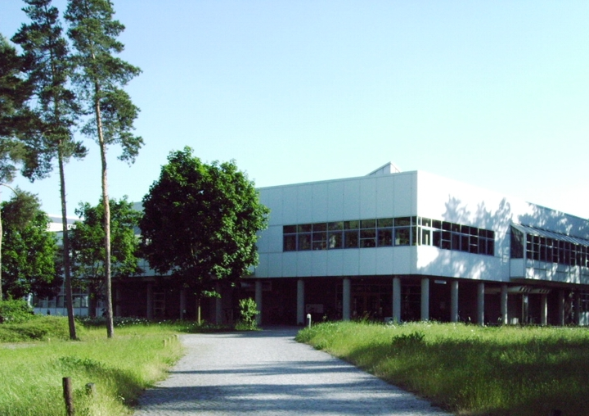
Teaching Concepts for Particle Technology
Wolfgang Peukert
Institute of Particle Technology
Center for Functional Particle Systems
Cluster of Excellence “Engineering of Advanced Materials”
Friedrich-Alexander-University Erlangen-Nürnberg, Germany

Slide 2

Particle Technology in Germany
Germany
Particle technology courses
compulsory in all
chemical engineering programs
(bachelor and master level)
Topics of the fundamentals similar
with local specialities
Aspects of particle technology
in programs of
Material science
Chemistry (colloids)
Nanotechnology

Slide 3

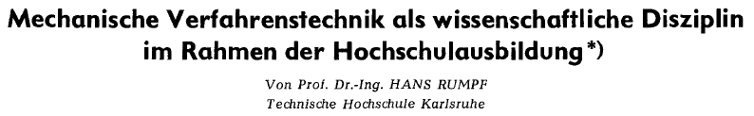
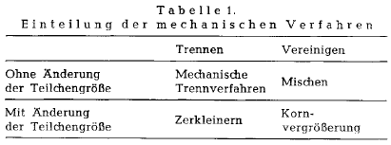
Mechanical Powder Processing ….
… in the classical picture of Hans Rumpf for particle systems > 1 µm
Chem. Ing. Techn. 33 (1961) 7, 502-509
Powder processing as scientific discipline …
…. unit operations with and without change of particle size

Slide 4
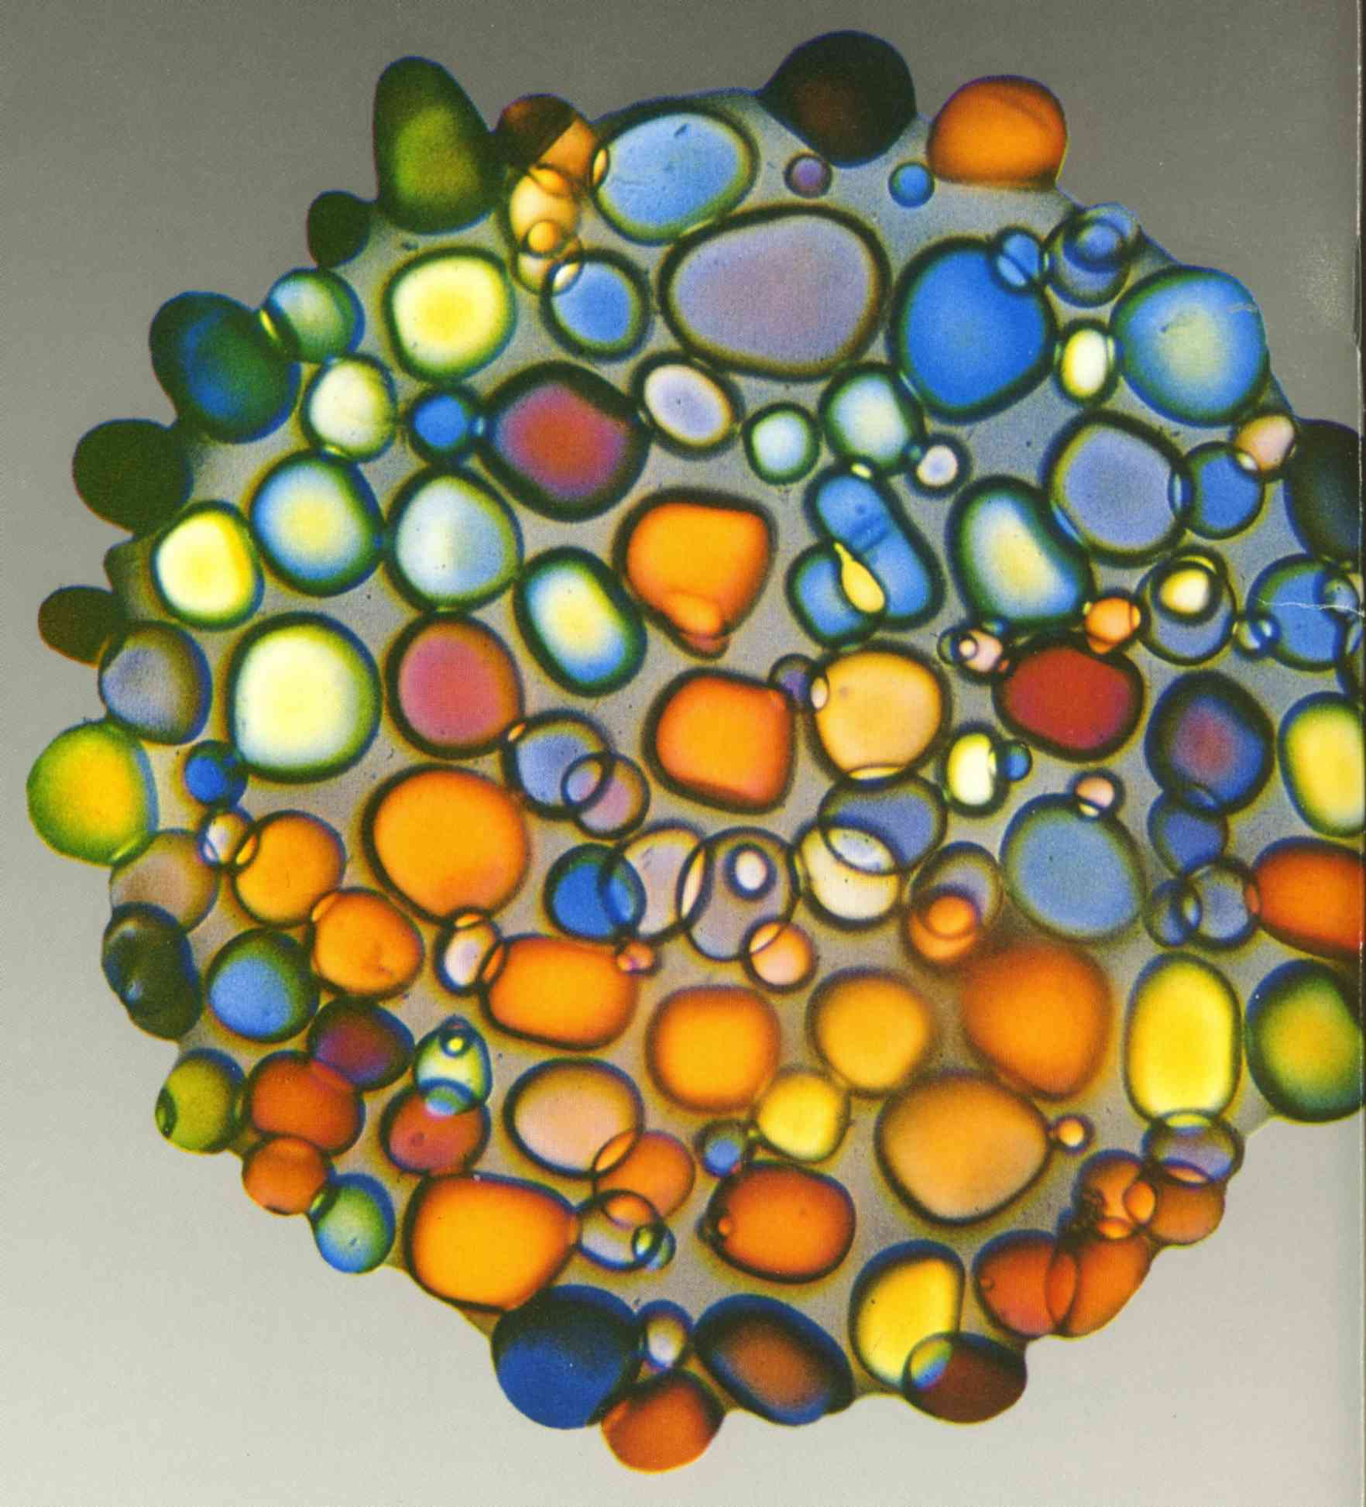
Modern view on particle science & technology
Particle systems engineering
Unit operations
Properties
Size
Shape
Morphology
Structure
Surface
Interactions
Electronic &
Optical
Reactivity
…..
Functions &
applications
Chemistry
Life science
Physics
Technology
Particle physics and chemistry

Slide 5
Format of curriculum (ChemEng)
Medical technologies
Chemical industry
Materials science
Food
Pharma
Environment
Energy
Electronics & Photonics
Applications in
examples
Life sciences
Chemical
Technologies
Physical
Technologies
Bio-, chemical & thermal process eng
Particle technology
Unit operations
Biology, Chemistry
Mathematics
Physics
Mechanics
Materials / CAD
Electronics/ Informatics
Fundamentals
(selection required acc.
to applications)
Basic science
Engineering

Slide 6
Courses and topics
Fundamentals of interface science and technology (Bachelor)
4th semester: 12 x 90 mins lecture, 6 x 90 mins exercise
Chemical engineering, life science engineering, nanotechnology
Interface thermodynamics: contact angle, wetting, capillary effects
Nucleation and crystal growth
Molecular und particulate interactions:
- Intermolecular forces
- Adsorption
- Adhesion (Hamaker – additivity of forces, Lifshitz)
Colloids: Charged interfaces, double layers, DLVO theory
Fluid and soft interfaces: emulsions, foams, proteins, membranes

Slide 7
Key aspects of Particle Technology
Mathematics
Thermodynamics
Statistical
foundations
Property distributions
Population dynamics
Mixing
Separation
Interfaces
Intermolecular &
interparticle forces
Stabilization &
functionalization
Adsorption, wetting
nucleation
Properties and Processes
Applications
Multiphase
flow
Particle trajectories
Separation &
Classification
Fixed &
fluidized beds
Powder flow
Formation &
Formulation
Synthesis
Comminution
Sprays
Dispersions &
Colloids
Characterization
Interactions with
fields
Properties of
particles &
particle systems
Chemistry
(Biology)
(Fluid)Mechanics
Physics (optics, solid state)

Slide 8
Teaching Particle Technology
Peukert et al., Chem. Eng. Educ. (2002) 272

Slide 9
Courses and topics
Fundamentals of Particle Technology (Bachelor)
5th semester: 14 x 90 mins lecture, 6 x 90 mins exercise, lab experiments
Chemical engineering, life science engineering, nanotechnology,
new materials and processes (7th semester), energy technology (7th semester)
Size and shape of particles
Particle motion in fluids: deterministic and stochastic
Particle size distributions
Separation
Mixing including a few statistical fundamentals
Pressure loss in fixed beds, fluidization, transport
Population balances – basic equations
Size reduction
Powder mechanics

Slide 10
Particles as enabler
Many new applications, e.g.
Additive manufacturing and 3D printing: from powders to devices
Energy technologies: Batteries, electrolysis, solar cells …
Life sciences: Biotechnologies, tissue engineering, individualized medicine …,
Nanotechnology: Transfer from lab to applications
New process chains and product classes, e.g.
Electrified interfaces, e.g. in batteries
Printable solar cells and electronics
Formulation in life sciences
require innovative methods for product design and process optimisation.
Collaboration with other disciplines in science and engineering, e.g.
Mathematics: PDEs, efficient solvers, optimisation
Materials science: Product properties
Physics: Electronics, optics, energy
Biology: Green, red and white biotechnology
New applications, new methods in diverse interdisciplinary fields require
unified concepts (shift from unit operations to product design)

Slide 11
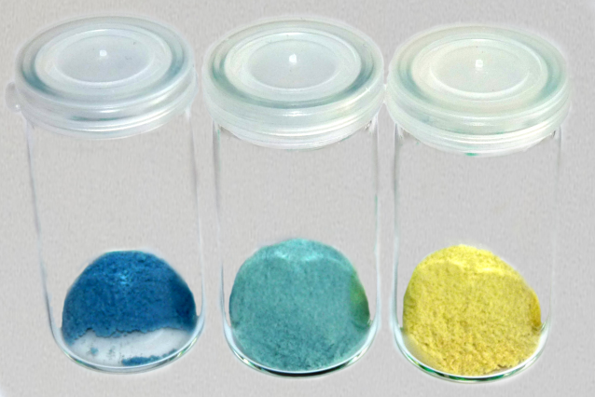
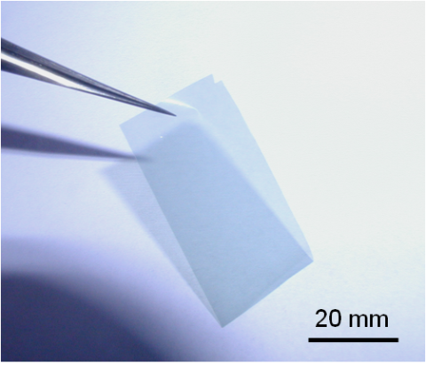
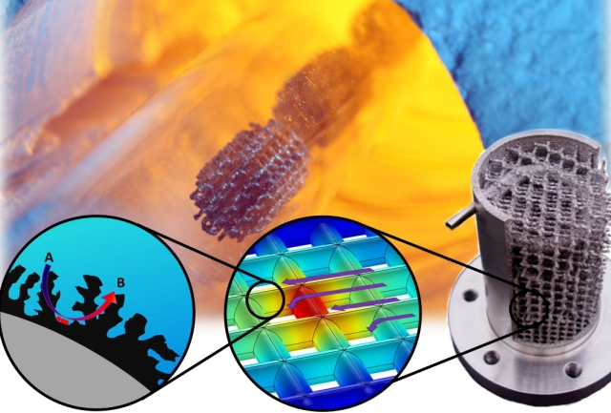
Product design
Structure – property functions across all levels:
Molecular, particulate, particle ensemble, final product
Free flowing & easily dispersible
& controlled defect state
Transparent & smooth
& very strong
High surface area &
low pressure drop & catalytic
Process – structure functions
Process design and process variables determine structure formation of
molecules, particles, particle ensembles and final product.
Synthesis
Phase A
Phase transfer
Phase B
Formulation
Thin film
Process chain, e.g. for semiconductor formation/application
W. Peukert, Adv. Chem. Eng. 2016

Slide 12
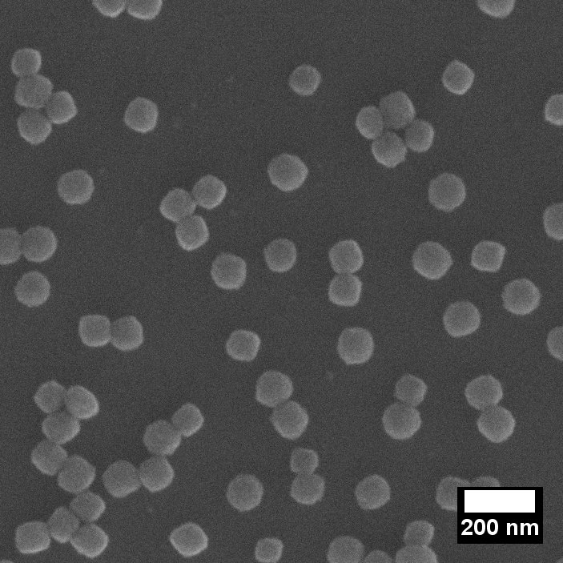
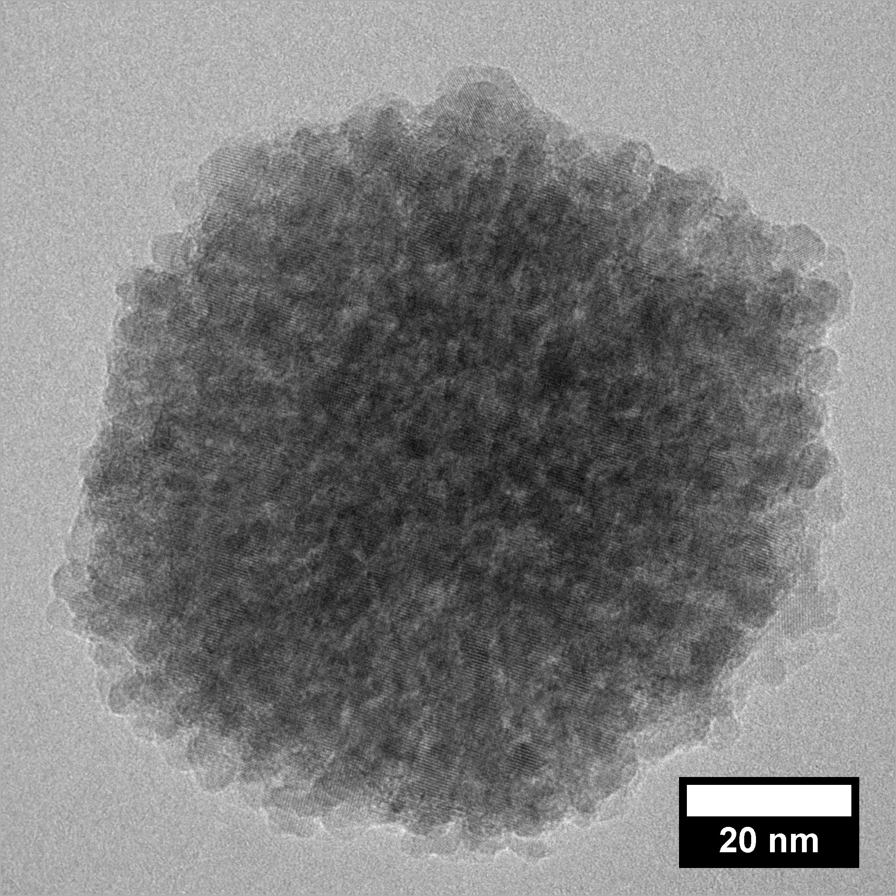

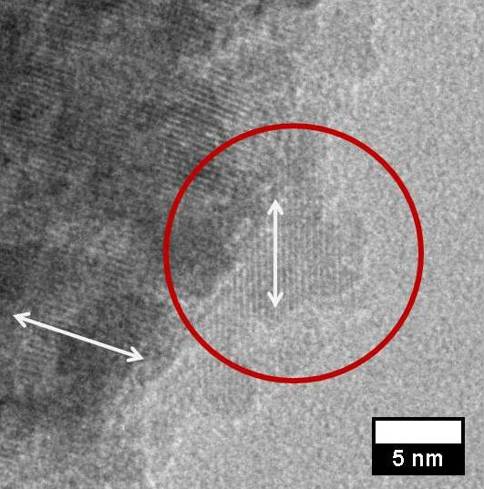
Unifying concepts of product design
Hierarchical structure in mesocrystals
200nm
20nm
5nm
Enabling technologies
Particle
formation
Interactions
Structure
formation
Character-
ization
Modelling &
Simulation
Top-down
Bottom-up
Intermolecular
Interparticulate
Phase behaviour
Transport
phenomena
Self-organization
Off-line
On-line
In-line
Multiscale
Quantum mechanics
Discrete elements
Continuum
W. Peukert, Adv. Chem. Eng. 2016

Slide 13
Courses and topics - Electives
Particle Technology II - Product Design (master)
12 x 90 mins lecture, 6 x 90 mins excercise, lab experiments
> 100 students / year
Property and process functions
Unifying principles of product design
Particle formation:
- top-down (comminution, emulsification)
- bottom-up (precipitation, gas phase processes)
Aspects of formulation
Aspects of structure formation (e.g. thin films)

Slide 14
Courses and topics - Electives
Product development (12 x 90 mins, taught by J. Uhlemann, Bayer)
Characterisation of particulate systems (14 x 90 mins)
Fluid-particle flows (14 x 90 mins)
Modelling of disperse systems (12 x 90 mins lecture, 6 x 90 mins, comp. Lab)
Nanotechnology of disperse systems (12 x 90 mins)
Colloids and polymer technologies (12 x 90 mins)
Defects in particles (12 x 90 mins)
Project design (3 weeks, compulsory)

Slide 15
Towards an integral university education
Peukert, Schmid CIT (2003), 177

Slide 16
Fine Particles
From powder processing to science and technology of particle systems
Solid particles (….)
Fluid particles (droplets emulsions, gels)
Gaseous particles (bubbles, foams).
Increasingly complex particles for innovative solutions in other disciplines, e.g.
Material science (microstructure)
Energy technologies (electronic structure, defects)
Life sciences and medicine (z.B. nanomedicine, drug delivery).
Nanoparticles as building blocks („Lego“) for hierarchical structure formation,
accordingly, interfaces come into focus
Particle shape and structure, chemical and electronic structure require
new high-end characterization methods
(e.g. HRTEM, SAXS/SANS, transient spectroscopy)
Efficient multiscale models in combination with mathematical optimisation
allow knowledge-based structure, property and process design

Slide 17


www.iceam2017.fau.de
10 years of interdisciplinary research at EAM in the international context of state-of-the-art science and engineering research
mix of invited plenary, keynote and submitted talks and posters
four parallel sessions
Deadline Abstract Submission 30 April 2017

