Slide 1
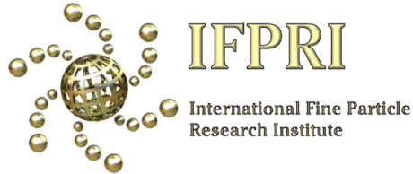
Particle Formation 2023
New analytical technique AFM-IR
Possible researchers for future IPFRI projects
Future casting…
Professor Karen Hapgood
Deputy Vice Chancellor, Research

Slide 2
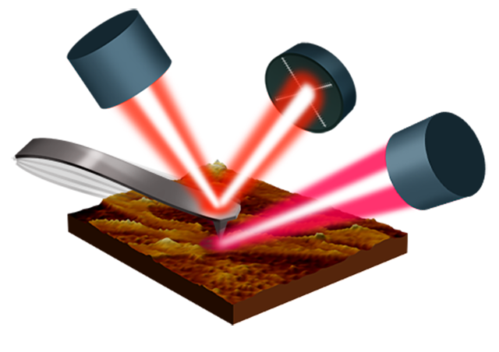

Shine a pulsed-tunable IR laser at an AFM tip ??
Is it?
Crazy – everyone knows you must avoid heat sources to avoid thermal drift in an AFM image
Genius –AFM can finally move beyond phrenology by combining topography with direct information on chemical content
Prof Mark Banaszak Holl
Dazzi, A. and C. B. Prater (2017). "AFM-IR: Technology and Applications in Nanoscale Infrared Spectroscopy and Chemical Imaging." Chemical Reviews 117(7): 5146-5173.

Slide 3
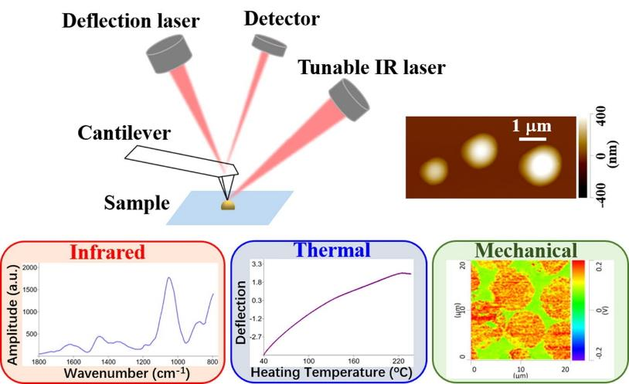
AFM-IR for drug delivery characterization
Zhang, J., D. Khanal and M. M. Banaszak Holl (2023). "Applications of AFM-IR for drug delivery vector characterization: infrared, thermal, and mechanical characterization at the nanoscale." Advanced Drug Delivery Reviews 192: 114646.

Slide 4

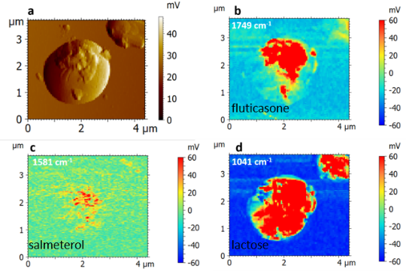
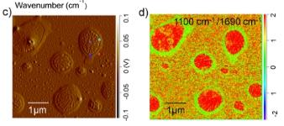
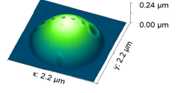
Photothermal Infrared Applications
From Banaszak Holl Laboratory
Drug Delivery
Microplastics, Materials
& Environmental Aerosols
Analytical Chemistry 2022, 94, 11973
Macromolecules 2022, 55, 5301
ACS Earth and Space Chemistry 2022, 6, 871
Chemical Engineering Journal 2021, 428, 132614
ACS Applied Materials & Interfaces 2021, 13, 46033
ACS Nano 2021, 15, 13721
ChemPhotoChem 2021, 5, 571
Polymer 2021, 222, 123643
Frontiers in Marine Science 2020, 7, 576170
Global Challenges 2019, 1800104
Analytical Chemistry 2017, 89, 8594
Advanced Drug Delivery Reviews 2023, 192, 114646
International Journal of Pharmaceutics 2023, 632, 122563
Analytical Chemistry 2020, 92, 8328-8322

Slide 5


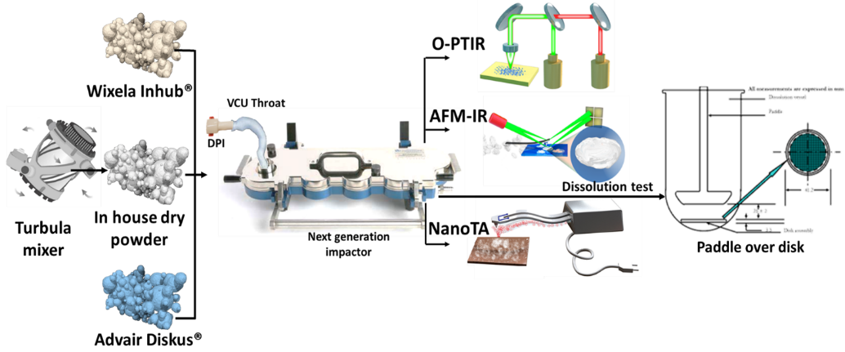
Summary
Division of Pulmonology, Allergy, and
Critical Care Medicine
“Generic”
“Name Brand”
Ongoing collaboration between HK (Kim) Chan at U Sydney and Mark Basanak Holl (U Alabama)
Ongoing study for FDA using combination of Spectroscopic, Thermal, and Mechanical data to evaluate Generic vs Name Brand aerosol drug formulations

Slide 6
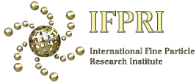
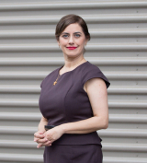
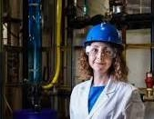
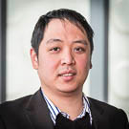

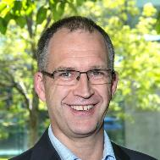
Talent – potential researchers and hiring skills
Dr Madshid Firouzi
Dr Andrew Ang
Prof Yansong Shen
Prof Brent Young
Assoc Prof
Elham
Doroodchi
Interfacial interactions in multiphase flows (froth/foams/emulsions, bubble coalescence, thin liquid films)
Expts + modelling
PhD UQ Chem Eng
Senior Lecturer
Chemical Engineering, University of Newcastle (Australia)
Metallic, ceramic and ceramic-metal composite (carbide-based) thermal spray, cold spray coatings and laser metal deposition
Mechanical Engineering /Ceramics background
Aero-space applications
Industry focussed
PhD Ceramics NUS
Senior Lecturer
Swinburne University
DEM modelling – especially with heat/mass transfer
Blast furnaces & fluidised beds
Industry focussed
President Australasian Particle Tech Society.
PhD UNSW
Postdoc w Aibing Yu (UNSW/Monash)
Uni New South Wales
Industrial Process control
Dairy industry
Particles consulting
Systems engineering and control options
Uni Auckland, NZ
Multiphase systems.
Hydrodynamics of fluidized beds
Solid particle, droplet and bubble motion
Minerals but other areas
Expts + modelling
Very industry focussed
PhD U Newcastle (Aust)
Chemical Engineering, University of Newcastle (Australia)

Slide 7
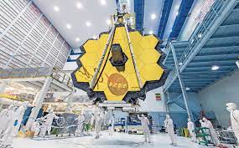
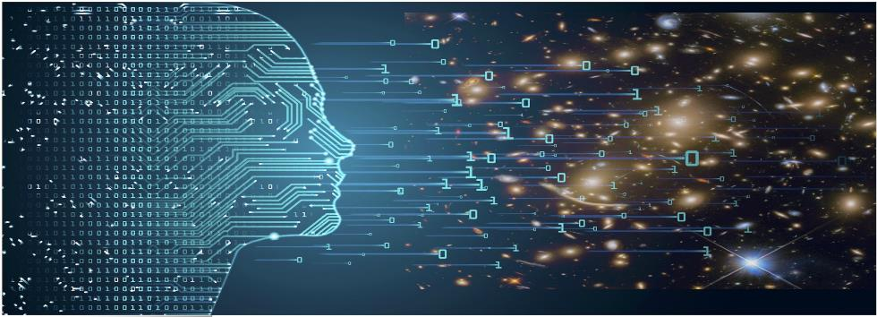

Astrophysics = Data Science (plus physics)
Big astronomy = big data
Astrophysicists are data scientists = AI/ML, coding, supercomputing with a physics background
More PhDs than academic jobs – think broadly!
Data science and modelling

Slide 8
