Slide 1
International Fine Particles Research Institute
The Conversion of Fundamental Particle Science and Technology Understandings into Practical Manufacturing
Filip Francqui
IFPRI President

Slide 2
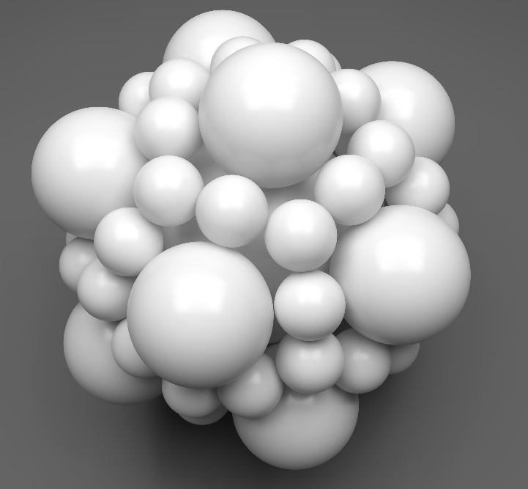
Why is Particle Science Important?
Particles are present in all industrial manufacturing but overlooked. 70% of raw materials are at one point in time in bulk
Powders are misunderstood with terrible consequences
Small changes in particle related processes and properties can have huge effects on productivity and profitability
~40% of value added to chemical industry is linked to particle technology

Slide 3
Historical Overview of Particle Technology
Prior to 1970’s individual schools in US, Europe and Japan (Pfeffer, Austin, Rumpf, Iinoya, Scarlett)
1970’s Franhoffer laser diffraction methods for particle size determination commercialized
1974 Stan Sadin at NASA conceived of the Technology Readiness Levels (TRL)
1979 IFPRI founded to promote industrial particle technology strategy
1994 NSF sponsored workshop on particle technology
Mid 1990’s PTF in AICHE and ERC in FL

Slide 4
Critical Studies in Particle Technology
E. W. Merrow Chem Eng 24, 89-92, 1988
  “Estimating Startup Times for Solids-Processing Plants”
B. J. Ennis, J. Green, R. Davies Chem Eng Prog. 32-43, 1994
  “The Legacy of Neglect in the U.S.”

Slide 5
Original Observations and Mission of IFPRI
Lack of fundamental particle science understanding
Lack of forum for intercompany discussion
Poor connectivity between universities and industry
Provide venue for particle technology discussion
Develop pre-competitive strategic plan for particle science
R&D focus on industry concerns

Slide 6
IFPRI History
Started in 1979 by 5 professors
  Pfeffer
  Leschonski
  Iinoya
  Scarlett
  Tiller
12 International Companies
  DuPont
  Unilever
  Standard Oil Of Indiana
  Bethlehem Steel
  Exxon
  British Nuclear Fuels
  Alcoa
  US Steel
  Eastman Kodak
  P&G
  3M
  ICI

Slide 7
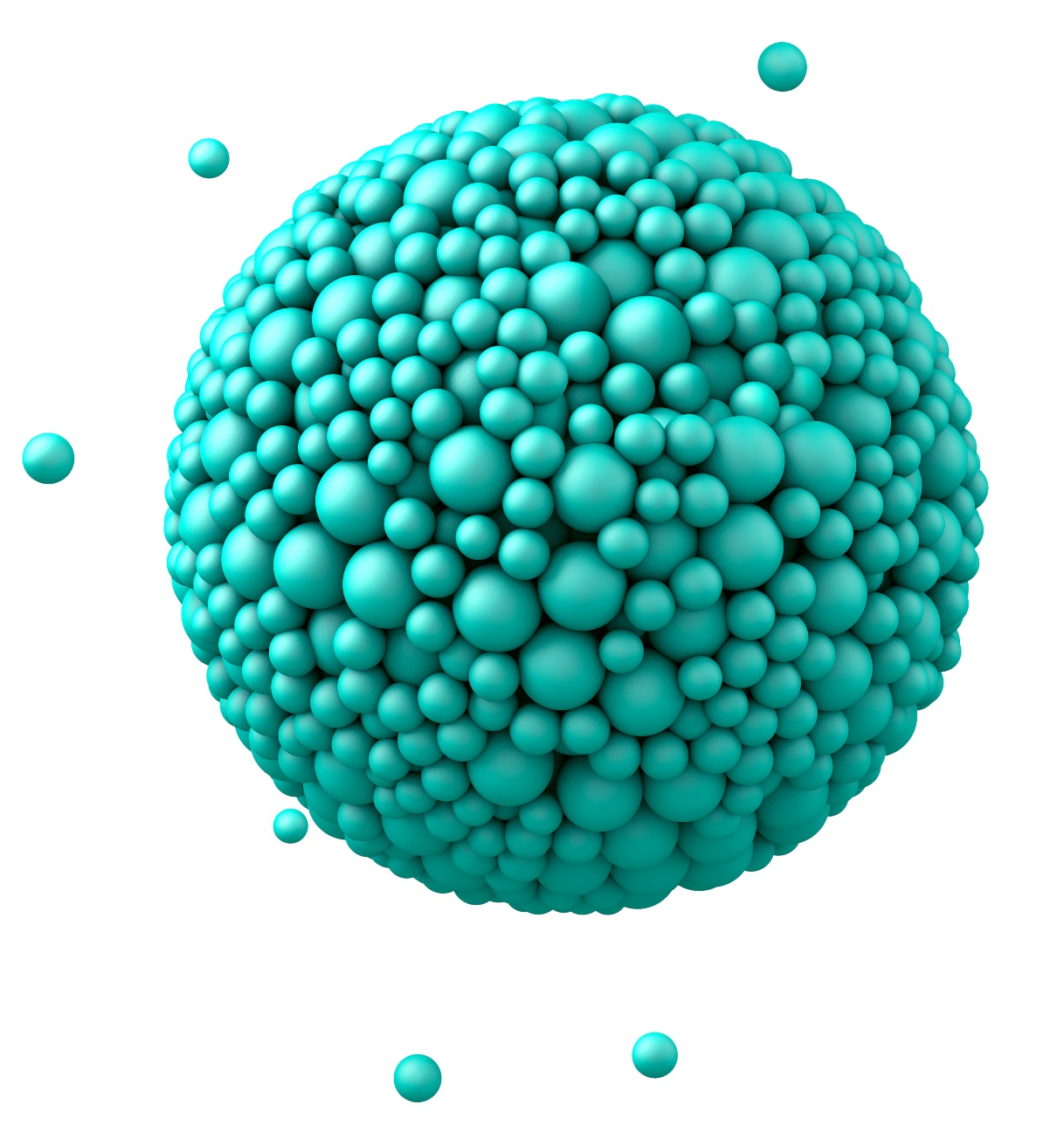
IFPRI Deliverables
Annual General Meeting
Winter Business Meeting
18-21 Annual Research Reports
Over 700 Commissioned Reports and Reviews
2-3 New Reviews Annually
Workshops
Roundtable Best Practices
Intensive Technical Interaction

Slide 8
More IFPRI Deliverables
Interpersonal Forum
  Annual General Meeting
  Winter Business Meeting
Defined Industrial Strategy
  Technical Research Program
  Technical Reviews
  Focused Workshops
  Roundtable Best Practices
Written Reports
  18-21 Annual Research Reports
  2-3 Annual Reviews
  Library of over 700 Reports and Review
Education Program

Slide 9
Annual General Meeting (AGM)
Reports from Academic Grantees
  Short Presentations
  Small Group Poster Sessions
  Industrial Feedback to Academics
Reviews and Invited Presentations
Small Group Discussions on New Areas for Research
Discussion, brief writing, and voting on new programs for funding
Local Student poster session
Informal Discussions, Meals, Happy Hours and Sporting Events

Slide 10
IFPRI Technical Program
Dynamic - responds to Member Company needs
Managed within 7 Subject Areas which have strong interactions and weak boundaries
Transition from wet to dry
Sols & Dispersions
Flow / Separations
Dry Powder Flow
Interparticle
Forces
Characterization &
Measurement
Attrition
Particle Formation
Size Reduction
Engineered Products

Slide 11
IFPRI 2025-2026 Projects (17)
Model-based Design of Granular Products | R. Smith | U. Sheffield | England
Simplified Industrial Formulations of Colloidal Dispersions | J. Vermant | ETH | Switzerland
A Systems Engineering Approach to Dry-Milling with Grinding Aid Additives | A. Kwade | TU Braunschweig | Germany
Precision powder feeding | P. Nott | IISc Bangalore | India
Predicting Powder Flow from Flexible-Wall Containers | M. Jones | U. Newcastle | Australia
Porosity Developent During Drying | Reza Kharagani | OVGU Magdeburg | Germany
Understanding Accelerated Aging of Gels | Lilian Hsiao | NCSU | USA
Selection of Flow Aids | Raj Dave | NJIT | US
Air-Induced Defect Formation During Compaction | Ken Kamrin | M.I.T. | US
Segregation of Cohesive Powders | Rich Lueptow | Northwestern U. | US
Syneresis | Emanuela Del Gado | Georgetown U. | US
Aeration & Deaeration of Geldart C Powders | Olivier Pouliquen | Aix Marseille U. | France
Numerical Modeling of Spray Droplet Formation | Olivier Desjardins | Cornell U. | US
Wetting of Heterogeneous Particles | Lucio Isa | ETH | Switzerland
High-Throughput Measurement of Jamming Fraction | Daniel Hodgson | U. Edinburgh | Scotland
Mechanism of Fisheye Formation | Patrick Spicer | UNSW | Australia
Model-based Control of Granule Porosity | Johannes Khinast | TU Graz | Austria

Slide 12
IFPRI 2025-2026 Collaborations (2)
Research Simplex Atomizer | Olivier Desjardins Vince McDonnell | Cornell U. UC Irvine | US US
Continuum Flow Modeling | Ken Kamrin Peter Vonk | M.I.T. Envalior | US Netherlands
Workshops – one per year
January 2026 - Adhesion
January 2027 - Triboelectricity

Slide 13
IFPRI 2025-2026 Reviews (5)
Dust Emission | Yaping Shao | U. Cologne | Germany
Atomic Layer Deposition | Ruud van Ommen | TU Delft | Netherlands
Sampling Equipment | Kim Esbenson | KHE Consulting | Denmark
Granulation Scaleup | Paul Mort | Purdue U. | US
Correlative microscopy for filled multi-components complex systems | TBD | TBD | TBD

Slide 14
IFPRI Membership
Full Membership (32)
  Alkermes
  ArcelorMittal
  AVEKA
  BASF
  Cargill
  Chemours
  Corning
  Corteva
  Danone
  Dow
  Ecolab
  Envalior
  FMC
  Hoffman LaRoche
  Imerys
  Janssen Pharmaceutical
  Johnson Matthey
  Keurig Dr Pepper
  Lincoln Electric
  Merck
  Nestle
  Novartis
  Novo Nordisk
  Novonesis
  Pfizer
  Procter & Gamble
  Sandia National Laboratories
  Sherwin-Williams
  Syngenta
  Topsoe
  USG
  Vertex Pharmaceutical

Slide 15
IFPRI Membership
Associate Members (8)
  Granutools
  Horiba
  JM Canty
  Origin Materials
  Paul O. Abbe
  PSE
  Schenck Process
  Silanano Technologies
40 Total Members
  Pharma
  Chemical
  Food
  Consumer
  Government Labs
  Ceramics
  Agriculture
  Equipment
  Modeling

Slide 16
IFPRI Membership
Members are powder companies with products in various markets
Examples
Pharma company active in small molecules
Battery/cell manufacturer
Welding rods manufacturer
Washing powder manufacturer
All the ingredients thereof from extraction to final products

Slide 17
Workshops as a Model for Strategic Development
2 Day Format
  2-3 Core questions posed for discussion
  4-8 Presentations on state of industrial and academic field in defined area
30-60 Attendees
  Worldwide distribution
  Approximately equal industrial and academic

Slide 18
Workshops as a Model for Strategic Development
The two days are spent in breakout discussions followed by development of:
  Action Items
  Recommended Programs
  Written Internal IFPRI Report

Slide 19
Workshops as a Model for Strategic Development
IFPRI has Sponsored 11 Workshops in Past 15 Years Including:
  Powder Flow NSF Sponsored Collaboration
  Grinding IFPRI Project on Nanotechnology
  Gel Formation Lead to Second Workshop
  Colloidal Gels IFPRI Project on Structure and Characterization on Colloidal Gels
  Particle Formation IFPRI Project on 3D Printing of Uniform Particles
  Crystallization IFPRI Project on Control of Crystal Morphology
  Powder Flow IFPRI Project on Powder Mixing
  Education in Particle Technology Education Sub-Committee to Present at Next AGM
  Dense Phase Rheology IFPRI Project on Slurry and Paste Rheology
  Cohesion Workshop held in January 2020
  Modeling of Powder Flow Workshop held in June 2023

Slide 20

Roundtable Discussions for Strategic Development
2-5 Hour Format
  Teleconference or Informal Meeting
  Industrial Best Practices Discussed
5-80 Attendees
  All Industrial Participants
  Non-member Participants Welcomed

Slide 21
Roundtable Discussions for Strategic Development
New Format for IFPRI
Started in 2015
  Powder Flow Measurements
  DEM
  Characterization
  Education
Called by members to investigate specific topics

Slide 22

Shear Testing Round Table Discussion (2015)
Intent of flowability measurements
What devices or methods employed?
Number of samples measured
Who conducts the tests?
What problems are encountered?
Unmet needs
Is this a topic for further IFPRI sponsored R&D?

Slide 23
Education Roundtable Discussion (2021)
50 attendees to the first 2 hour session
  Defined areas that need more training and education
  Defined need for operator and engineer level courses
Small Subgroup Formed
  Further refinement and development of example short video library
  Looking to continue the discussion at the upcoming AGM

Slide 24
Other Programs at IFPRI
Round Robins
  Evaluation of DEM Modeling with University of Birmingham and IFPRI members
Promotional Outreach for Particle Science and Technology
  Merrow Report
Collaboration with other groups and conferences
  Gordon Conference on Granular Flow
  World Congress on Particle Technology
  AIChE Particle Technology Forum

Slide 25
The IFPRI way
IFPRI academic associates are world-class authorities providing a unique global network and forum in Particle Technology to help IFPRI Members develop a strategic plan in particle technology
Full profit of IFPRI membership is based on an active participation among members and contractors in meetings, workshops and roundtable discussions

Slide 26
Realizing the Benefits
Participate actively
  AGM attendance is crucial; winter meeting is important
  Continuity is important: try to send the same representatives each year
  Be vocal in research program planning sessions: bring your companies interests; be flexible and creative in merging them with those of other members
Make use of deliverables
  Get reports and reviews to people in your company who need (or should need) them
Make use of the network
  Don’t hesitate to contact IFPRI members and academic associates for:
    Answers to questions
    Sources of information
    New recruits

Slide 27
Value of the Network
Global recruiting (no cost)
  Used EU academic contacts to staff groups in Netherlands & Switzerland
Informal consulting (no cost)
  w/ academics: neutron scattering (U. Del); interparticle force measurement (Purdue)
  w/ industrial members: many “quick questions”; visits by DuPont & Dow
Research contracts, sabbaticals, courses
  4 sabbaticals: granulation, compaction
  Internal short courses: particle design, granulation, powder flow

Slide 28
Benefit 1: Projects & Deliverables
Full Projects ($42K/yr)
  3-year duration with one renewal
  Typically leveraged against other funding sources
  Annual reports and comprehensive final report after 3 and 6 years
Collaboration Grants ($10-20K)
  1-year duration, $10K
  Final report
Reviews ($8K)
  Comprehensive critical review, either to introduce membership to new technology area (state-of-the-art) or as instruction tool

Slide 29
Benefit 2: Technical Program Definition
Develop Briefs
Members, consultants, & RAs
Prioritize Briefs
Members
Solicit 2
Proposals
Members & consultants
Members
Review &
Comment
Select Grantee
Members

Slide 30
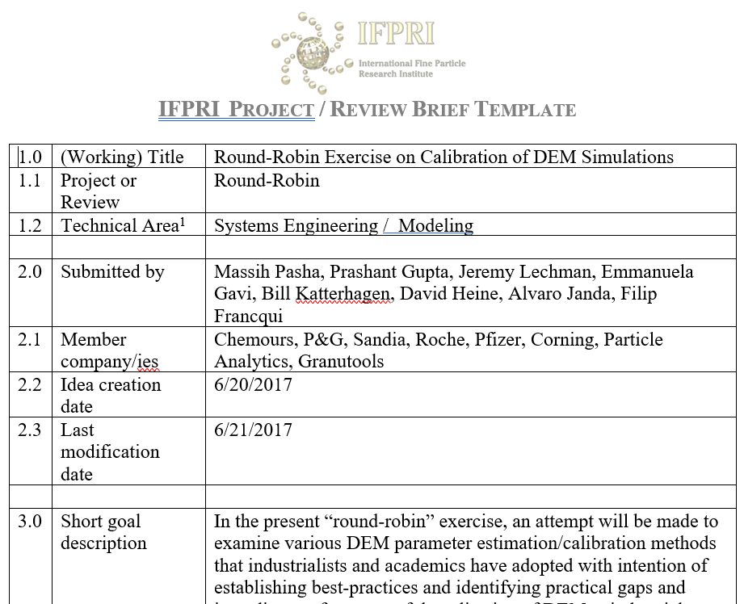
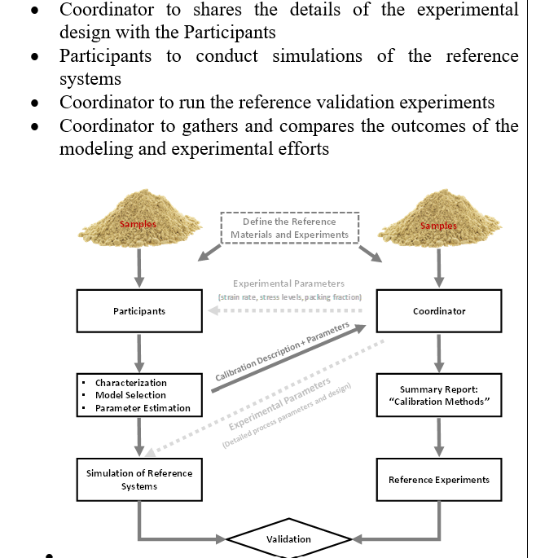
Example of a brief

Slide 31
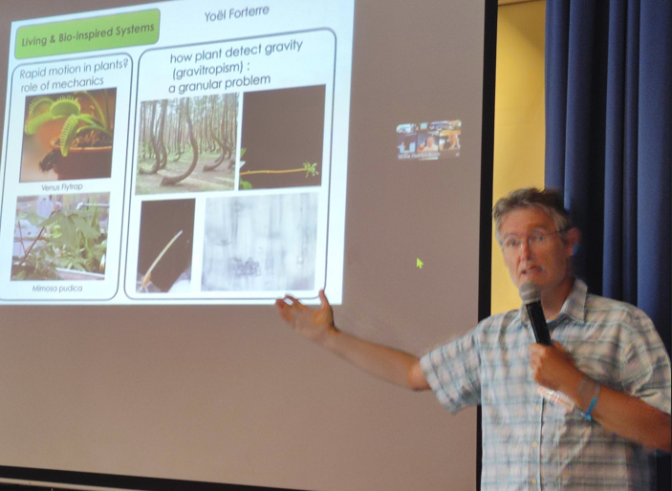
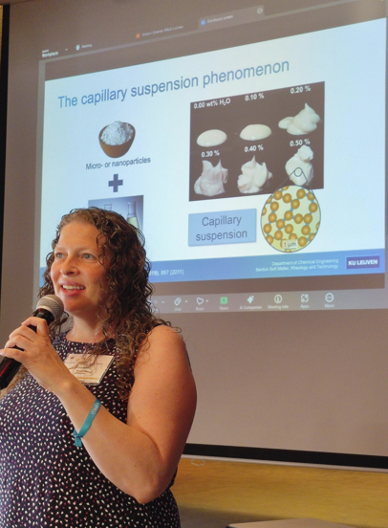
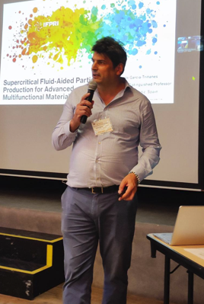
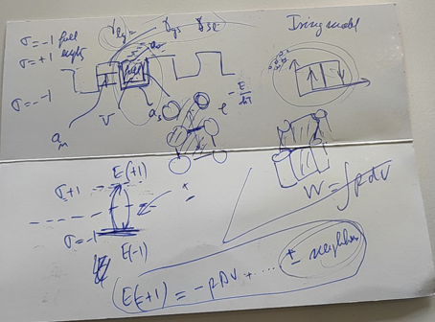
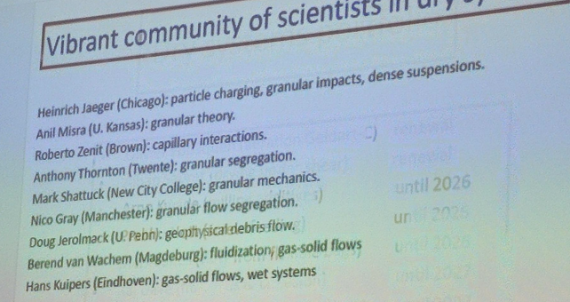
Why academics love us …

Slide 32
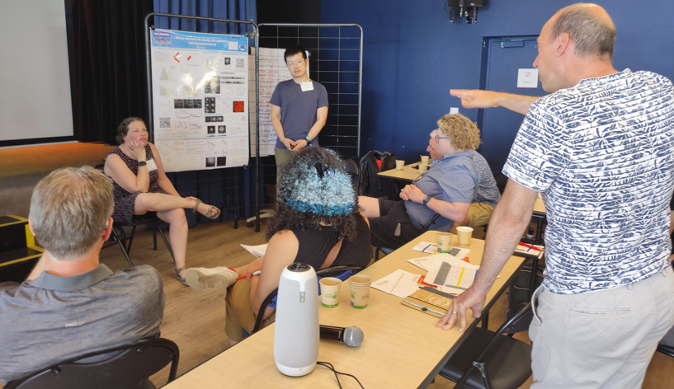
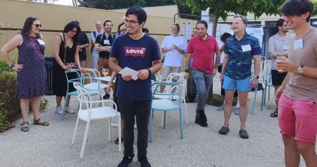
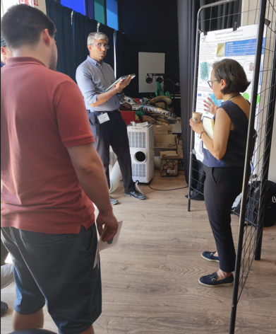
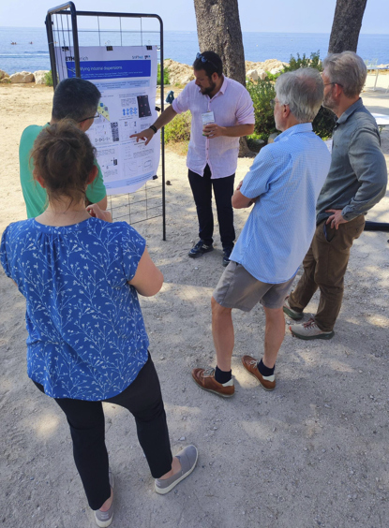
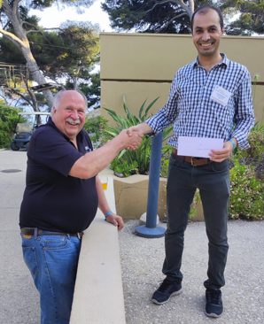
… & why it is not a conference

Slide 33
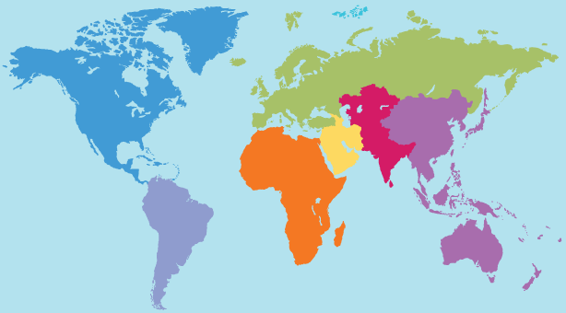
Benefit 3: Globally Distributed Network
Projects & reviews
Consultants

Slide 34
ROI – you pay 33-99k$ and you get 86-339k$
Short term ROI (the same year) 86k$
  Two projects relevant for your company = 2x42k$ = 84k$
  Review 2k$
Long term ROI (3 years) up to 339k$
  Three years of projects 2x126k$ = 252k$
  Four reviews 8k$
  Your own project proposed and accepted 42k$
  On average a workshop every three years 2k$
  Collaborations with members 5k$
  New hire who fits and stay for at least 5 years 30k$

Slide 35
ROI – intangibles
Short term ROI (the same year)
  Employee network immediately expanded across both industrial and academic circles
  A snapshot of the industry state of the art across sectors
Long term ROI (3 years)
  Employee network with long term relationships, experts readily available a ‘phone call away’
  Employee technical training
  Employee engagement and retention

Slide 36
Testimonials
TBA

Slide 37
General Conclusions
Broad research portfolio serving diversified membership
Research portfolio is a result of strategic thinking and implementation
Projects provide new relevant scientific knowledge for membership
Broad array of intangible but high value benefits like best practices, know how and recruitment of new hires

