Slide 1
Industrial need for particle technology education – a Pharma perspective
Gavin Reynolds
IFPRI Workshop on Education in Particle Technology, Sheffield, UK
April 2017

Slide 2
Drivers for change in Pharmaceutical Development
Yesterday
Today
QUALITY
Payers increasingly
dominant
The prescriber is the key
stakeholder
Company
Increasingly Complex
Distribution Channels
(inc market access)
FLEXIBILITY
Simple Distribution Channels
Branded competition
(on-patent)
Branded + Generic
Competition
4-6 Major Brands
More Smaller Brands with
multi-indications
(stratification)
1-2 launches/year
4-6 launches/year (inc.
Expedited programs and
licensed products)
SPEED
Market
Mature Markets Focus
Mature/Emerging Markets
Focus
Primary Care Focus
AGILITY
Specialist Care Focus
Adapated from IMS Thought Leadership Presentation March 2013

Slide 3
Regulatory Push (Quality by Design)
  …improving the quality of our products and processes through increased understanding – by identifying and removing the causes of defects, and minimising variation in our products
Process Parameters
Method Parameters
Sampling
Scale
Intentional Variation
Starting Materials
Reagents
Solvents
Excipients
API
Packaging Materials
Manufacturing Processes & Measurements
Inputs
Outputs
Unintentional Variation
Manufacturing Site
Manufacturing Equipment
Instruments
Environment
Operators

Slide 4
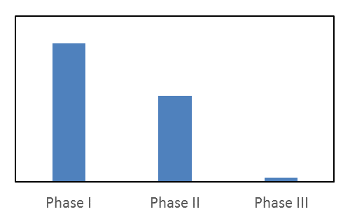
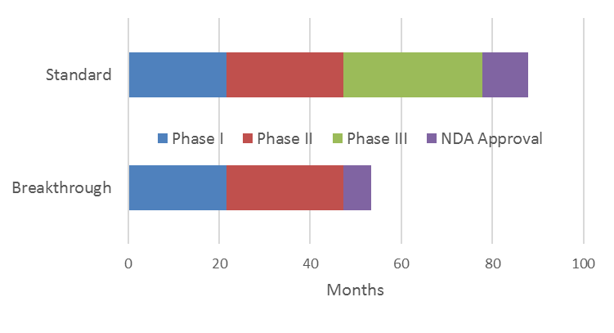
Regulatory Pull (Breakthrough Status)
In addition, rapid clinical development for breakthrough-therapy drugs will put more pressure on other components of drug development, such as drug manufacturing: development of a final formulation and scale-up of processes will have to occur more rapidly than they traditionally do. It is possible that manufacturing will become the rate-limiting step in some breakthrough-therapy drug-development programs.
Janet Woodcock (2013) (Director, CDER, FDA)
~ 3 yrs
Notes:
http://www.focr.org/11-14-2013-new-england-journal-medicine-expediting-drug-development-%E2%80%94-fdas-new-%E2%80%9Cbreakthrough-therapy

Slide 5
Typical (particle) Pharmaceutical Processes
API Synthesis
Formulated Product
Drying
Feeding
Wet granulation
Roll Compaction
Crystallisation
Milling / Micronisation
Transport
Tabletting
Filtration
Mixing / Blending
Coating
Encapsulation
Spray Drying
Hot melt extrusion
Micro / nano-particle formation
Suspensions
Ordered mixtures
BATCH
continuous

Slide 6
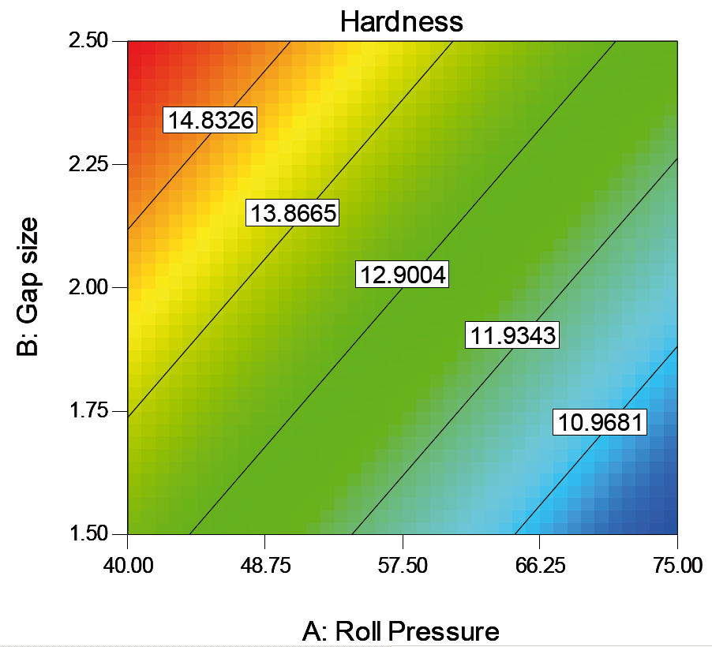
Typical ‘black box’ experimental approach
Roller
Compactor
Design of Experiments
  An efficient method to determine significant
  parameters and interactions
Develop relationships between
factors and responses
Response
Hardness
Dissolution
Factor | - | +
Roll Pressure (bar) | 20 | 80
Gap (mm) | 1.5 | 3.0
Roll Speed (rpm) | 5 | 10
Response
Porosity
Tensile strength
Granule size
‘SCALE-DEPENDENT’
UNDERSTANDING
6

Slide 7
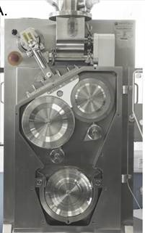
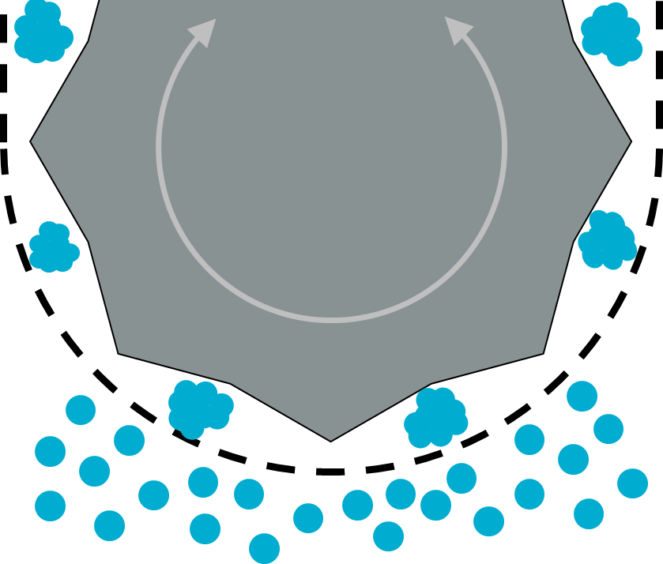
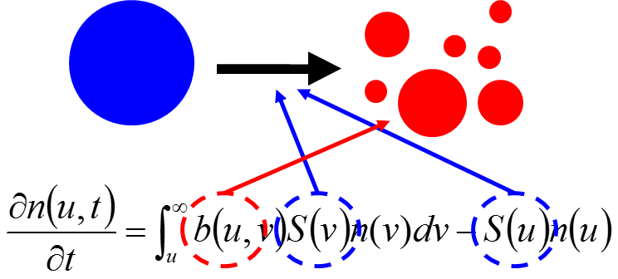
Engineering approach – ‘Looking inside the black box’
Powder
Can we write mass/energy balances?
Can we generate qualitative understanding and turn this into a quantitative description of the process?
Do we know the governing laws associated with the changes in material properties?
Can we model the influence of process settings and equipment design?
How does it interact upstream/downstream?
Can we develop control strategies for batch and continuous processes?
…
Rollers
Ribbon
Mill/Granulator
Granules

Slide 8
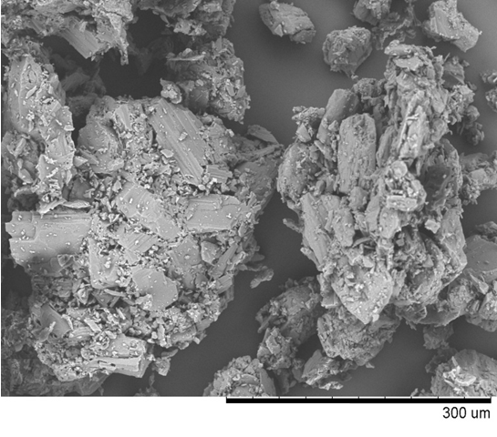
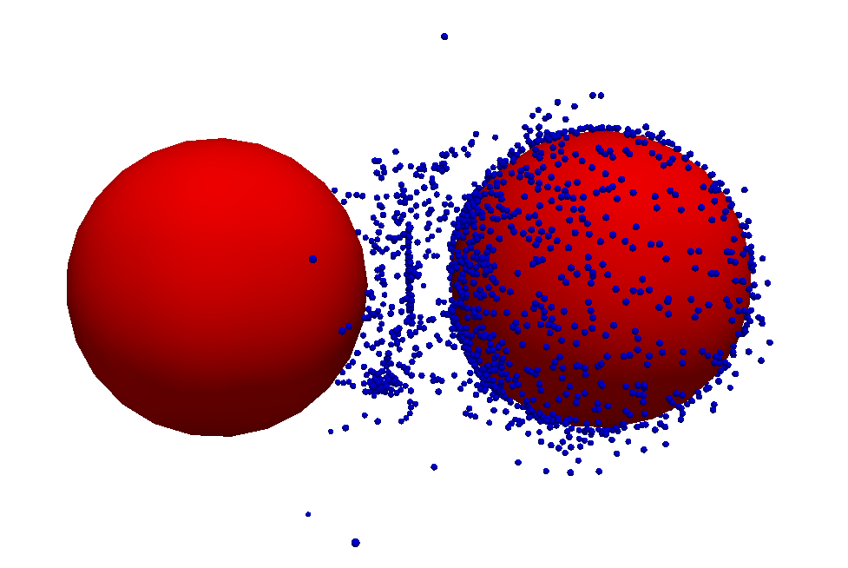
Properties and Performance
Characterising
  Particulate and bulk properties of powders
  Particulate product performance
Modelling
  Properties of mixtures of materials
  Product performance
Measurement, modelling and control
  Using in-line measurement to control particulate processes
Remmelgas, van Wachem (2014)
Wilson et al. (2012), Pharm. Res. 29, 198

Slide 9
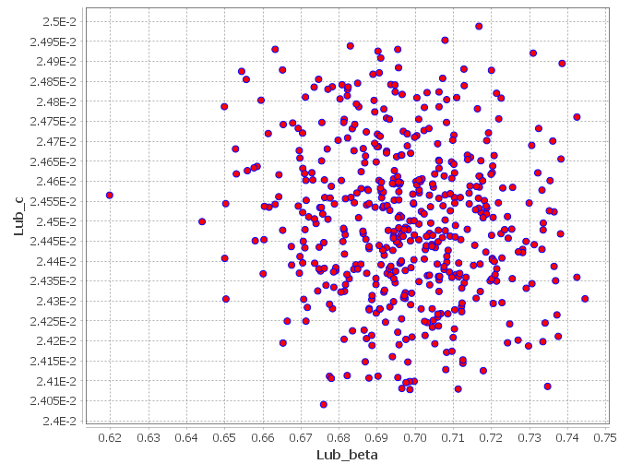
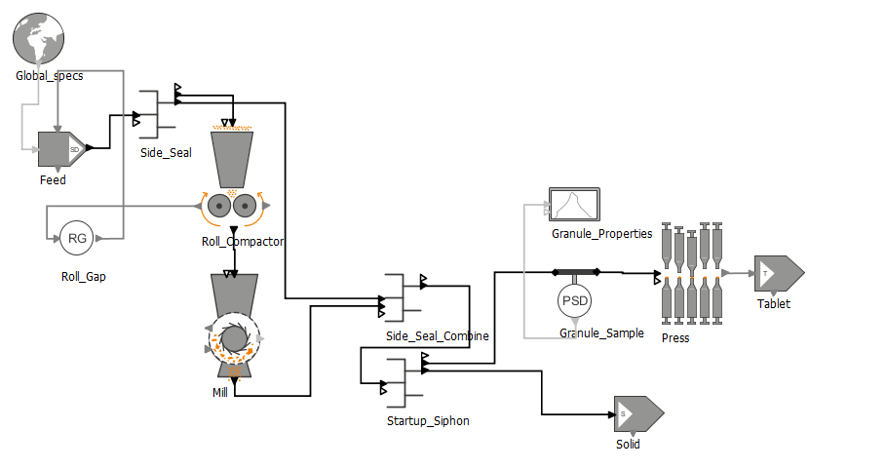
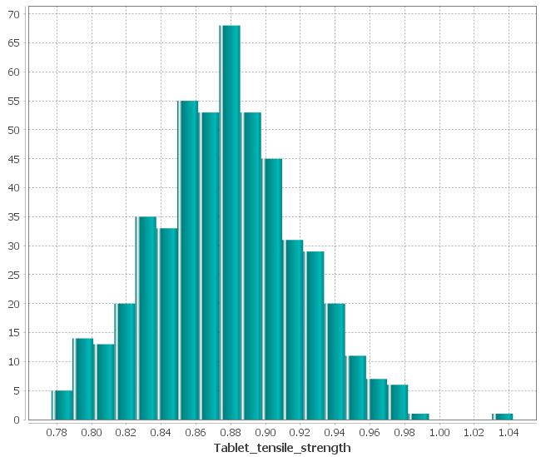

Systems based modelling

Slide 10
What do I find myself having to teach graduate engineers…?
Particle size analysis
  Where does the data come from?
  What do the numbers mean?
  What is particle shape?
  How to manipulate the numbers and use for modelling?
Particulate material properties and behaviour
  Bulk properties, such as flow, mechanical properties, segregation etc.

Slide 11
What do I find myself having to teach graduate engineers…?
Unit operations (occasionally someone may have come across filtration…)
  Understanding of fundamental principals
  Design, operating parameters, scale-up approaches etc.
Process modelling – using modelling packages (e.g. gFormulate, in-house, being able to implement own/literature models)

Slide 12
Summary
Capabilities for our engineers:
  Understand, develop, scale-up, transfer and optimise any process, with constrained material usage
  To be effective at this takes a lot longer for those without a strong particle technology background

Slide 13

?

