Slide 1
Consultant report 2016
Jim Litster

Slide 2
Particle formation projects
Tunable agglomerates by 3-D printing
  Good progress
  Nice collaboration with Ghadiri
  What model, hypothesis is being tested?
  Resist temptation to broaden scope
Spray drying
  Delayed start
  Good plan
  Expect progress in year 2

Slide 3
Particle formation projects
Compaction of mixtures
  Difficult, multi-faceted, problem
  Interesting work on contact models
    How much difference does major deformation make?
    Comparison with Ghadiri approach
  Nice methodology on XRCT
  Experimental system for validation is complex: generalisable?

Slide 4
Particle Formation Projects
Templated nucleation for polymorph control
  Great start in year 1 with acetaminophen
  Support form industry on other systems
  Scale up?

Slide 5
Diversity in the IFPRI program
By gender: 2015/2016 contractors
  Male 10
  Female 2
Proposals
  Male 4
  Female 0

Slide 6
Diversity in the IFPRI geography
By geography: 2014/5
  Europe 7 [UK 5, Germany 1, Spain 1]
  USA 4
  Asia-Pacific 1
Proposals
  Europe 2
  USA 2

Slide 7
The UK scene
Expansion at Surrey and Sheffield
Research Hub proposals (£10M over 10 years)
  CMAC led proposal in pharmaceuticals
  Additive manufacturing led by Sheffield
  Powder technology led by Greenwich
ADDopt program at Leeds
National Formulation Centre
GSK, Astra Zeneca, Pfizer, Novartis active in these initiatives

Slide 8
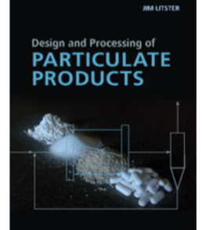
Education
The book is out!
  Buy it (please)
  Give feedback
Workshop to be organised by Jim M, Mojtaba and Jim L
  When?
  Where?
  Who?

