Slide 1

Reverse Engineering Particle Technology Education
Jim Litster
The University of Sheffield

Slide 2
Consider a case study …
One minute to read
Five minutes to brainstorm with your neighbor

Slide 3
Consider a case study
What aspect of the handling in the plant is most likely to cause attrition?
What properties of the granule are most likely to impact the granule attrition resistance?
Are these properties most easily controlled by formulation changes or changes to process conditions?

Slide 4
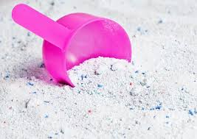

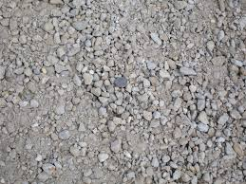
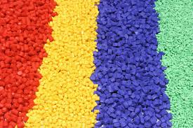


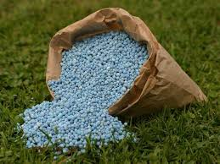
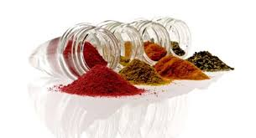
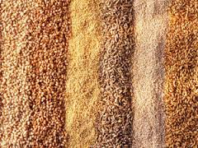
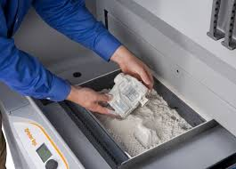
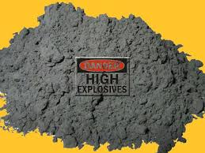
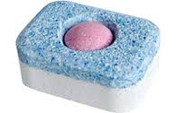
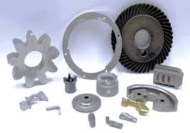
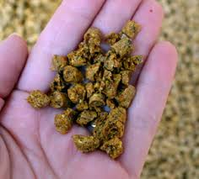
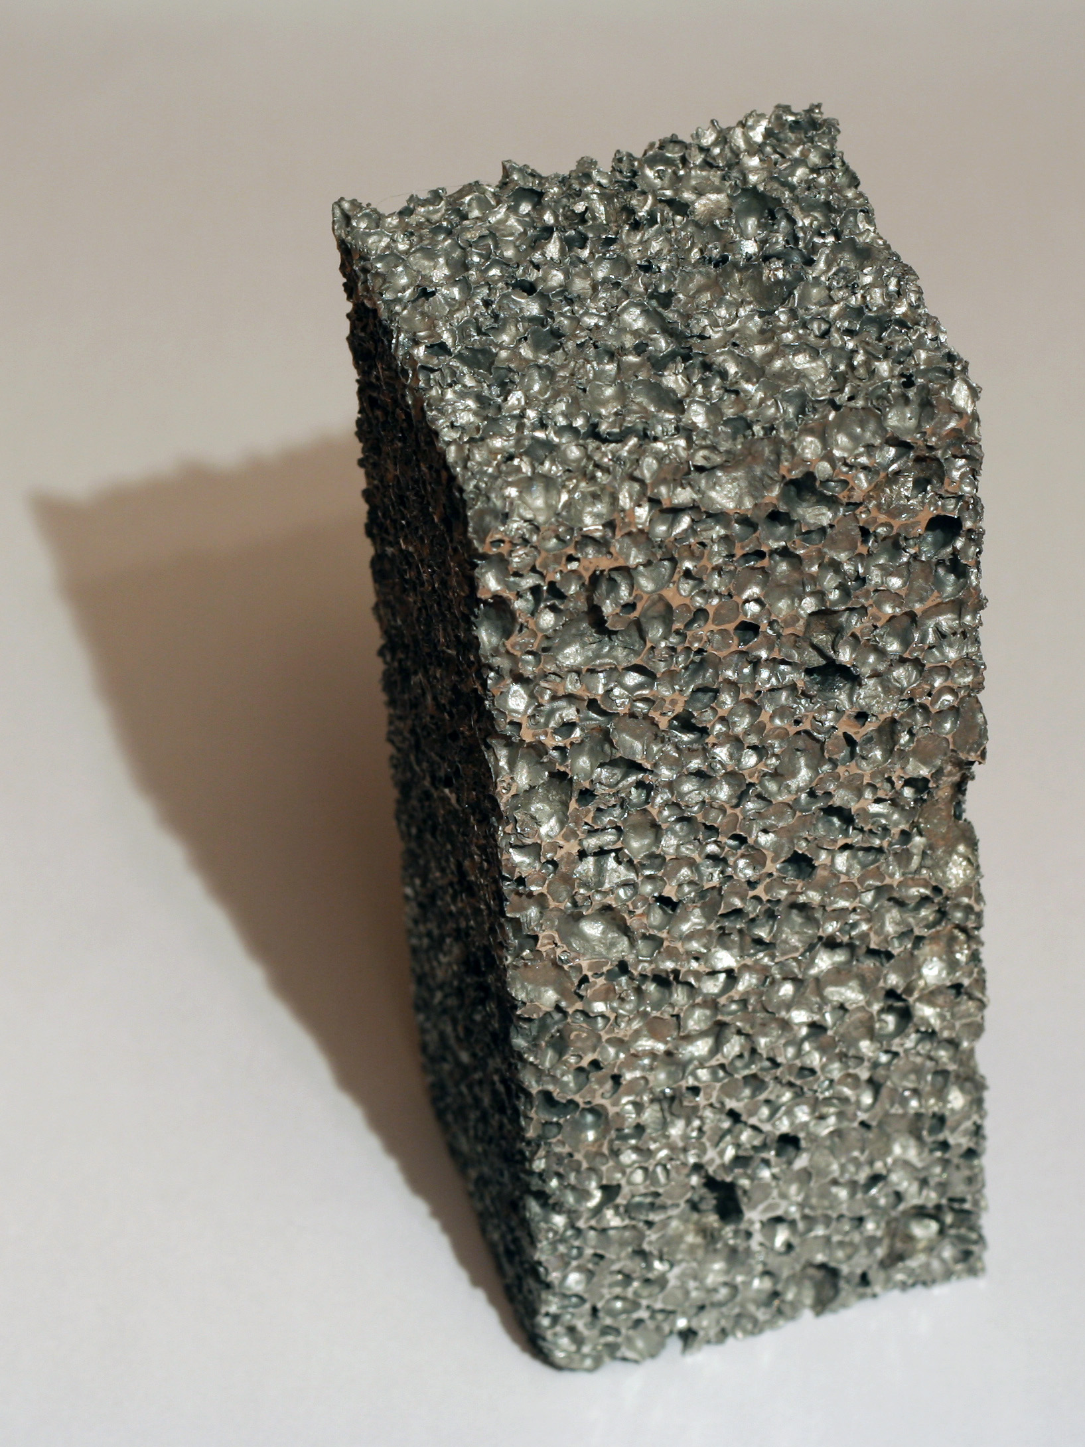


Slide 5
Particulate Products
Primary particles
Structured delivery forms
Devices
Crystals
Powders
Aggregates …
Granules
Compacts
Pastes …
Inhalers
Coffee pods
Batteries …

Slide 6
x
FORWARD PROCESSING
FORMULATION PROPERTIES
size distribution
surface properties
viscosity …..
PROCESS MODEL
PRODUCT MODEL
PRODUCT ATTRIBUTES
Controlling physics
size
shape
porosity
structure …
PROCESS PARAMETERS
strength
dissolution
flow properties
flowability ….
impeller speed
temperature
geometry …
REVERSE ENGINEERING

Slide 7
x
STUDENT DEVELOPMENT
LEARNING
ENVIRONMENTS
ASSESSMENT
PROGRAMME
LEARNING
GOALS
GRADUATE ATTRIBUTES
COURSES AND CONTENT
CURRICULUM DESIGN

Slide 8
Graduate attributes
What attributes should a graduate have to be equipped to work in an industry manufacturing particulate products?
Individual reflection for three minutes
Use the case study and your own experience as a guide

Slide 9
Graduate Attributes
Characterise the properties of powders, particles and structured products
Perform quantitative design of a particulate product given required product attributes
Perform quantitative design of particle formation and particulate delivery form unit operations
Synthesise a flowsheet for manufacture of particulate products using simulation tools and models
Work comfortably in interdisciplinary team of scientists, engineers, regulators and marketers

Slide 10

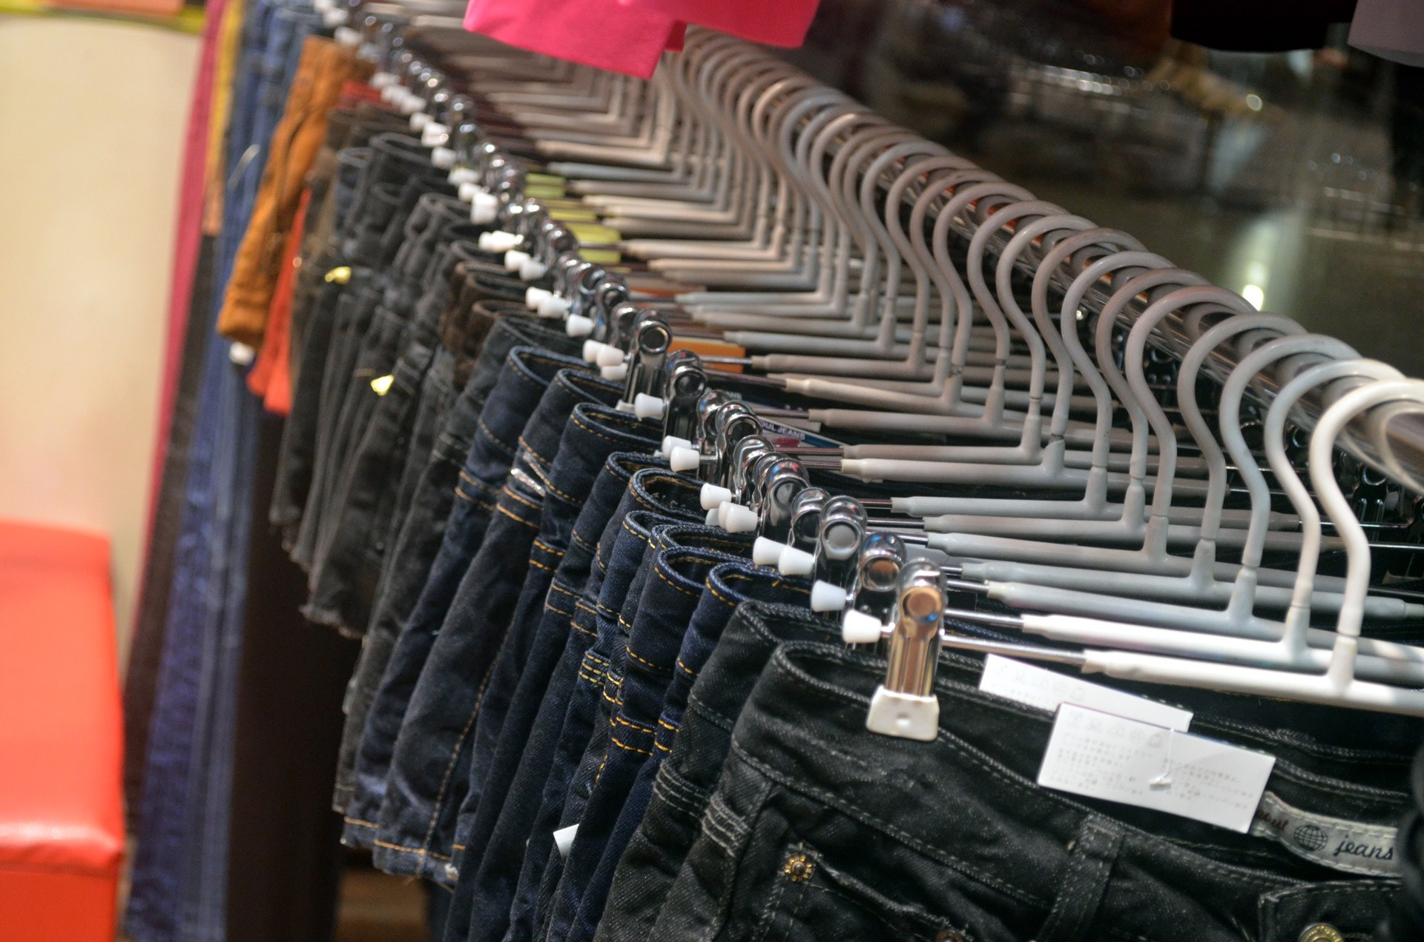
Curriculum Implications
Focus on designer particles not off the rack particles

Slide 11
Key elements in particle design
Maths
Tools
Unit
operations
Particle
Design
Physical
Phenomena
Formulation
Characterization

Slide 12
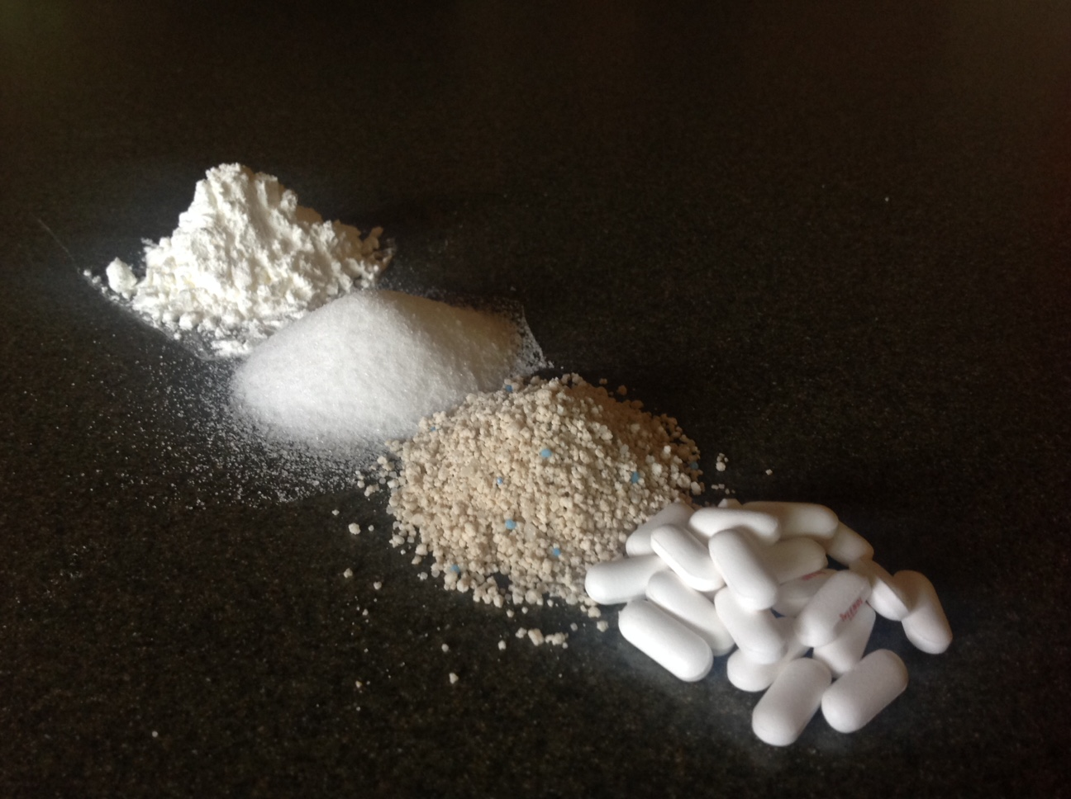
Particulate system characterisation “Measure properties, don’t perform rituals”

Slide 13
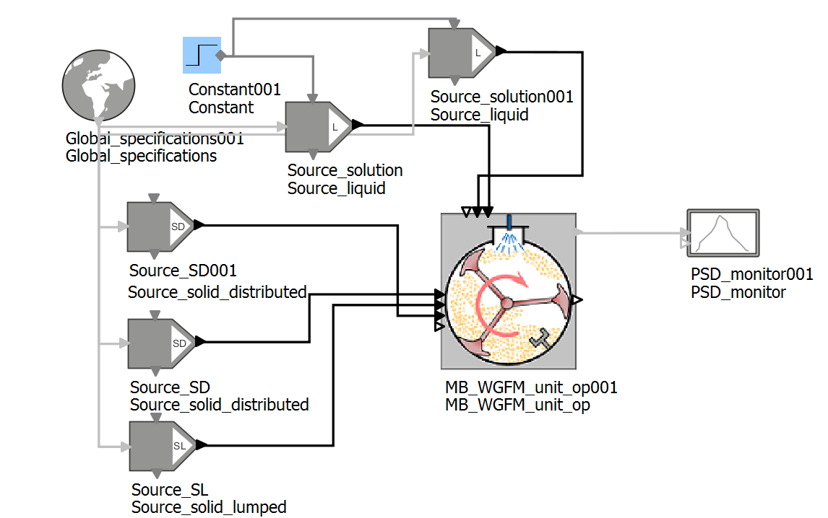
Mathematical tools – the population balance

Slide 14
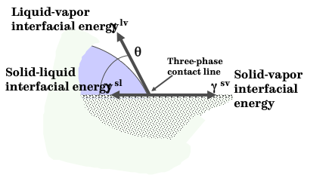
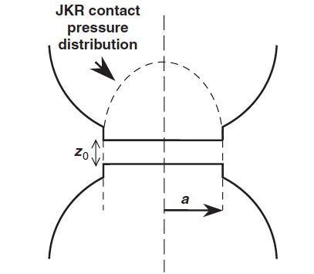
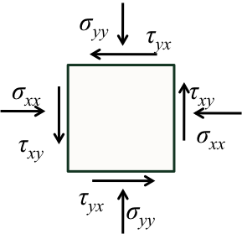
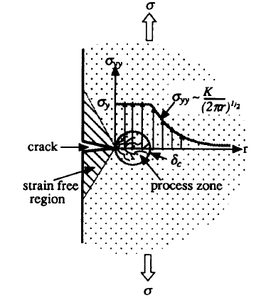
Different Science Foundation

Slide 15
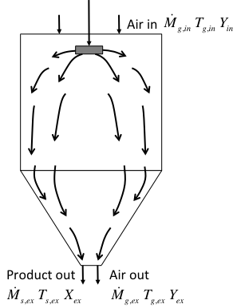
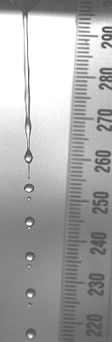
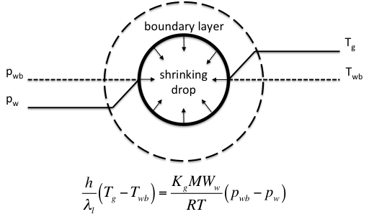
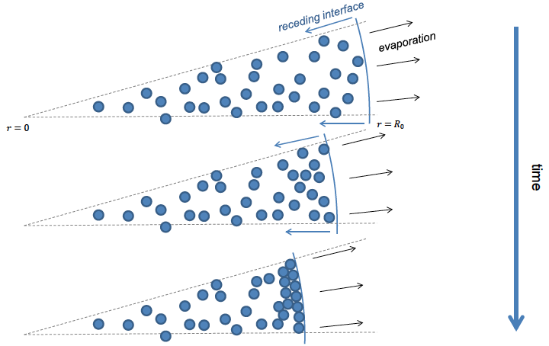
Spray drying example

Slide 16
Focus on product design
In the creative and synthesis process
In the quantitative engineering – product models
Strength and attrition
Dispersion and dissolution
Segregation
Physical and chemical stability

Slide 17

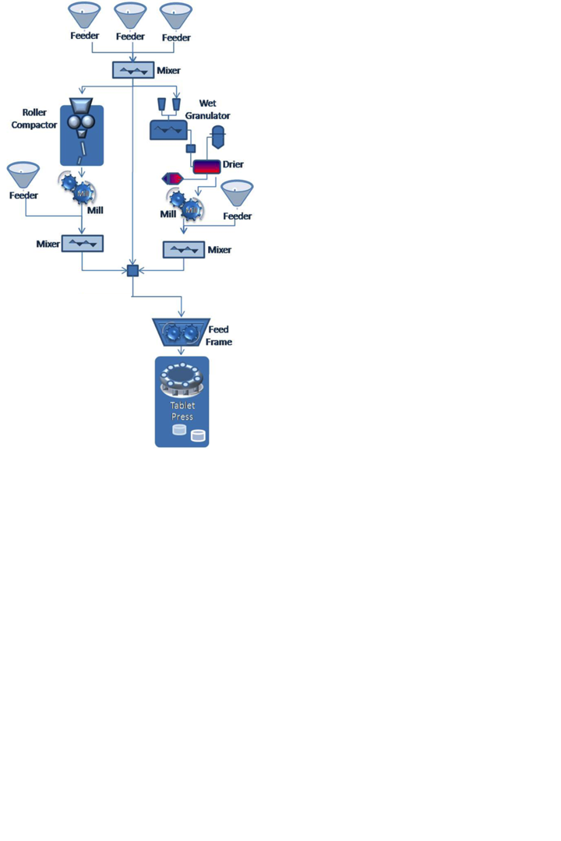
Implications for Learning Environments
Laboratories are essential
Characterisation
Manufacture (Sheffield pilot plant)
Product performance
Interdisciplinary teams
Open ended problems and product design projects

Slide 18
Programme Models (MSc)
Delaware
Particulate Rate Processes
Particle Properties and Characterisation
Mathematics for Particulate Processes
Particle Transport
Unit Operations
Particle Based Product Design
Purdue
Particle Transport and Separation
Particle Design and Processing
Particle and Powder Characterisation
Electives from pharmaceutical, food and agricultural applications

Slide 19
Programme Models (MSc)
Delaware
Particulate Rate Processes
Particle Properties and Characterisation
Mathematics for Particulate Processes
Particle Transport
Unit Operations
Particle Based Product Design
Leeds PhD/MSc
Creativity, innovation, teamwork
Chemical Product Design
Particulate Processing Project
Particulate Product Design Project
Professional Development & Research Skills

Slide 20
It’s a change in mind set, not a survey course
Can we change the way we view our undergradaute programmes?

Slide 21
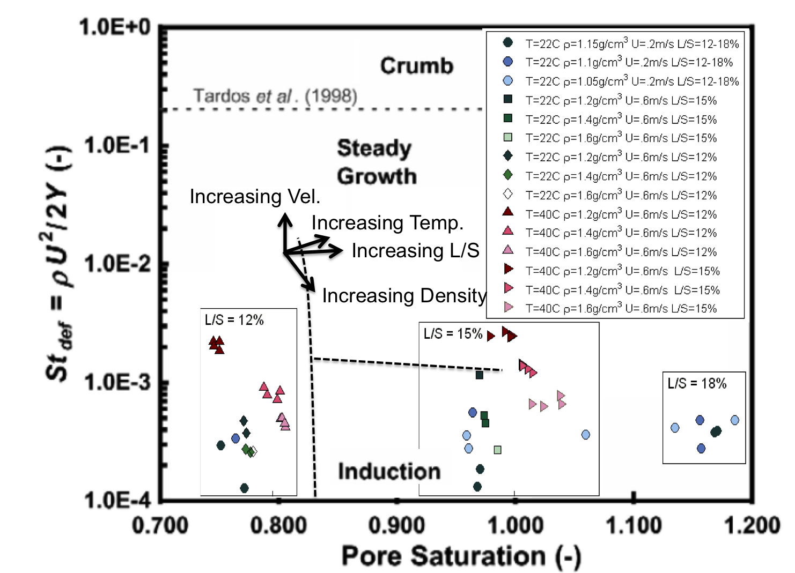
IFPRI research can contribute greatly to curriculum

Slide 22
Reverse Engineering Particle Technology Education
Product and Process Engineering integrated
There is an engineering science base – we should use it
There are mathematical tools – we should use them
The time is right to formalise curriculum

Slide 23
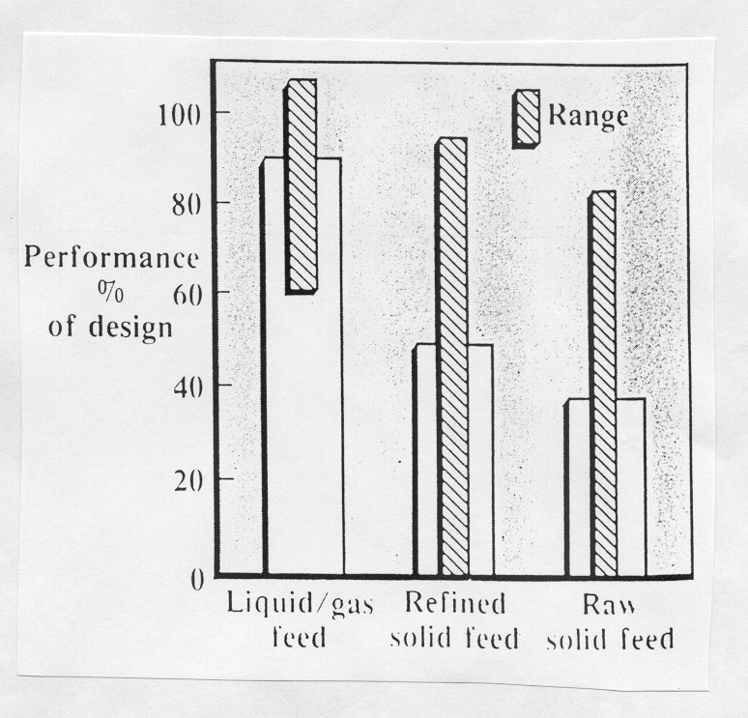
The Joy of Particulate Products
Are particles the problem ….

Slide 24
The Joy of Particulate Products
Are particles the problem ….
Or the solution!
Hugh part of economy
Better product stability
Complex product performance possible
Don’t transport solvents
Consumers like them

Slide 25
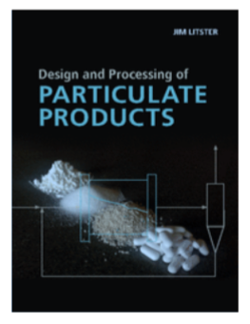
Acknowledgments
Co-author, and co-conspirators:
Jim Michaels, Bert Diemer,Tony Howes, Carl Wassgren, Norm Wagner
IFPRI colleagues over the last 20 years

Slide 26
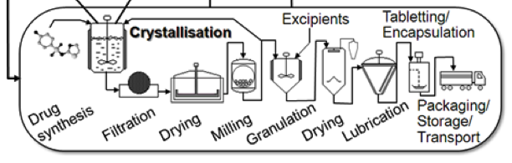
Complex flowsheets

