Slide 1
IFPRI Milling & Classification Report 2023
Wolfgang Peukert
Institute of Particle Technology
Friedrich-Alexander University Erlangen-Nürnberg (FAU)

Slide 2
Milling project
Arno Kwade: A systems engineering approach of dry milling grinding aids additives
Multiscale view: From tailored powder surfaces to mill-classifier circuits
Objectives:
Qualitative/quantitative effect of grinding aid additives on material behavior,
processing and energy flows.
Develop a system engineering approach for optimizing and scaling industrial dry fine grinding processes.
Renewal proposal
From Micro to Macro
Relation between microscopic particle properties to macroscopic powder behavior
Design of a characterization procedure to obtain required model parameters
Modelling of axial powder transport during milling
Validation of flowsheet tool with industrial data
Collection of industrial plant data (either provided or by a sampling at the plant)
Material characterization and flowsheet simulation of circuit for validation

Slide 3

Results of a national priority program
Ca. 20 projects, 580 pages
New Dynamic Process Models
Material Parameters in Solids Process Engineering
Material Parameters in Solids Process Engineering
… presents the latest advances in flowsheet simulation of solids processes, focusing on the dynamic behavior of systems with interconnected solids processing units such as, for example, comminution, sifting and particle formulation.
New approaches for the description of solids and their property distributions and for the mathematical treatment of flowsheets with multivariate population balances.
Editor: Stefan Heinrich, TU Hamburg Harburg

Slide 4
Two-phase flow models for particle transport in mills
(and other unit operations)
Dry impact, table roller (ball/bead) mills
(cage mills, sieves, dynamic classifiers)
Gas phase (liquids evtl. later)
Mill function
Material function
Mill operation:
Transport to stressing zone,
hold-up and
classifier
Key question:
Stress transferred to particles (energy, number)
Particle properties
Size, shape, density,
hardness, fracture
toughness, strength,
surface properties by grinding aids (Kwade‘s project)
powder/slurry rheology
Reaction
Mill:
wear, abrasion
Particles:
Breakage probability
Breakage functions

Slide 5
Fluidized bed opposed jet mill (AFG)
Capacitance probe: solids concentration
jet region boundary dense phase
high k
Number of impacts k: low
Horizontal secondary gas injection in ﬂuidized beds: Solid concentration and velocity in multiphase jets
B. Koeninger, T. Hensler S. Schug, W. Arlt, K.E. Wirth, Powder Technology 316 (2017) 49–58

Slide 6
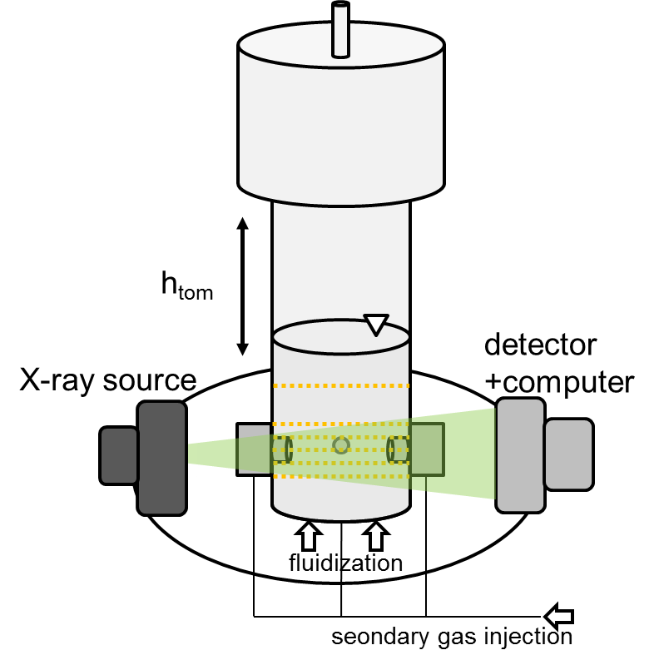
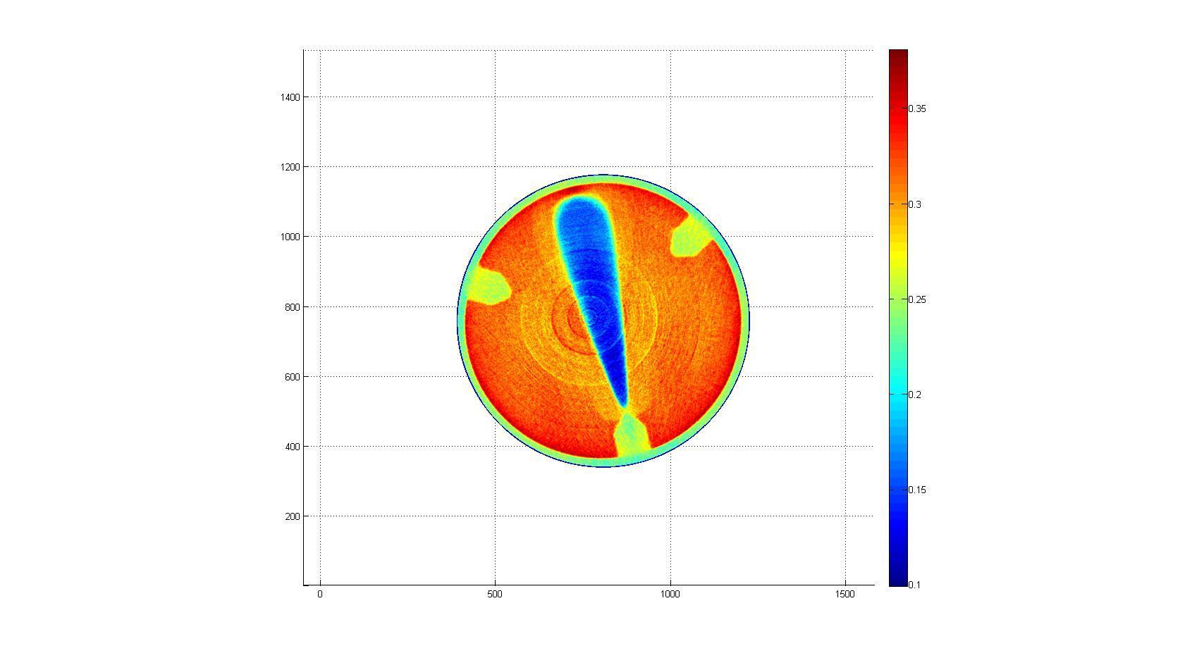
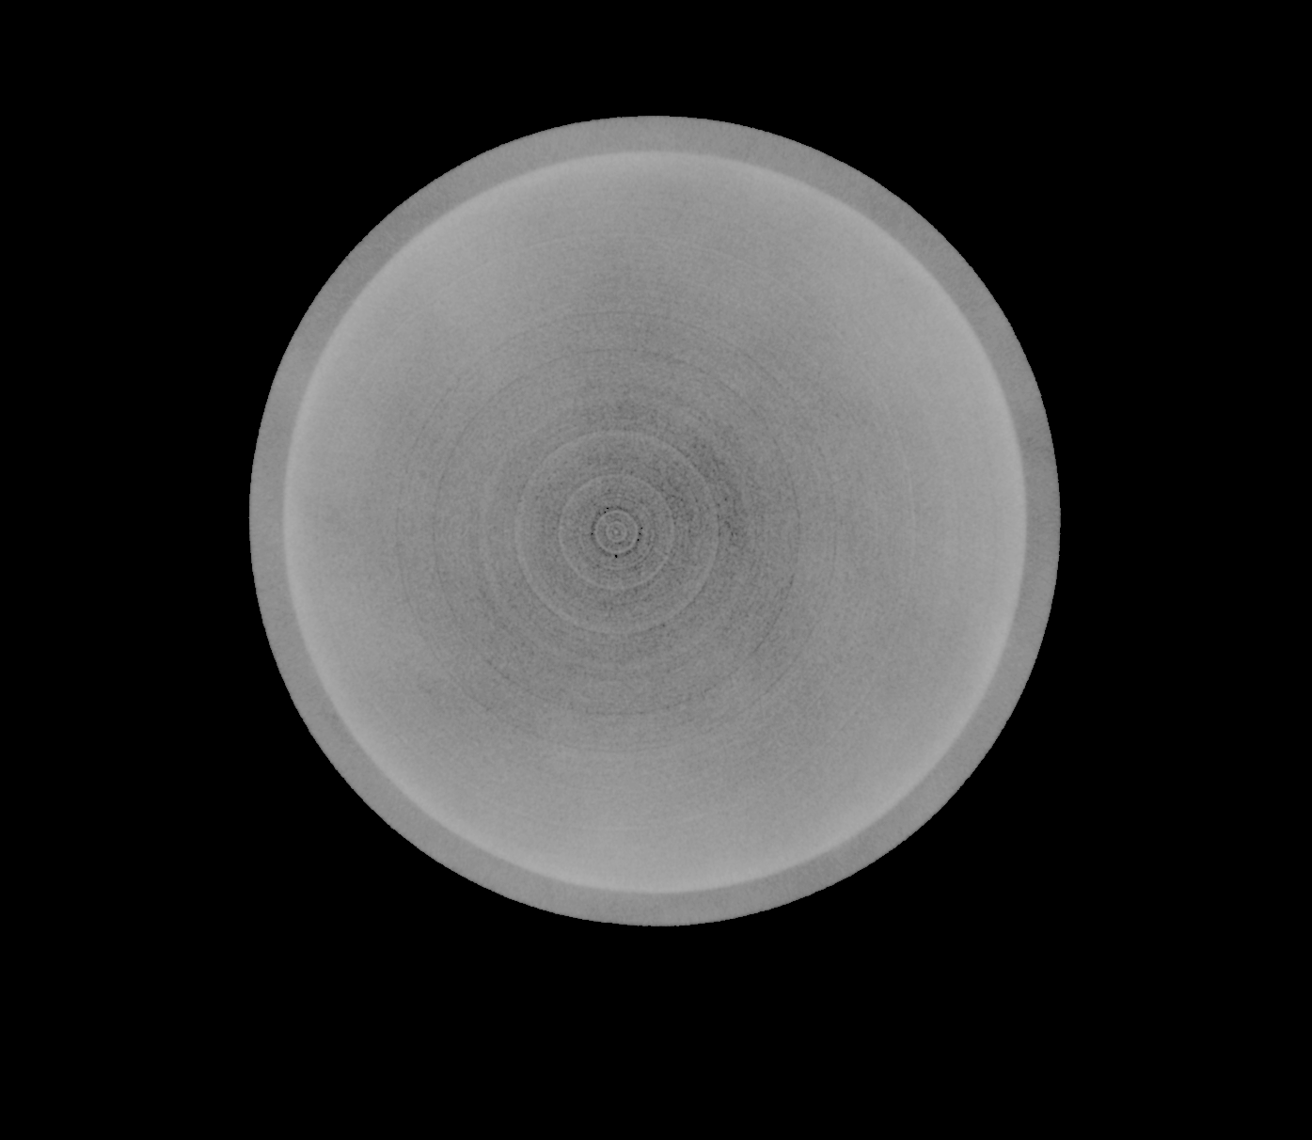

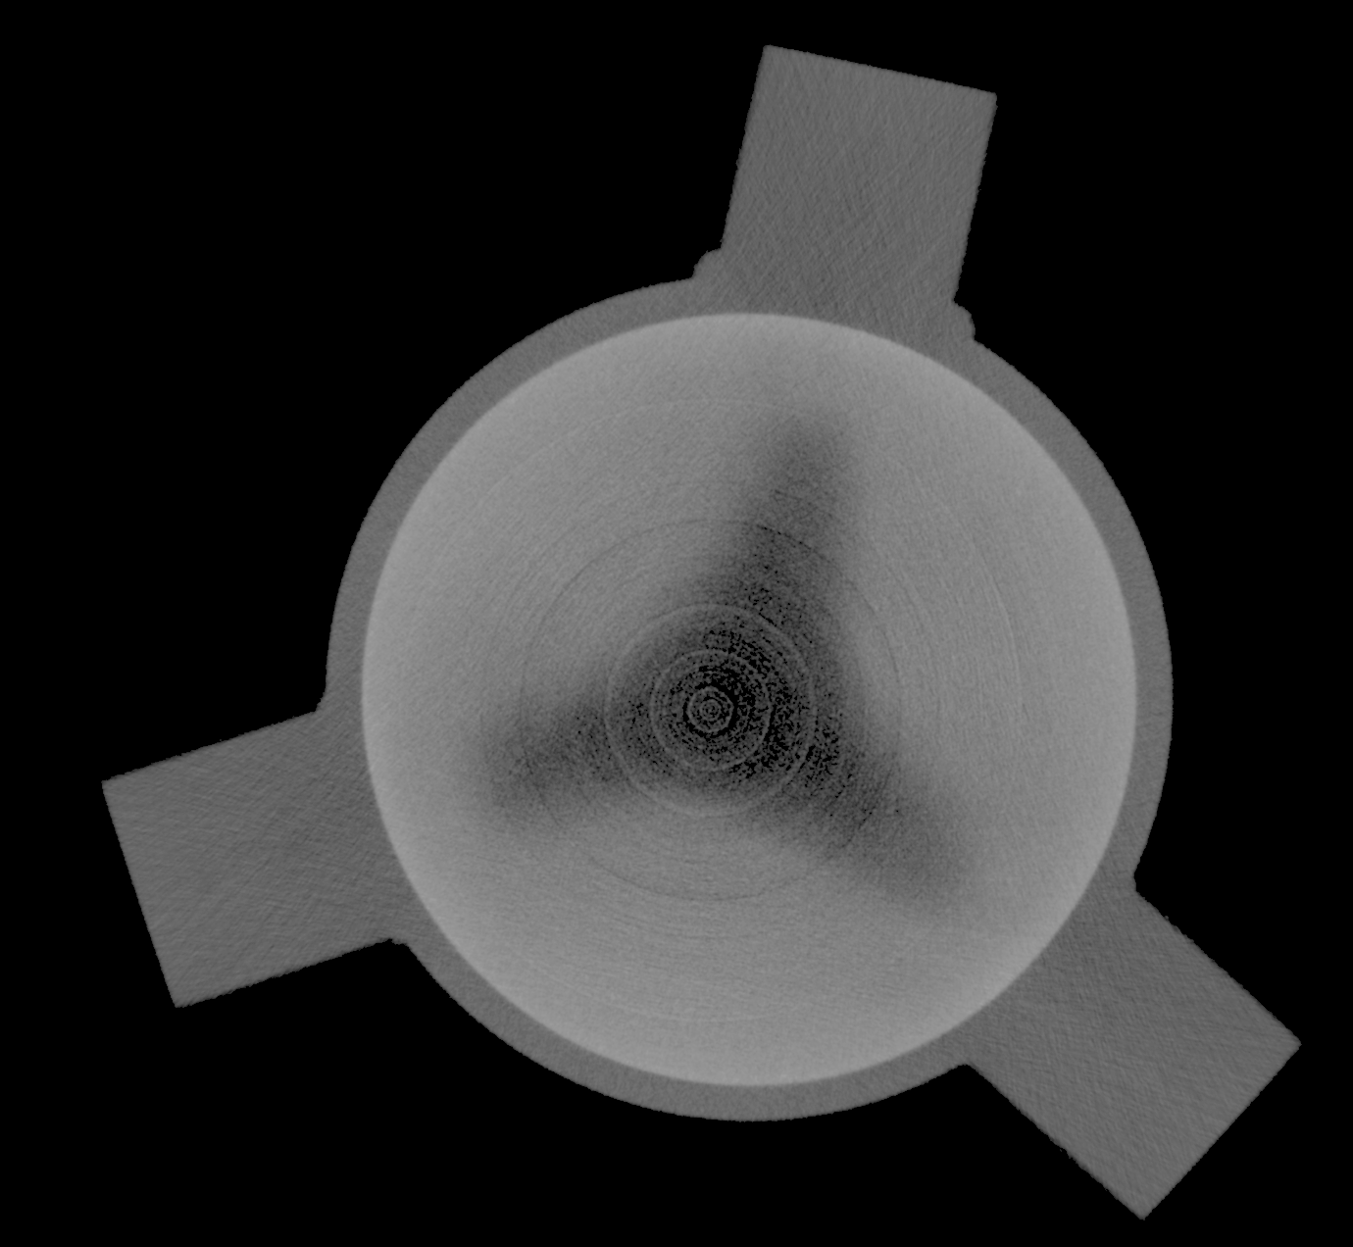
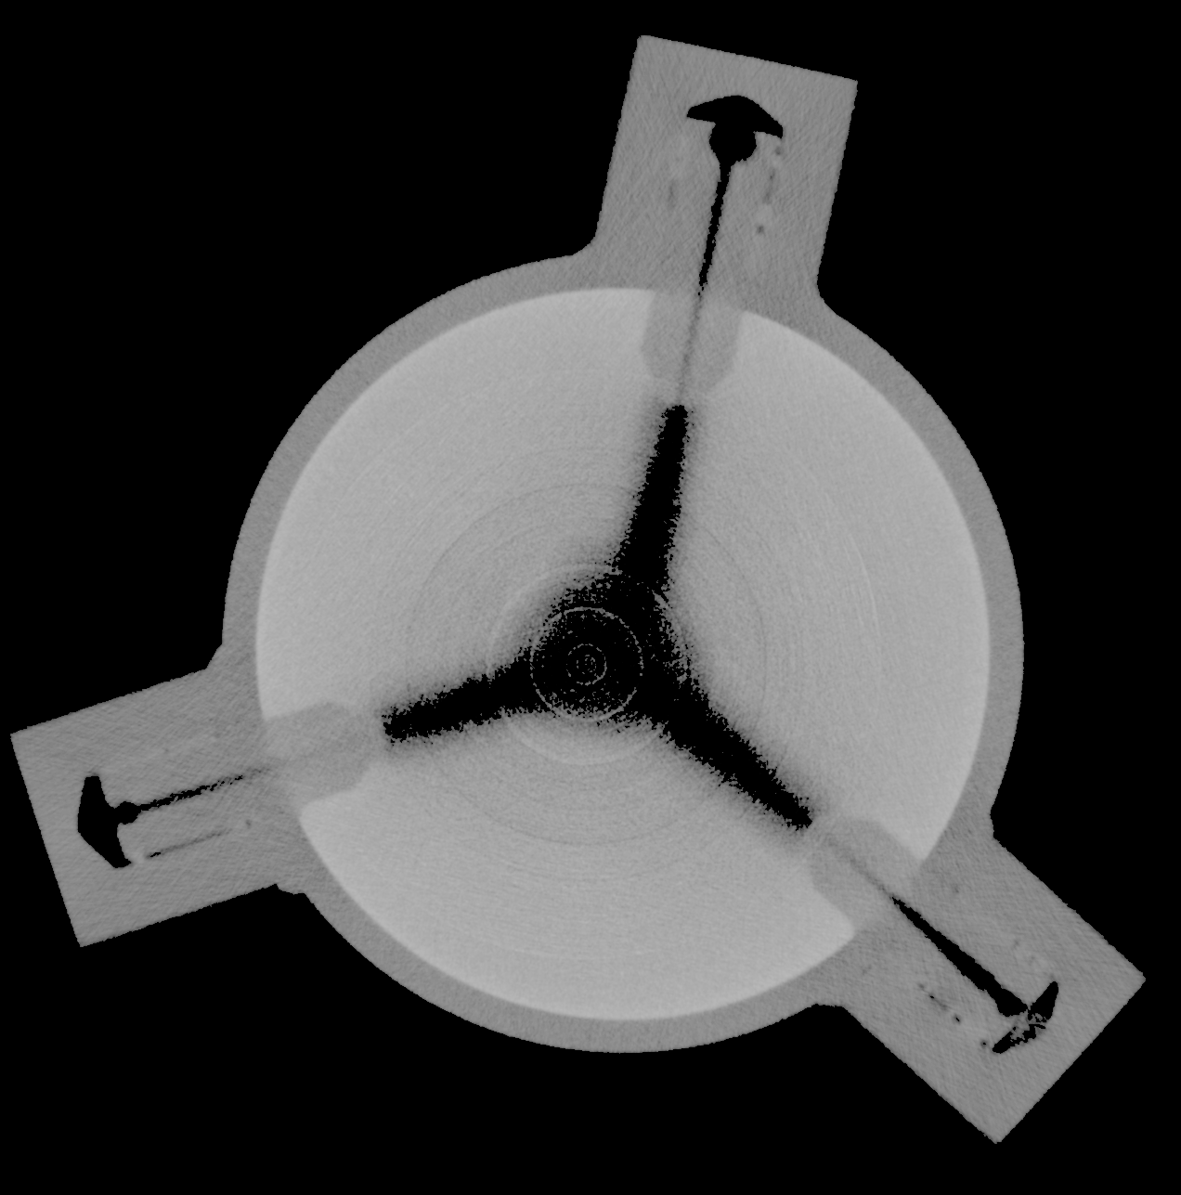
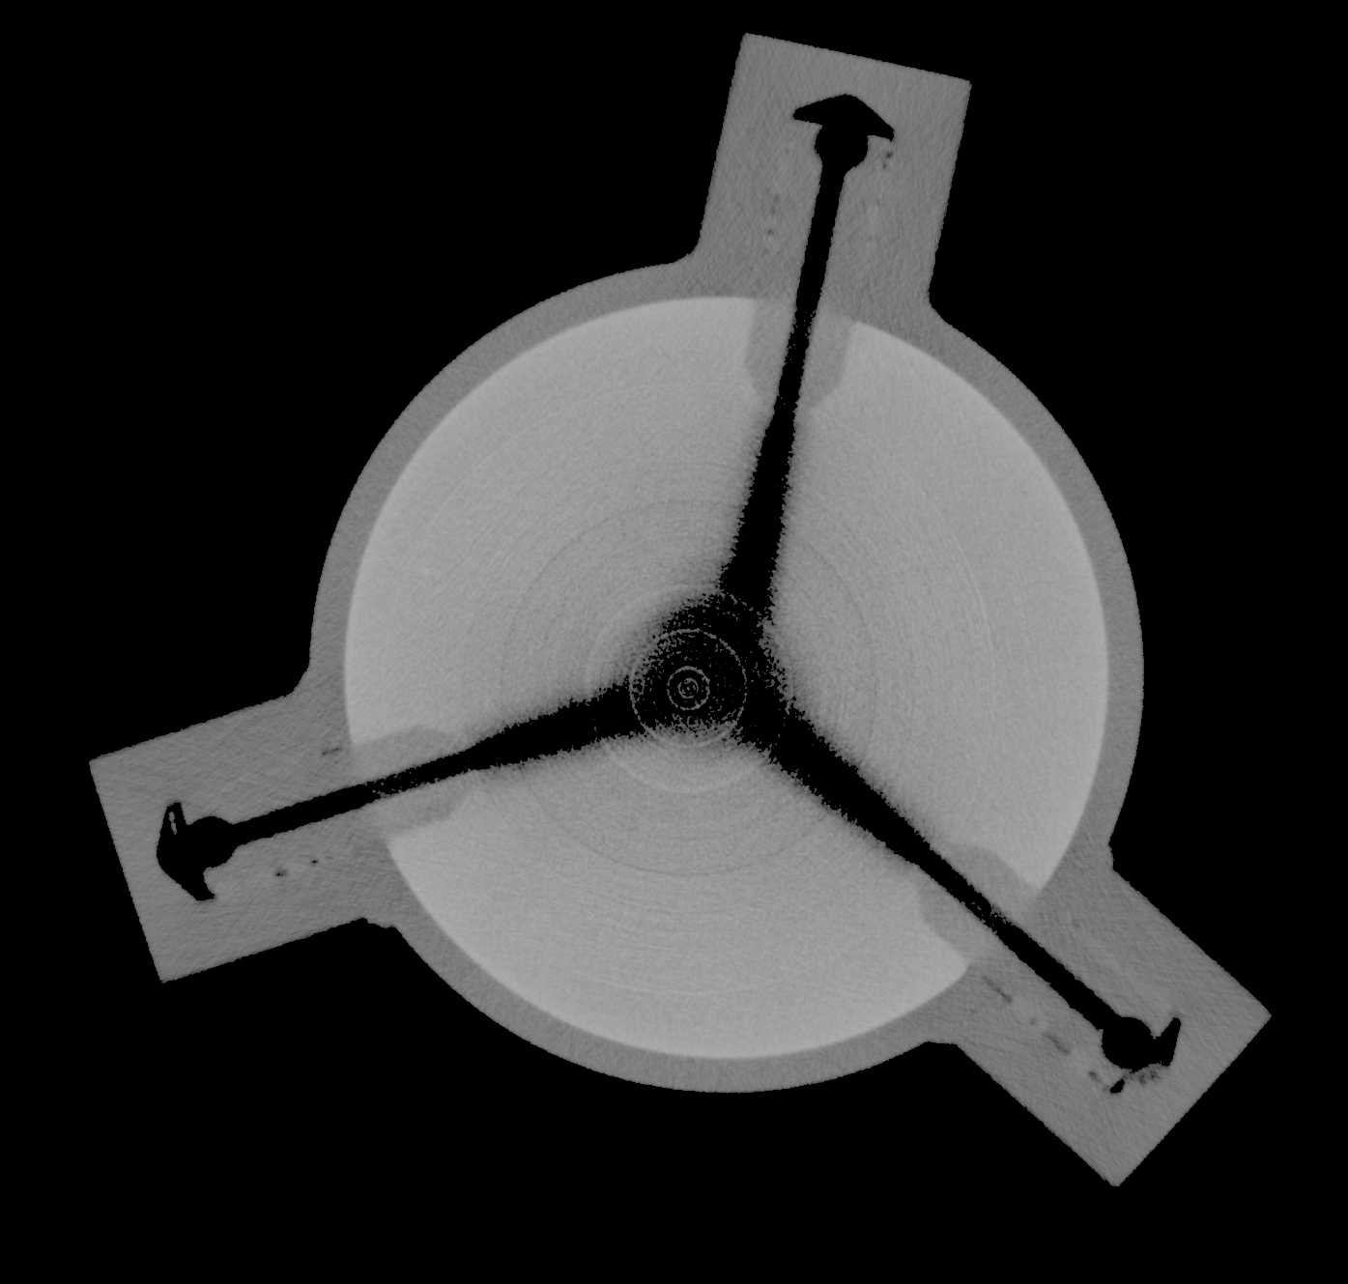
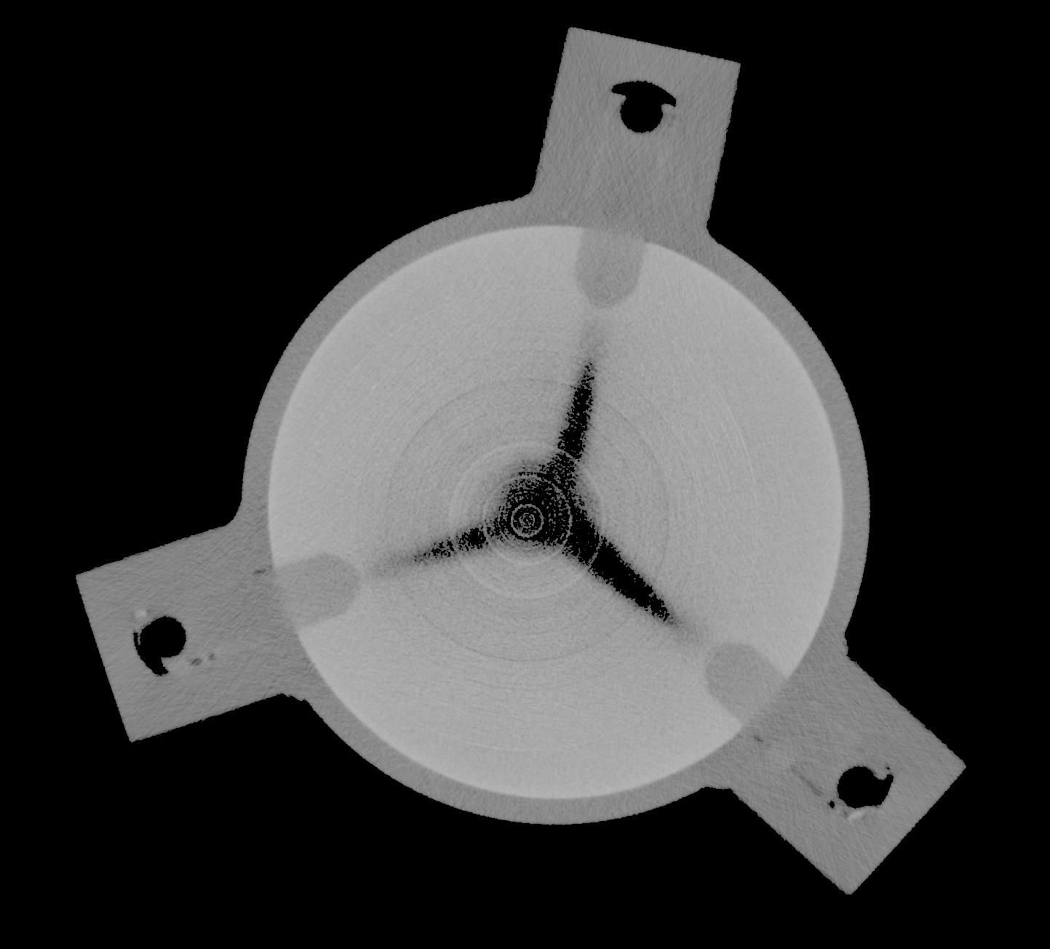
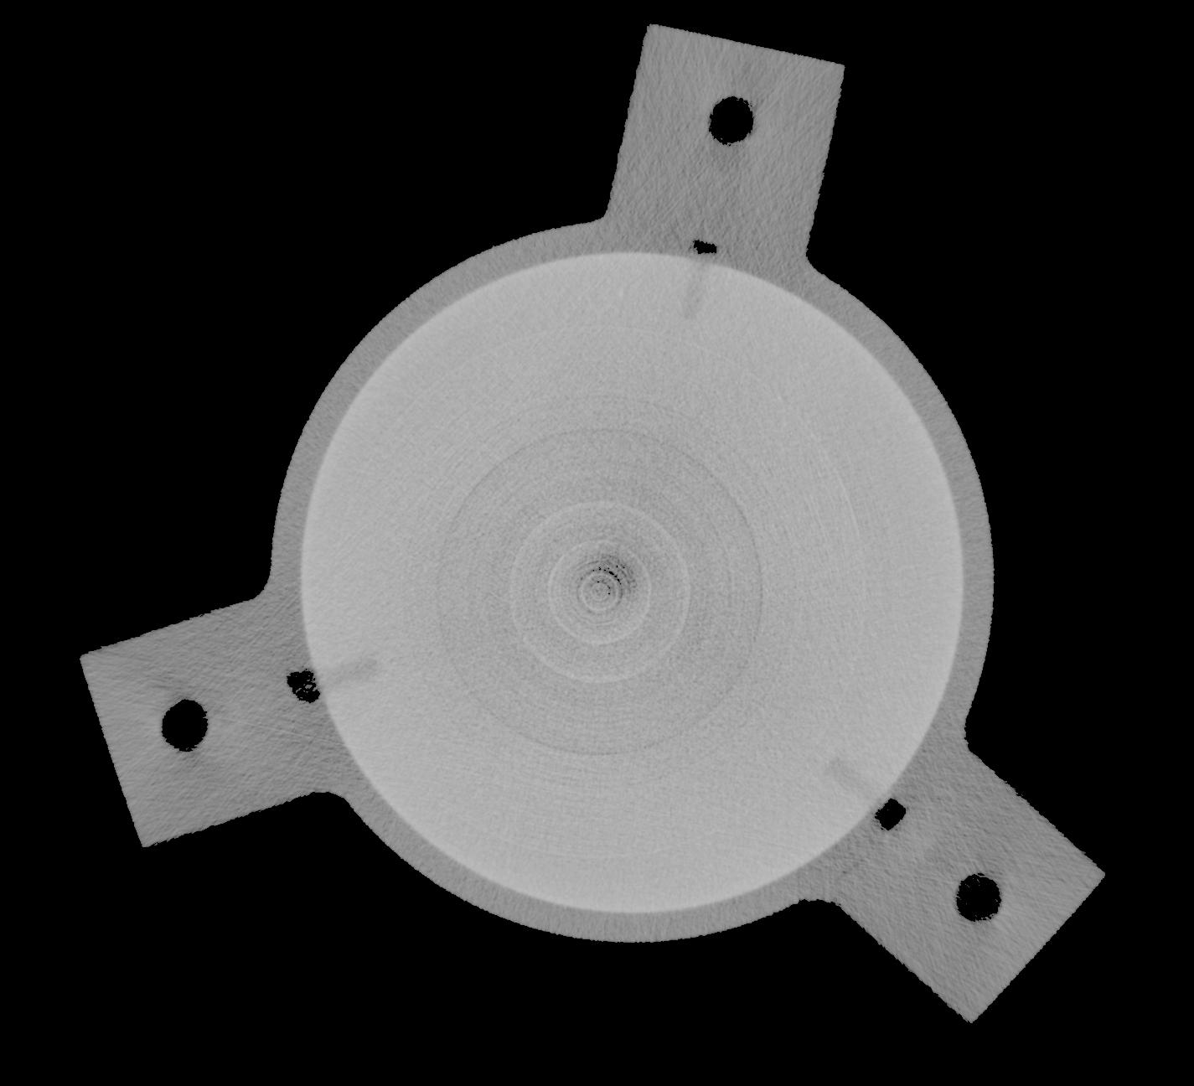
X-ray tomography: Flow pattern
Flow pattern
(1-ε)
0,56
d₀= 2 mm
0
Entrainment zone
No disturbance of flow
Measurement directly at nozzle exit possible

Slide 7
PIV in half-sided fluidized bed: Particle velocity field
v_{gas} = 250 m∙s⁻¹
v_{f} = 1,2 cm∙s⁻¹
particle
velocity
l_{y}/d₀ / -
l_{x}/d₀ / -
I : Jet core
II: Zone of flow establishment
III: Zone of established flow
Impact events
Horizontal secondary gas injection in ﬂuidized beds: Solid concentration and velocity in multiphase jets
B. Koeninger, T. Hensler S. Schug, W. Arlt, K.E. Wirth, Powder Technology 316 (2017) 49–58
Boundary: high (1-ε), low velocity
Jet zone: low (1-ε), high velocity

Slide 8
Particle velocity on jet axis
Surprisingly small particle velocities
Good agreement with the calculation model of Schlichting
$$S=1−exp\left\{−f_{Mat}∙x∙k∙\left(W_{m,kin}−W_{m,min}\right)\right\}$$
W_{m,kin} → particle velocity on jet axis
Assumption: 2 opposed jets
Number of impacts k = 1 (single impact)
Köninger B., Romeis S., Hensler T., Peukert W., Wirth K.E., Dynamics of fine grinding in a fluidized bed opposed jet mill, Powder Technology 327 (2018) 346-357

Slide 9
Assessing stress conditions via probe particles
Strobel, WP et al, Particuology 2020

Slide 10
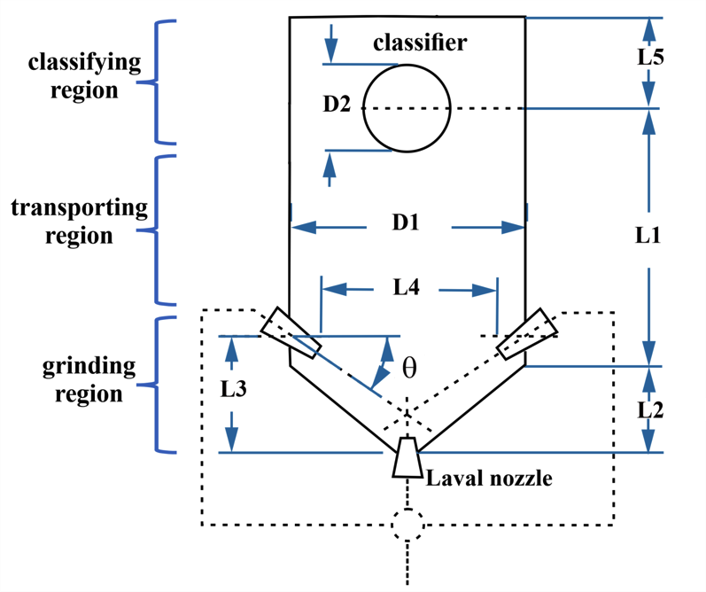
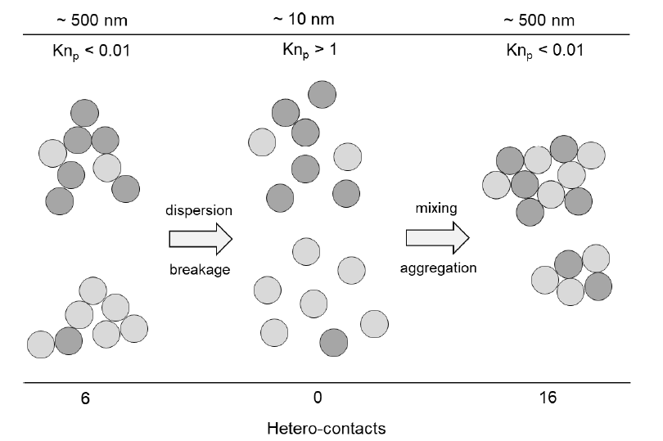
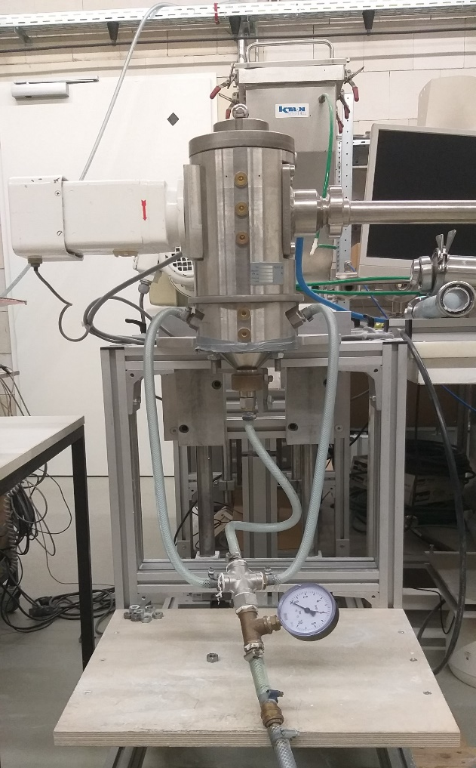
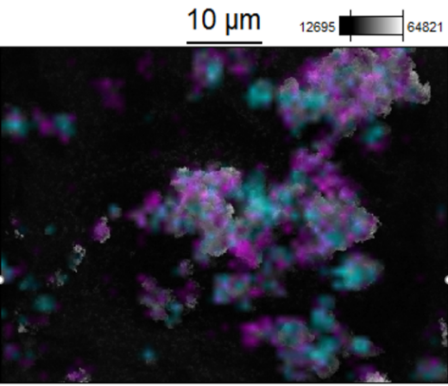
Hetero-aggregates (National priority program in Germany) Coordinator: Lutz Mädler, U Bremen
https://www.uni-bremen.de/spp2289
Project by Andreas Bück and Jochen Schmidt (FAU):
Spouted bed and opposed jet fluidized mills are investigated for their capability for dry formulation of nanostructured heteroaggregates, offering a large variety of aggregate sizes and structures: First results for Al₂O₃-TiO₂ and TiO₂-ZrO₂ aggregates.
AFG-100 (Hosokawa-Alpine)
Pink: TiO2 Turquoise: ZrO2
Jochen Schmidt, Andreas Bück et al., Chem. Ing. Tech. 2023, 95, 107-113.

Slide 11
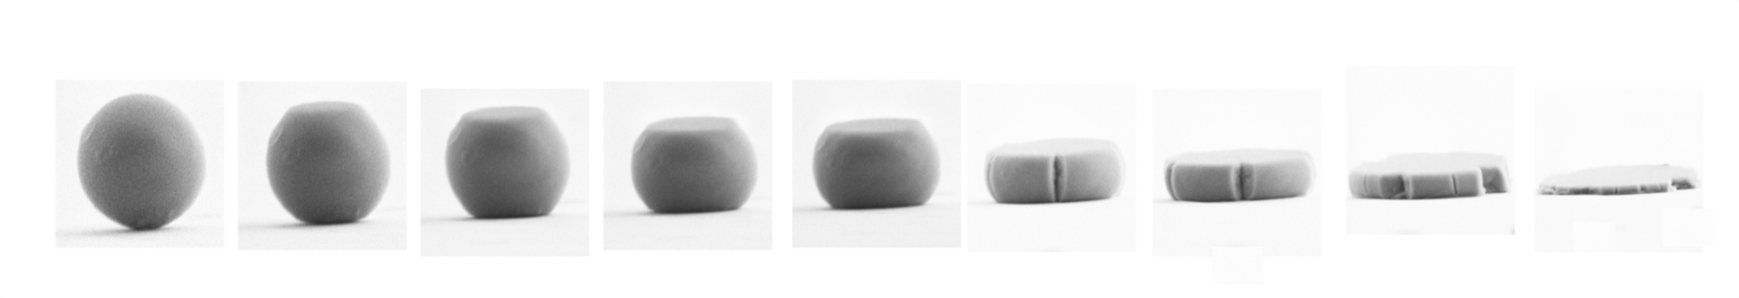
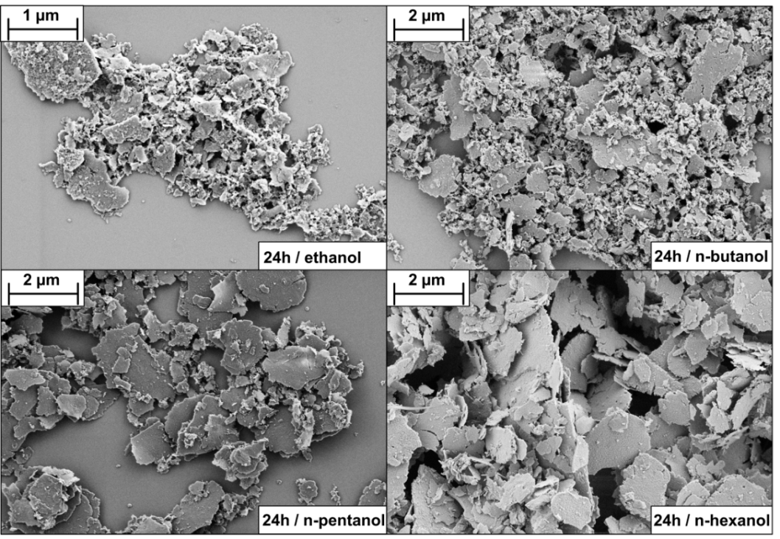
Shape control by wet grinding in bead mill
Examples:
Bioglass
Tissue bonding capability
ion release
apatite precipitation
cell bonding
Li-ion batteries
Glasses (e.g. Si-Ge-Co …)
Delamination of 2D materials (graphene, Bn, MoS2)
Esper, WP, Boccaccini., Bioactive glass flakes as innovative fillers in chitosan membranes for guided bone regeneration, Advanced Engineering Materials 24 (2022) 4, 2101042
Esper, WP et al, SiO₂-GeO₂ glass-ceramic flakes as an anode material for high performance lithium-ion batteries, Energy Technology (2022) 2200072
Nacken, WP et al, Quantitative investigation of the fragmentation process and defect density evolution of oxo-functionalized graphene due to ultrasonication and milling, Carbon 96 (2016) 897-903
Breakage down to brittle-ductile transition (B-D-T)
Below (B-D-transition), only plastic deformation
Formation of thin platelets with high aspect ratio

Slide 12

Research Training Group at FAU
Fracture Across Scales (FRASCAL)
Coordinator: Paul Steinmann, FAU
12 projects
(chemistry, mechanics, physics, math)
Focus: Computational modelling of fracture
Scale-bridging from the atoms to continuum
Funded for 4.5 years
Now prolonged for a second period
https://www.frascal.research.fau.eu/

Slide 13

Special Issue in Computational Particle Mechanics:
Fragmentation and wear in DEM Vol 8 (2021) 5
Editors: Thomas Weinhart (U Twente), Jeremy Lechman (Sandia Lab), Thorsten Pöschel (FAU)
New peridynamics model for modeling molecular crystal particles
Effects of pre-cracks in the internal structure of the particles on the fracture behavior using peridynamics.
Constrained DEM model to predict the effect of pore size distribution on fracture behaviour
A calibrated DEM bond model to predict stress-strain relationships and dust formation in a bulk sam-ple.
How a DEM model can be used to predict the abrasive wear of an impeller in a tumbler
How to use experimental data of gravel rock particles to calibrate fracture models
Coupled peridynamics-contact dynamics model to predict the particle size and shape distribution in a granular sample.
Open challenges: The breakage and abrasion of a granular material depend strongly on the individual particles’ characteristics and structure. A careful calibration and model selection are essential to obtain reliable predictions from numerical simulations.

Slide 14
IFPRI
Excellent individual projects
Project design according industrial needs
Worldwide network of leading experts
Counteracts the divergent developments in industry (fast & efficient) and academia (visibility & track record)
Options to discuss:
Exploit synergies from project clusters (e.g. spray drying, adhesion and powder flow)
Trend towards higher dimensional description, processing, characterization of particulates
How to make review writing more attractive?
„Green“ particle technology?

Slide 15

Green particle technology: White fields
Functional particles widely used in batteries, fuel cells, LEDs, solar cells etc.
How about commodity products („green“ titania, chocolate …)?
Life cycle analysis for particulate products
Design principles including optimized product recycling after usage
Flowsheet simulation including comprehensive energy and ressource balances
Alternative production routes with minimized CO2-footprint at constant/better product quality
Rigorous optimization of driving forces (here stress energy distributions): Precision production
Highest particle concentrations - mimimal solvents (e.g. in spray drying, solid-liquid separation …)
Replacement of liquid-phase processes by dry processes
Mechano-chemical activation/synthesis pathways (e.g. new routes to green cement)
Cyclic operation (due to fluctuating energy supply from renewables): Efficiency and product quality
Electrification of production routes (e.g. micowave drying, electrical steam cracker)
WP, Andreas Bück, Chem.Ing.Techn. 2023

