Slide 1
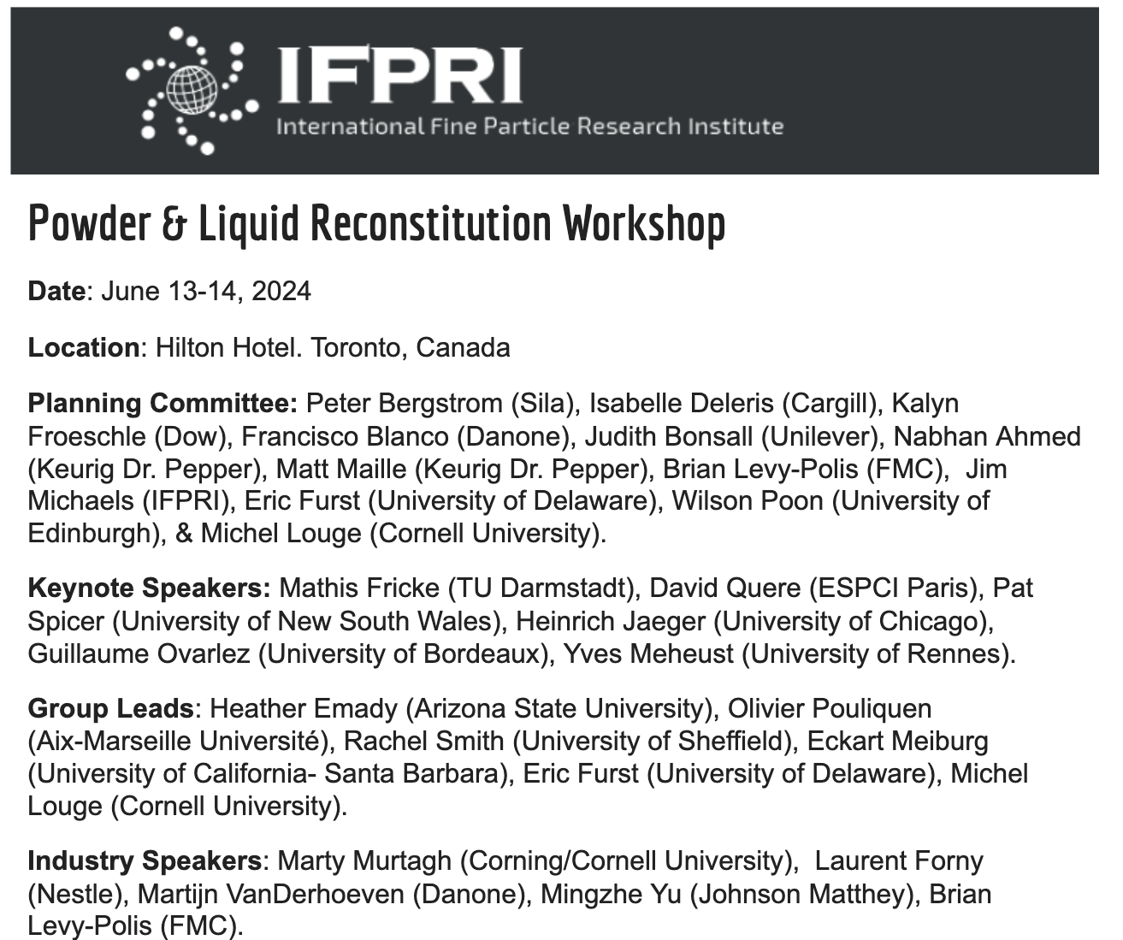
2024 Reconstitution Workshop Report
Report Overview
2025 IFPRI AGM

Slide 2
Contents of the Workshop Report
Problem Statement
Reconstitution Definition and Stages
Session 1: Industrial Challenges & Speakers
Session 2: Fundamental of wetting powders
Session 3: Transformation
Session 4:Gap Identification
Road Map
Industrially Relevant Model Systems

Slide 3
Problem Statement
In industry, a disconnect often exists between powder suppliers and end users when dealing with reconstitution. Manufacturers modify production processes to optimize yield, enhance safety, reduce costs, or scale up production. While such changes may produce powders that meet specifications, they can inadvertently alter the powders’ behavior when combined with liquids.
Significant Market Size Opportunities In Reconstitution, including:
Facial Cleaning Products ($13 B →$32 B by 2032)
Conventional Lithium Ion Batteries ($54 B→ $180 B by 2030)
Pasta ($68 B→ $100 B by 2032)

Slide 4
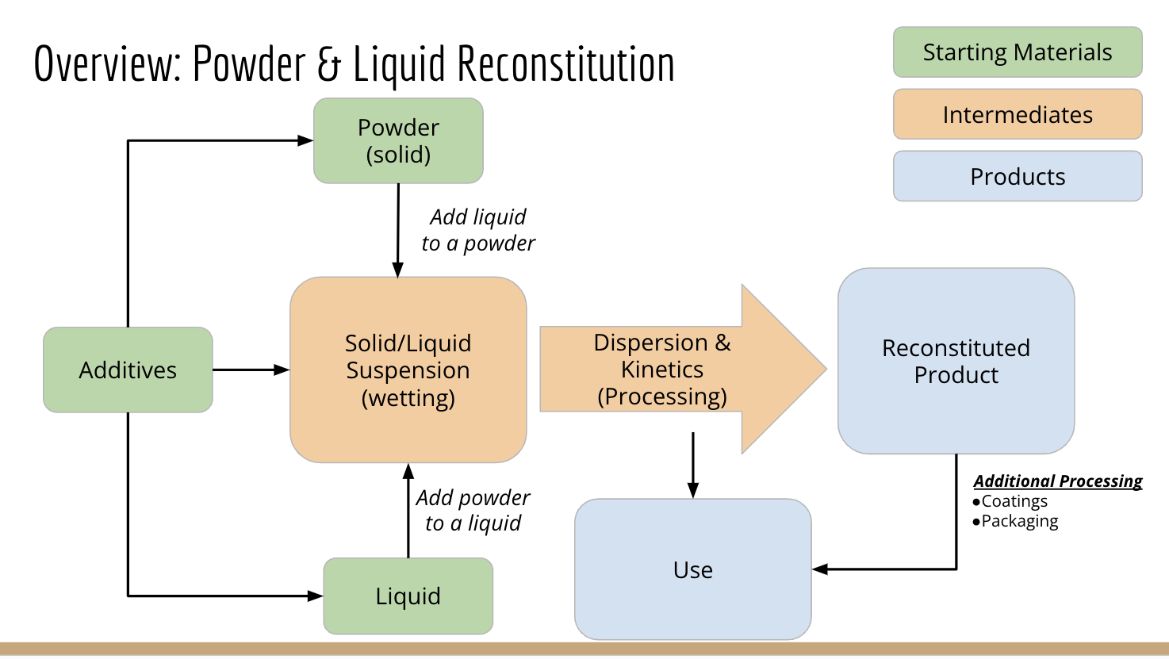
Reconstitution: Going into the workshop

Slide 5
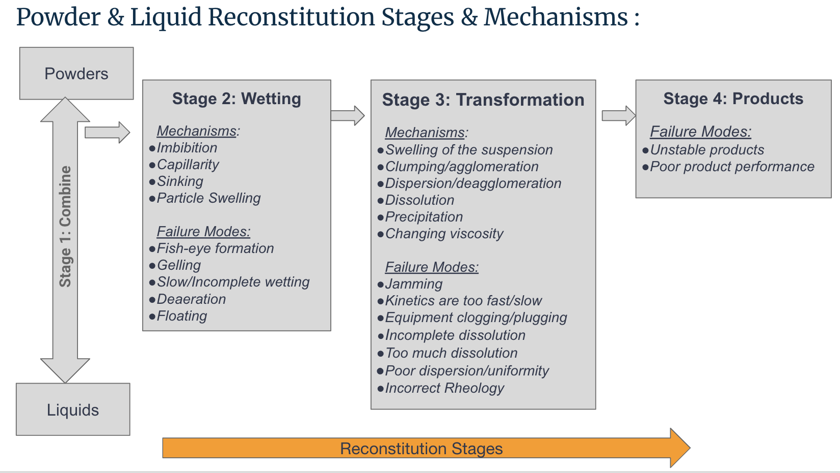
Gap #1: Industry Lacks Language and Relevant Model Systems.

Slide 6
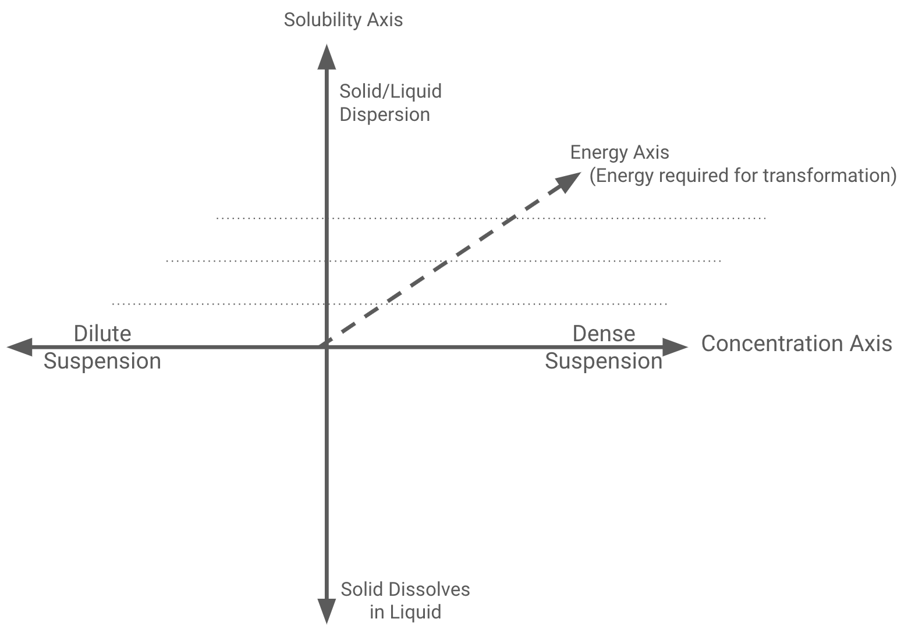
Gap #1: Industry Lacks Language and Relevant Model Systems.
Recommendation:
Describe Products Using
-Concentration (dense/dilute)
-Solubility (disperse/dissolve)
-Energy (high-low)
*Examples info in a few slides

Slide 7
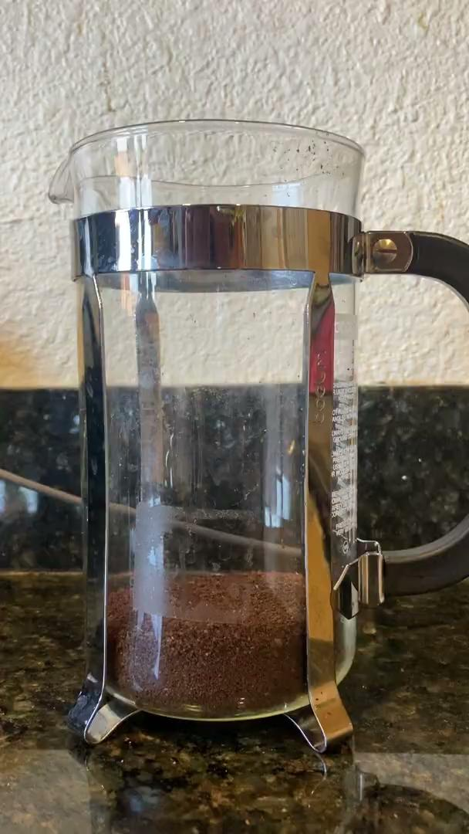
Gap #2: Three Phases
Solids
Liquids
Gasses (we often don’t consider gas)

Slide 8
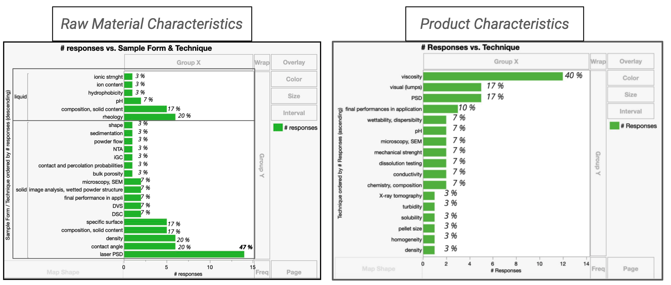
Gap #3: Poor alignment in Characterization & KPI’s

Slide 9
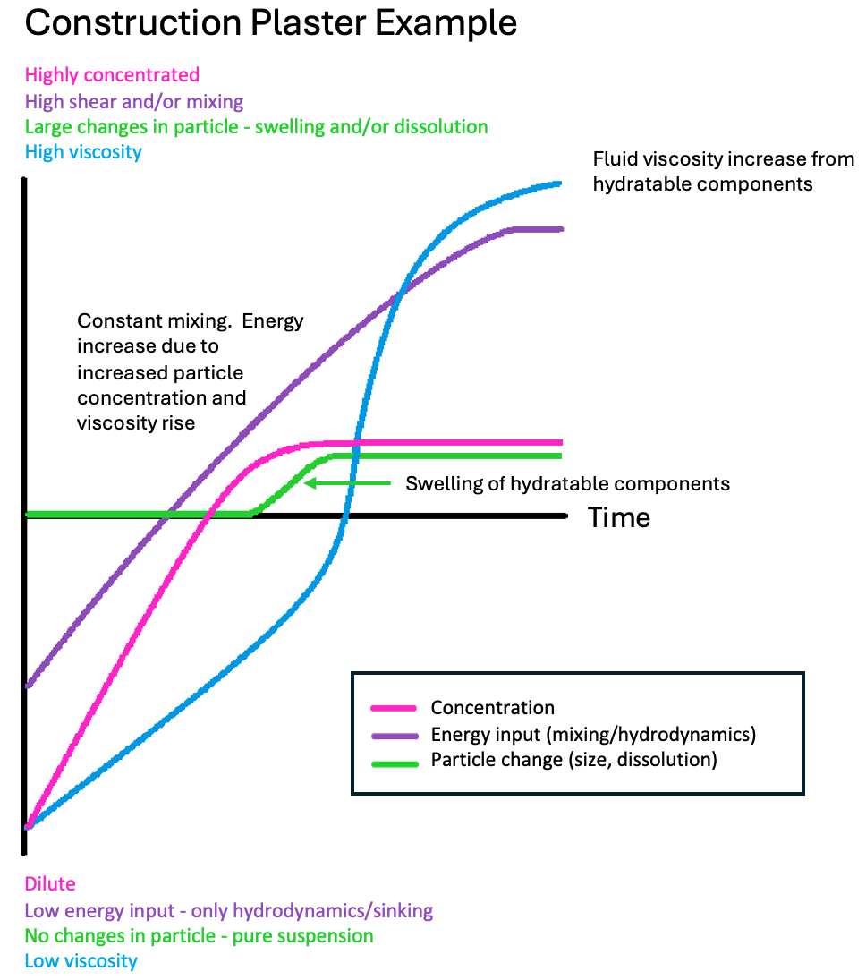
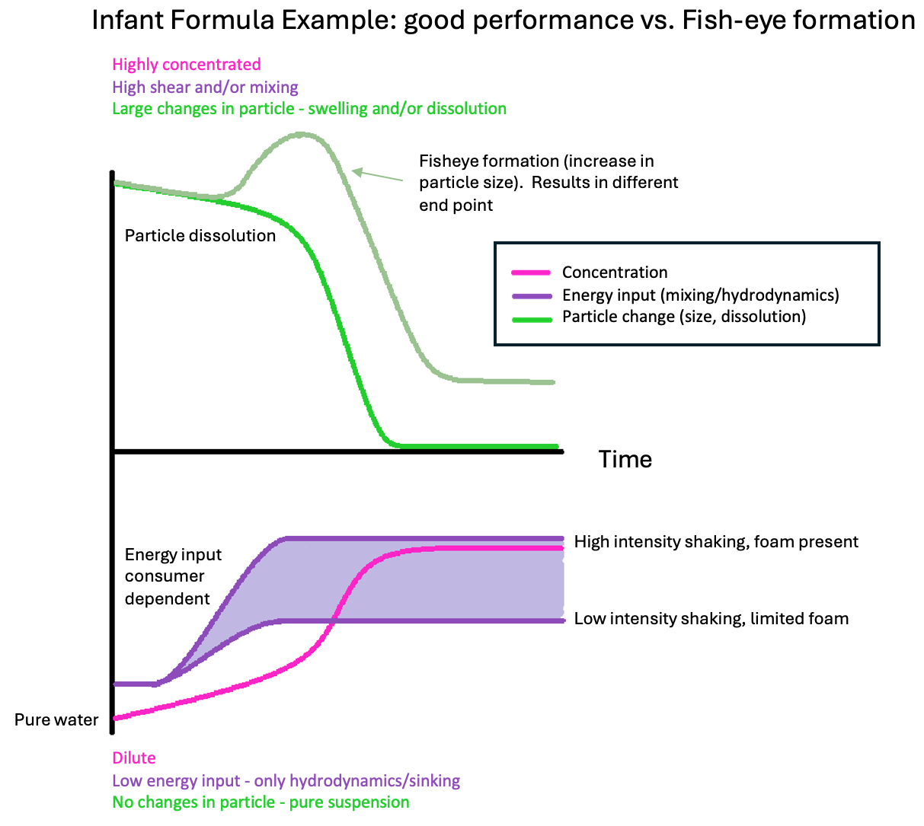
Gap #4: Kinetics are Dynamic and Complex.
Time Axis: shows reconstitution for a single system: starting materials through product

Slide 10
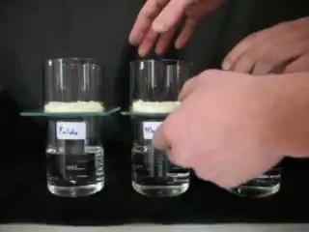
Gap #5: Failures Show up During Scale-Up
Example from Workshop:
Reconstitution times of infant milk differs across production lines.

Slide 11
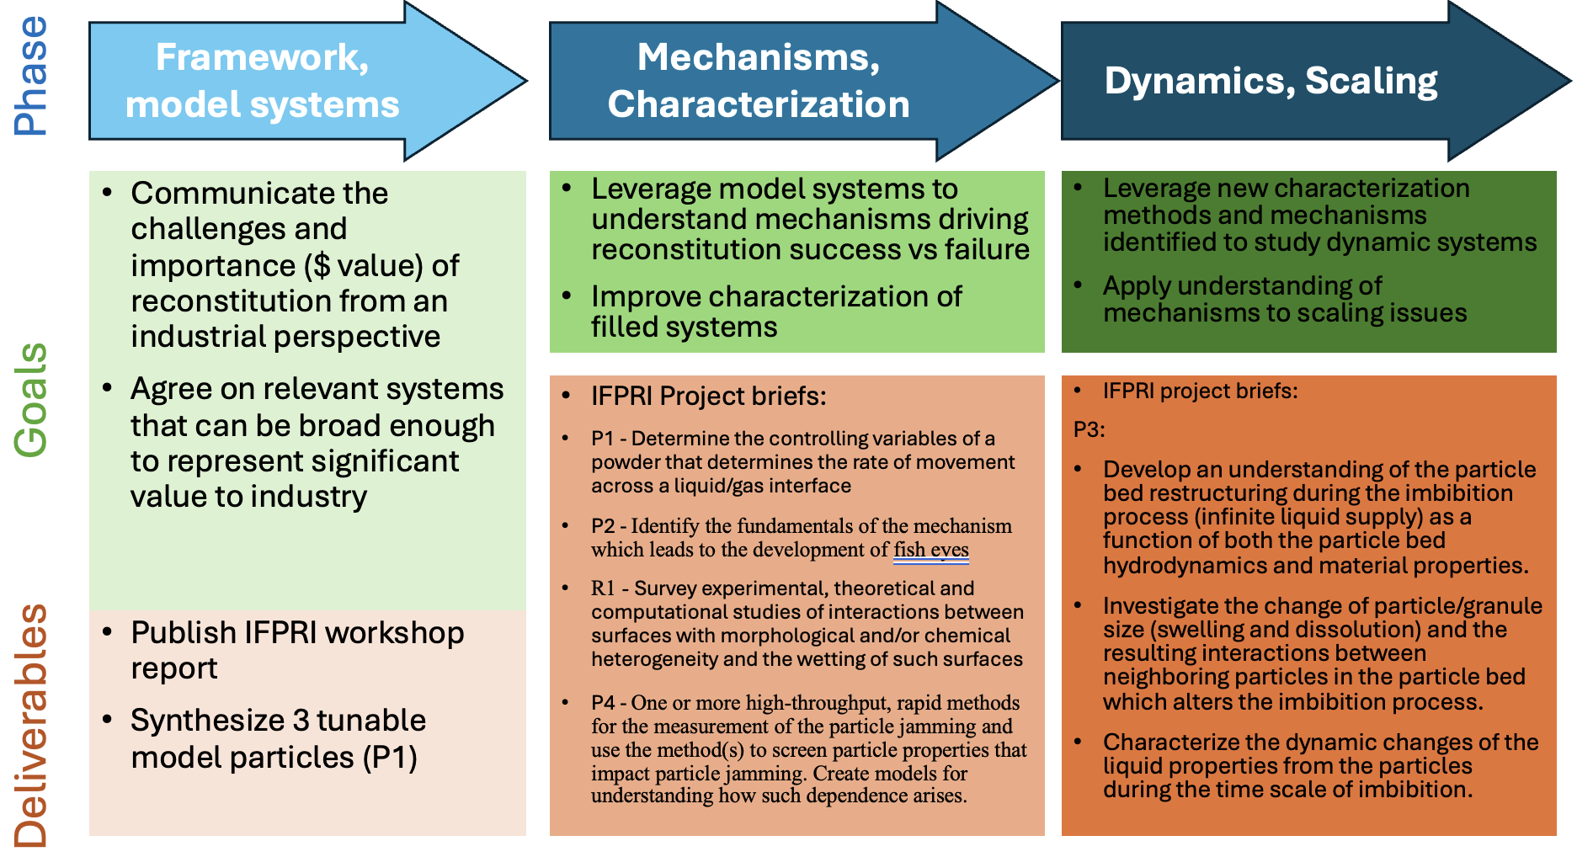
Road Map

Slide 12
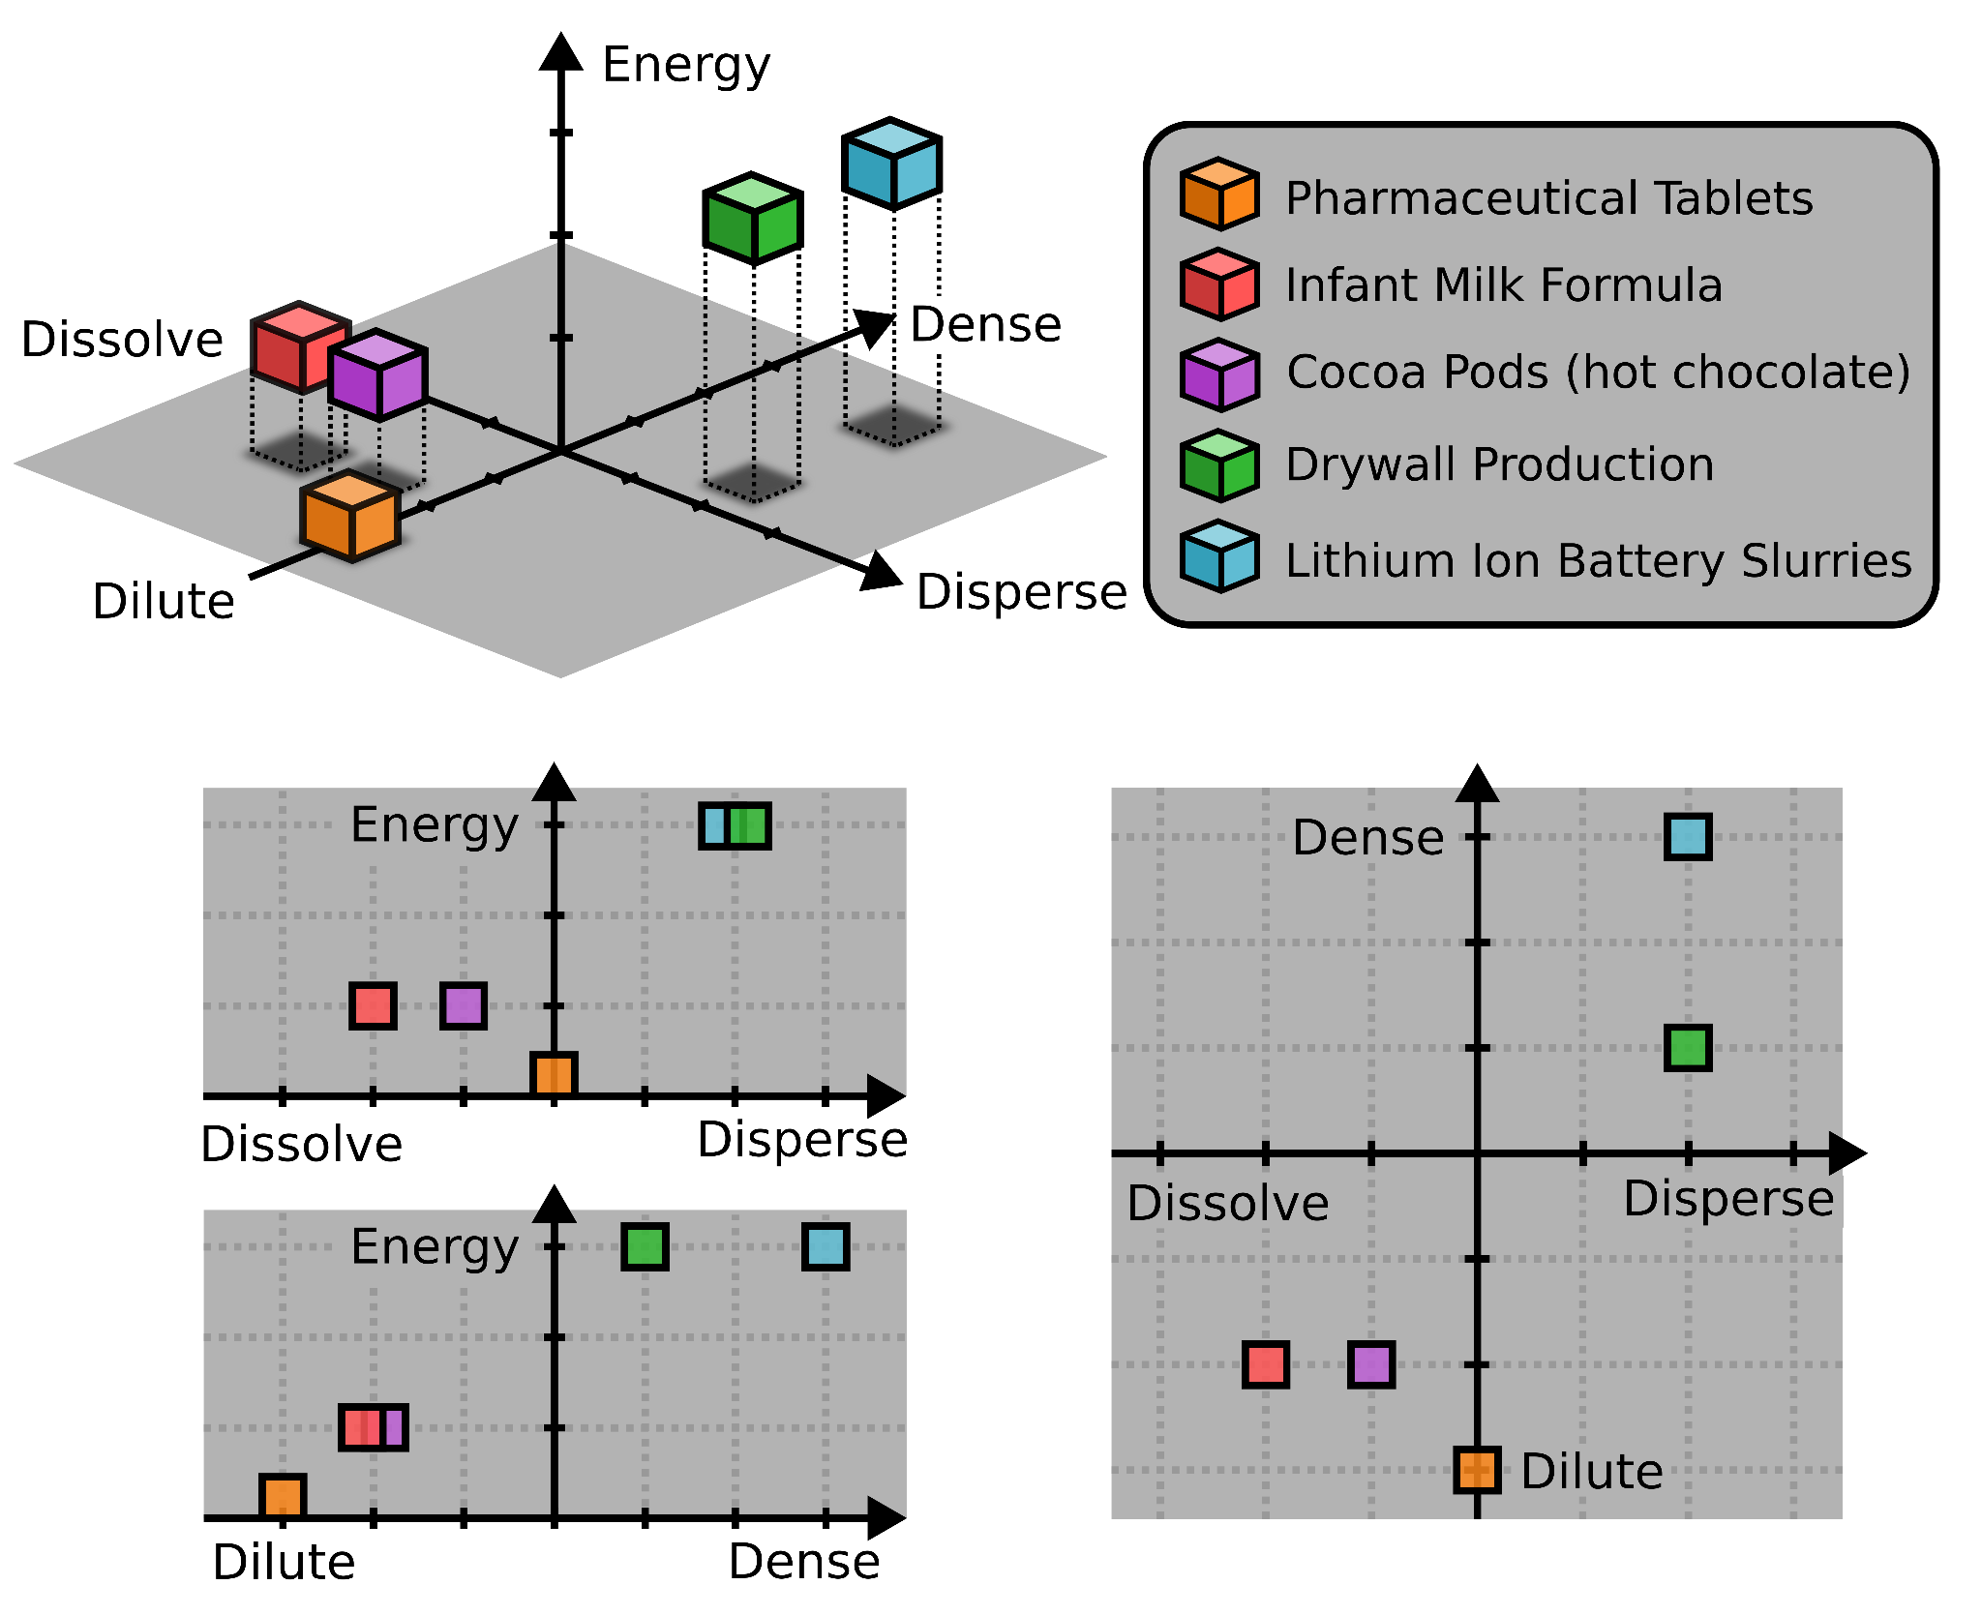
Industrially Relevant Systems
Additional systems that complement examples from the workshop.
Milk Powder
Ceramics
Catalysts
Agricultural

Slide 13
Briefs/Proposals & Outcomes at 2024 AGM
Topics | Ref | Type | IFPRI area | Gaps addressed | Results
Surface energy of heterogeneous surfaces | R1 | Review | Characterization | Gaps 1 & 3 | Completed
Measurement of multimodal, multicomponent PSD in suspensions | R2 | Review | Wet systems Characterization | Gaps 3 & 4 | Voted yes, discontinued
Transport of heterogeneous particles through a gas/liquid interface w/ tunable particles | P1 | Project | Dry systems Wet systems | Gaps 1, 2 & 3 | Proposals received
Fish Eye Avoidance & Break up | P2 | Project | Wet systems | Gaps 3, 4 & 5 | Proposals received
Dynamic imbibition | P3 | Project | Wet systems | Gap 4 | No
High Throughput Measurement of Jamming | P4 | Project | Wet systems Characterization | Gaps 3 & 5 | Proposals received
Friction in wet & dry systems | W1 | Workshop | Wet systems Dry systems Modeling | Gaps 1, 3 & 4 | On target for 2026

Slide 14
How We’re doing: Closing some gaps, more to do!
Complete
Work in Progress
Work Needed Here
Not Started
Under investigation

