Slide 1
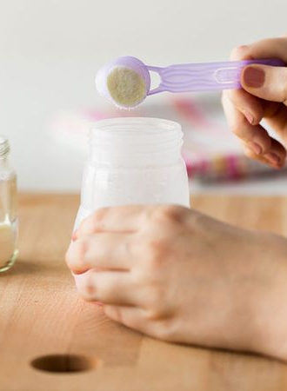
Challenges in reconstitution of infant milk: what do customers do and how to measure it?
IFPRI Reconstitution workshop
Toronto, 13 & 14 June 2024
Martijn van der Hoeven, PhD
Principal Technologist Blending & Powder handling

Slide 2
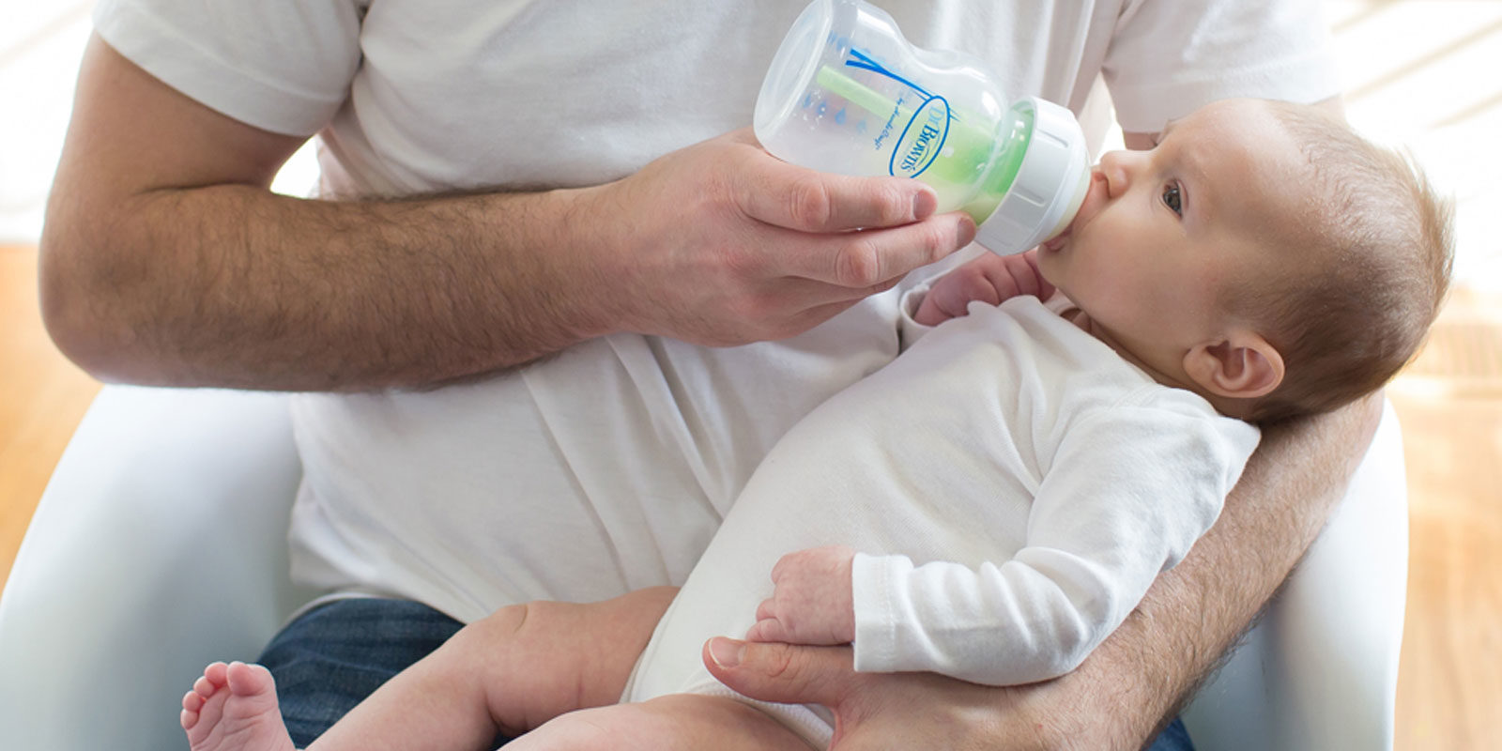

Slide 3
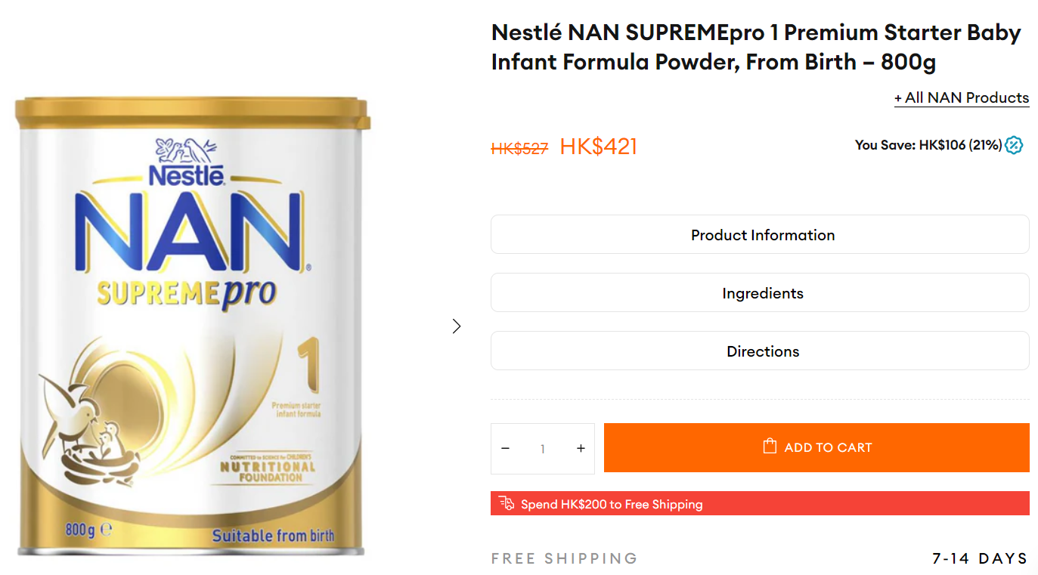
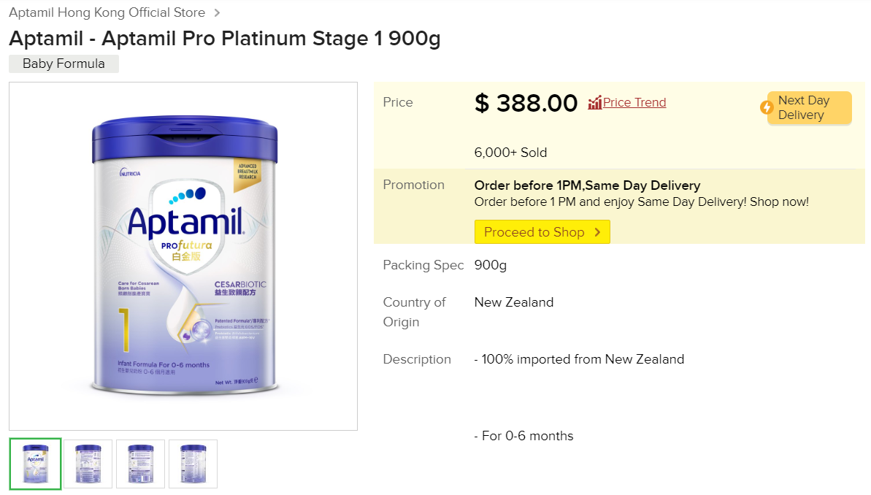

EUR 50 / USD 54
EUR 46 / USD 50

Slide 4
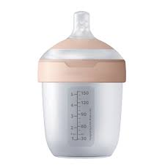
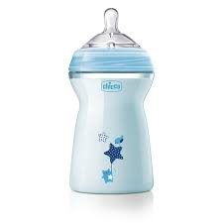
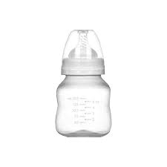
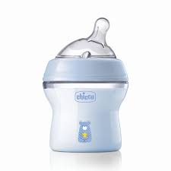
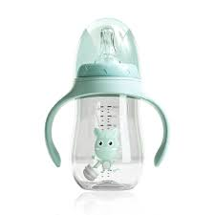
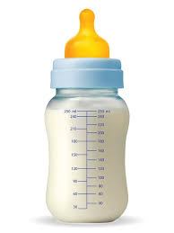
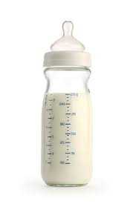
What baby bottle is the consumer using?

Slide 5
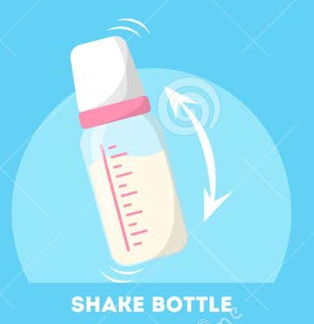
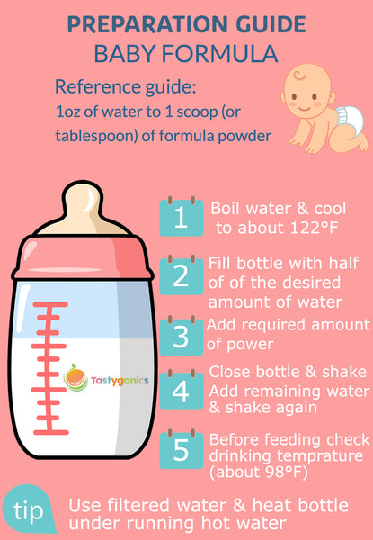
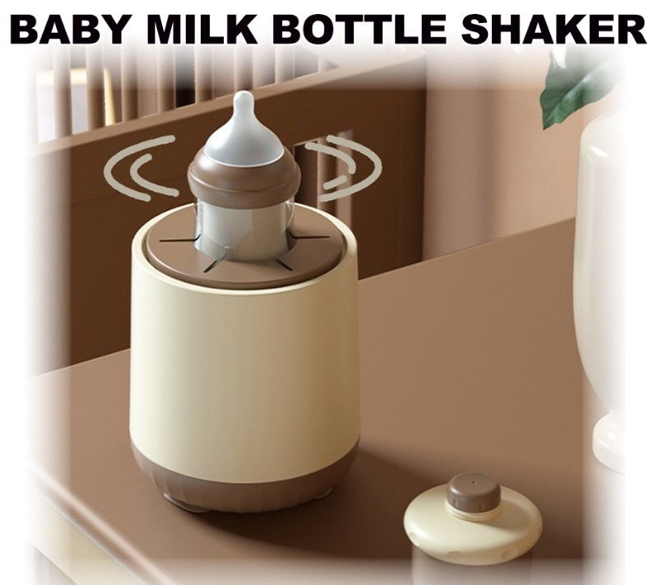
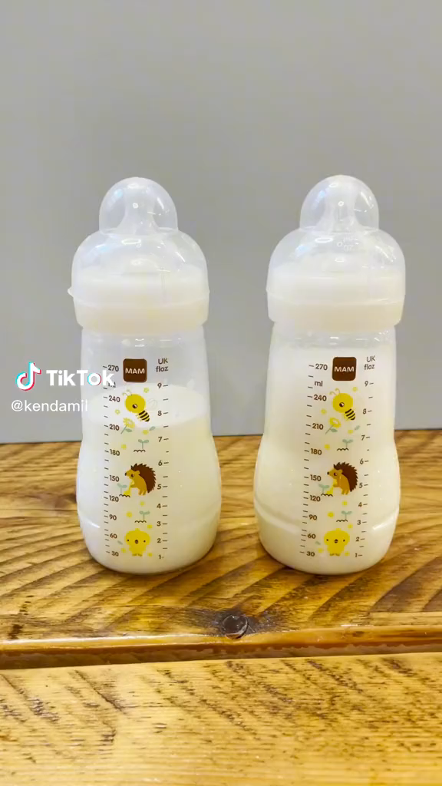
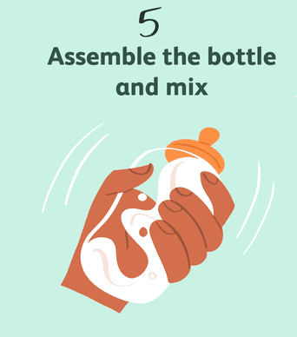
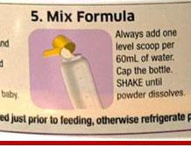
How to prepare a bottle of infant milk?

Slide 6
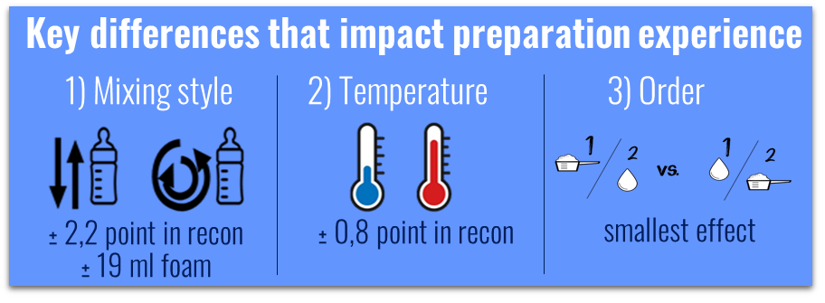

What do people actually do?
Parents do not always follow instructions in the way they mix and the temperature they use, impacting the experience directly
These differences results into more lumps and less foam
shaking
swirling
Lumps
China users mix very gently
Foam

Slide 7
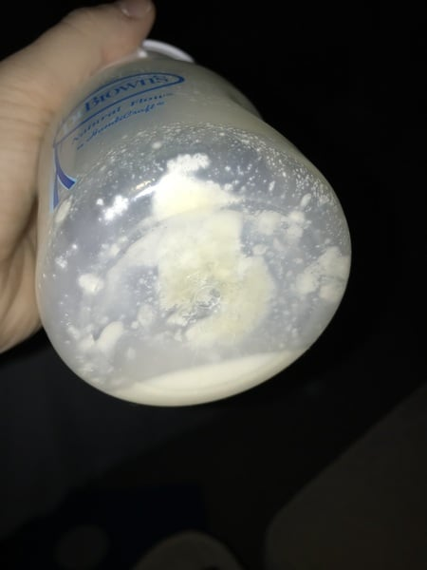

lumps or foam?

Slide 8
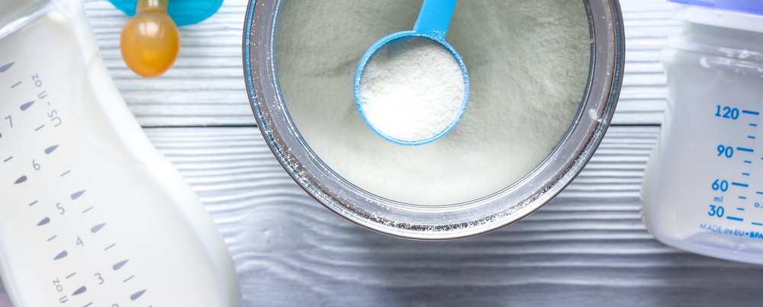
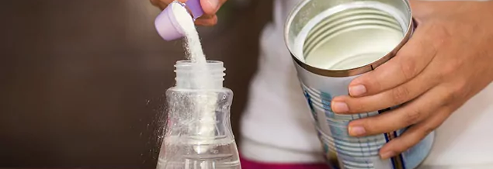
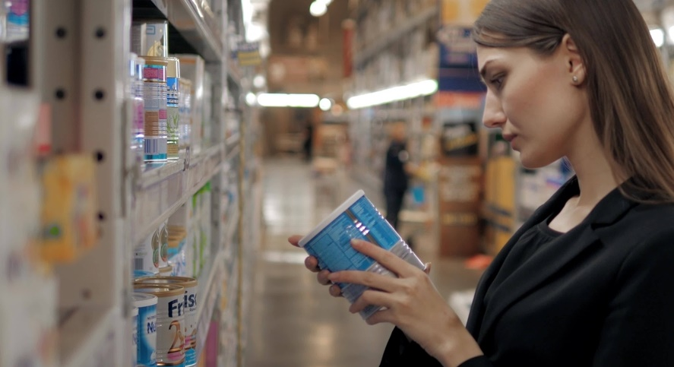
Preparation EXPERIENCE IS key
Preparation experience is a key moment of truth
More people would switch brands instead of complaining
Lumps, foam and bad aroma are reasons for brand switch. #1 complaint is poor mixing.

Slide 9
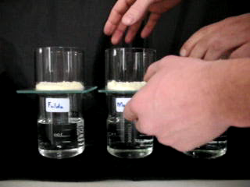
Reconstitution: same product – 3 different spray dryers
left
middle
right

Slide 10
Particle density & recon
Powder | Left | Middle | Right
Powder bulk density (g/ml) | 0.48 | 0.46 | 0.48
Particle density (g/ml) | 1.231 | 1.224 | 1.021
Porosity (=1-(BD/PD)) | 0.61 | 0.63 | 0.53
Mean particle size (µm) | 148 | 105 | 154

Slide 11
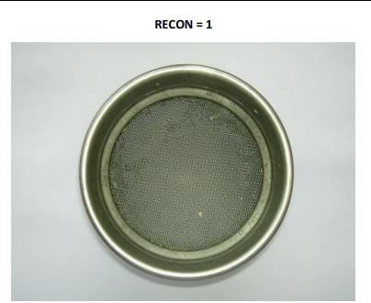
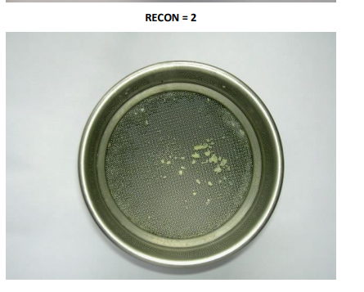
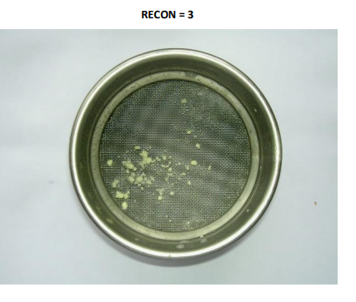
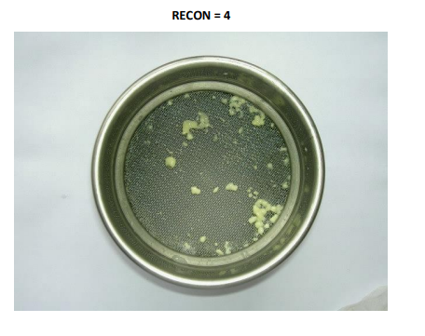
Score 0
Score 1
Score 2
Score 3
CONSUMER EXPECTATION
SPECIFICATION

Slide 12
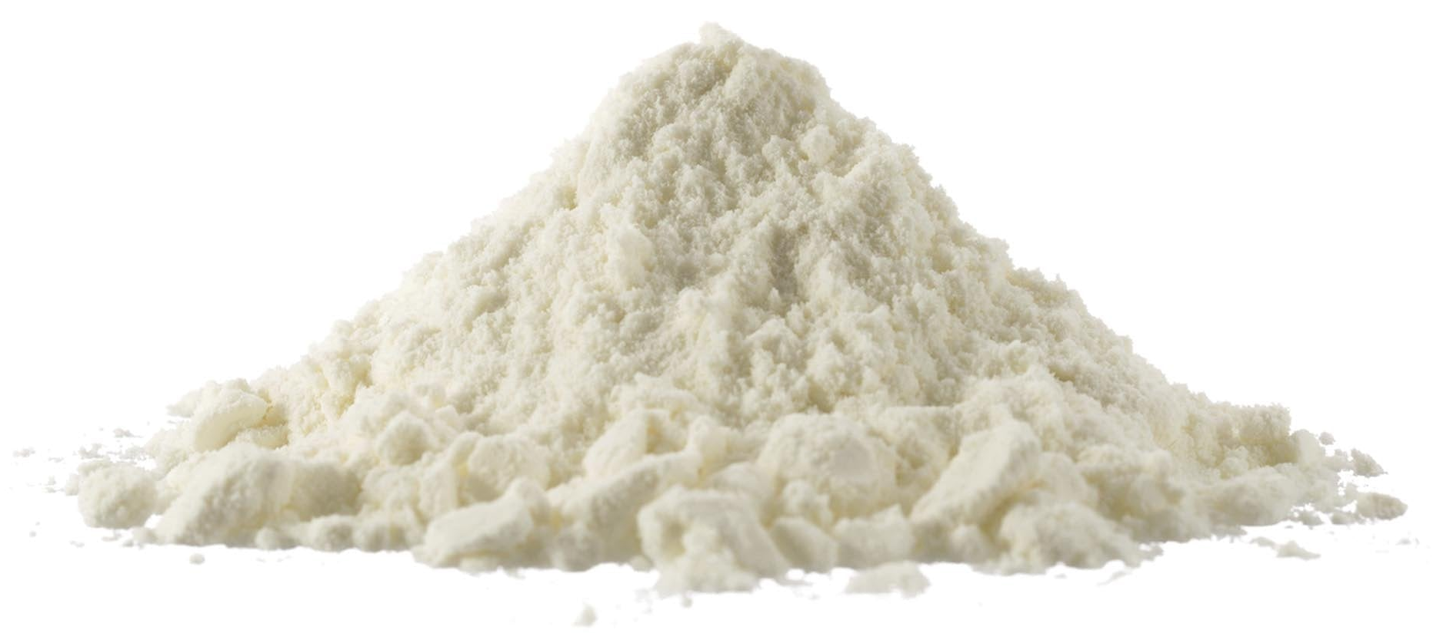
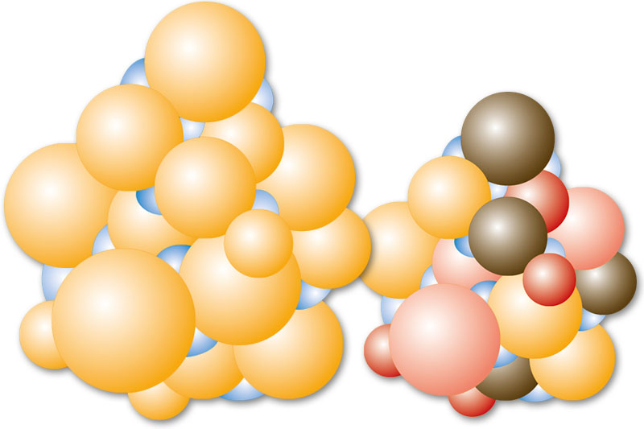
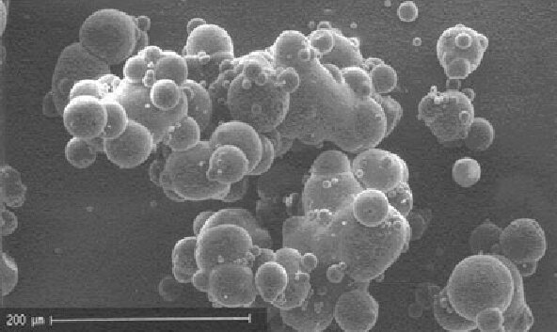
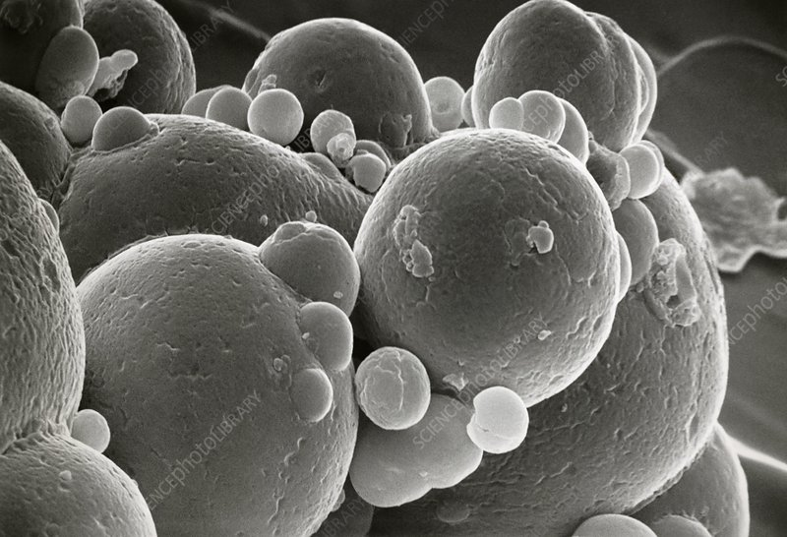
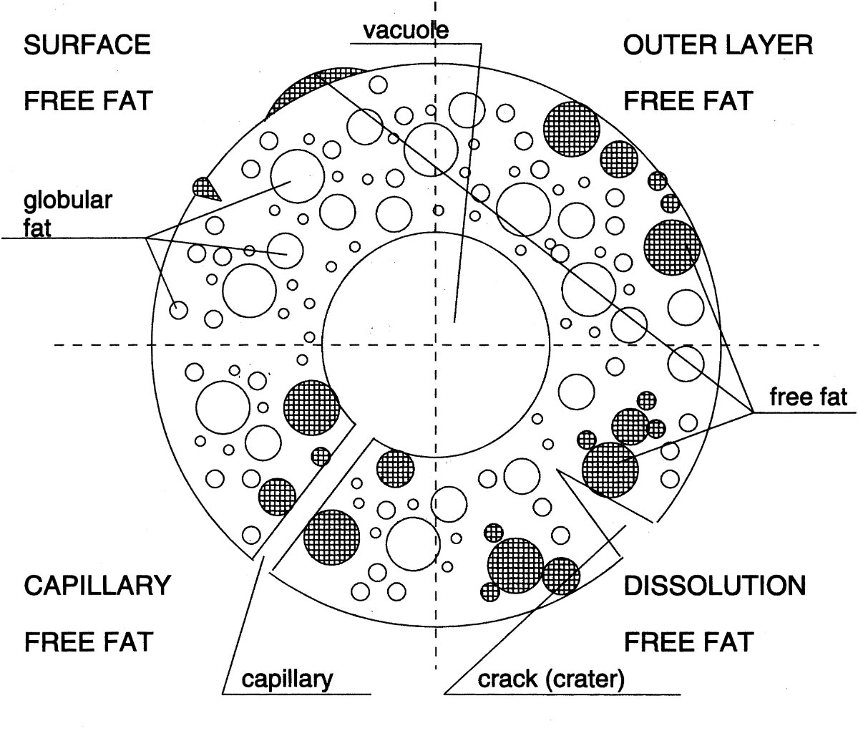
The 4 levels of Powder structure and morphology
Bulk volume
Stickiness
Homogeneity
Reconstitution
Bulk powder
Agglomerates
Porosity
Size, amount of fines
Primary particles
Particle density
Size (distribution)
Moisture
Structure within particle
Free fat
Hydrophobicity
Composition

Slide 13
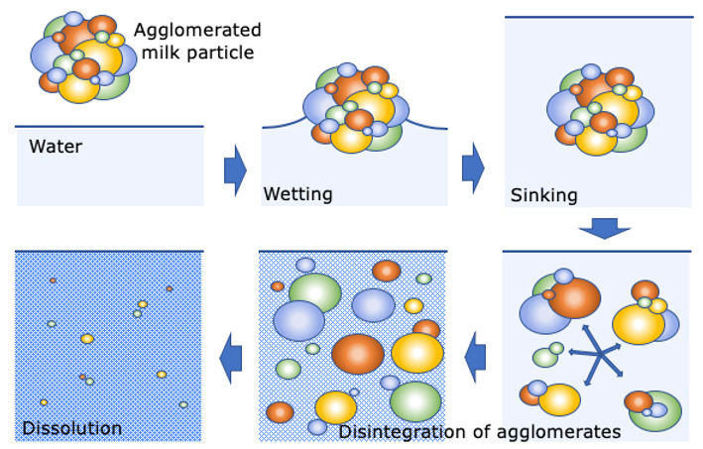
Steps in powder dissolving

Slide 14
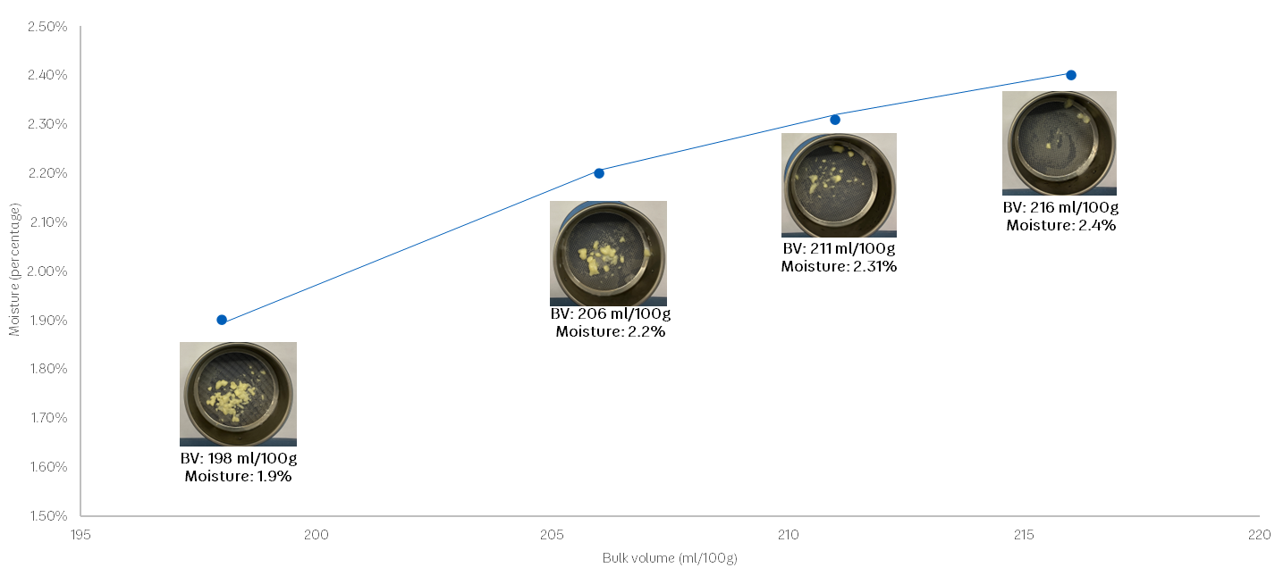
Reconstitution: effect of bulk volume and moisture content
Moisture content (w/w%)
Bulk volume (ml/100g)

Slide 15
