Slide 1
Crop Protection Water Dispersible Granules
Formulation Development and Launch Troubleshooting

Slide 2
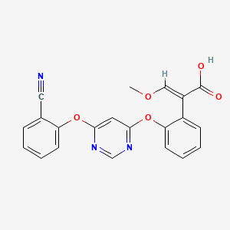
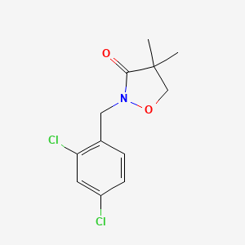
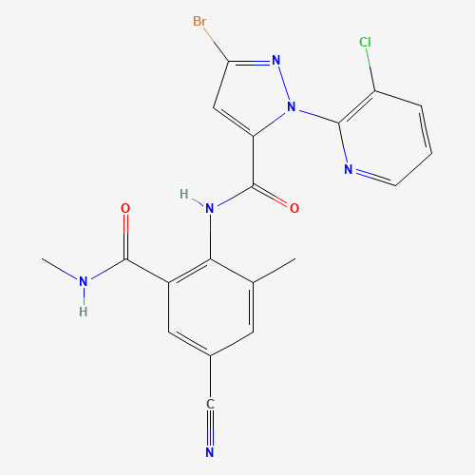
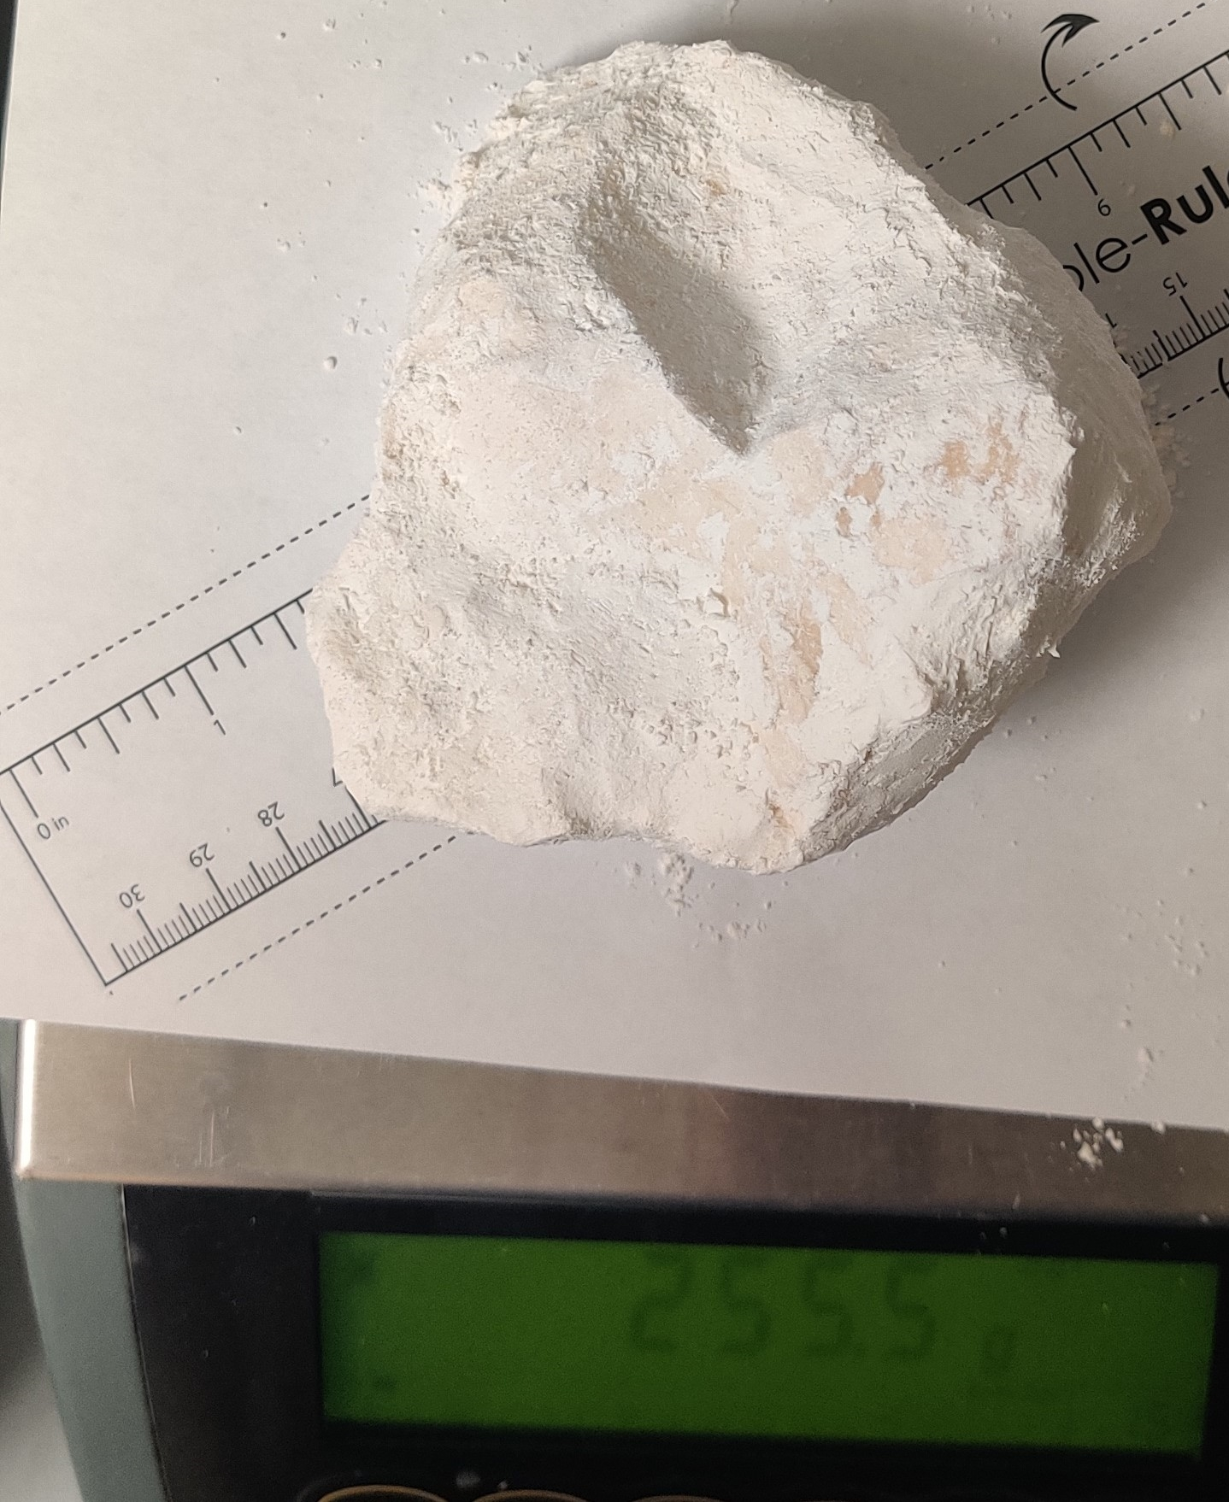
Agricultural Formulations
Active ingredients often are…
  Fungicides, Herbicides, or Insecticides
  Solids initially less than 500 microns
  Applied at less than 20 microns
Some formulations goals are…
  AI highly loaded in product
  Excellent dispersion upon dilution in water and sprayability
  Stable in container and on field
Usually.

Slide 3

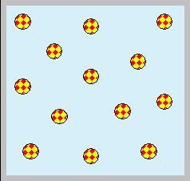
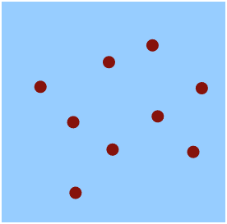
Formulation Type Flow Chart
Solubility in Water
High
AI Dissolved
Soluble Liquid (SL)
Soluble Powder (SP)
Soluble Granule (SG)
Low
Med / Low
Low
Solubility in Water Immiscible Solvents
High
AI Dissolved
Emulsifiable Concentrate (EC)
Oil in Water Emulsion (EW)
Melting Point
Med/High
AI Suspended
Oil Dispersion (OD)
Suspension Concentrate (SC)
Wettable Powder (WP)
Water Dispersible Granule (WG)
Melting Point
Low
AI Suspended or Dissolved
Capsule Suspension (CS)
Molten Impregnation (GR)
3

Slide 4
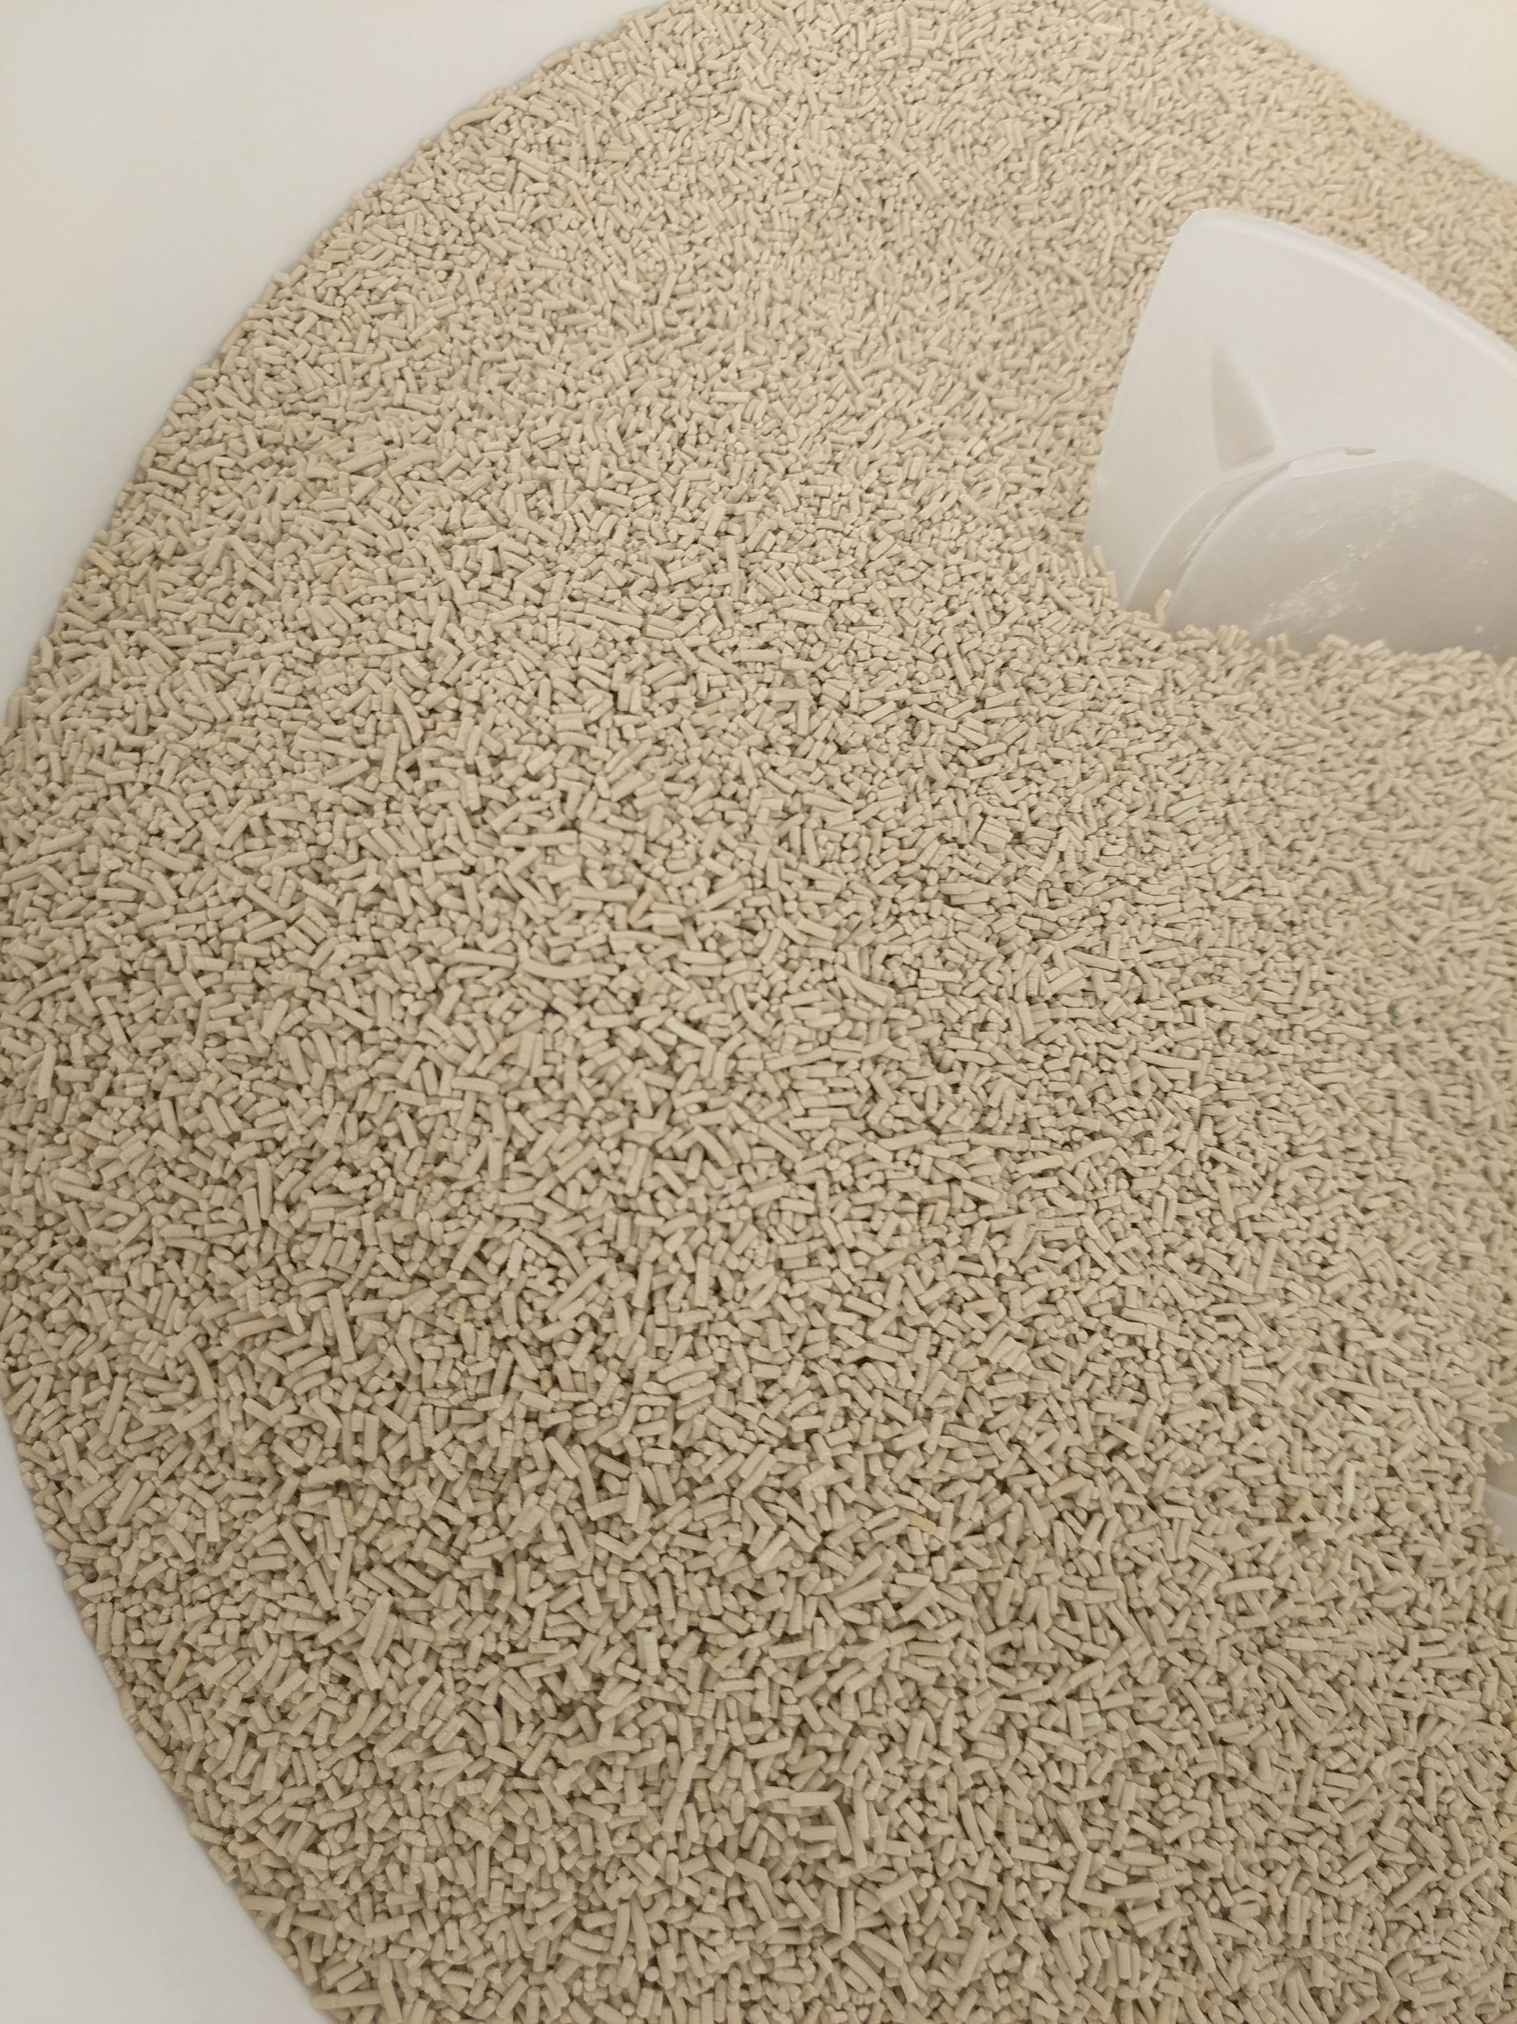
Water Dispersible Granules
Free flowing, cylindrical
~1mm x 2 mm
Highly loaded, up to 75% AI
Stable up to 3 years
Disperses quickly in water
Leaves no residue
Formulation primarily…
AI
Wetting aids
Dispersants
Flow aids

Slide 5
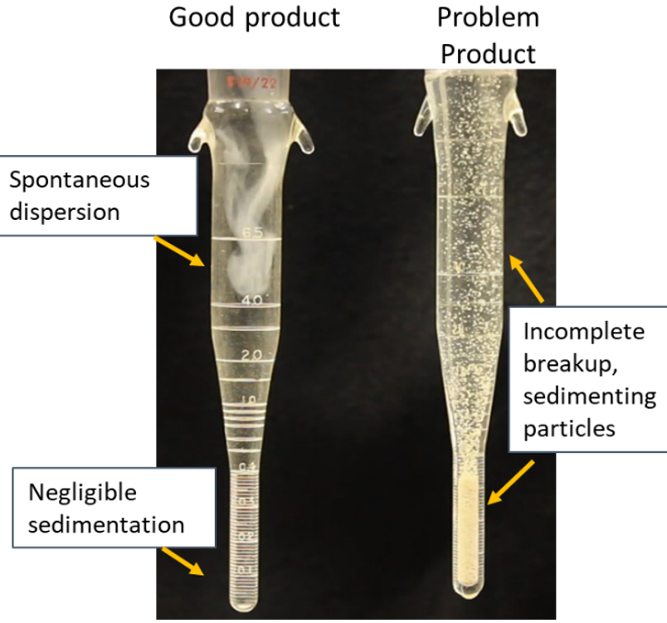
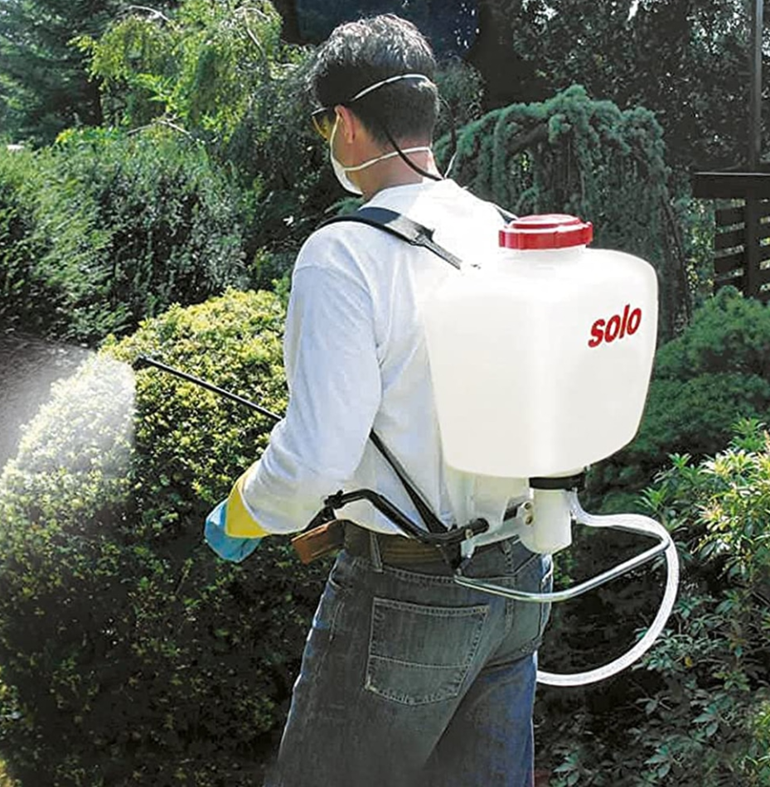
Typical Specifications
Test | Target
Assay, % | 75
D₅₀ | <8 micron
D₉₀ | <15 micron
Moisture, % | <1.3
Suspensibility | >90%
Wet Screen, 50/100/200-mesh, % | <0.01, <0.1, <0.2
Sediment | <0.02 ml/g
No in-tank mixing!
https://www.bestproductguider.com/wp-content/uploads/2020/12/image-feature-Backpack-Sprayers.jpg

Slide 6
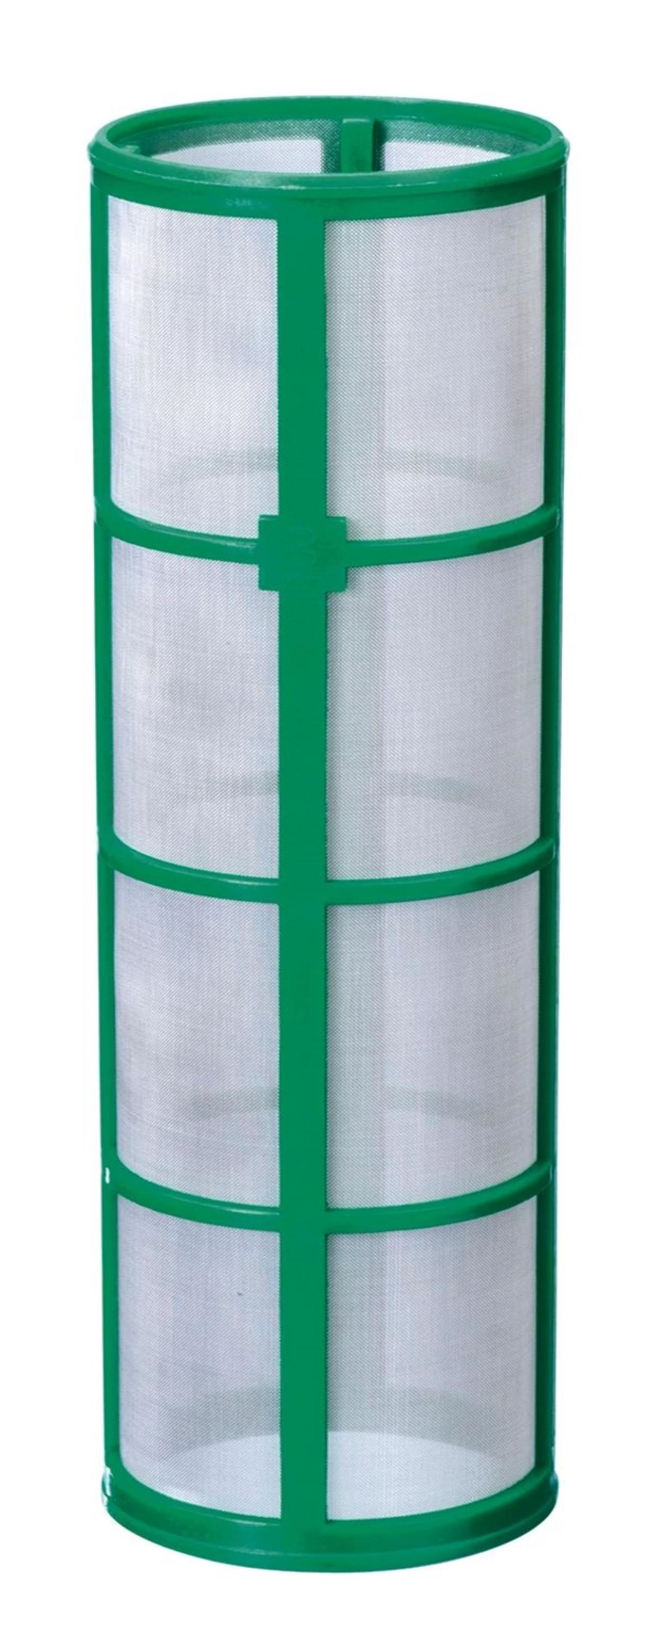
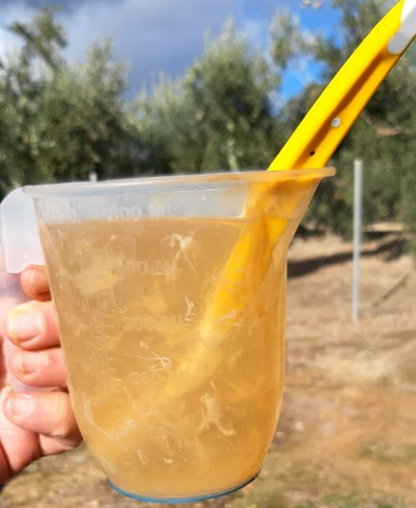
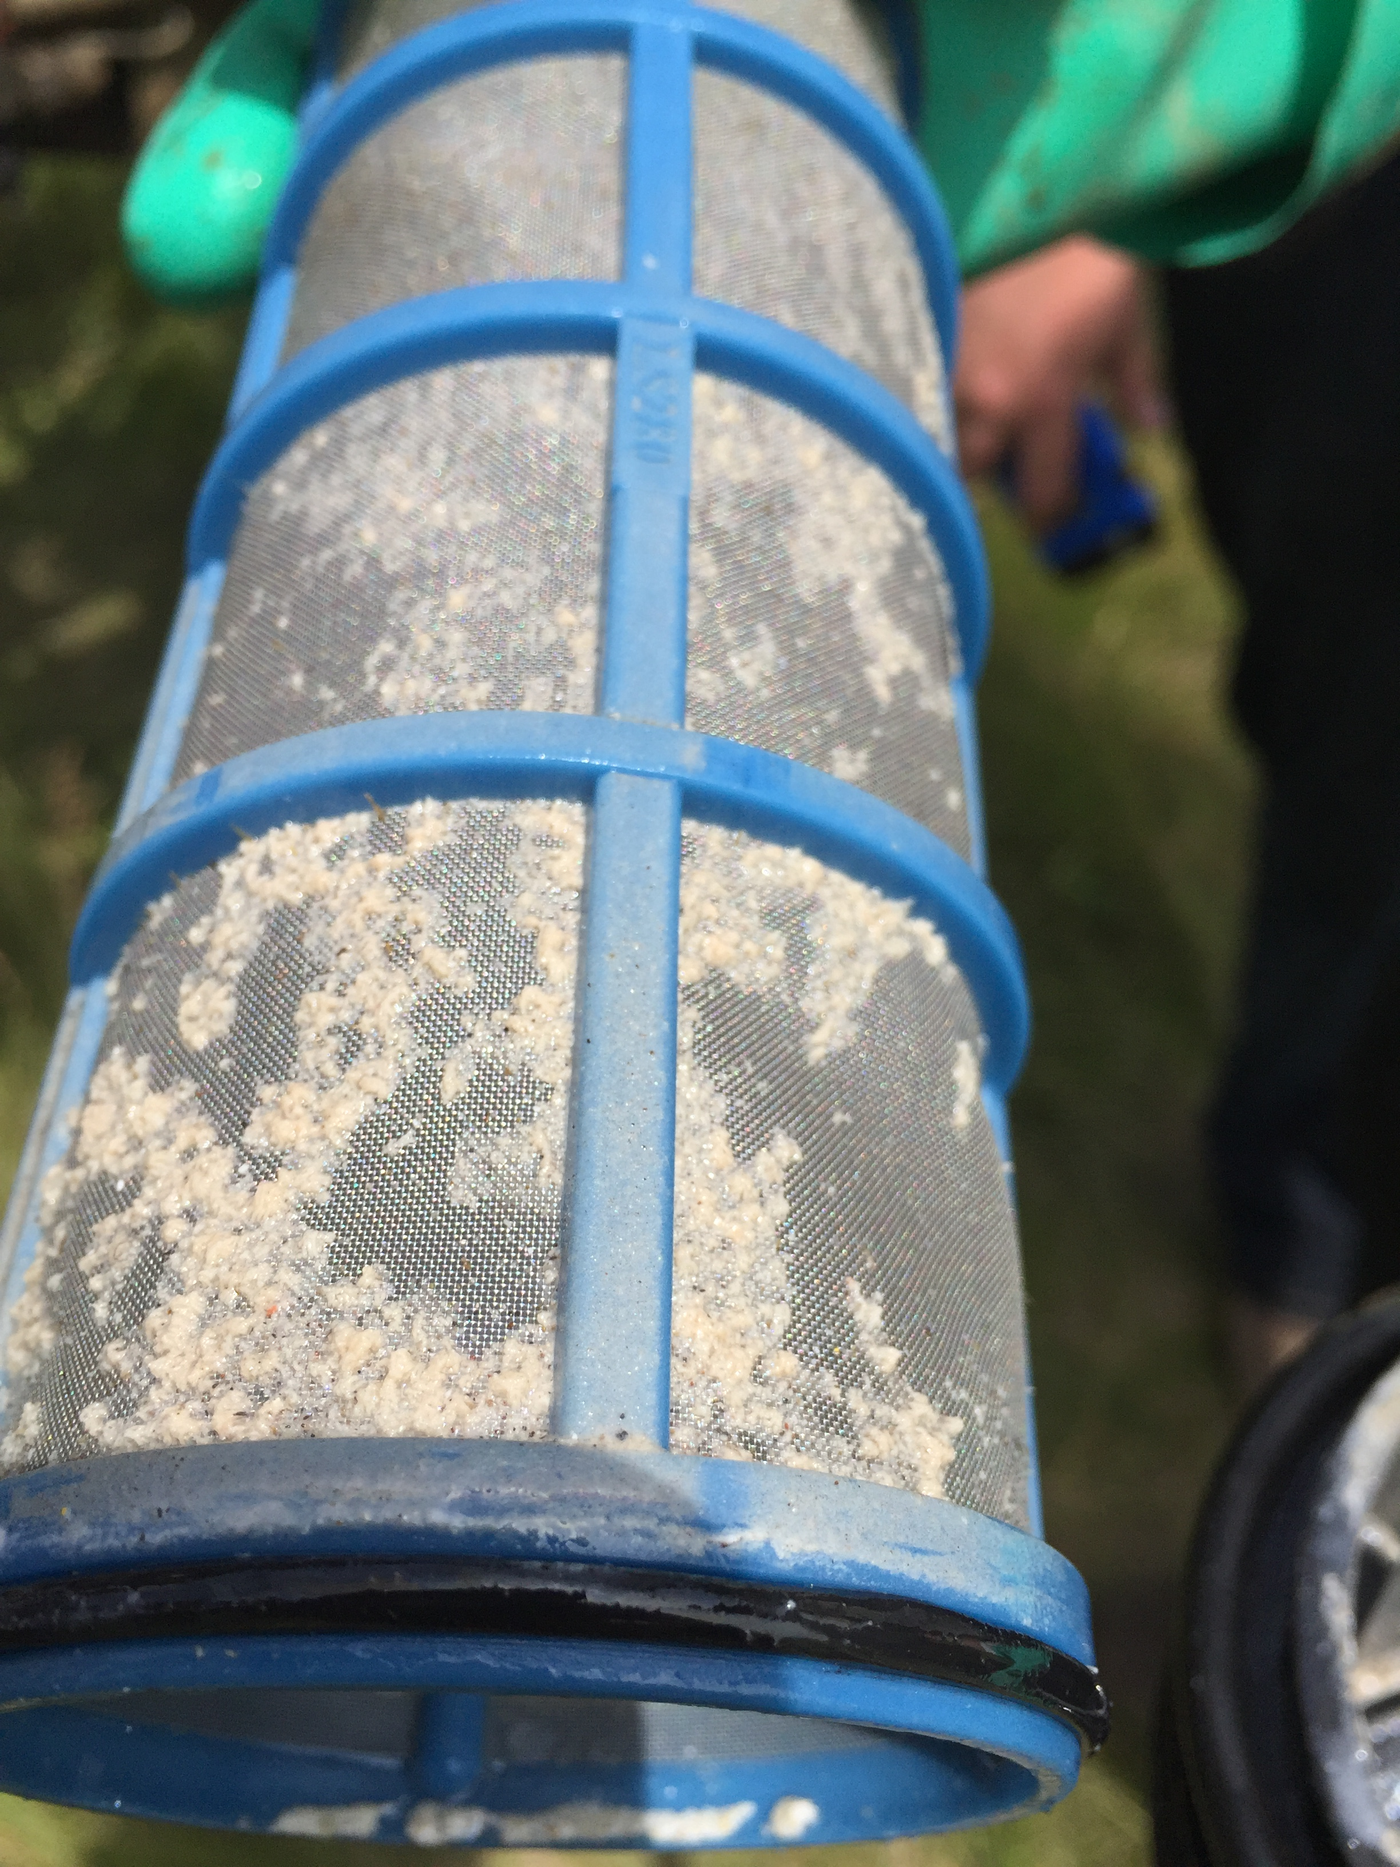
Commercial Screens

Slide 7
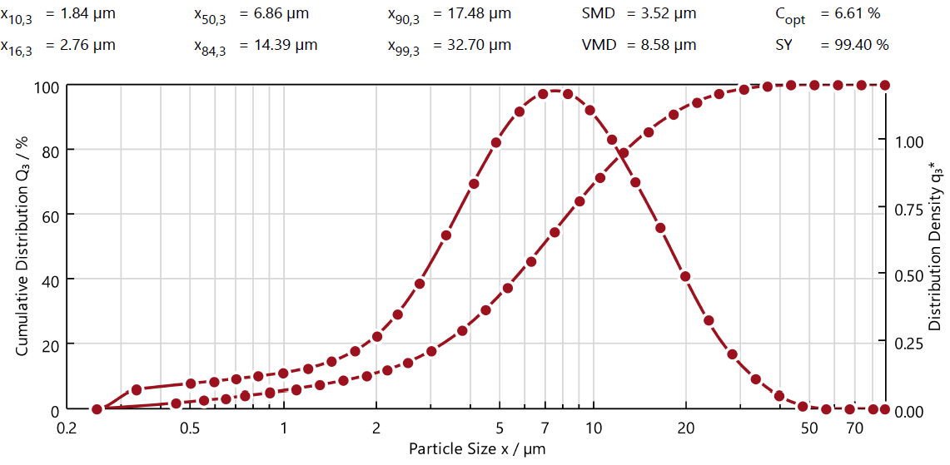
Wet Screens Pt. 1
Regulatory Specification – Maximum 2% greater than 75 microns
Realistically most cases must be much less

Slide 8
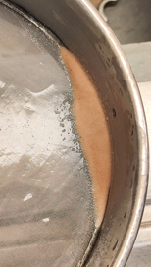
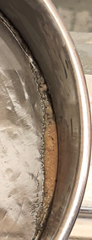
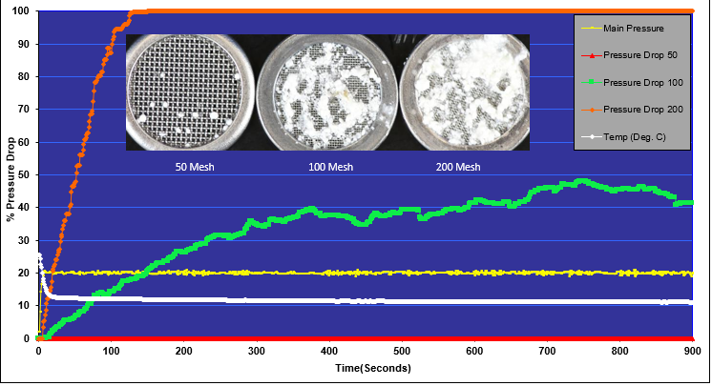
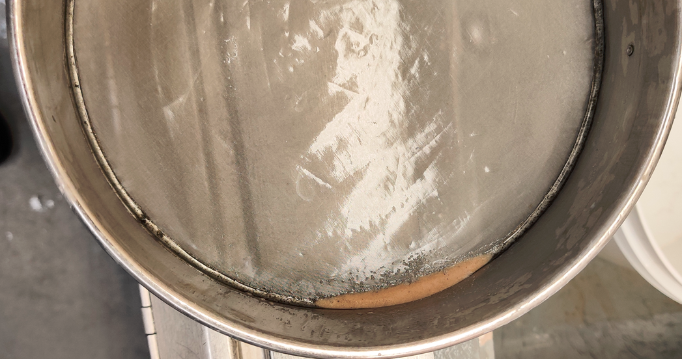
Wet Screens Pt. 2
Disperse known mass of product in water
  Pass through screen of interest
    Measure retained solids
Poor results will clog spray nozzles during application
Further processing/increased milling energy

Slide 9
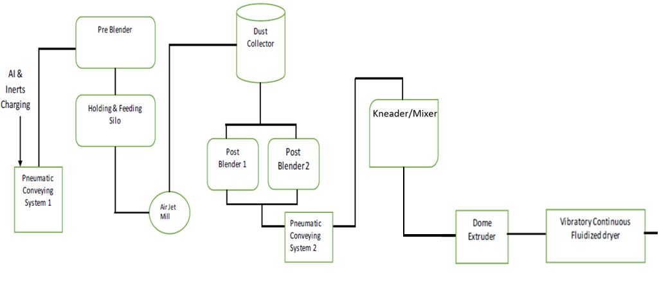

Process Flow Diagram

Slide 10

Continuous Kneader

Slide 11
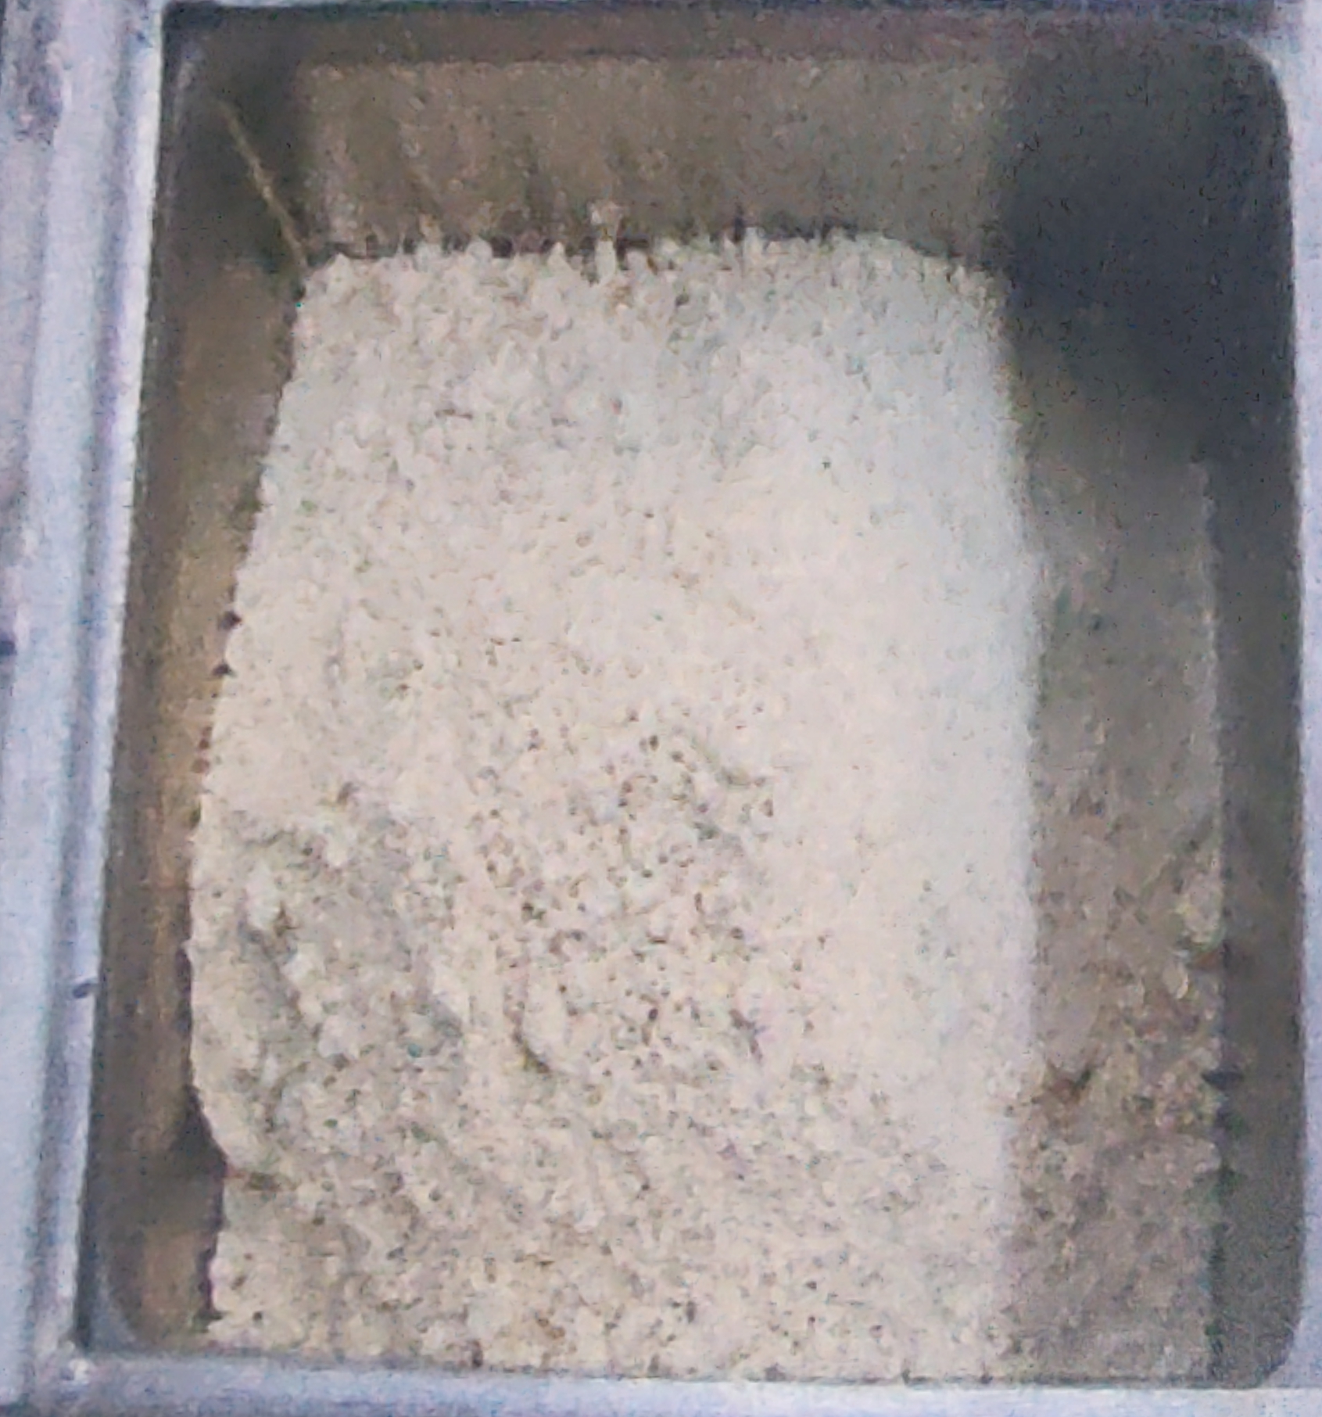
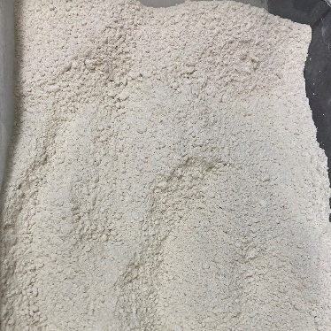
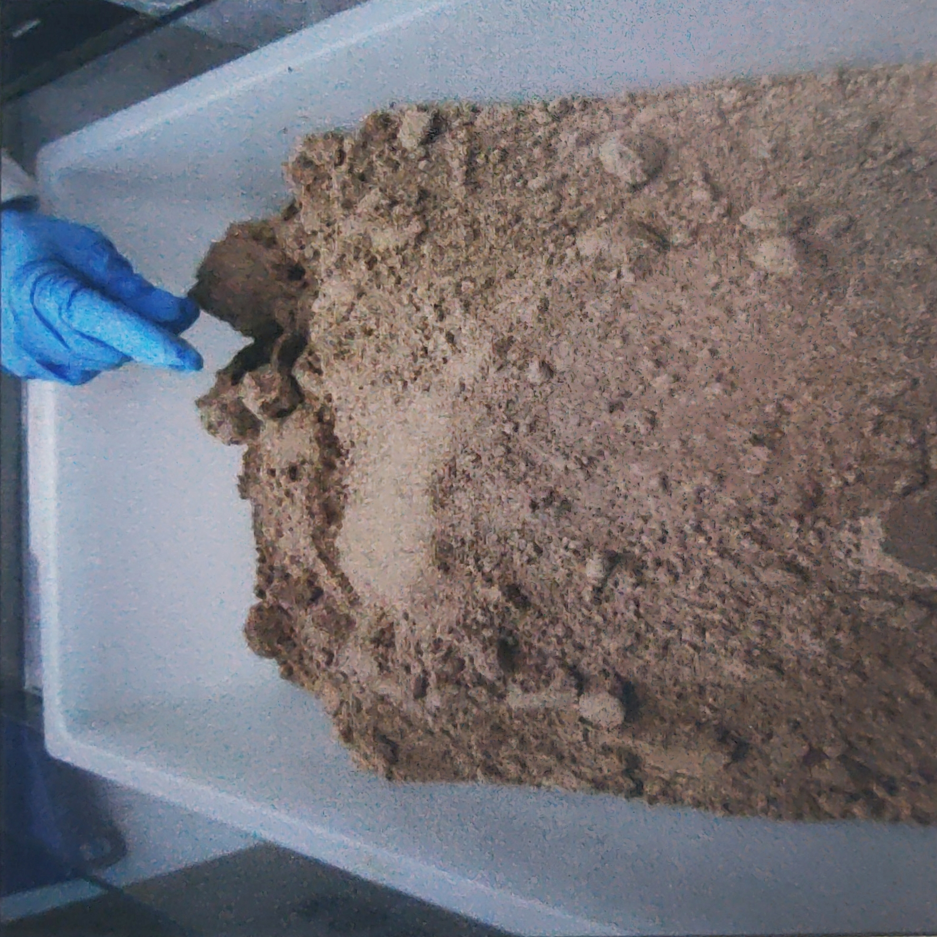
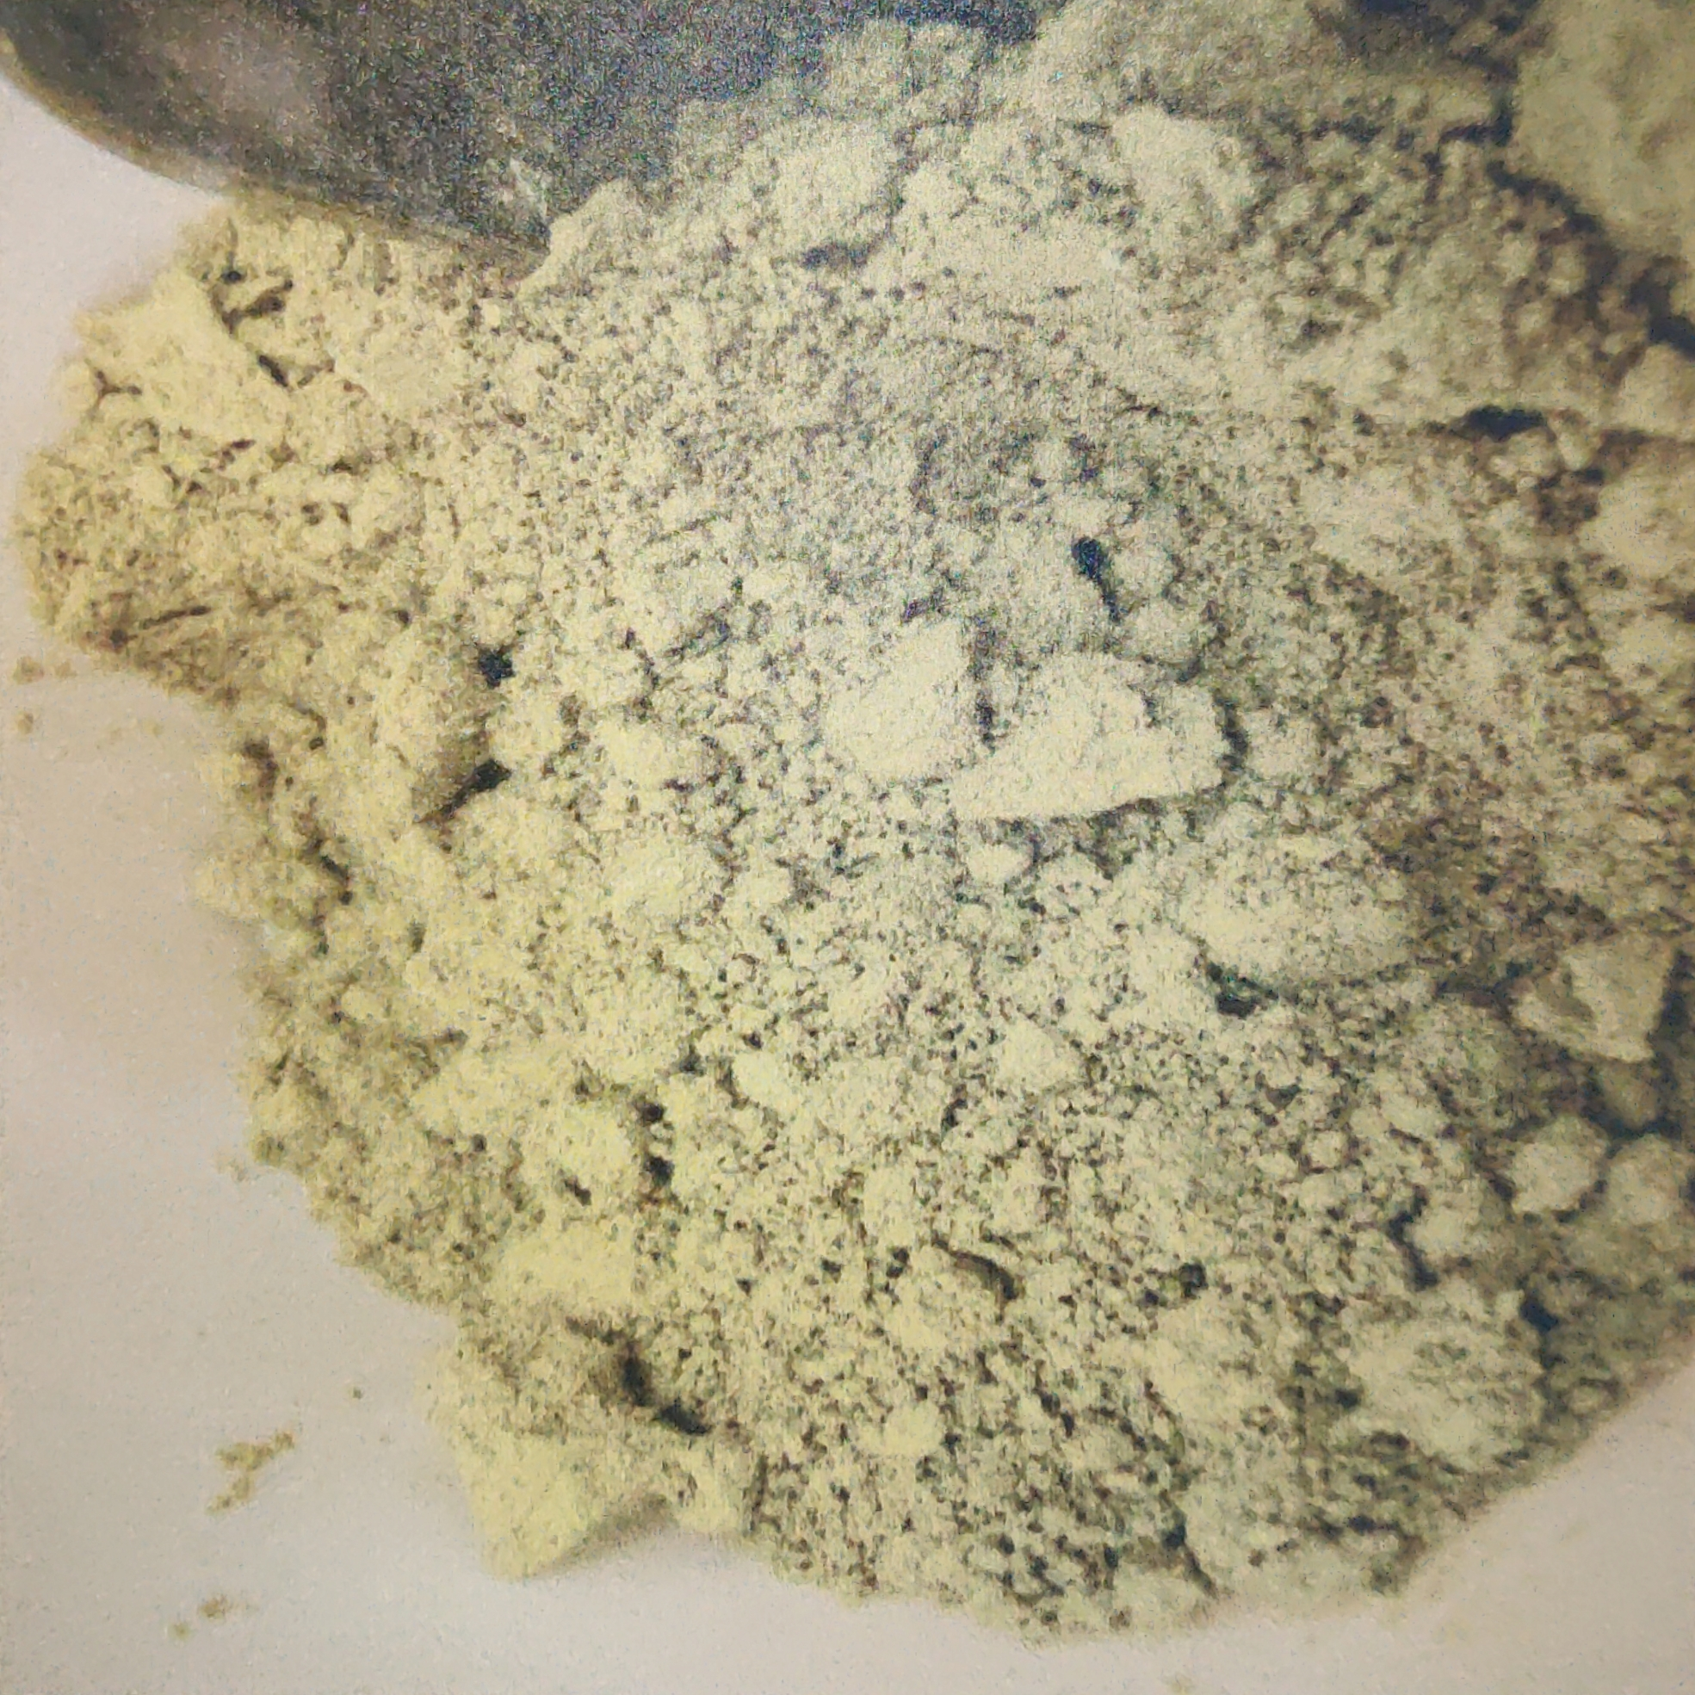
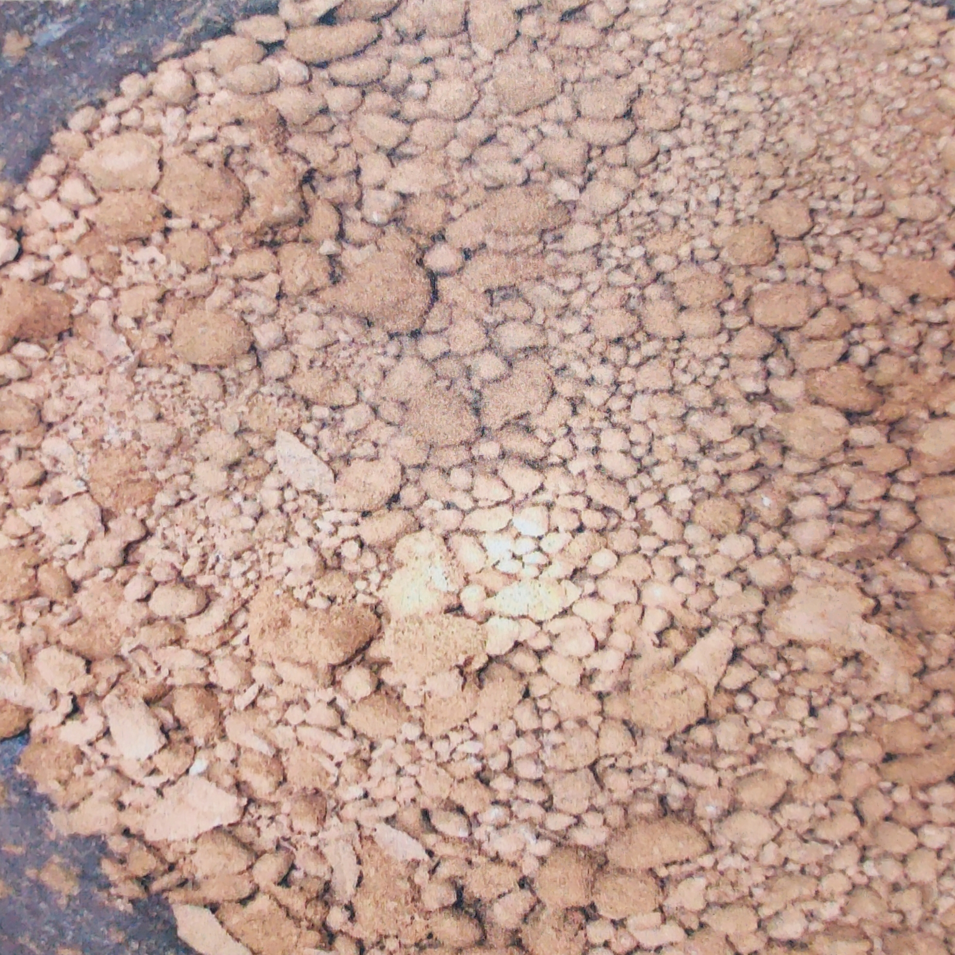
Water – How much do we knead?
Product moisture windows can vary, 5-20% d.b. - generally looking for ‘peas and powder’
Induction times are product/equipment specific
All determined experimentally, possible to under- or over-knead

Slide 12
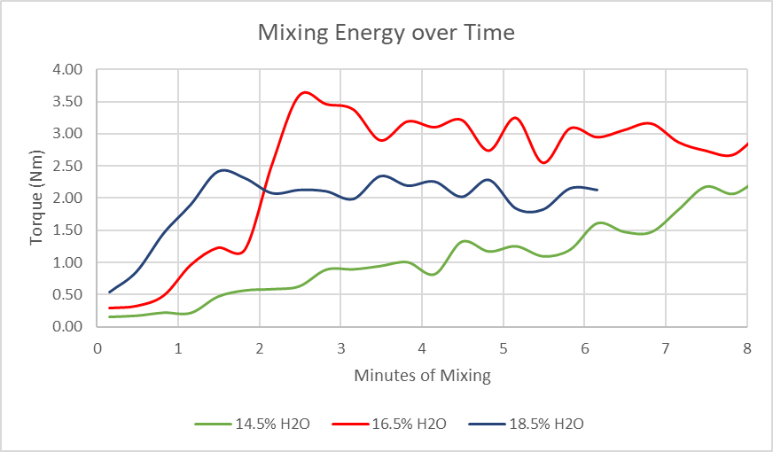
Induction Time and Torque
Too low moisture – Too slow to wet out (if ever)
Correct moisture – Wets out, higher torque values
Too high moisture – Can quickly make a wet mess
Affects extrusion pressure, intragranule voids, dispersibility

Slide 13
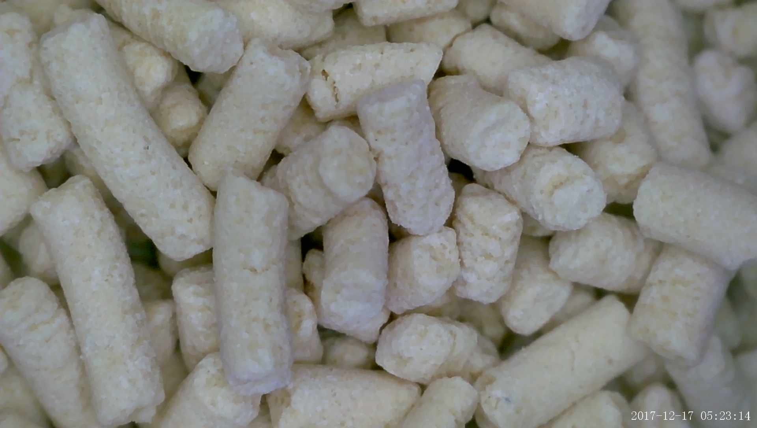
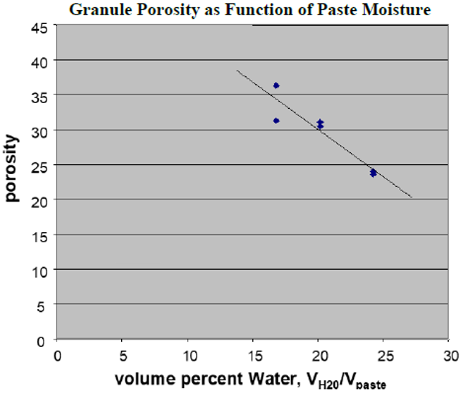
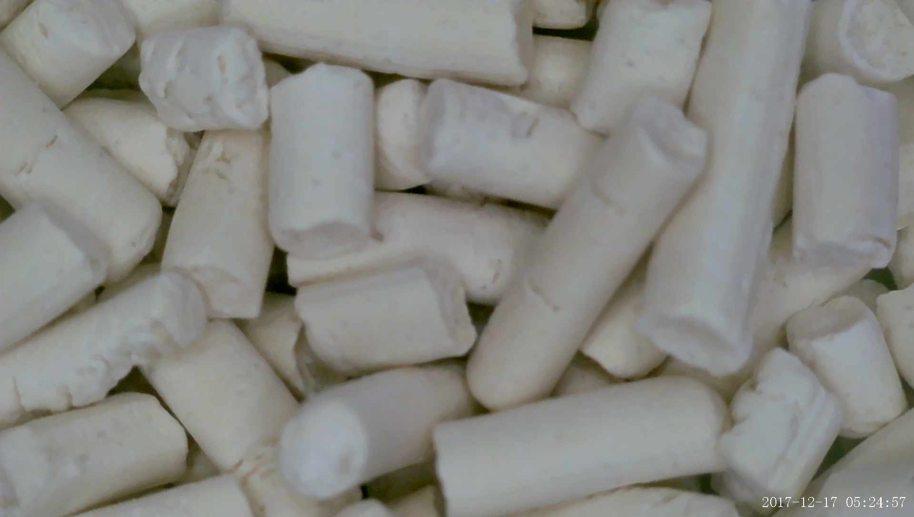
Intragranule Voids
Voids are a function of material properties, processing, and moisture content
  Affect imbibition and granule breakup time
Notes:
These are two different products shown only to illustrate the differences in intragranule voids that are possible. Chart is for 1 particular product.

Slide 14
PSD/Aging Affect Wetting Time
140
120
100
80
wetting time, s
60
40
20
as made
after aging
0
0
1
2
3
4
5
6
particle size, d_{4,3}, micron
Larger PSD or aged milled formulation can be faster to wet out and form a paste
Could affect SOP for commercial kneader

Slide 15
Process Flow Diagram

Slide 16
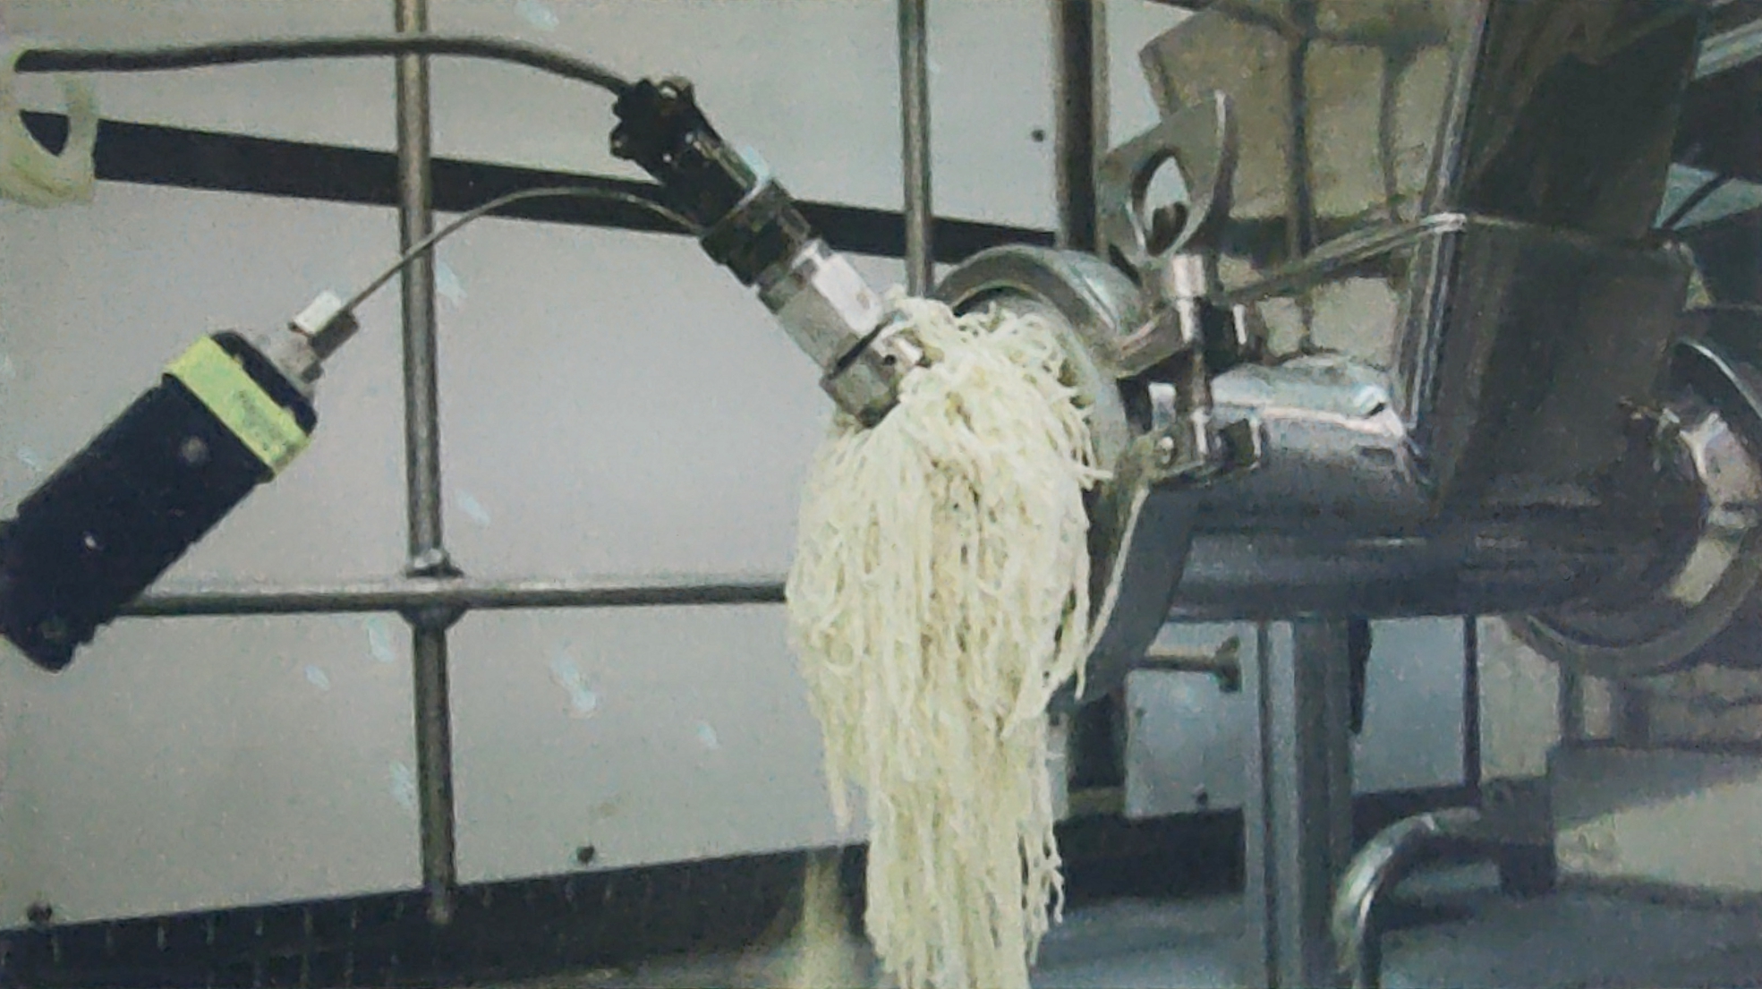
Stranules to Granules
Fluidized Bed
Dryer
Properly wetted paste is extruded, fed to a dryer
Product! Simple, right? Except…

Slide 17
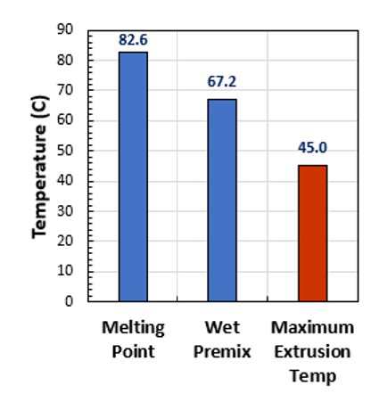
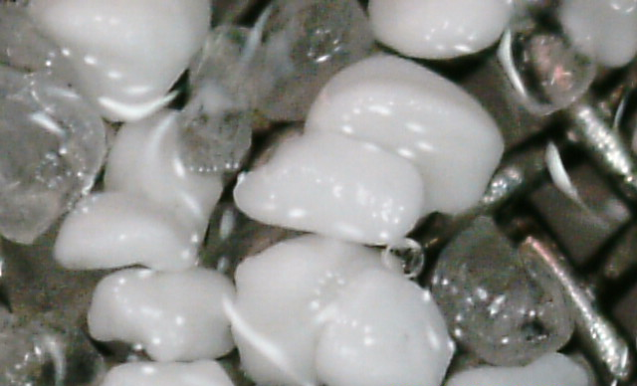
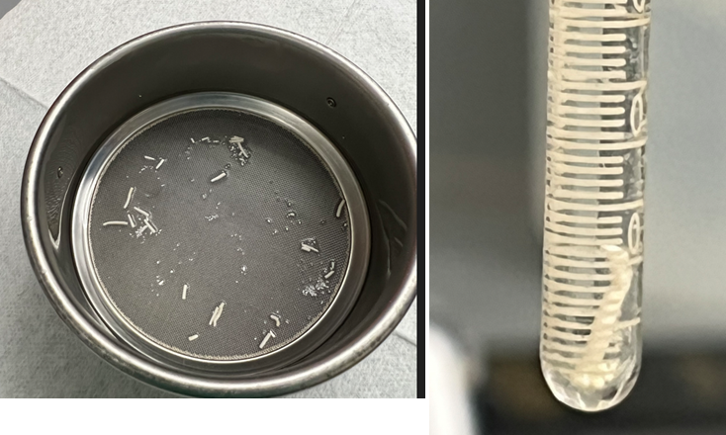
Granules with low MP
Demand can include lower MP actives…
Surfactants, other AIs, etc. can cause lower
‘softening point’ temperatures or eutectic melts
Extrusion can have significant ΔP, ΔT
Active becomes sticky, fusing may occur at extrusion and dryer
Oversized, non-dispersing particles
and granules

Slide 18
Process Flow Diagram
Wet screen results checked after air mill and dryer

Slide 19
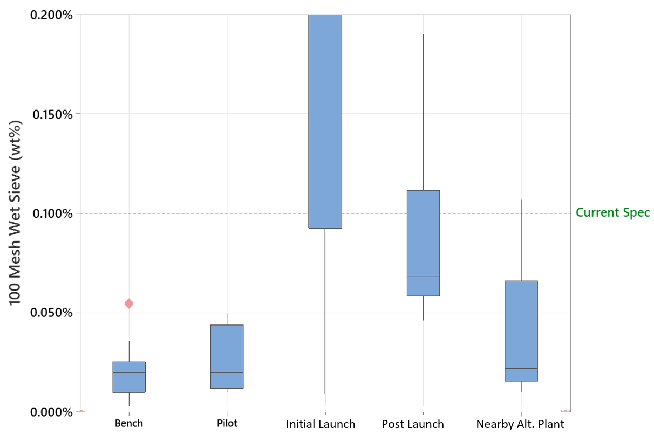
Case Study
Low melting product launched after pilot studies
  Moisture window tested and confirmed ±1%
  Maximum 57°C dryer temperature (>10°C from MP of premix)

Slide 20
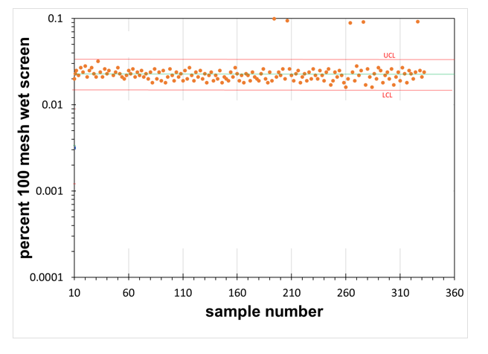
Post-Launch Investigation
Unit Operation | Issue | Consequence
Air Mill | SOP not followed | High wet screens post-mill
Kneader | Moisture Variability | Higher ΔT for dry portions at extrusion
Extruder | Ambient temperature | Too high T_{out} caused fusing
Dryer | Poor fluidization | Overdrying caused fusing
After implementing corrections

Slide 21
Acknowledgements
Brandon Newman
Luann Marshall
Oliver Gutsche
Ted Lang

