Slide 1

Capillary Imbibition: Progress in Understanding Powder Wetting Phenomena and Applications Mathis Fricke, Department of Mathematics, Technical University of Darmstadt

Slide 2




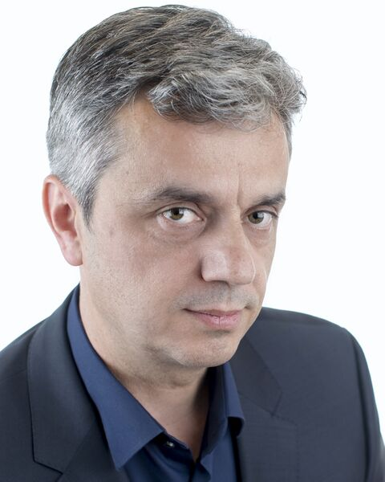


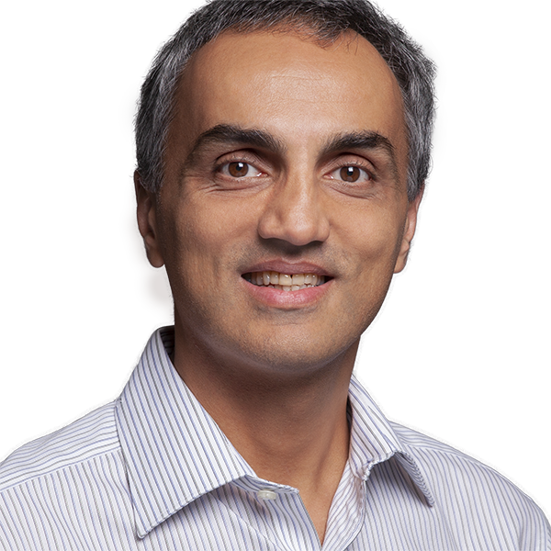


Thanks to my collaborators ..
D. Bothe
T. Maric
J. De Coninck
S. Raju
Z. Tukovic
T. Fullana
Y. Kulkarni
S. Afkhami
S. Popinet
S. Zaleski

Slide 3
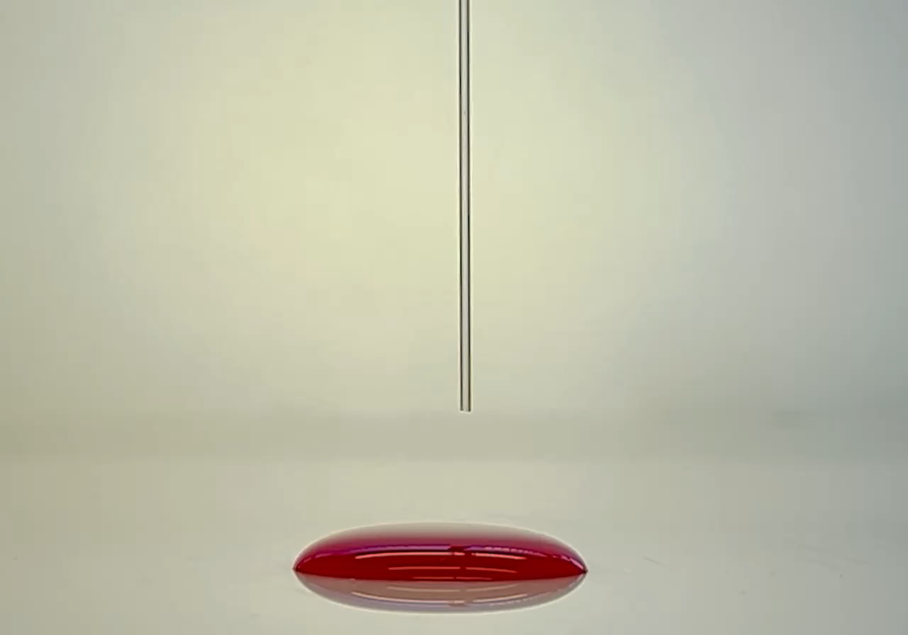
A prototypical dynamic wetting process
Why is Capillary Rise interesting?
Numerous applications (in particular powders)
Prediction of the dynamics is non-trivial!
Axial symmetry Simplified models available
Two major challenges
Predictive models only use well-defined material parameters
Multiscale character very high computational costs
5mm
Notes:
„Sie sehen einen alltäglichen Prozess: Eine Flüssigkeit benetzt spontan und entgegen der Schwerkraft eine dünne Kapillare bis sich ein Kräftegleichgewicht einstellt.“
Dieser Prozess ist zentral für viele Anwendungen wie Strömung in porösen Medien oder Biomedizin.
Trotzdem ist die Vorhersage der Dynamik alles andere als trivial.
Vorteilhaft für die Theorie ist hier aber die Achsensymmetrie.
Wesentliche Herausforderungen sind hier 1) Prädiktivität zu erreichen und andererseits
2) Ergebnisse für realistische Parameter in akzeptabler Zeit zu erreichen -> Mehrskaligkeit

Slide 4
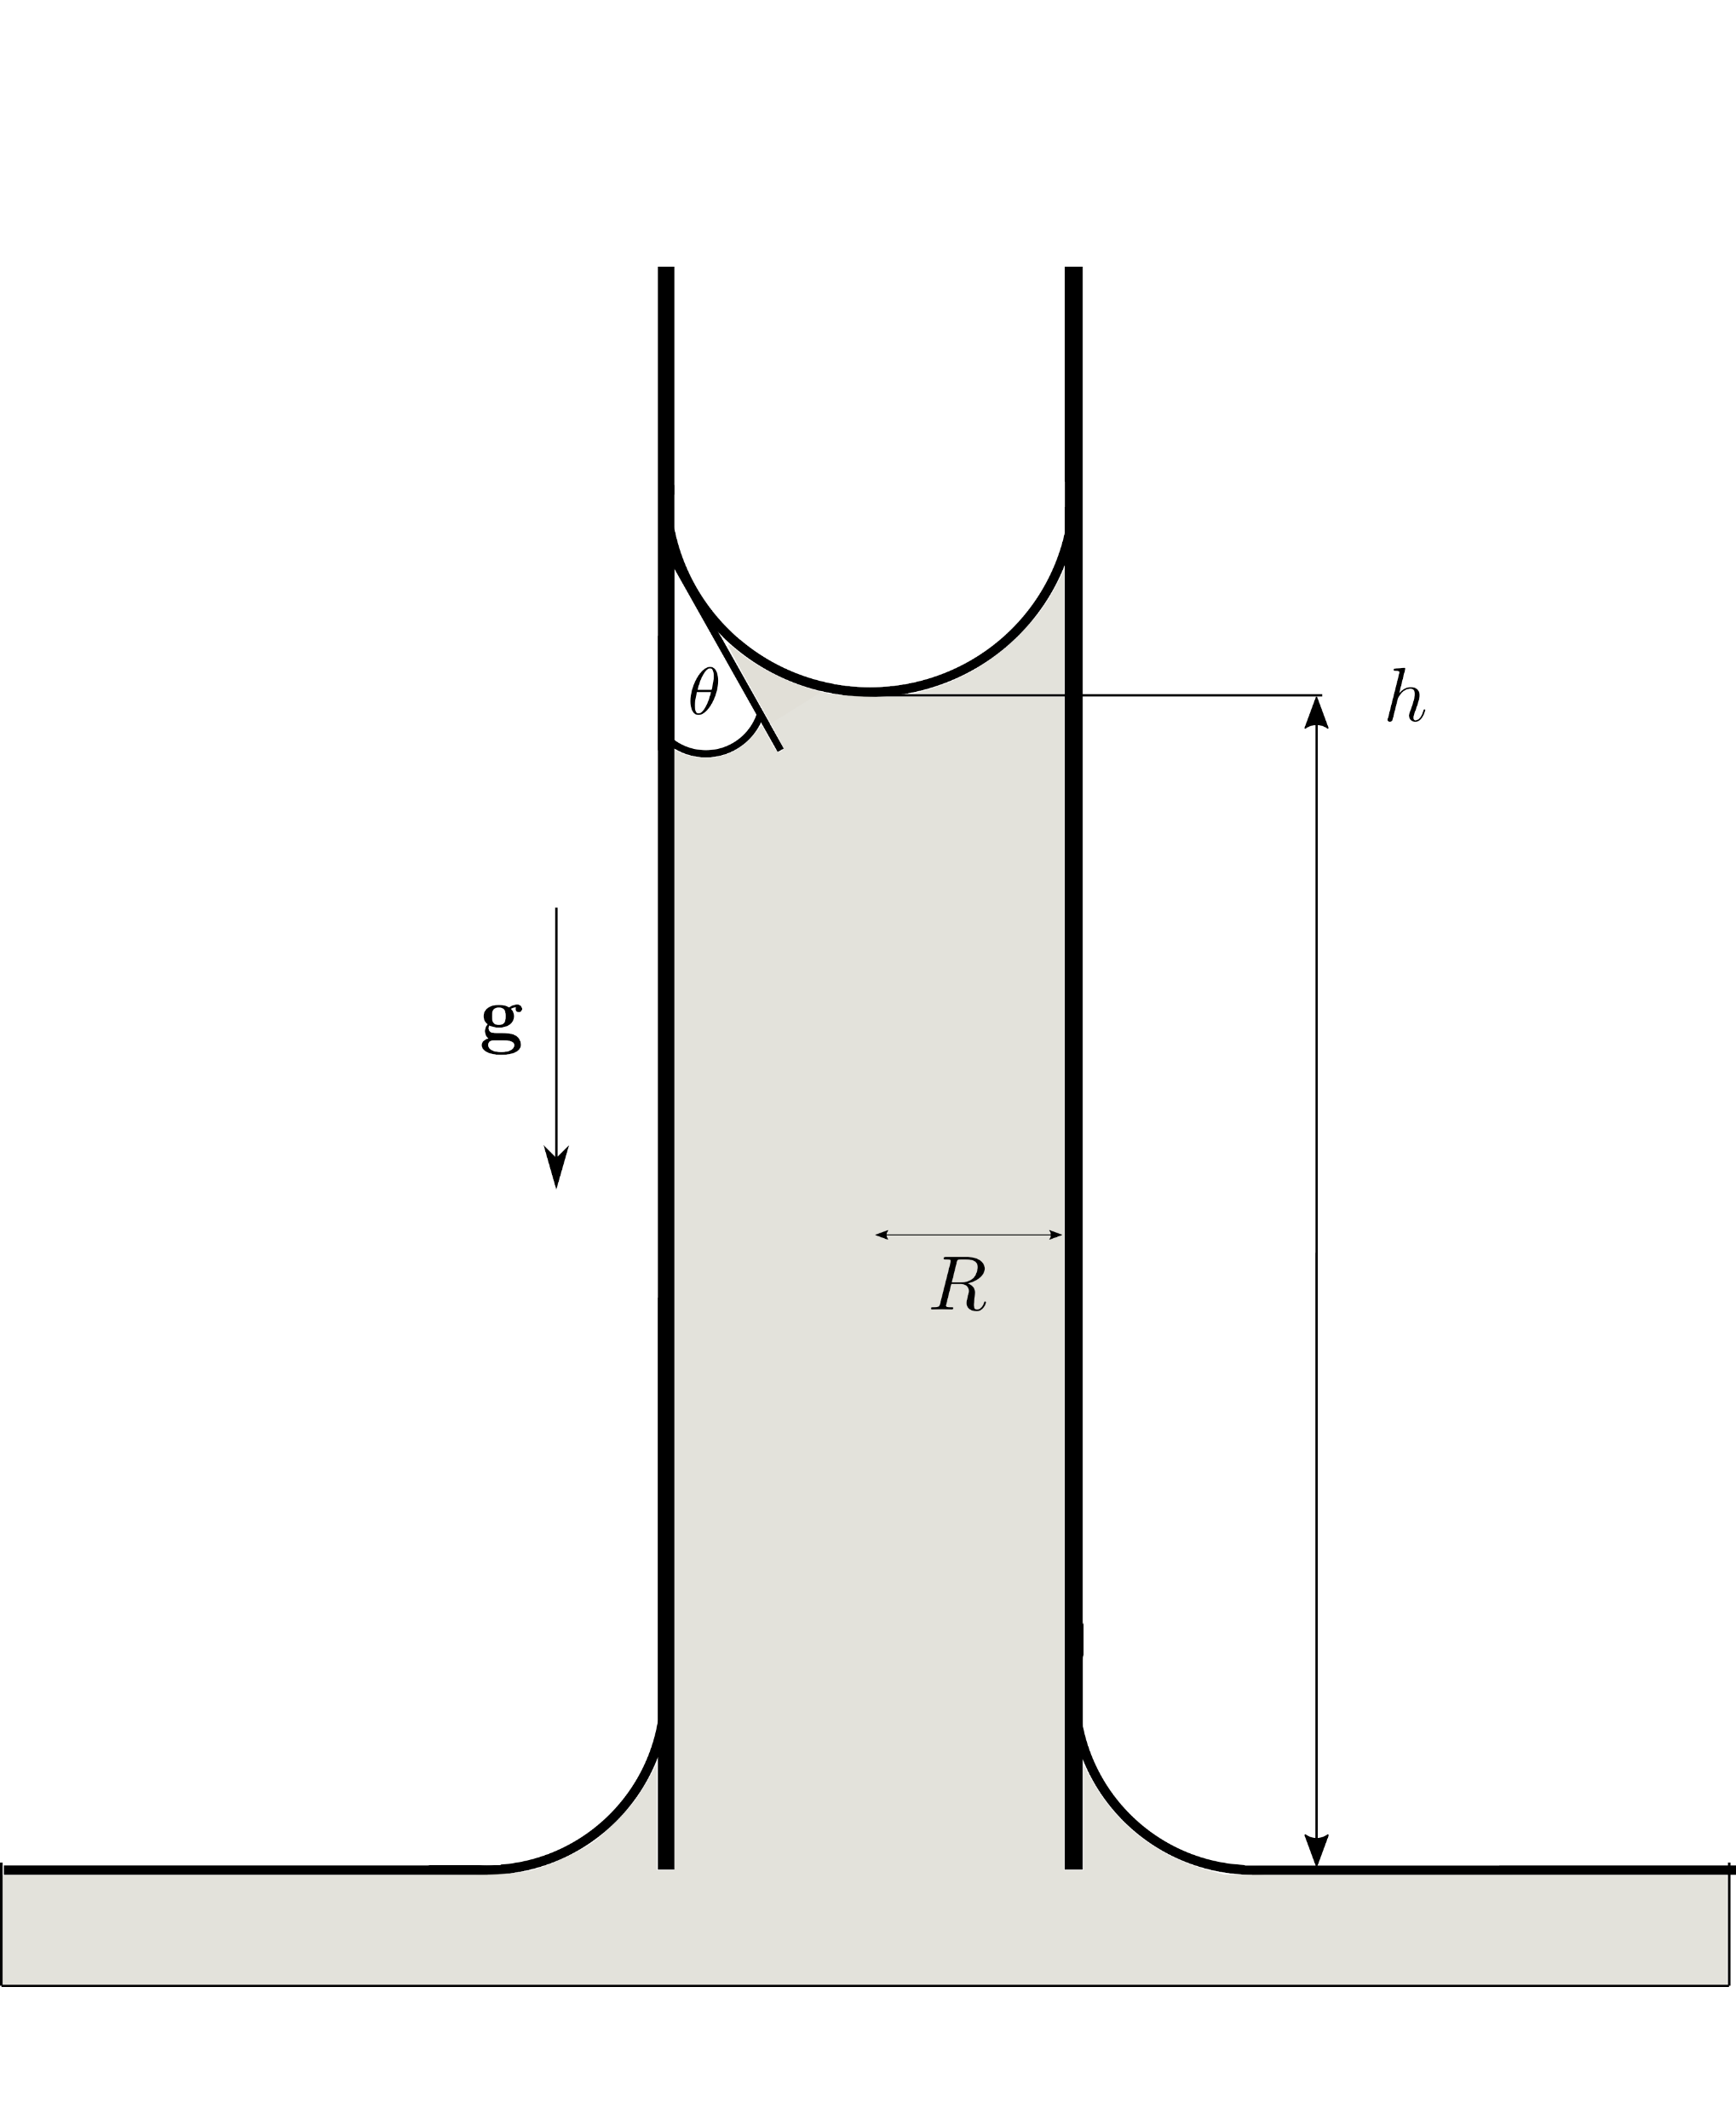
A prototypical dynamic wetting process
Why is Capillary Rise interesting?
Numerous applications (in particular powders)
Prediction of the dynamics is non-trivial!
Axial symmetry Simplified models available
Two major challenges
Predictive models only use well-defined material parameters
Multiscale character very high computational costs
Goal: Predict rise height h=h(t)
Notes:
„Sie sehen einen alltäglichen Prozess: Eine Flüssigkeit benetzt spontan und entgegen der Schwerkraft eine dünne Kapillare bis sich ein Kräftegleichgewicht einstellt.“
Dieser Prozess ist zentral für viele Anwendungen wie Strömung in porösen Medien oder Biomedizin.
Trotzdem ist die Vorhersage der Dynamik alles andere als trivial.
Vorteilhaft für die Theorie ist hier aber die Achsensymmetrie.
Wesentliche Herausforderungen sind hier 1) Prädiktivität zu erreichen und andererseits
2) Ergebnisse für realistische Parameter in akzeptabler Zeit zu erreichen -> Mehrskaligkeit

Slide 5
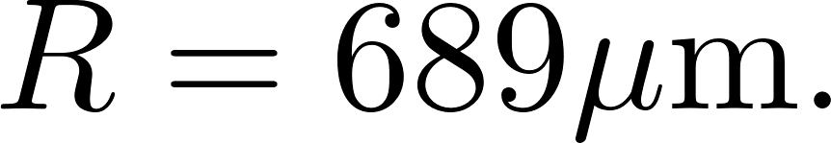
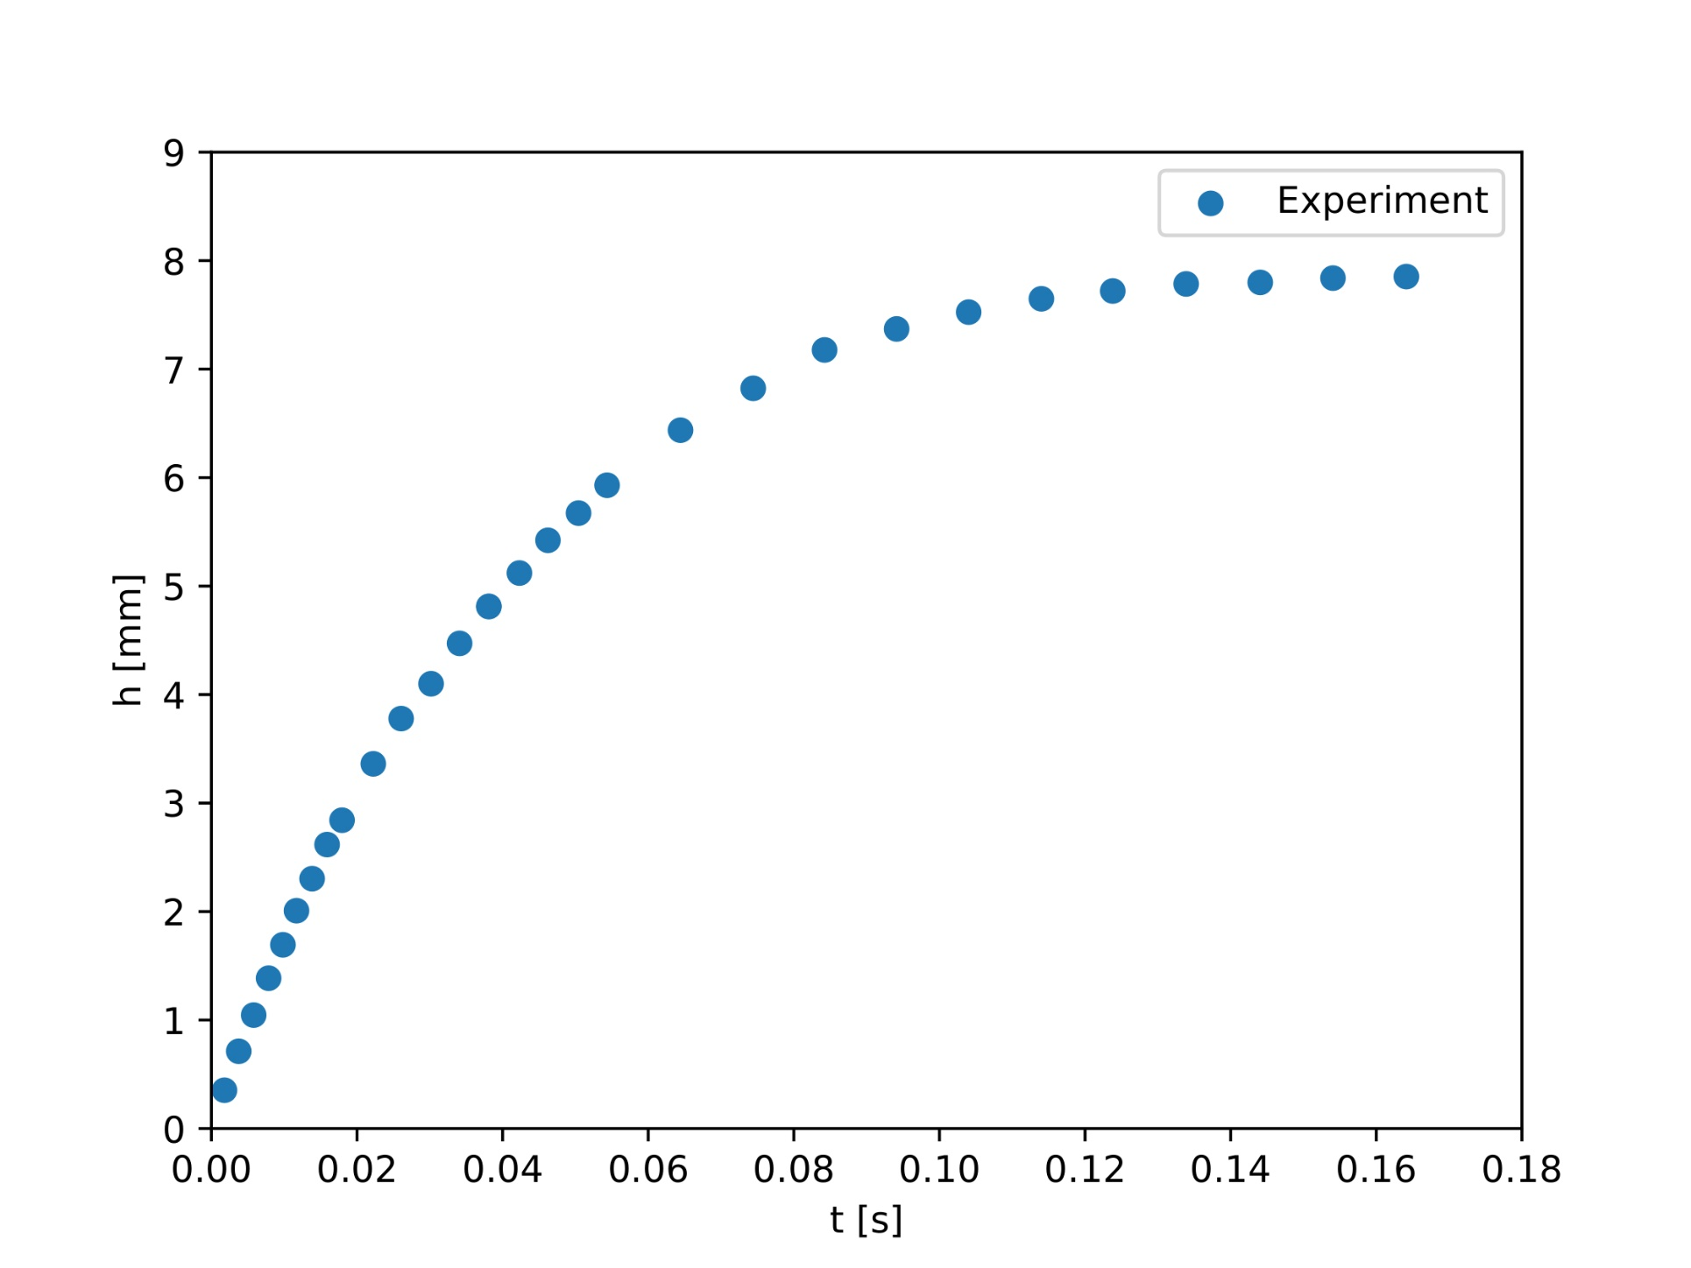
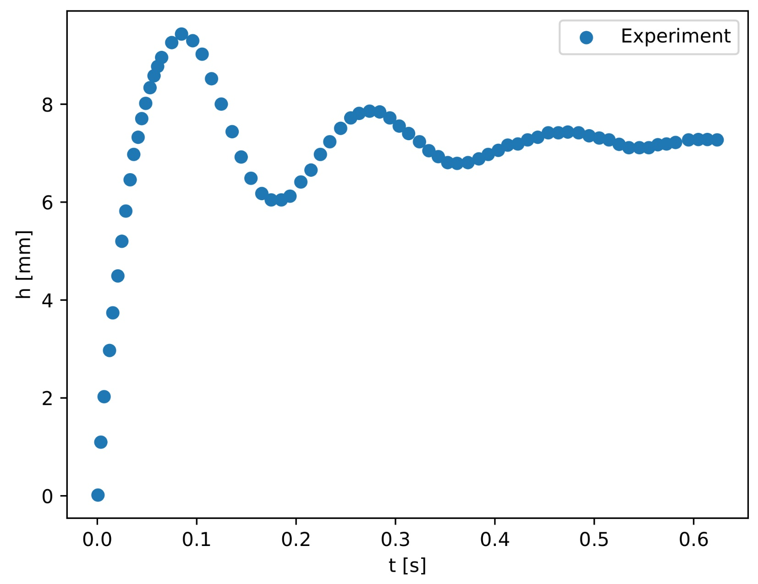
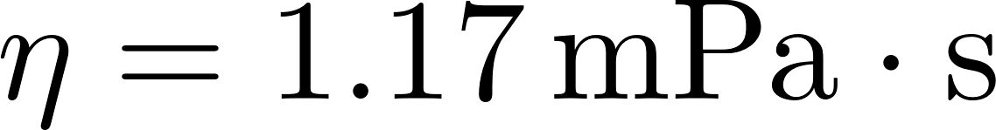
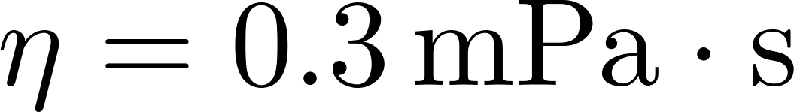
Experiments: Monotonic vs. Oscillatory Rise (Quéré, 1997)
Experimental data for glass capillaries with radius
Can we predict the dynamics? Is there a link between the dynamics and the characteristics of the pore ?
Ethanol:
Ether:
High viscosity
Low viscosity
Notes:
Aus Experimenten weiß man, dass die Steighöhe als Funktion der Zeit Oszillationen aufweisen kann wenn die Viskosität hinreichend klein ist. Recht sehen wir dazu Ether als Beispiel. Bei höherer Viskosität (wie links für Ethanol zu sehen) werden die Schwingungen zunehmend gedämpft bis keine Oszillation mehr zu erkennen ist. Für den Rest dieses Kurzvortrages wollen wir uns auf das linke Beispiel fokussieren.
-> Ich werde Ihnen zeigen, dass sich auch im linken Plot eine Oszillation versteckt!

Slide 6
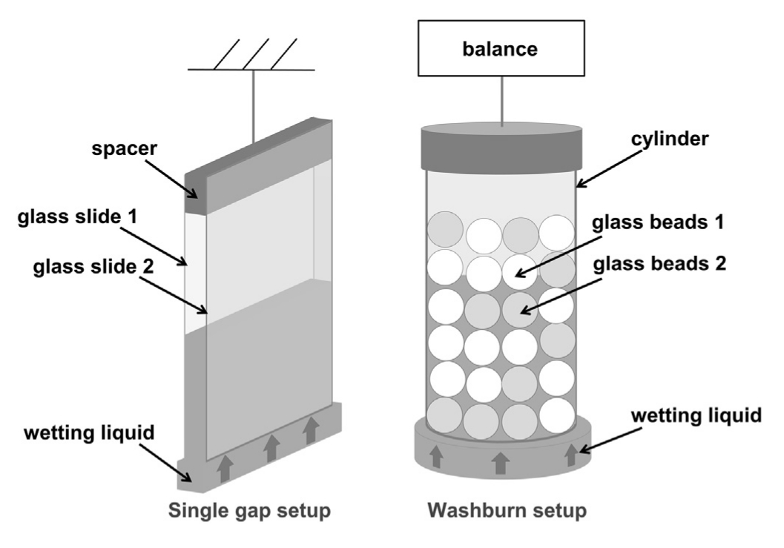
Capillary Rise and Powder Reconstitution
Stages of Powder Reconstitution (Kammerhofer et al.):
Wetting of Powder Surface
Sinking
Dispersion
Dissolution for soluble material
Increased complexity compared to single cylindrical pore:
Heterogeneous materials
Complex geometries on different scales
Dissolution and swelling during wetting
Figure by Kammerhofer et al., Powder Technology 328 (2018).

Slide 7
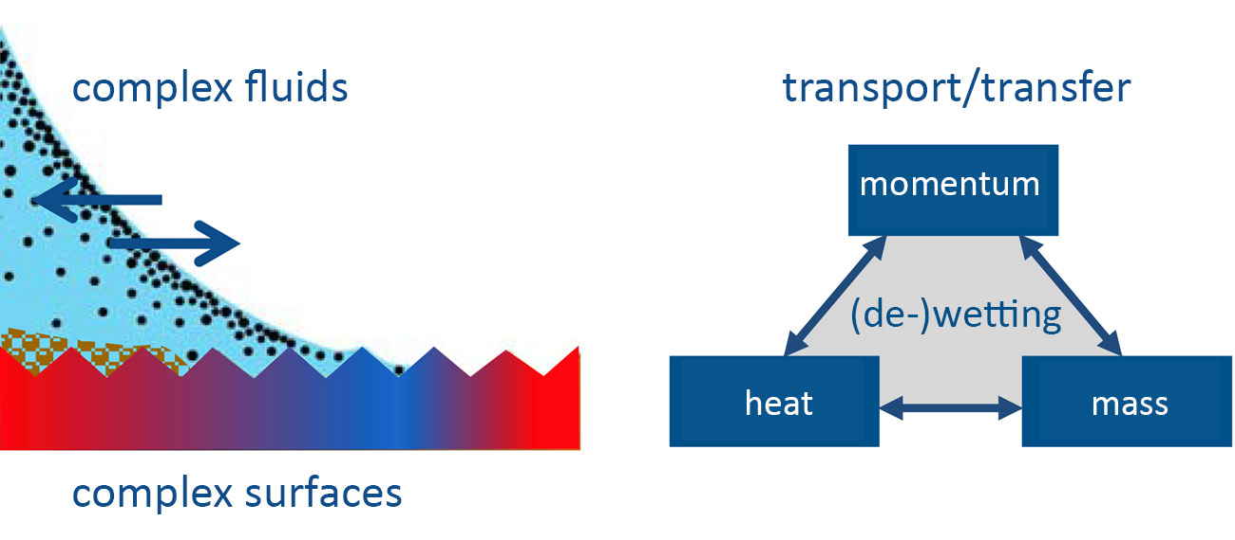


Collaborative Research Center on Wetting and Transport Phenomena

Slide 8

Some Guiding Questions

Slide 9
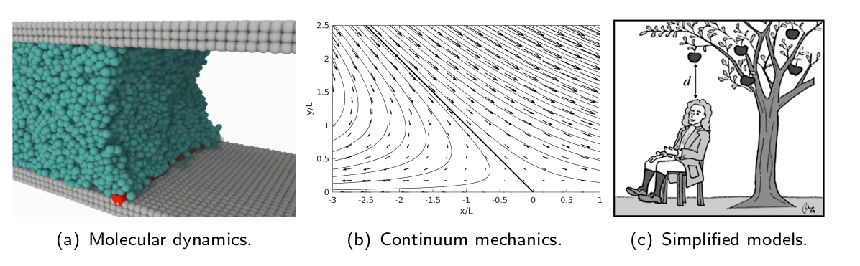
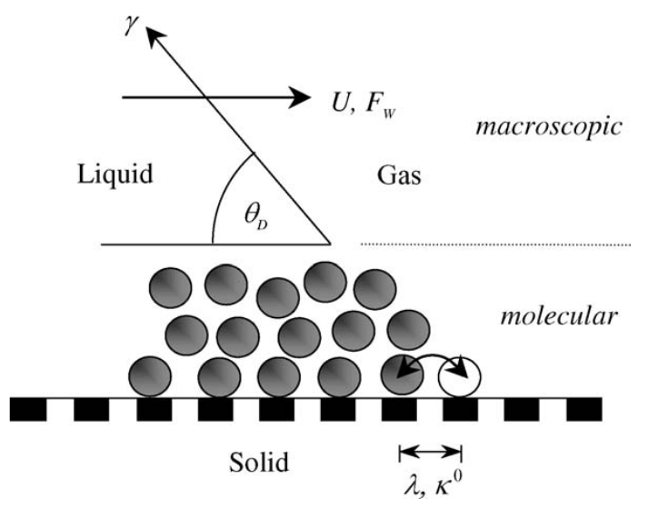
Predictive Theories vs. Fitting of Models
There are many theories on the market for the moving contact line.
Maybe the most important ones are HDT and MKT (see below).
Which one is the „right“ theory for a given problem?
We have to distinguish predictions from simple „curve fitting“!
Hydrodynamic Theory (HDT)
Molecular Kinetic Theory (MKT)
Viscous dissipation due to flow close to the contact line
Key parameter: Slip Length
Dissipation at the contact line itself.
Key parameter: Contact Line Friction

Slide 10
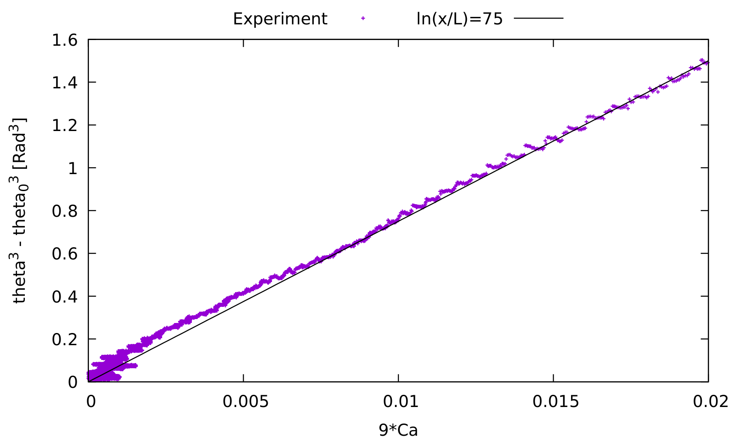
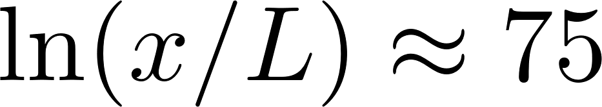
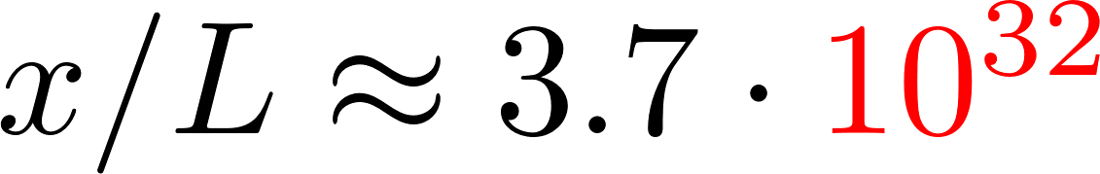
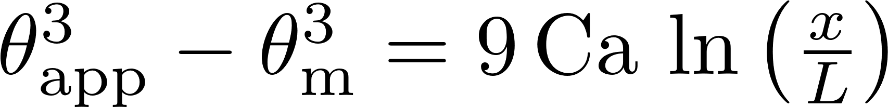
Example for HDT: Spreading glycerol-water droplet
Finding: Cox-Voinov theory „works“ but with a ratio of length scales
or in other words
How can we make sense of this data set?
Cox-Voinov theory („pure“ HDT):

Slide 11
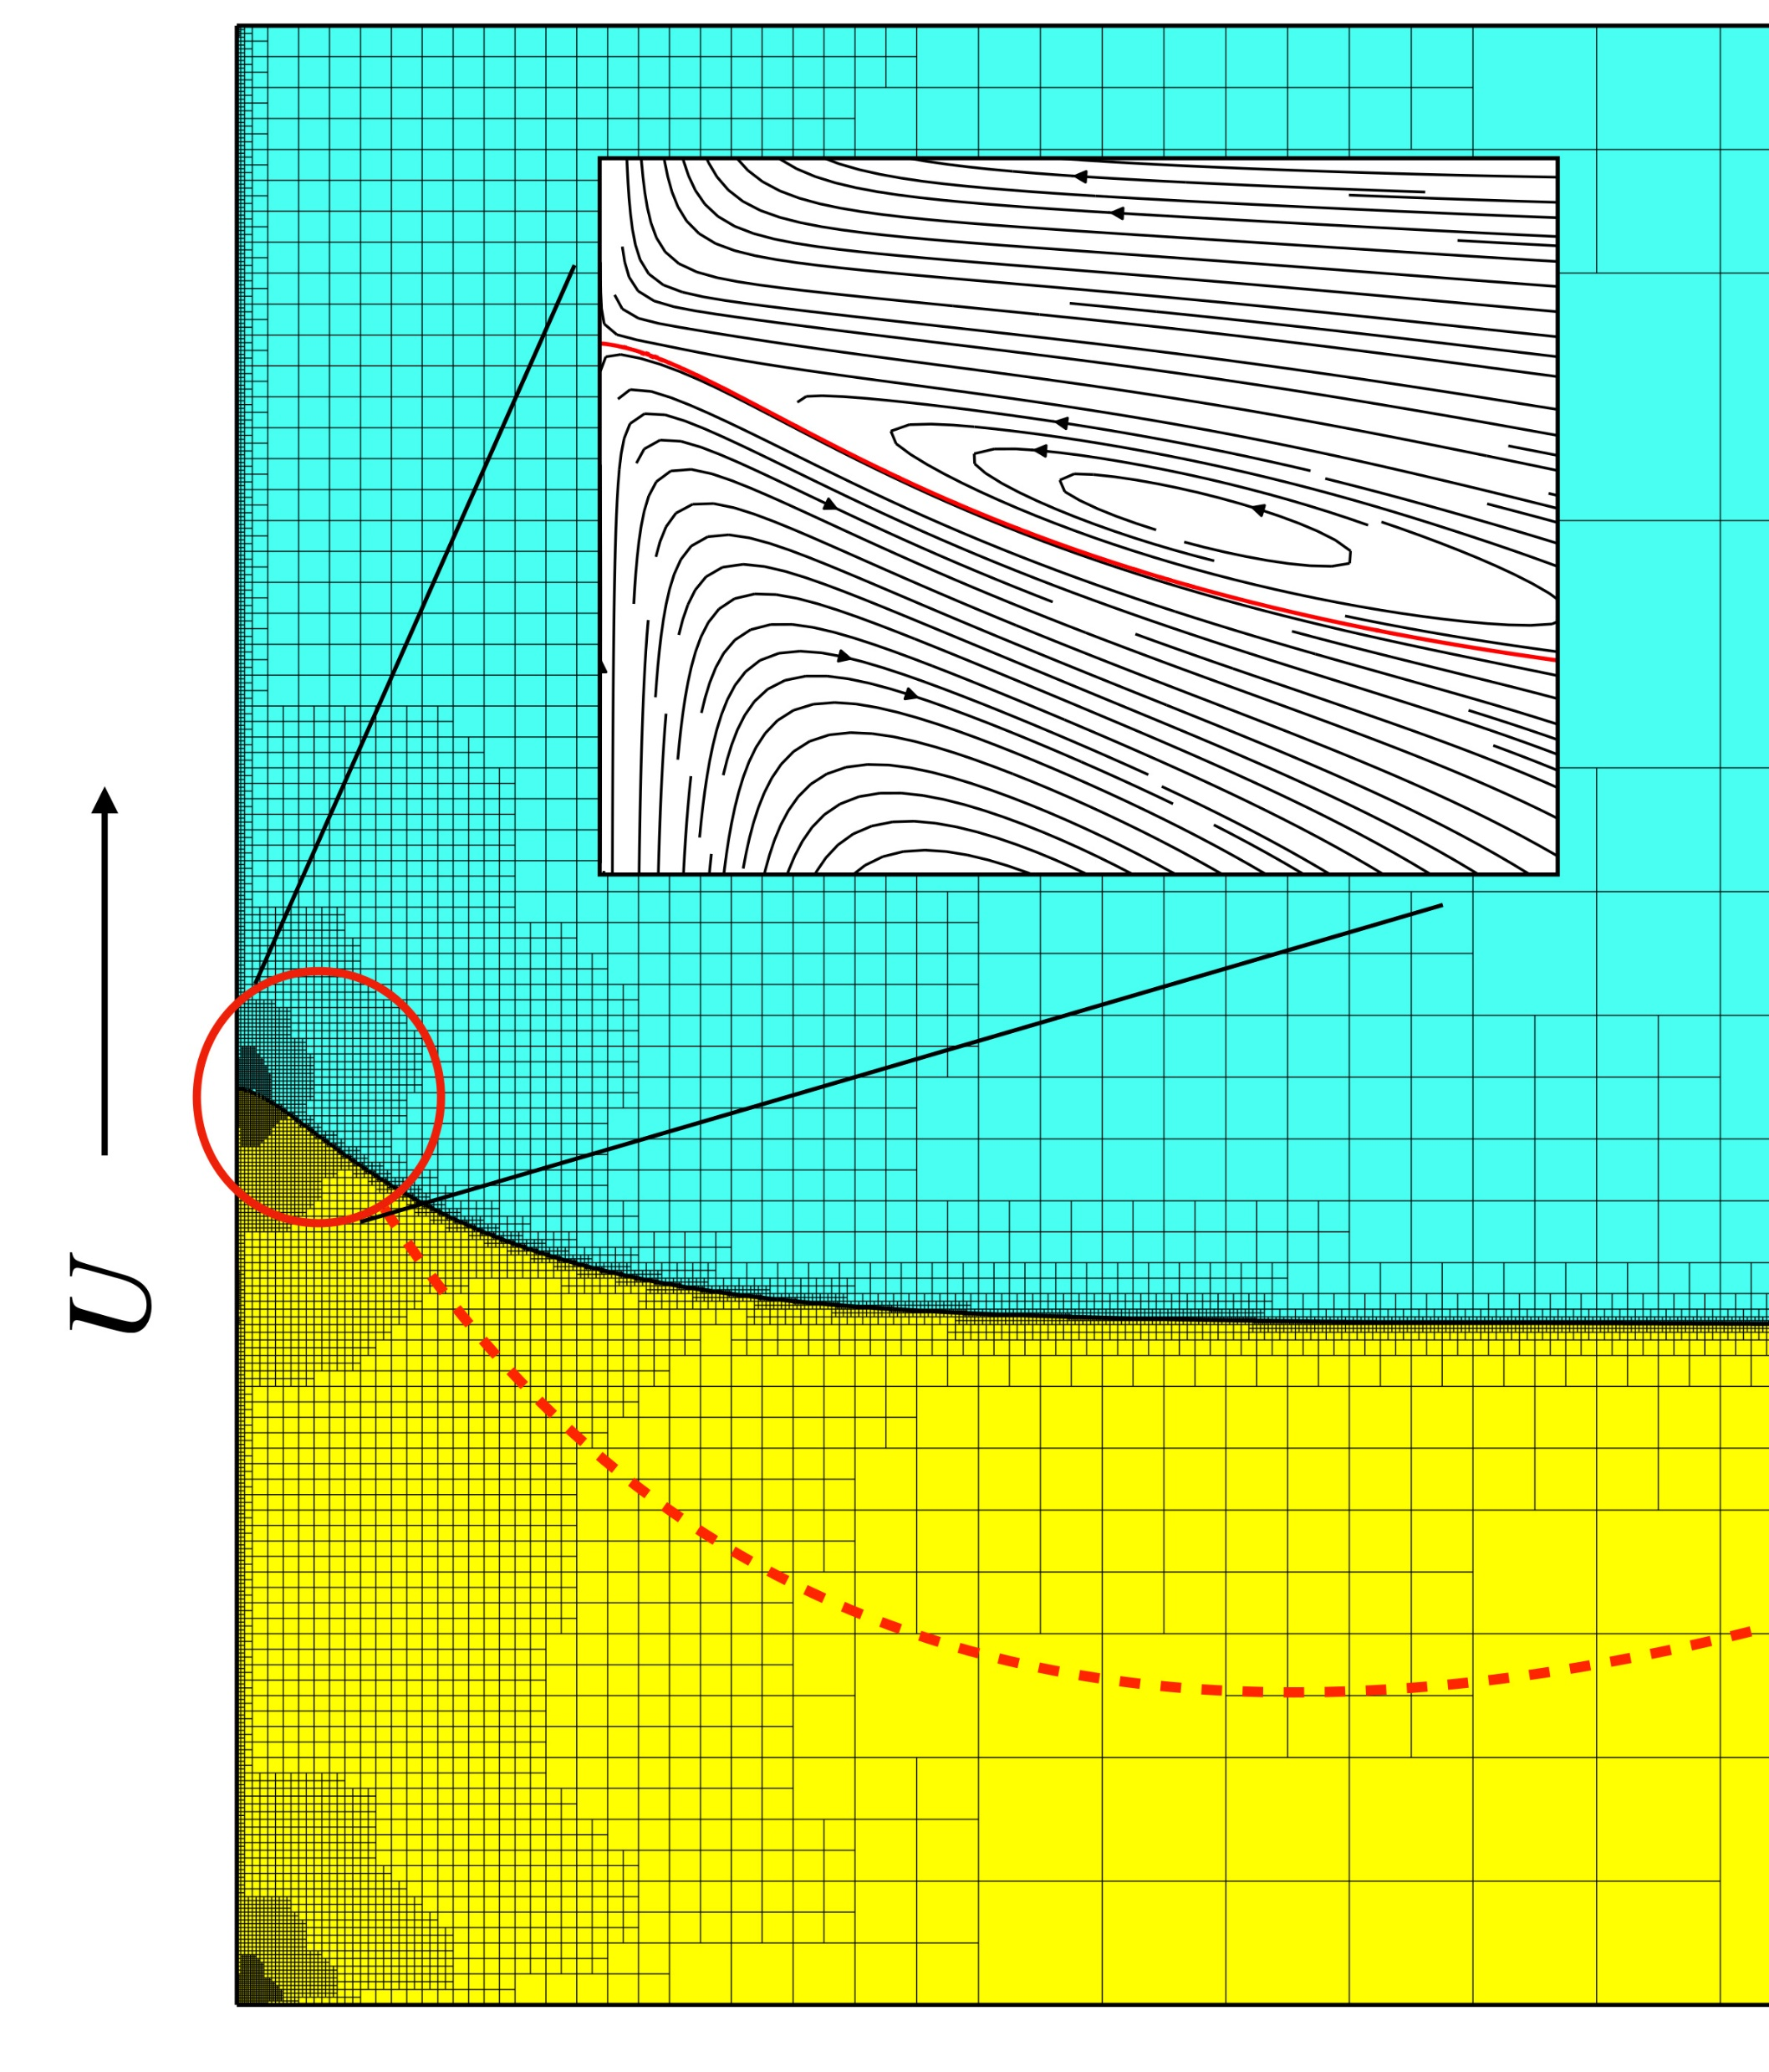
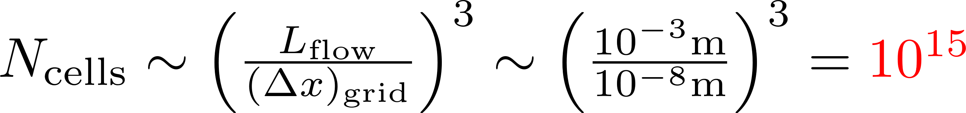
How to tackle the multiscale nature of the problem?
Dynamic wetting is a multiscale problem.
Experiments tell us that the Navier slip length should be a few nanometers on hydrophilic substrates.
For applications, we usually want to simulate problems on the millimeter scale or larger.
„Brute-force“ simulations with uniform grids in 3D are practically impossible:
Adaptive refinement in Basilisk code.

Slide 12

Modeling Fundamentals

Slide 13
Modeling Hierarchy
Molecular Dynamics: Modeling from first principles, highly accurate, limited in terms of time and length scales.
Continuum mechanics (Navier Stokes): Inherits knowledge from MD in form of constitutive laws and boundary conditions, still costly.
Simplified models (e.g. Washburn): Fast to solve, Taylor-made, basis for optimization!
Constitutive Laws
Effective Models

Slide 14
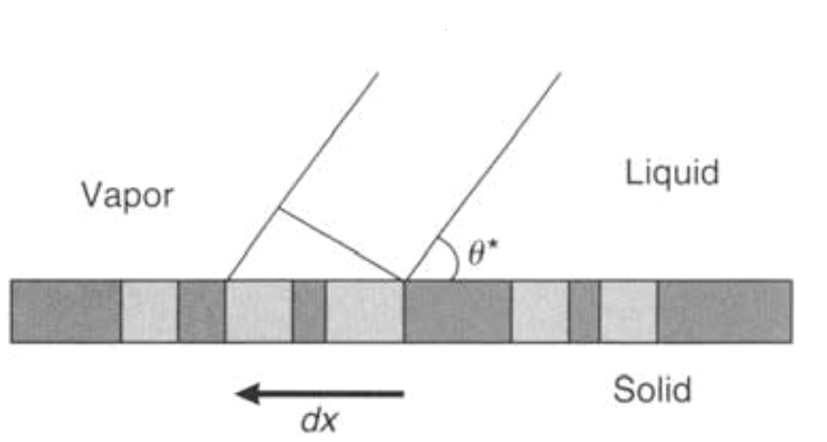
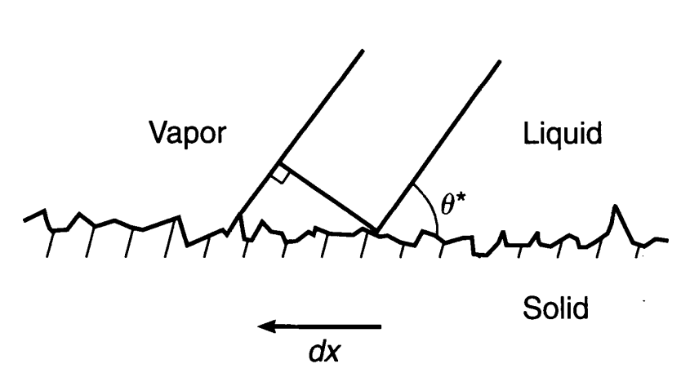
Static Wetting of textured surfaces – Cassie-Baxter & Wenzel Models
The contact angle on an ideal surface is governed by a balance of surface tension forces (Young equation):
Model for the contact angle on chemically textured surface (Cassie-Baxter equation):
Chemically textured
Images on this slide from de Gennes, Brochard-Wyart, Quere, 2004
Rough surface

Slide 15
Wetting of textured surfaces – Cassie-Baxter & Wenzel Models
The contact angle on an ideal surface is governed by a balance of surface tension forces (Young equation):
Can we use the Cassie-Baxter angle to model the imbibition in a powder bed?
Model for the contact angle on chemically textured surface (Cassie-Baxter equation):
Chemically textured
Images on this slide from de Gennes, Brochard-Wyart, Quere, 2004
Rough surface

Slide 16
Modeling the dynamics of capillary rise
Surface energy is released during the rise (for hydrophilic surfaces)
A certain amount of this energy is dissipated into heat during rise.
The remainder is converted into kinetic (and gravitational) energy.
We can essentially infer the rising speed from the dissipation!

Slide 17
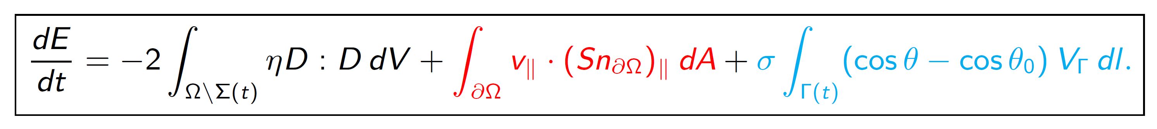

Dissipative mechanisms in the continuum model
Available energy of the system:
Viscous bulk dissipation
Dissipation due to slip at the solid surface
Contact line dissipation
Notice that the total dissipation rate controls the speed!

Slide 18
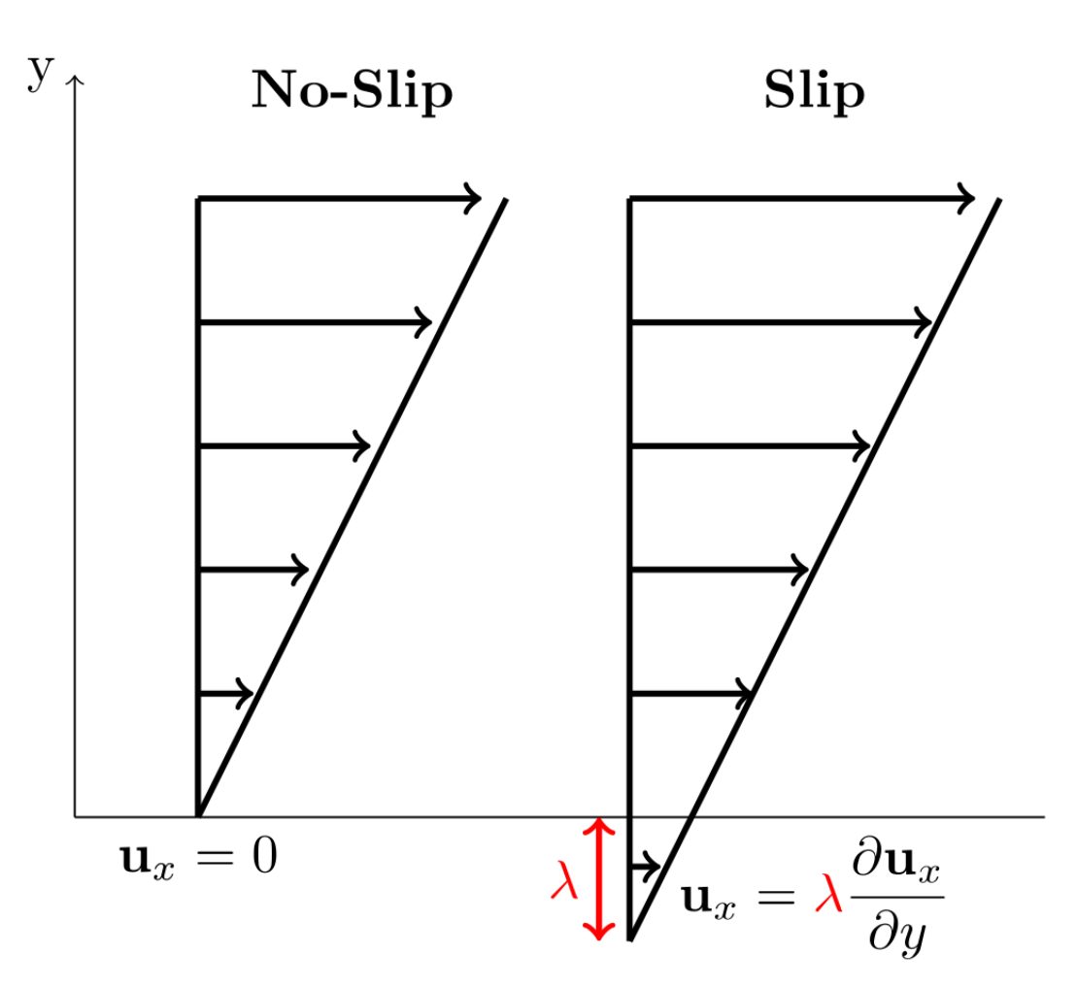
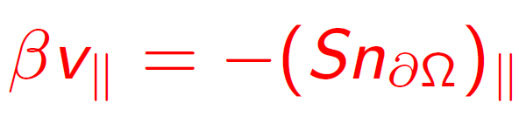
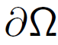
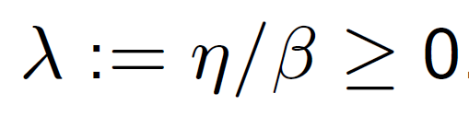
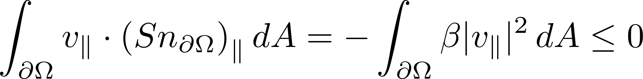
Dissipative mechanisms in the continuum model – Slip Condition
No slip condition must be relaxed to allow for a moving contact line (Huh & Scriven, 1971)
Navier slip boundary condition:
(NBC)
at
Friction coefficient
⇒ slip lenth

Slide 19
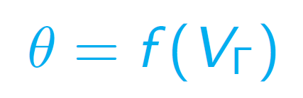
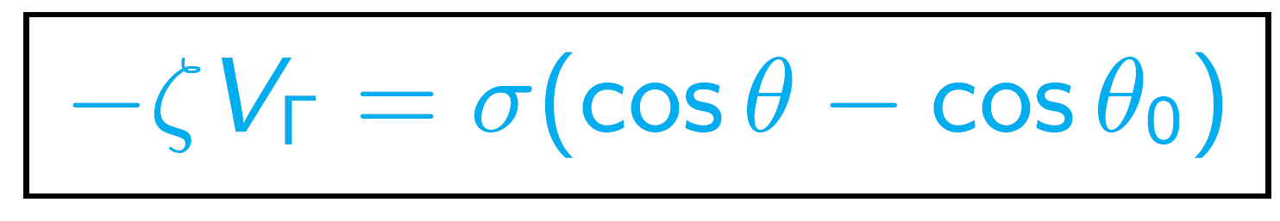
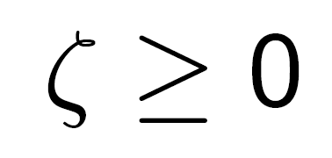
Dissipative mechanisms in the continuum model – Dynamic Contact Angle
dynamic contact angle „model“:
Linear special case:
Contact line friction coefficient

Slide 20
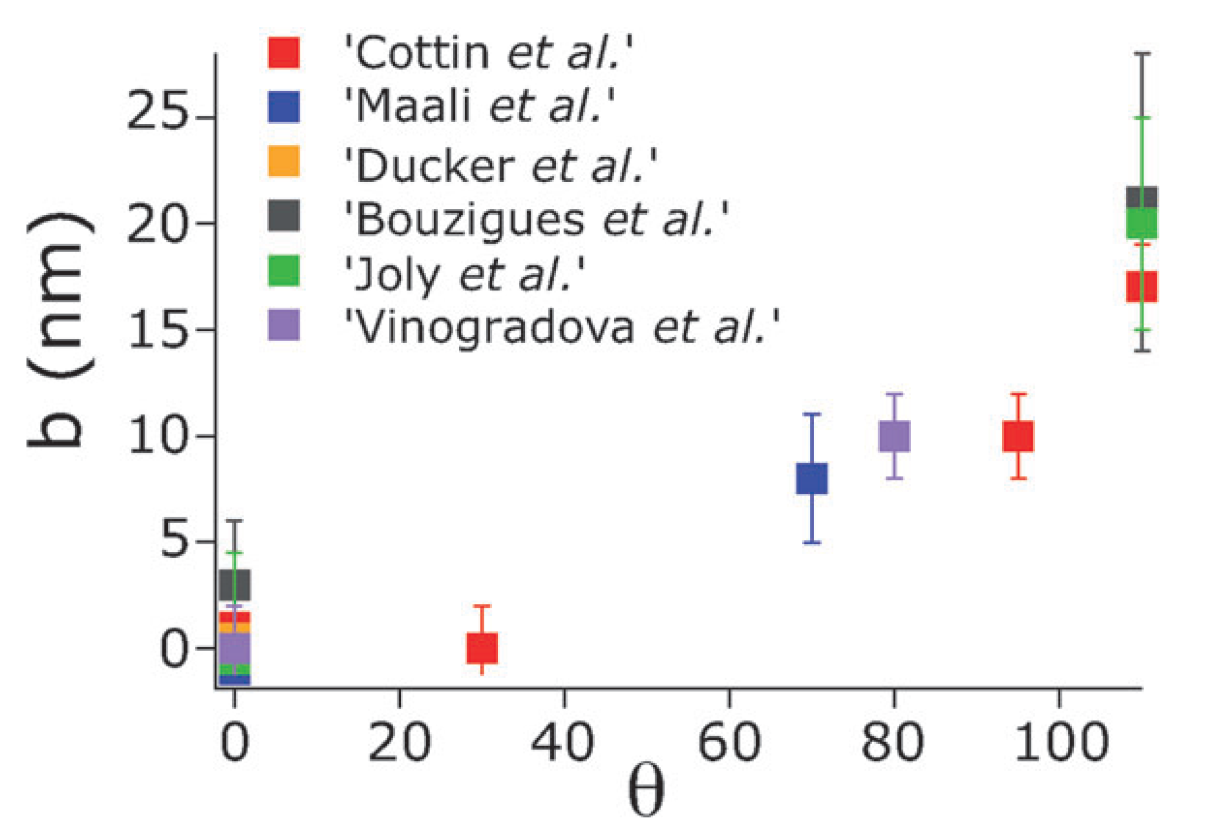
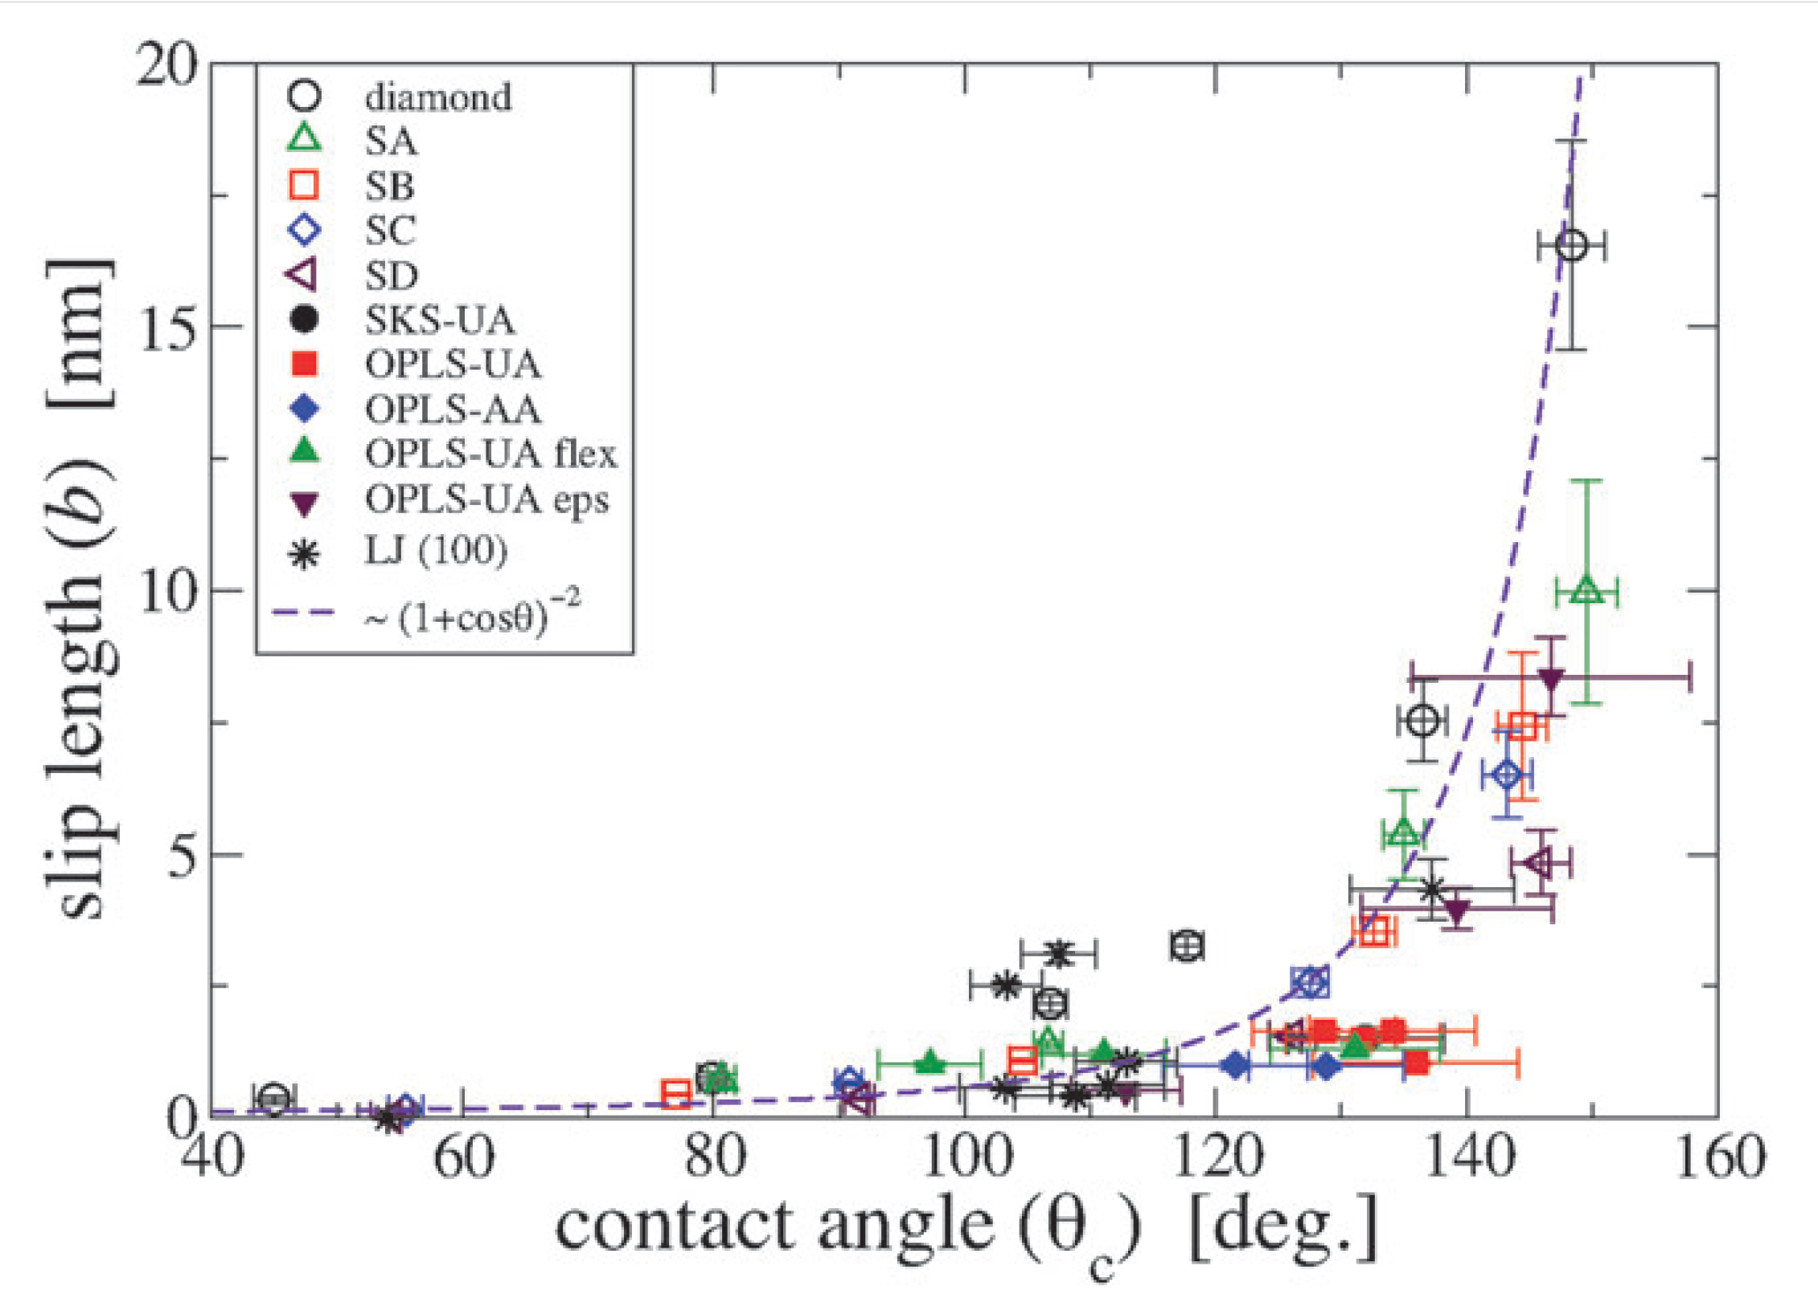
Important observation: Wettability and mobility (slip) are linked!
Slip is large on hydrophobic surfaces.

Slide 21
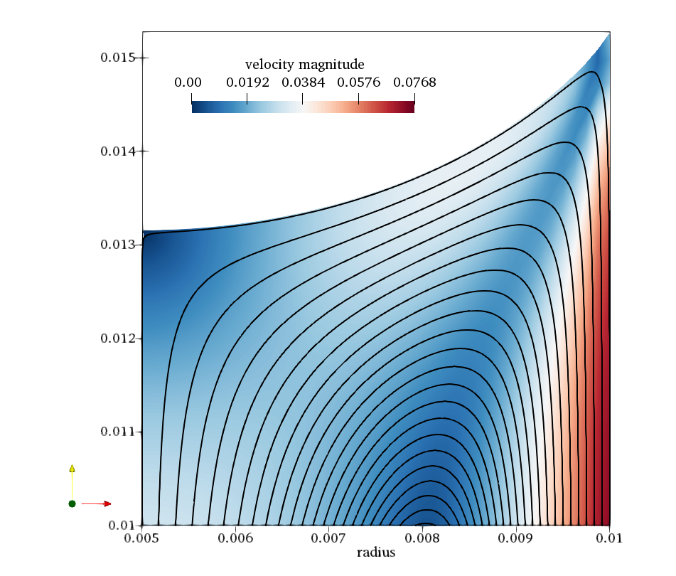
Two-phase CFD Simulations

Slide 22
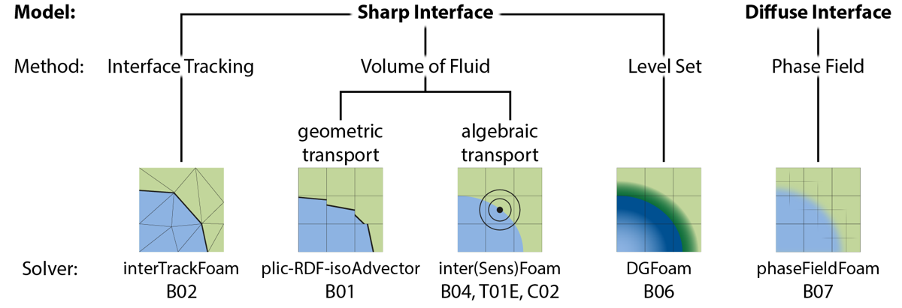
Our approach to modeling and simulation
There is no single method suitable for every problem!
We develop diverse numerical methods for two-phase flows in the OpenFOAM librabry.
Specific methods to tackle, e.g., topological changes, surfactant transport, evaporation, …
B04
B02
B01
T01E
B06
B07

Slide 23
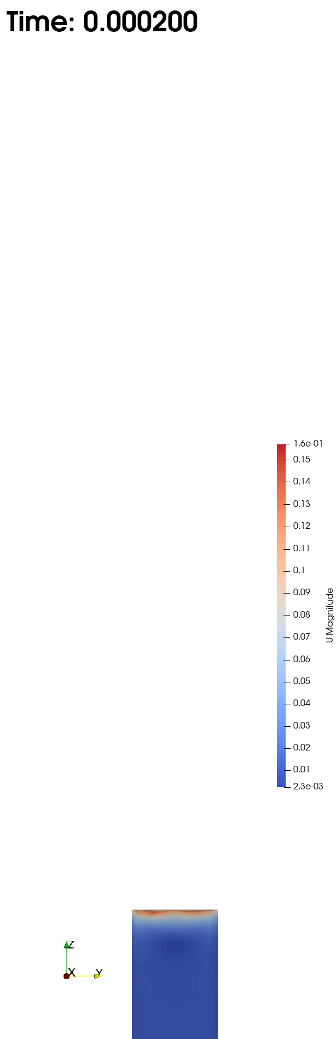
CFD simulations of the capillary rise process
Simulation study with four very different numerical methods from CRC1194: Gründing et al: A comparative study of transient capillary rise using direct numerical simulations, Applied Mathematical Modeling 86, 2020
Main findings:
Mesh convergence is obtained if all length scales are resolved!
Detailed information on the flow structure is obtained.

Slide 24
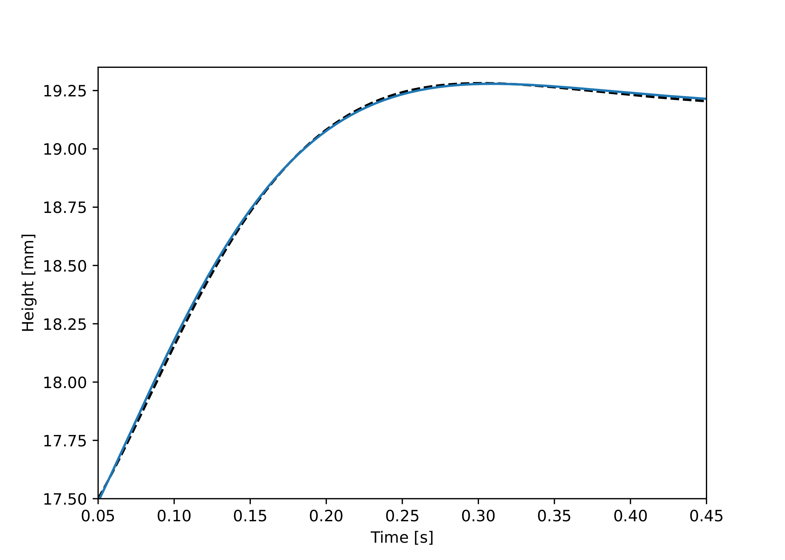
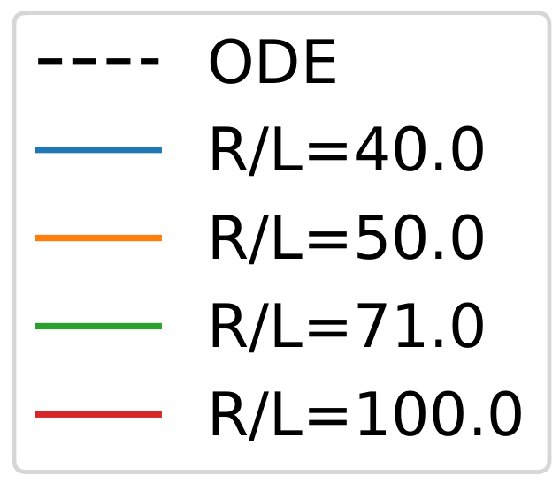
Effect of Navier Slip Length

Slide 25
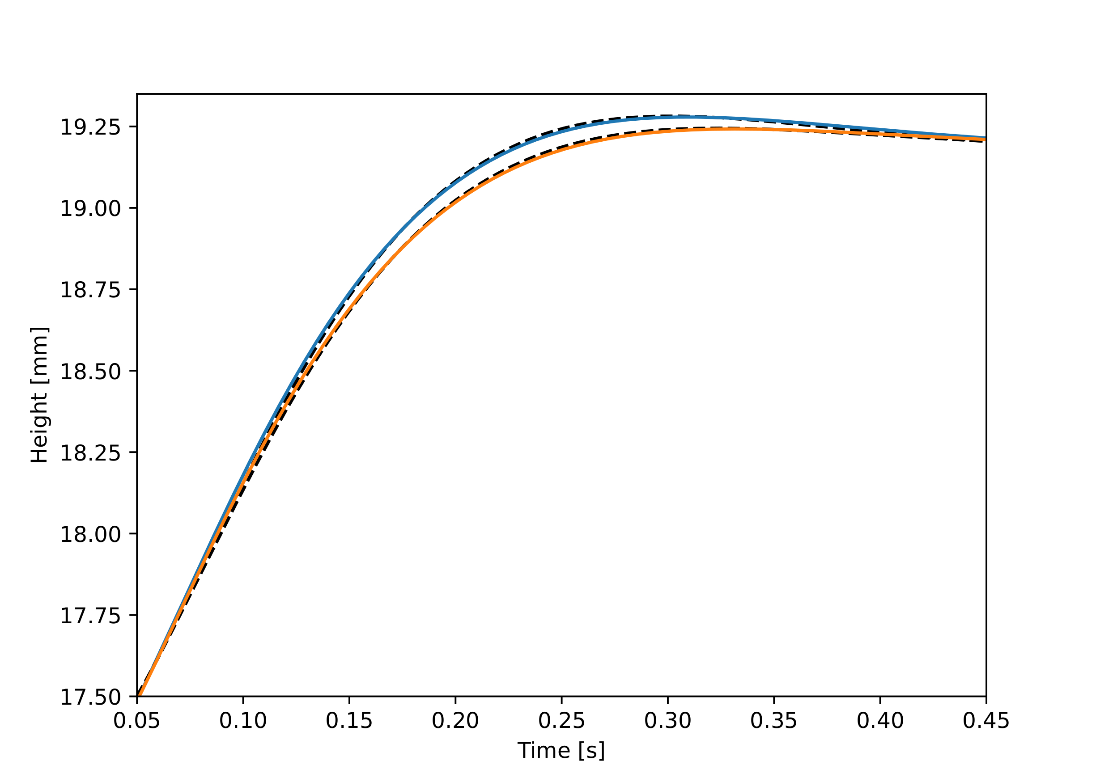
Effect of Navier Slip Length

Slide 26
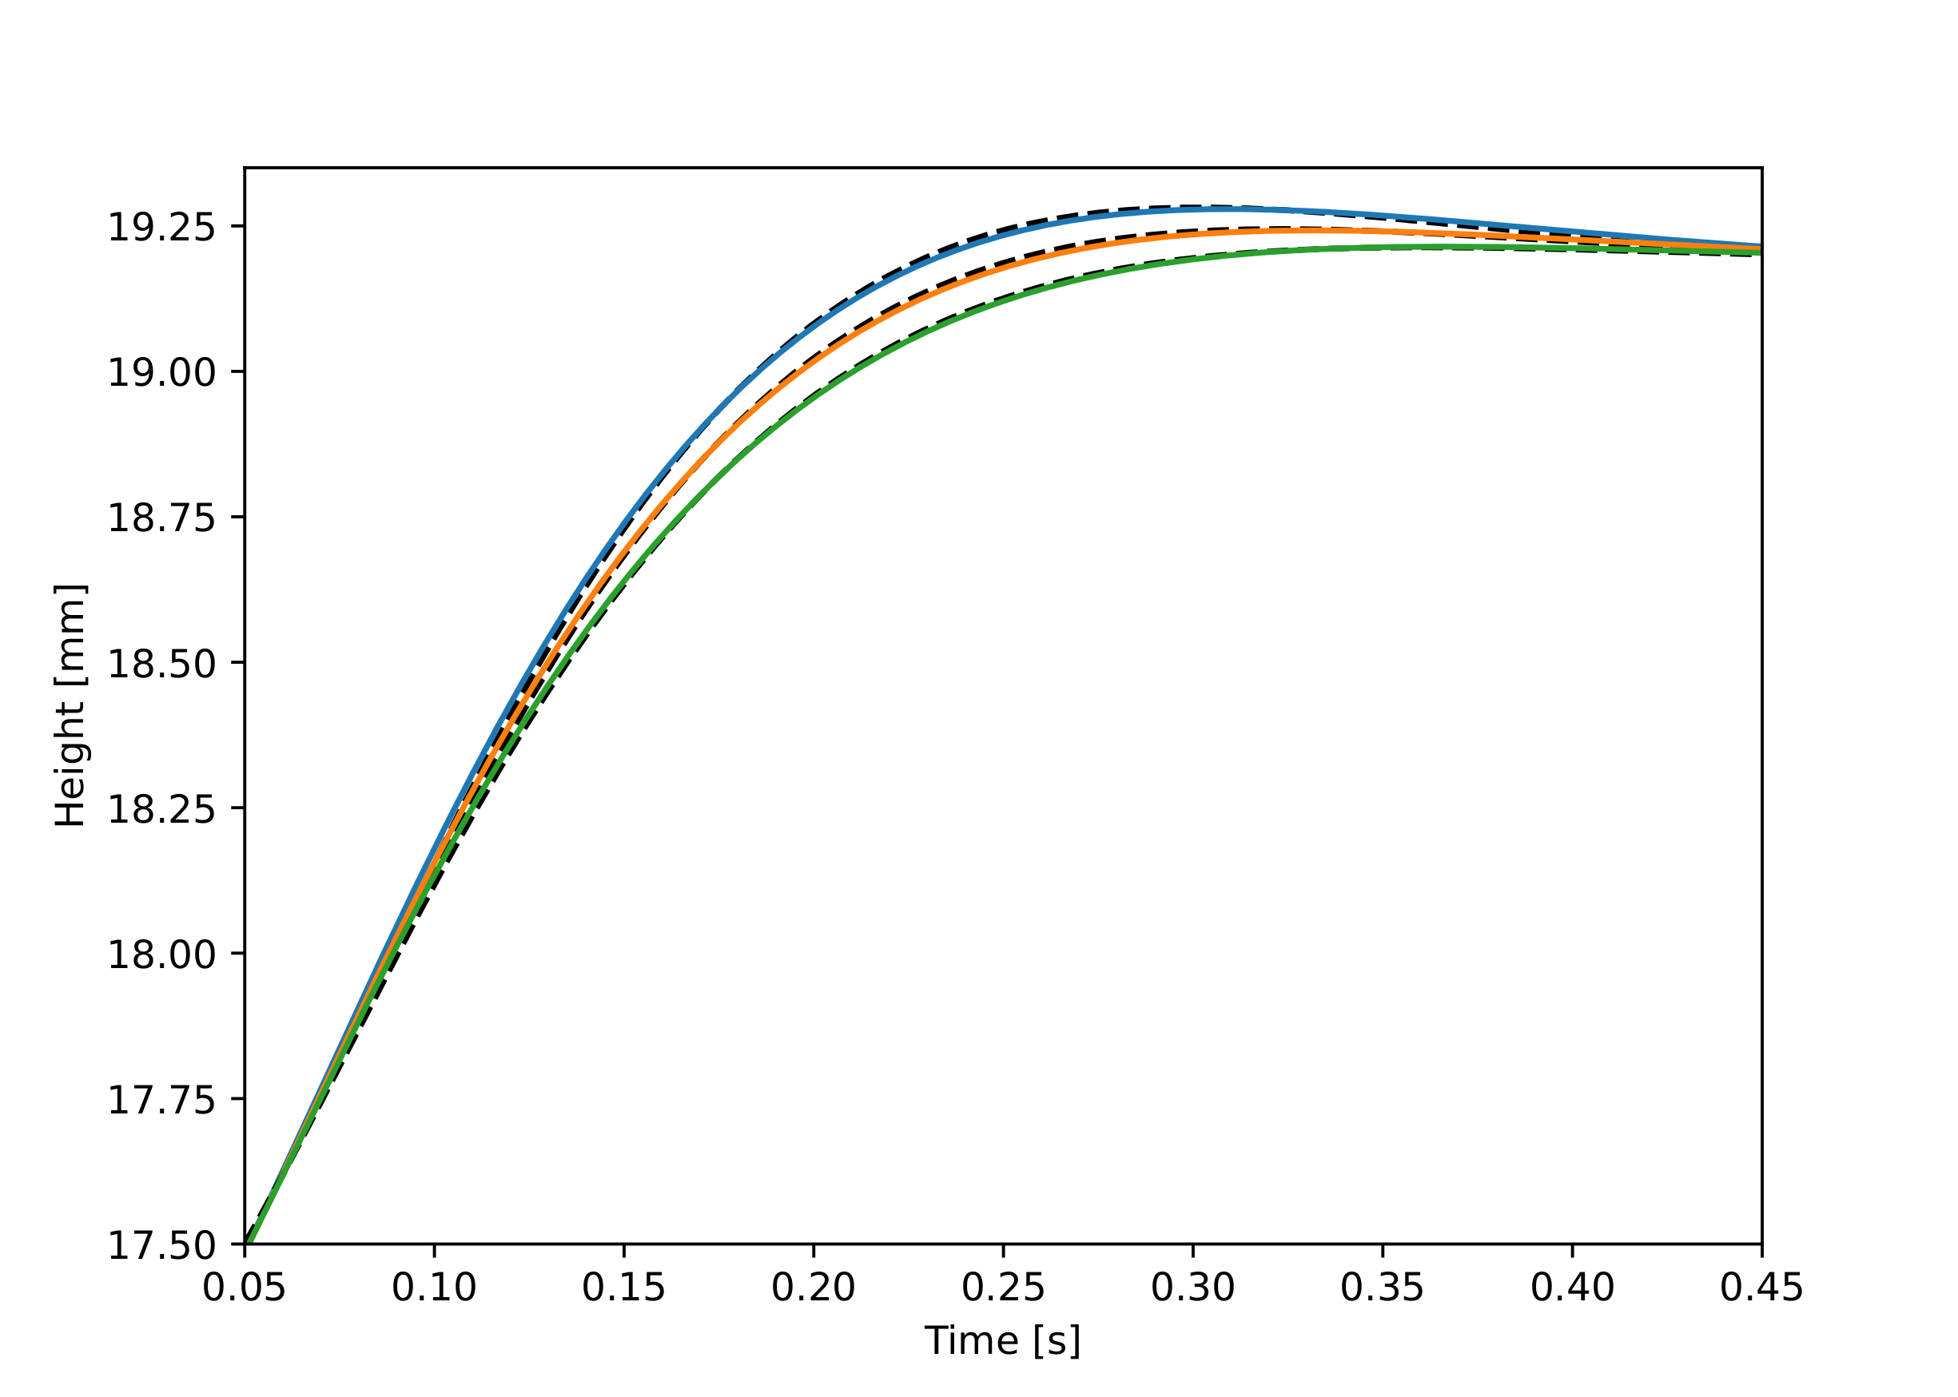
Effect of Navier Slip Length

Slide 27
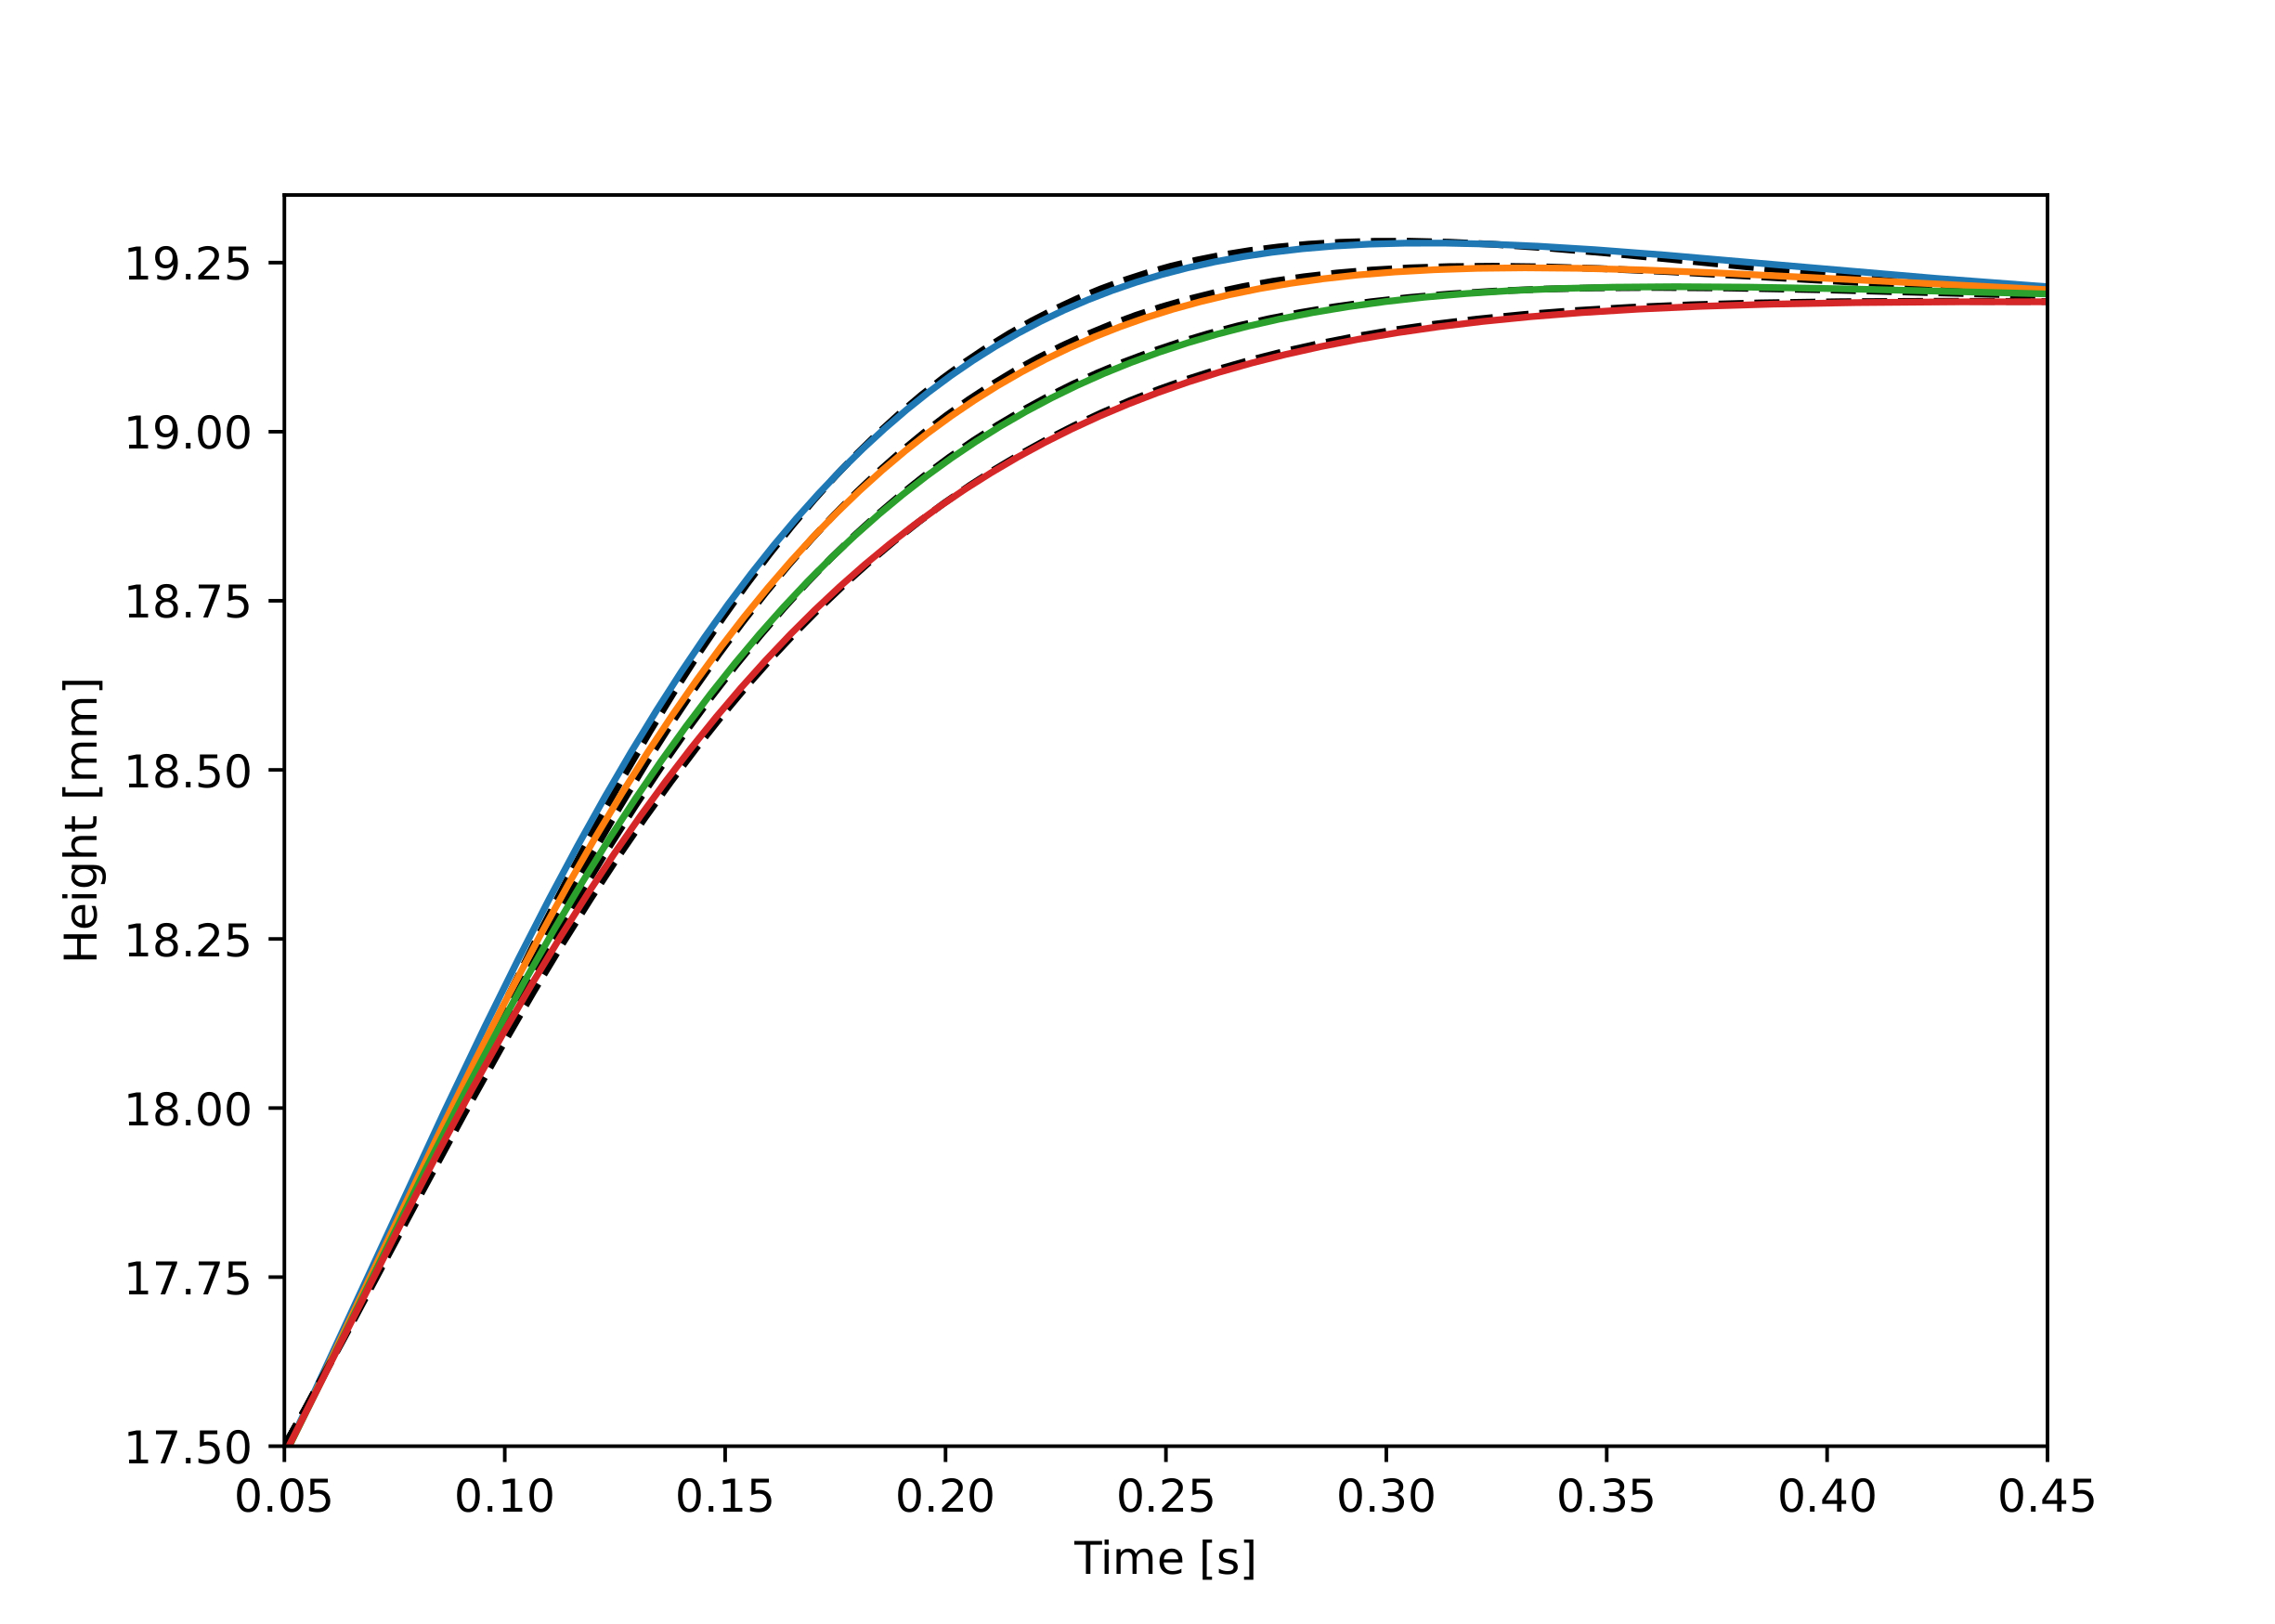
Effect of Navier Slip Length
Damping increases with R/L. How can we reach R/L=10⁶ ?

Slide 28
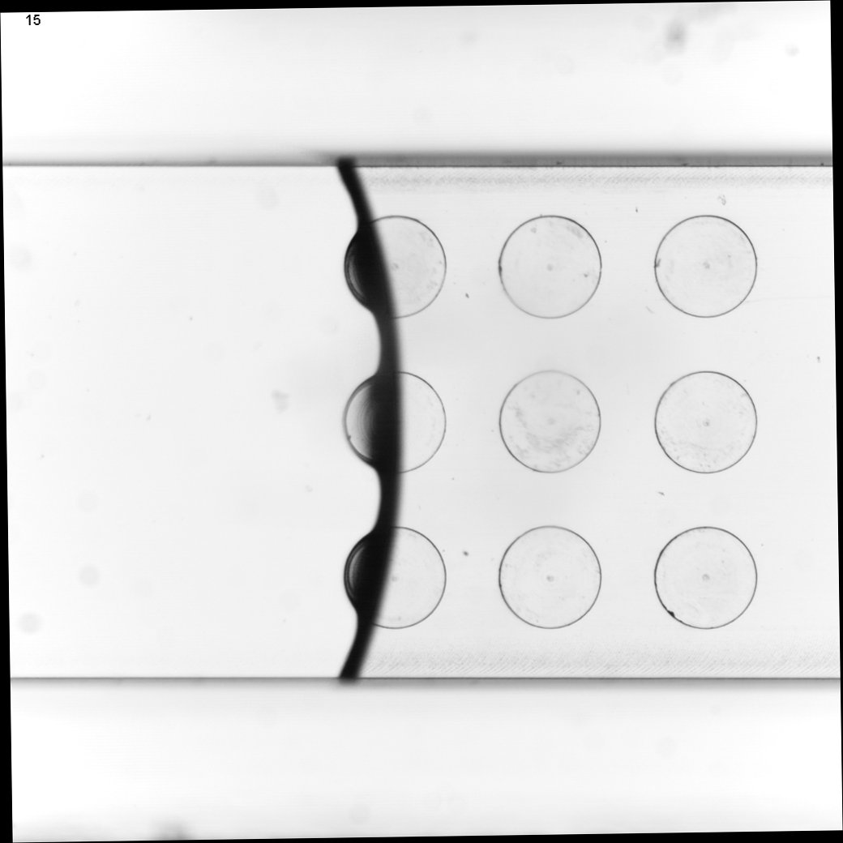
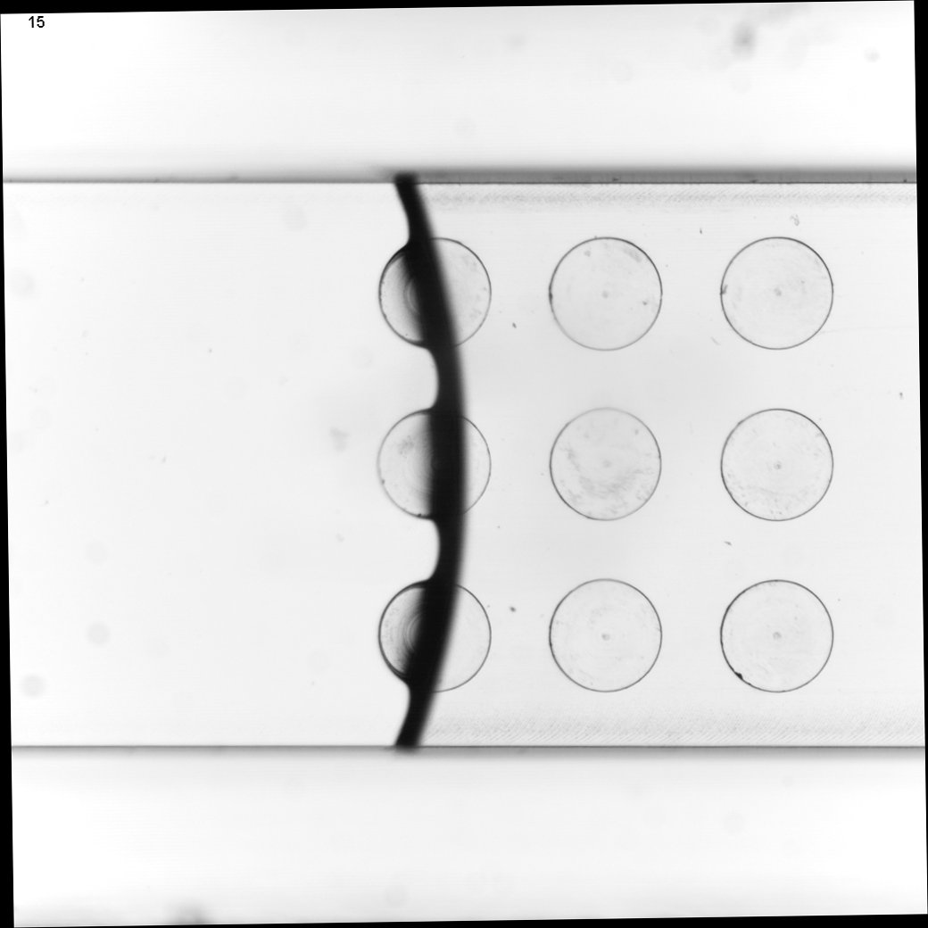
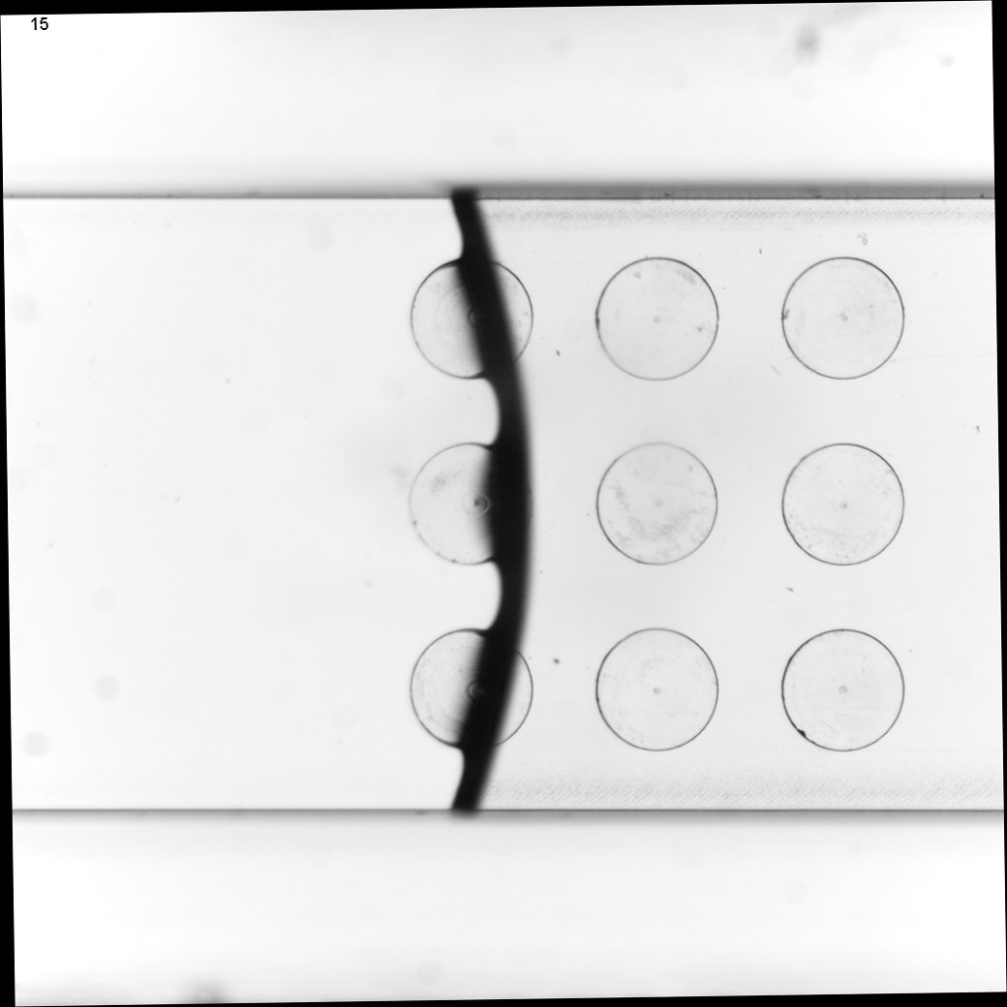
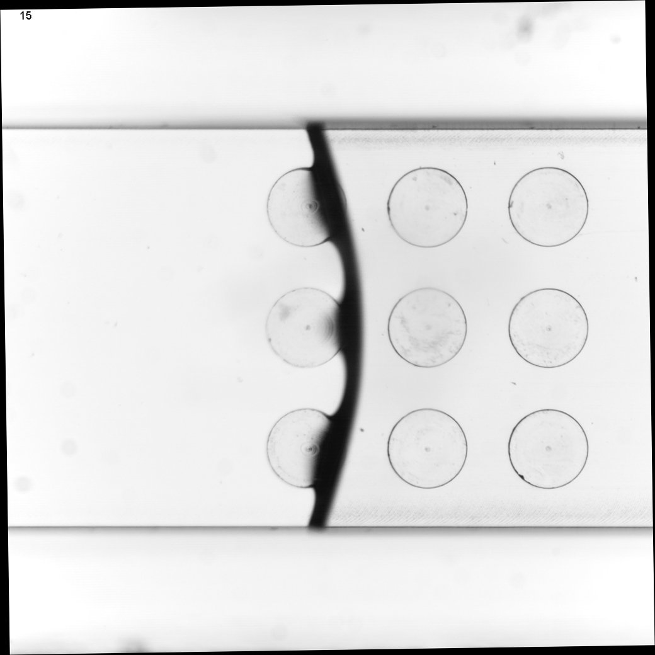
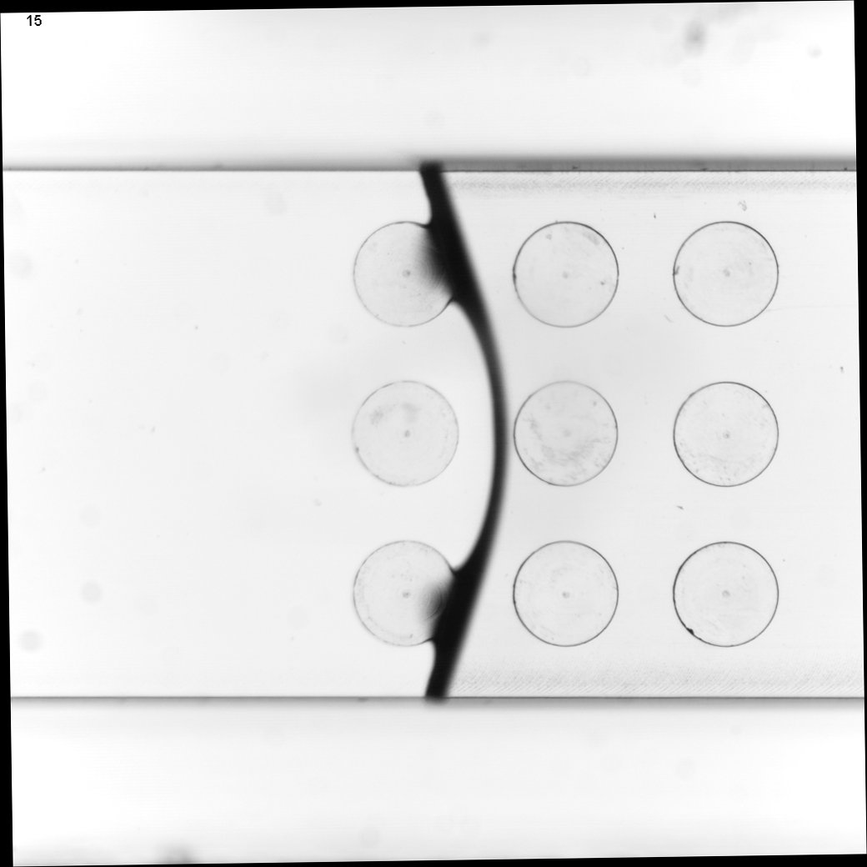
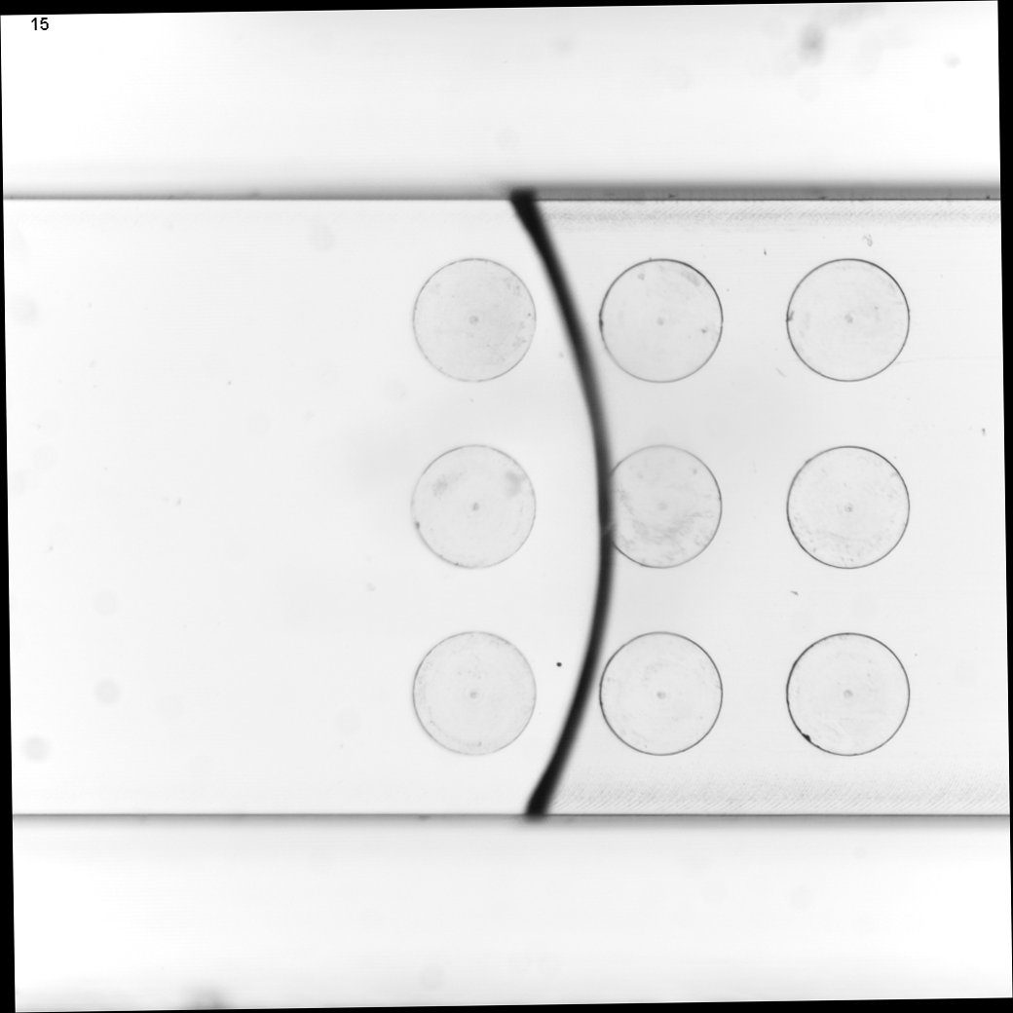
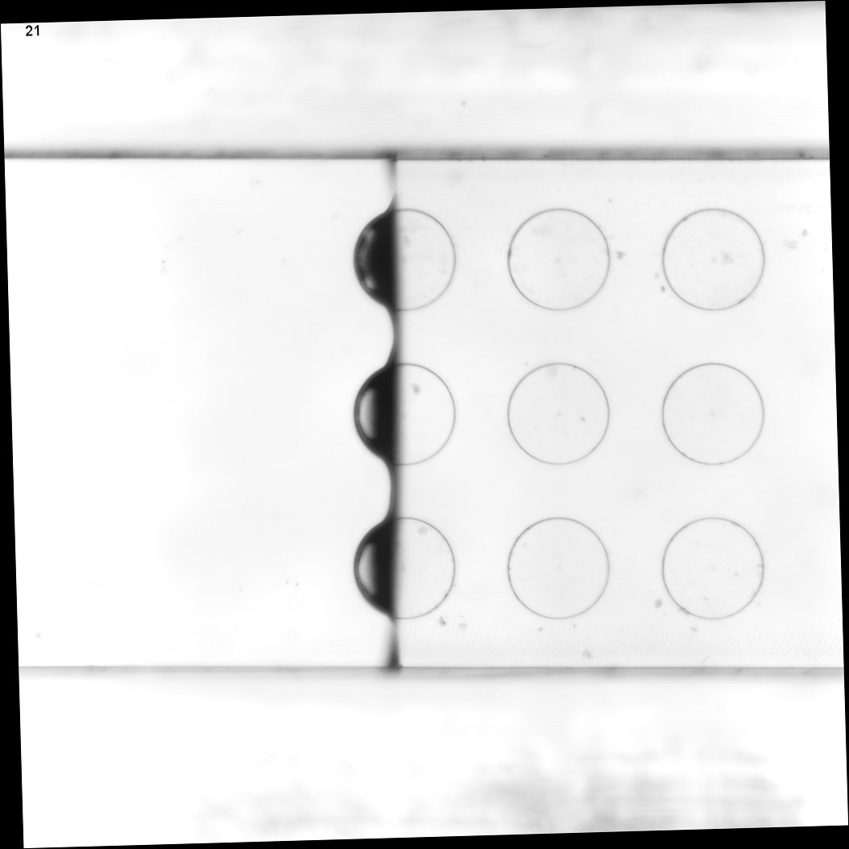
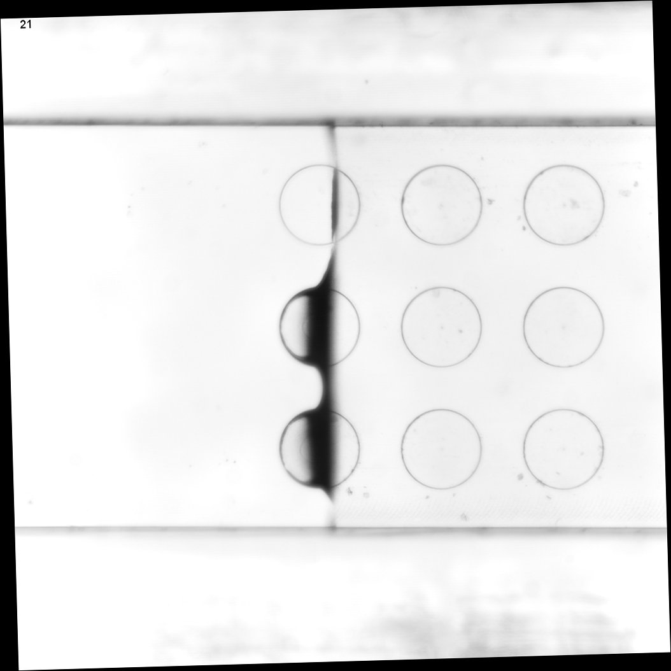
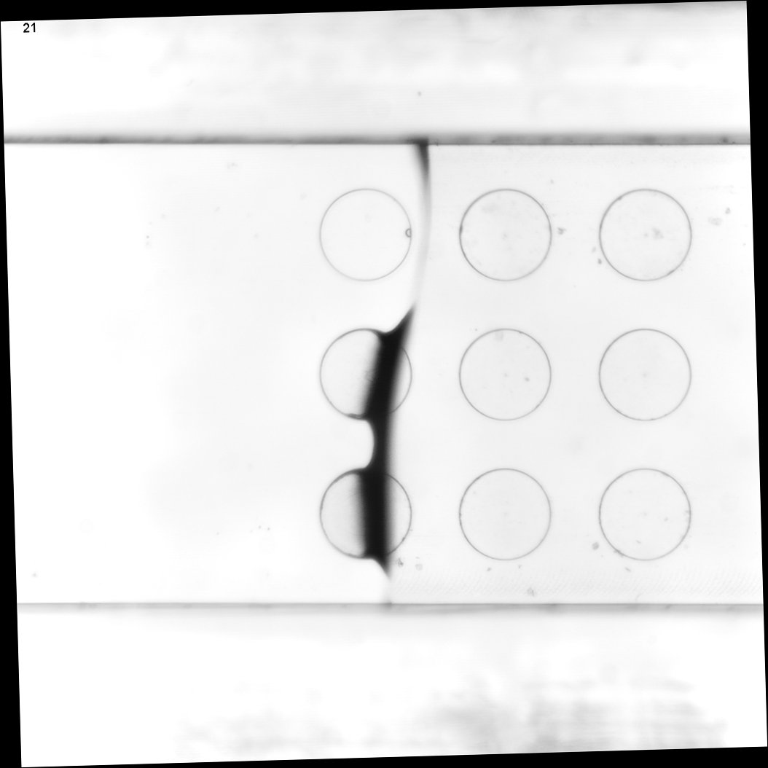
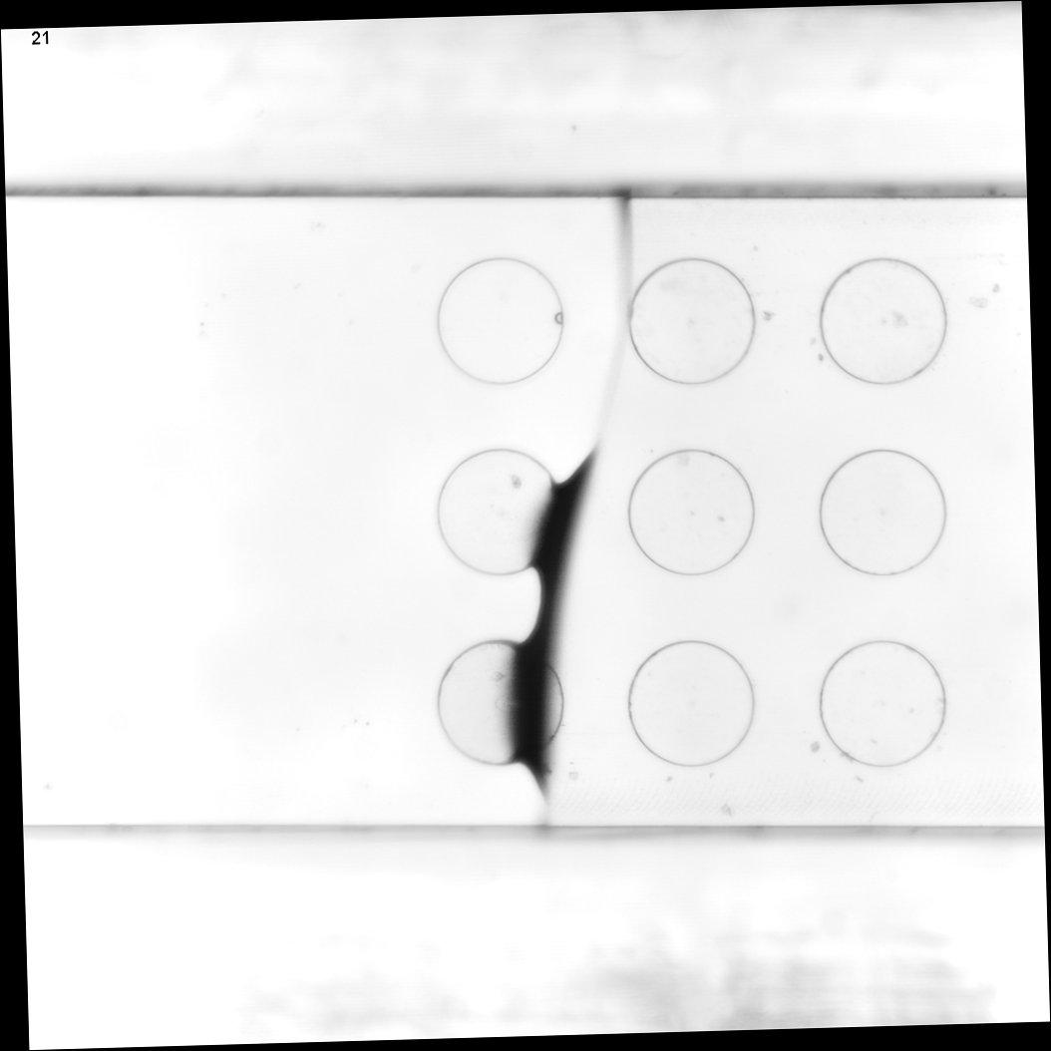


Collaboration with Robert Bosch GmbH (T. Maric, TU Darmstadt)
Experiments of fluid interface passing over microcavities.
(a) Novec-air, Ca = 7.67 x 10⁻³
interface moving through cavities
interface moving through cavity
pinned
pinned
cavities filled
(b) Water-air, Ca = 2.74 x 10⁻⁴
cavities not filled
pinned
(c) Tween-air, Ca = 2.85 x 10⁻⁵
interface moving through cavity
filled
pinned
not filled
filled

Slide 29






Volume-of-Fluid method on unstructured meshes
VOF simulation and experiment of fluid interface passing over microcavities (air-water system). Lab-on-a-chip research @Robert Bosch GmbH.
State-of-the-art numerical methods enable the investigation wetting problems in complex geometries.

Slide 30

Applications: Powders & Heterogeneous Materials

Slide 31


The basis: The Lucas-Washburn Equation
Simplified model for a single pore of radius $R:$
External pressure
Viscous dissipation due to Poiseuille flow
Inertia
Non-dimensional form

Slide 32



The basis: The Lucas-Washburn Equation
For the special case we arrive at the Lucas-Washburn equation with the well-known solution
The model can be generalized in various ways.

Slide 33


Including HDT and MKT in the model
Lucas-Washburn equation only considers dissipation due to Poiseuille flow.
But, in reality, there is also dissipation in the flow close to the contact line (HDT) as well as contact line friction (MKT).
We can show, that both lead to a similar term in the model!
MKT:
HDT:
(Fricke et al., arXiv:2311.11947 ) and (Fricke et al., Physica D, 2023) see also (Delannoy et al., Soft Matter, 2019).

Slide 34



Lesson learned: Spreading glycerol-water droplet
Finding: Cox-Voinov theory „works“ with
Solution: We have to allow for contact line friction:
Neglecting $ζ$ forces $L$ to compensate for the missing contact line friction! The result is an unphysical value.
Cox-Voinov theory („pure“ HDT):

Slide 35



A model for an inert, heterogeneous powder system
Model by Benavente et al. (2002) and Kammerhofer et al. (2018)).
Let $M_{l}(t)$ denote the time-dependent mass of the liquid.
Cross sectional area
Porosity
Height
Modified Lucas-Washburn model for $M_{l}\left(t\right)$:
Effective radius
Cassie-Baxter Angle

Slide 36

A new approach to heterogeneous materials – Work in Progress (joint work with J. De Coninck)
We revisit the classical Lucas-Washburn model but allow for heterogeneous surface, i.e. we study
The length of the segments of A and B are statistically distributed such that a certain mixture is realized.
J. De Coninck
Research goal: How should one arrange the mixture of A and B to minimize the crossing-time?
Material A
Material B

Slide 37
A simple example
Let us assume that A is more hydrophilic than B.
What do you think: Which configuration gives faster imbibition?
Hydrophobic first
Hydrophilic first

Slide 38

A simple example
Let us assume that A is more hydrophilic than B.
What do you think: Which configuration gives faster imbibition?
Hydrophobic first
Hydrophilic first

Slide 39
A simple example
Let us assume that A is more hydrophilic than B.
Fortunately, we can solve the problem analytically!
The solution shows that „hydrophobic first“ gives significantly faster imbibition.
Hydrophobic first
Hydrophilic first

Slide 40

A quantitative example
Let us look at a concrete example. We choose
This yields the Cassie-Baxter angle
The lengths of the segments follow a Gaussian distribution.
We average over 50k samples of that material in the following.

Slide 41

Distribution of segment length (where $r_{A}=0.3)$

Slide 42

Distribution of crossing time (according to Lucas-Washburn)

Slide 43

Distribution of crossing time (according to Lucas-Washburn)
Finding: Cassie-Baxter model fails!!
Cassie-Baxter model
Hydrophobic first
Hydrophilic first

Slide 44
Some Conclusions
We have seen that predictive theories need to consider all relevant channels of dissipation during wetting.
Predictive theories are necessary prerequisite for process optimization for applications.
We have shown that the wetting speed for heterogeneous materials depends (in a non-trivial way) on the material composition.
Suprisingly, Cassie-Baxter theory fails for the crossing time!
Effective pore radius compensates for inadequate contact angle value?

Slide 45

What‘s next?
Can we make use of the „eat the frog“ principle in the context of powder reconstitution?
How can we understand the failure of the Cassie-Baxter model?
Increase complexity by allowing for a statistical distribution of the pore radius.
Include inertial effects to study blockage effects by hydrophobic defects.
Resolved CFD simulations in complex geometries.
(…. To be continued …)
Cai et al., Langmuir, 2021

Slide 46

Thank you very much for your attention!
Dr. Mathis Fricke Research Group Leader at Mathematical Modeling and Analysis Group Technical University of Darmstadt, Germany
fricke@mma.tu-darmstadt.de
www.mathis-fricke.de and www.mma.tu-darmstadt.de, www.sfb1194.tu-darmsatdt.de
This work was funded by German Research Fundation (DFG) SFB 1194 – Project ID 265191195.

Slide 47
List of references (I)
M. Fricke, S. Raju, E. A. Ouro-Koura, O. Kozymka, J. De Coninck, Z. Tukovic, T. Maric, D. Bothe: Bridging the scales in capillary rise dynamics with complexity-reduced models, Preprint: arXiv:2311.11947 (2023)
M. Fricke, C. Bernklau, E. Diehl, J. De Coninck, S. Ulbrich, D. Bothe: On the problem of optimal fluid transport in capillaries, Preprint: arXiv:2404.12263 (2024)
M. Fricke, E. A. Ouro-Koura, S. Raju, R. von Klitzing, J. De Coninck and D. Bothe: An analytical study of capillary rise dynamics: Critical conditions and hidden oscillations, Physica D: Nonlinear Phenomena (2023), DOI: 10.1016/j.physd.2023.133895, arXiv:2305.05939
T. Fullana, Y. Kulkarni, M. Fricke, S. Popinet, S. Afkhami, D. Bothe, S. Zaleski: A consistent treatment of dynamic contact angles in the sharp-interface framework with the generalized Navier boundary condition, DOI:10.5281/zenodo.10142047 (2023)
M. Hartmann, M. Fricke, L. Weimar, D. Gründing, T. Marić, D. Bothe, S. Hardt: Breakup dynamics of Capillary Bridges on Hydrophobic Stripes, International Journal of Multiphase Flow (2021), DOI:10.1016/j.ijmultiphaseflow.2021.103582
D. Gründing, M. Smuda, T. Antritter, M. Fricke, D. Rettenmaier, F. Kummer, P. Stephan, H. Marschall, D. Bothe: A comparative study of transient capillary rise using direct numerical simulations, Applied Mathematical Modelling (2020), DOI: 10.1016/j.apm.2020.04.020.

Slide 48
List of references (II)
M. Fricke: Mathematical modeling and Volume-of-Fluid based simulation of dynamic wetting, PhD Thesis, TU Darmstadt (2021), DOI: 10.12921/tuprints-00014274.
Delannoy, J., Lafon, S., Koga, Y., Reyssat, É., Quéré, D.: The dual role of viscosity in capillary rise, Soft Matter (2019), DOI: 10.1039/c8sm02485e
Kammerhofer, J., Fries, L., Dupas, J., Forny, L., Heinrich, S., Palzer, S.: Impact of hydrophobic surfaces on capillary wetting, Powder Technology (2018), DOI: 10.1016/j.powtec.2018.01.033
Kammerhofer, J., Fries, L., Dymala, T., Dupas, J., Forny, L., Heinrich, S., Palzer, S. : Penetration rates into heterogeneous model systems and soluble food material, Powder Technology (2018), DOI:10.1016/j.powtec.2018.08.068
Quéré, D., Raphaël, É., Ollitrault, J.-Y.: Rebounds in a Capillary Tube, Langmuir (1999), DOI:10.1021/la9801615
Quéré, D.: Inertial Capillarity, Europhysics Letters (EPL) (1997), DOI:10.1209/epl/i1997-00389-2

Slide 49
Backup Material

Slide 50

Trapping of a meniscus by a hydrophobic defect (VOF simulations)
Hydrophobic defect

Slide 51

Collaborative Research Center on Wetting and Transport Phenomena

Slide 52

Simplified Models (ODEs)

Slide 53



Classical Theory for oscillations by Bosanquet und Quéré
Experimental data for glass capillaries with radius
Simplified model by Bosanquet (1923) :
Inertial force
viscous force (Poiseuille flow!)
Capillary force
Gravity
Critical condition for oscillations (Quéré et al., 1997):
Ethanol:
Notes:
In der Literatur kennt man die klassische Theorie der Oszillationen nach Bosanquet und Quere. Hier wird zunächst ein vereinfachtes Modell hergeleitet, dass, unter vereinfachenden Annahmen, eine Balance der angreifenden Kräfte darstellt.
Hervorzuheben ist die hierbei die viskose Kraft, die sich aus der inneren Reibung in der Poiseuille Strömung ergibt. Dieses Strömungsprofil beobachtet man auch experimentell unterhalb der freien Grenzfläche.
Quere konnte für dieses Modell zeigen, dass Oszillationen auftreten falls der dimensionslose Parameter Omega kleiner als der kritische Wert 2 ist.

Slide 54


Classical model by Bosanquet needs improvement
Finding:
Strong oscillation predicted but not observed!
Hydrodynamic Theory (HDT)
Viscous dissipation due to flow close to the contact line
Key parameter: Slip Length
Molecular Kinetic Theory (MKT)
Dissipation at the contact line itself
Key parameter: Contact Line Friction
Ethanol:
Notes:
Ein wesentliches Ergebnis unserer Forschung in der Förderperiode 2 war nun zu zeigen, dass sich beide Theorien in einem generischen DGL-Modell zusammenführen lassen.
Beide Theorien liefern eine verallgemeinerte Reibung beta auf der rechten Seite der Differentialgleichung.
Man erkennt in der Abbildung, dass die Daten mithilfe des zusätzlichen Reibungsparameters sehr gut beschrieben werden können.
Außerdem haben wir die kritische Bedingung für das neue Modell hergeleitet und gezeigt, dass:
Im vorliegenden Fall von Ethanol eine Oszillation vorliegen müsste. Diese wird aber augenscheinlich nicht beobachtet.

Slide 55





TODO Zusammenführung der Theorien
Beobachtung:
Starke Oszillation vorhergesagt aber nicht beobachtet!
Ergebnis FP2
Generisches Modell für Capillary Rise
Verallgemeinerte Reibung:
Neue kritische Bedingung:
Ethanol:
Hier:
!
Notes:
Ein wesentliches Ergebnis unserer Forschung in der Förderperiode 2 war nun zu zeigen, dass sich beide Theorien in einem generischen DGL-Modell zusammenführen lassen.
Beide Theorien liefern eine verallgemeinerte Reibung beta auf der rechten Seite der Differentialgleichung.
Man erkennt in der Abbildung, dass die Daten mithilfe des zusätzlichen Reibungsparameters sehr gut beschrieben werden können.
** Jetzt Besschreibung mit phys. Realistischen Parametern möglich!
Außerdem haben wir die kritische Bedingung für das neue Modell hergeleitet und gezeigt, dass:
Im vorliegenden Fall von Ethanol eine Oszillation vorliegen müsste. Diese wird aber augenscheinlich nicht beobachtet.
-> **Schlaflose Nächte**!

Slide 56



Nachweis der Oszillation durch nichtlineare Transformation
Transformation
Ethanol:
Notes:
Dieser scheinbare Widerspruch wird aufgelöst, wenn man eine geeignete nicht-lineare Transformation der Daten durchführt. Diese entfernt den exponentiell abklingenden Anteil der Lösung und macht die Oszillation sichtbar. Dadurch konnte unsere neue Theorie auch quantitativ nahe am Regimeübergang bestätigt werden.

