Slide 1
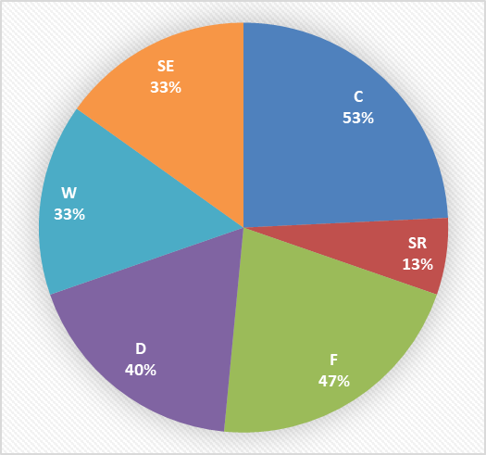
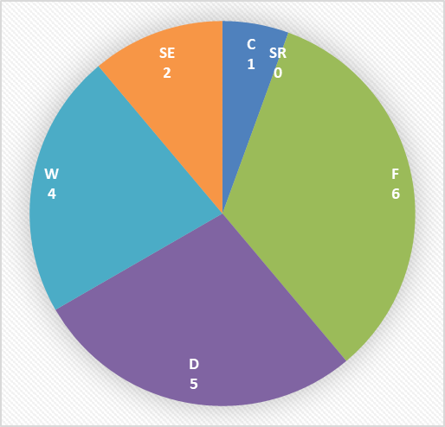
Current Technical Program: 2021-2022
Geographic Dist’n
NA – 6
EU - 5
UK – 3
AP - 1
Notes:
Uli Wiesner’s project finished 1 year early (6 vs.7 years)
Karen Daniels ending this year
Three renewals: Gaiani, Ashgriz, Koos
Three collaborations – one holdover (Hsiao), two chartered after last AGM
Only one project ending next year – DEM Round Robin
Project distribution
Left: multi-attribute distribution
Right: single (main) attribute distribution
A bit overweighted in formation, underweighted in size reduction

Slide 2
New Project and Renewal Proposals: 2022
Notes:
Two proposals for 2 briefs
1 proposal for 3 briefs
0 proposals for dry powder reconstitution brief
Sustainability review withdrawn after discussion with Roland Clift & brief authors

Slide 3
Other Activities: 2021-2022
Workshops - none
Roundtables
Particulate Product Specifications (2 sessions)

Slide 4
AGM Decisions: 2022
Projects
15 projects ongoing (inc. DEM RR), 3 up for renewal, 1 ending
5 new project briefs with proposals
3 renewal proposals
Assuming 17 full projects = select up to 6 from 8
Briefs
Next year, 2 projects ending and 5 up for renewal
Need at least 3 new project briefs to maintain 17 projects
Workshops
Suggestion: 1 per year, rotating between concentration areas (wet systems, dry systems, formation, milling, characterization, systems engineering)
Scheduled to coordinate with winter meeting
Roundtables
No limit to number
If you want one, organize it – Jim & Willie can facilitate
A good mechanism for generating topics for workshops and reviews

