Slide 1
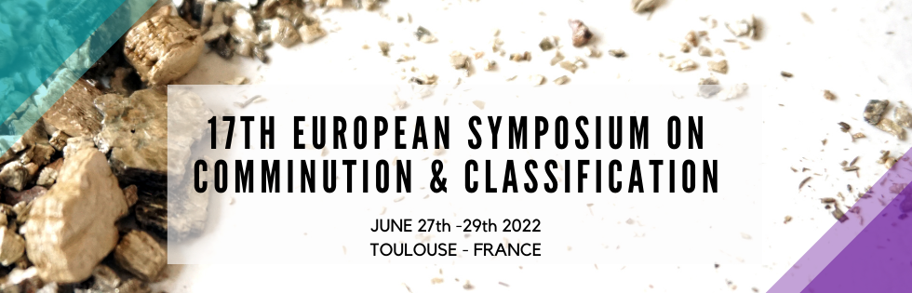
Main topics on the forthcoming ESCC conference in Toulouse:
Fine grinding
Autogenous grinding for low contamination (Sanda Breitung-Faes, Arno Kwade)
Multicomponent grinding in batteries (Arno Kwade)
Parameter optimization and scale-up (Mende, Netzsch)
Production of 2D materials by mechanical delamination (WP)
Grinding limit for organic nanoparticles (WP)
Shape formation below the brittle-ductile limit (WP)
Grinding of powders for additive manufacturing: hydroxyapatite (Frances Christine), polymers (Jochen Schmidt)
Coarse grinding
Towards green mining industry: Eco-efficient dry comminution by vertical roller mill
Size-dependent transport (Malcom Powell, also with Marcelo Tavares, Dion Weatherley)
Classification:
Multi-dimensional separation in the focus of a national priority program in Germany (coordinator Urs Peukert)
Ultrafine classification in bowl-centrifuges: Dynamic modelling (Hermann Nirschl, KIT)
Classification in super-heated steam

Slide 2
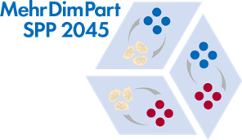
Main topics on the forthcoming ESCC conference in Toulouse:
Modelling and simulation
Several CFD-DEM approaches, e.g. transport of non-spherical particles (Jennifer Curtis), attrition in mechanofusion device, spiral jet mills (Mojtaba Ghadiri)
Single particle tracking for validation of PEPT (Govender Indresan)
Energy absorption from compression analysis of single particles (WP)
Artificial intelligence in grinding modelling (Carsten Schilde, TU Braunschweig)
Machine learning for impact crusher monitoring (Holger Lieberwirth)
Flow-sheet simulation in recycling
Specific materials
Bio and food applications
Recycling, in particular of batteries (Kwade group)
Mechano-chemical aspects
Drugs (solubility enhancement)
Solid electrolytes
Attrition and leaching in passivation-limited hydrometallurgy

Slide 3

Conclusions based on topics:
Modelling and simulation
CFD-DEM studies now standard with ever increasing complexity
Size- and shape-dependent transport
Direct measurement of stress energy by probe particles
Particle properties still largely missing (the material function)
Artificial intelligence for unknown properties/effects (towards hybrid (mechanistic + AI) models)
Mechano-chemical aspects
Growing interest, also from industry
Fine grinding
Mechanical delamination for 2D materials
Grinding limit for organics (~ 30 nm for Naproxen)
Grinding of powders for additive manufacturing
Towards green industry:
Eco-efficient powder production and handling
Increasing complexity
Multi-component (soft) materials, multidimensional classification

Slide 4
Mechanochemistry for …
Ammonia synthesis under mild conditions, Nature Nanotechnology (2021)
Liquid assisted grinding in the formation of pharmaceuticals Adv. Synthesis and Catalysis (2021)
The many flavors of mechanochemistry, Nature Reviews Chemistry (2021)
Polymer mechanochemistry for responsive materials and additive manufucturing, Nature Reviews Materials (2021)
Mechanochemistry towards green synthesis of MOFs, Materials Today (2021, ChrystEngComm (2020)
Halid Perovskites and other multinary metal halids, Adv. Energy Materials (2020)
Mechanochemistry for synthesis, Angewandte Chemie, Int. Ed. (2020)
…..
Mechanochemical solvent-free reactions by milling, grinding or other types of mechanical action have emerged as a viable alternative to solution chemistry. Mechanochemistry offers not only a possibility to eliminate the need for bulk solvent use, and reduce the generation of waste, but it also unlocks the door to a different reaction environment in which synthetic strategies, reactions and molecules previously not accessible in solution, can be achieved. This Minireview examines the potential of mechanochemistry in chemical and materials synthesis, by providing a cross-section of the recent developments in using ball milling for the formation of molecules and materials based on covalent and coordination bonds.

Slide 5
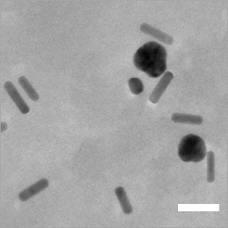
Priority Program 2045
Multidimensional separation of particles (coordinator: Urs Peuker, TU Freiberg)
Property function
Example: 2D measurements of
Au nanorods and spheres by AUC
Particle size
Particle shape
Wawra te al, Nature Comm. 2018

Slide 6
Nanoparticle chromatography (Au, Ag, alloys, ZnS, SiO₂, fullerenes, carbon dots)
Au NP fractions (SEC)
SEC: Universal calibration
Classification of multimodal PSDs
AuMUA
Gromotka et al, in preparation
Calibration curves of AuMUA, AgMUA and SiO₂ NPs nearly identical in size exclusion chromatography
→ Separation / retention independent of core material
→ Separation / retention depends only on surface charge / zeta potential
Baseline separation of multimodal distributions
Interaction chromatography
→ Purification of complex mixtures (carbon dots)
→ Classification ultrafine clusters
Process development and scale-up on the agenda
Hinterberger, Süß, Michaud, Damm, WP
Powder Technology 2018
J. Phys.Chem C 2019
Nanoscale 2019, 2020, 2021

Slide 7
mathematics
Article
Conservative Finite Volume Schemes for Multidimensional Fragmentation Problems
Jitraj Saha ¹ and Andreas Bück²,*
Department of Mathematics, National Institute of Technology Tiruchirappalli, Tamil Nadu, India; jitraj@nitt.edu
Institute of Particle Technology (LFG), Friedrich-Alexander University Erlangen-Nürnberg, D-91058 Erlangen, Germany, * Correspondence: andreas.bueck@fau.de
Abstract: In this article, a new numerical scheme for the solution of the multidimensional fragmentation problem is presented. It is the first that uses the conservative form of the multidimensional problem. The idea to apply the finite volume scheme for solving one-dimensional linear fragmentation problems is extended over a generalized multidimensional setup. The derivation is given in detail for two-dimensional and three-dimensional problems; an outline for the extension to higher dimensions is also presented. Additionally, the existing one-dimensional finite volume scheme for solving conservative one-dimensional multi-fragmentation equation is extended to solve multidimensional problems. The accuracy and efficiency of both proposed schemes is analyzed for several test problems.

Slide 8
Beneficial effects of a polysaccharide‑based grinding aid on magnetite flotation: a green approach
Vitalis Chipakwe*, Tommy Karlkvist, Jan Rosenkranz & Saeed Chehreh Chelgani*
Grinding is the most energy-intensive step in mineral beneficiation processes. The use of grinding aids
(GAs) could be an innovative solution to reduce the high energy consumption associated with size
reduction. Surprisingly, little is known about the effects of GAs on downstream mineral beneficiation
processes, such as flotation separation. The use of ecofriendly GAs such as polysaccharide-based
materials would help multiply the reduction of environmental issues in mineral processing plants. As a
practical approach, this work explored the effects of a novel polysaccharide-based grinding aid (PGA)
on magnetite’s grinding and its reverse flotation. Batch grinding tests indicated that PGA improved
grinding performance by reducing energy consumption, narrowing particle size distribution of
products, and increasing their surface area compared to grinding without PGA. Flotation tests on pure
samples illustrated that PGA has beneficial effects on magnetite depression (with negligible effect
on quartz floatability) through reverse flotation separation. Flotation of the artificial mixture ground
sample in the presence of PGA confirmed the benefits, giving a maximum Fe recovery and grade of
84.4 and 62.5%, respectively. In the absence of starch (depressant), PGA resulted in a separation
efficiency of 56.1% compared to 43.7% without PGA. The PGA adsorption mechanism was mainly
via physical interaction based on UV–vis spectra, zeta potential tests, Fourier transform infrared
spectroscopy (FT-IR), and stability analyses. In general, the feasibility of using PGA, a natural green

Slide 10
Drying of wet powders with shear to prevent agglomeration
Target: how does method of drying and shear intensity influence and redispersability
Heather Emady, Arizona State U
Equipment: Rotating drum and jet mill,
Materials: unclear, to be defined by IFPRI members
Driving forces: T-profiles for drying (particle temperature by IR camera) and shear rates/local energy input by PIV (accessability)?
More practical approach, regime maps via dimensional analysis, general insights beyond specific experimental approach?
Surface properties by AFM and SEM
Alban Sauret, UC Santa Barbara
Equipment: Oscillating box (plastic – electrostatics?) with estimated velocity and particle energy; and rotating drum
Materials: calcium carbonate, starch, quartz, ….
Driving forces:
T-profiles for drying by chamber with controlled temperature and humidity,
shear rates/local energy input to particles via high speed imaging, also visualization of agglomerates in process (optical access), shear rate vs particle strength by scaling law approach,
Fundamental approach, control of boundary conditions, general insights expected; however, path to direct application in equipment/specific dryer resp. mills?
Surface characterization mentioned, but how?

