Slide 1
Characterisation
A few things that you may have missed during the pandemic

Slide 2

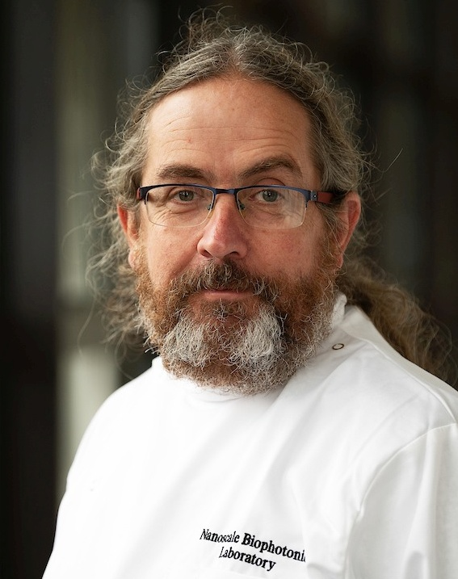


Process Analytical Technology Tools for Real-Time Physical and Chemical Characterization of Nanosuspensions
https://pat4nano.com
Prof. Alan G. Ryder, Nanoscale Biophotonics Laboratory @ NUIG (Ireland)
€ 5M, start date: May 2020

Slide 3


Light scattering characterization of turbid samples
Convention laser diffraction or DLS: dilute = non-native, non in situ
Time-resolved
(2020 IFPRI webinar)
‘Fancy’ Dynamic Light Scattering (DLS)
3d
Diffusing wave spectroscopy (DWS)
Differential Dynamic Microscopy
(DDM; Soft Matter 18, 1858 (2022)

Slide 4
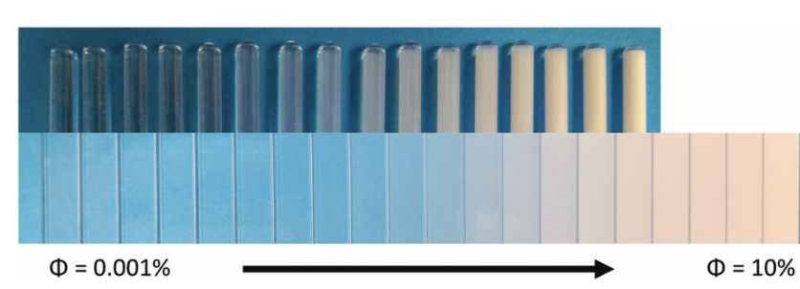
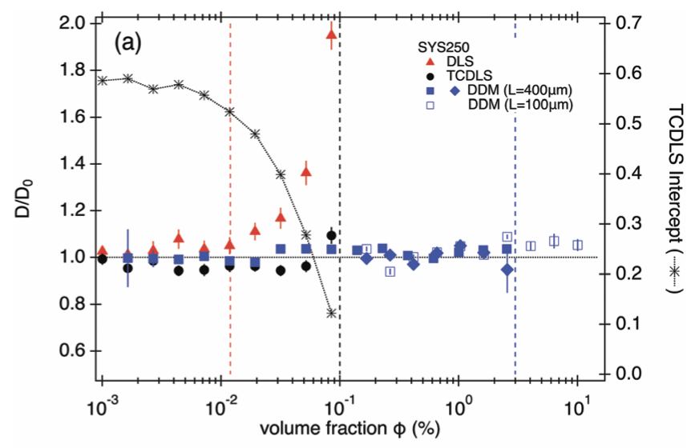


$$φ=0.001\%$$
$$φ=1.6 \%$$
4 mm tube
250 nm PS
@
@ ≈ DWS
*
* ≈ TR-DLS
0.4 mm capillary
210 nm PS
1 %
DLS
D/D₀
TCDLS (≈ 3dDLS)
DDM 0.4 mm
DDM 0.1 mm

Slide 5
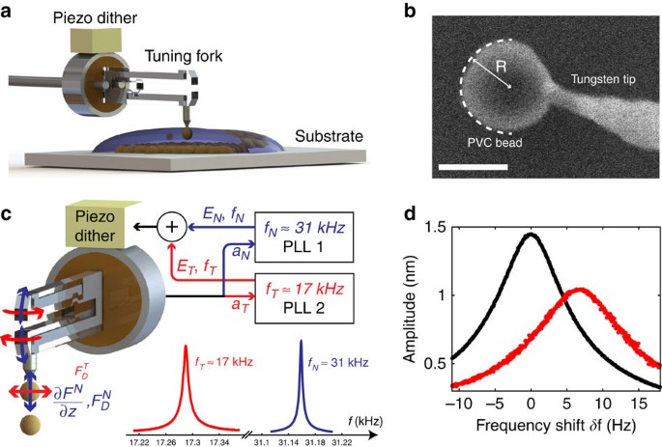
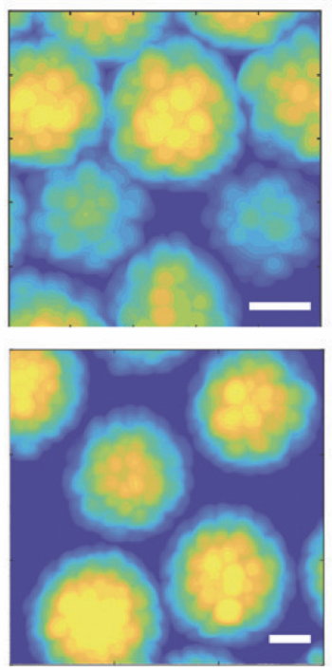
Interactions generated by detailed particle surface features
Roughness, patichiness (e.g. sugar coating), …
Conventional AFM
Tuning-fork AFM
Lucio Isa group,
Soft Matter, 15, 7888-7900 (2019)
Annie Colin group, Nat Commun 8, 15633 (2017)

Slide 6

ECIS2022 Satellite Meeting
Tribological effects on rheology of suspensions: Surface forces, contact effects, and chemical modifications (4-5 September)

