Slide 1
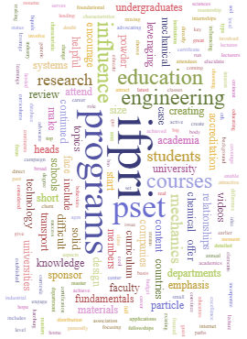
IFPRI Education Update, 2022 AGM
Paul Mort, Purdue University Materials Engineering, Center for Particulate Products and Processes
Agenda
Powder Technology IFPRI Collection
IFPRI Education context
Round Table Review
Native Content
Feedback!

Slide 2
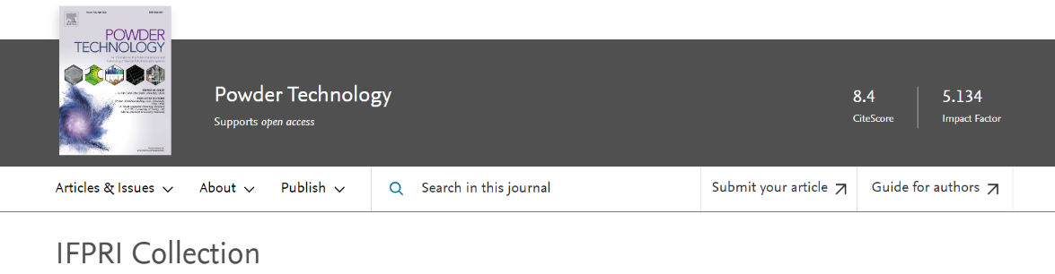




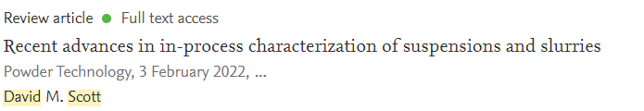
Highlights pre-competitive research, perspectives, and topical reviews that are industrially relevant; Elsevier provides 1 year open access.
In Queue:
W. Hendrickson, “The History of the International Fine Particle Institute; Thoughts on the Challenges and Successes of Particle Processing”
SUBMIT !!!

Slide 3
IFPRI Education Context
Education Workshop (2017, Litster et al)
Ad-hoc discussions
  Michaels, Murtagh, Louge, Bell, Pasha, Jacob, Mort…
AGM 2019 presentation (Murtagh et al):
  Where does PS&E belong?
  Baseline for PS&E in industrial practice
  What can IFPRI do to promote PS&E education?
  Reco: Renew/revise Merrow report
Education Round Table (2021)
  Advocacy (Ninna Jokil, IFPRI Leadership)
  Survey and analysis (Bell, Jacob, Mort)
Native CONTENT:
  UD MEPT notes (Michaels, Diemer et al)
  Edinburgh courses:
    Practical rheology (Royer)
    Particle technology (Sun, Murtagh)
  Purdue MSE512 modules (Mort)

Slide 4
IFPRI Education (and Advocacy) Discussion
June 23, 2019 (Burlington AGM)
Marty Murtagh, Massih Pasha, Michel Louge, Willie Hendrickson, Jim Michaels, Paul Mort, Tim Bell
Curriculum
Offer small “inducement grants” to prepare and teach particle technology subjects.
  Recipients would report to IFPRI on results
  IFPRI would critique and endorse favored outcomes
Discuss forward-looking vs. current industrial needs in education
  Faculty and some/most students would be most motivated by future needs (additive mfg, drug development, etc)
  Industry may favor training in existing technologies and problems, which is where the money is most obvious.
Short Courses
Identify gaps amongst existing short course offerings:
  Content
  Instruction technique (lecture vs. demo vs. lab)
  Venue – hotel, university, industrial (Aveka, etc)
  Instructor skills and reputation
Motivations for IFPRI
  Courses would serve as IFPRI recruiting tool and member benefit.
  Leverage/expand existing PT programs (Delaware, Purdue…)
  Program might be self-funded via tuition
Distance Learning
Distance learning programs can be profitable for universities and lower cost for students
Distance learning program structures are evolving rapidly and growing quickly
Potential to reach industrialists as part-time students
IFPRI could endorse a program structured with our input.
Advocacy and Outreach
Strong interest in updating of Rand/Merrow report
  Scope must be broader than original
  May need multiple authors
  Outcomes must include numbers (percentages, dollars) that can be cited by others
  Consider business school instead of engineering?
Case study approach, e.g., iron ore beneficiation and granulation

Slide 5
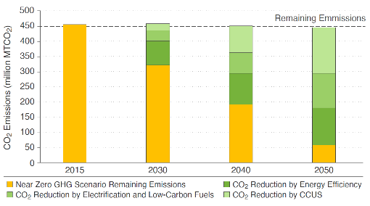
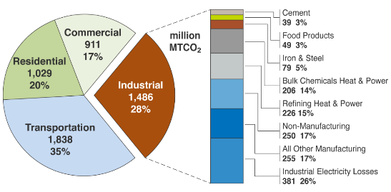
US DOE call: Clean Energy Manufacturing Institute
CO₂ emissions (million MT/year) reduction across decarbonization pillars:
Efficiency,
Electrification & Low Carbon Fuels & Feedstock,
Carbon Capture, Utilization & Storage
AMO Industrial Decarbonization Roadmap, under review.
Workforce of the Future:
Anticipates shift away from carbon-based economy.
What new skills are needed in the workforce of the future?
  Undergraduate, community & technical school students,
  Continuing education to help workers earn and retain professional certifications,
  Define career pathways and resources for education-to-work (entry-level pipeline), currently employed (upskilling), and dislocated (unemployed).
U.S. energy-related CO₂ emissions (million MT) by economic sector and a breakout by industrial subsector in 2015.
Particle Science, Engineering & Technology
DE-FOA-0002564: Request for Information on Establishing a New Manufacturing Institute, July 2021

Slide 6
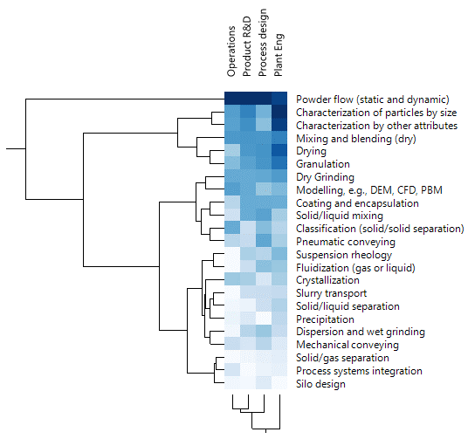

Industry Priorities for Education in Particle Science, Engineering & Technology (PSET)
Audience
2021 IFPRI Round Table; 2-way cluster analysis of survey responses (N=24) from IFPRI industrial members:
Powder Flow cited as the top priority
Characterization, Mixing, Granulation, Drying and Milling are high priorities.
Preferred mode of delivery:
Pre-recorded modules:
  < 30 min
  < 1 hour
Distance learning (zoom, webex, etc)
Priority for training:*
*Focus on continuing education, i.e., training within industry
Notes:
The Merrow report was published 35 years ago.
One week ago, we held a round table discussion among the IFPRI members where we considered and discussed Industry Priorities for Education in Particle Science, Engineering & Technology. The discussion focused on the results of a member’s survey, in which companies were asked to assign priorities for educational training among target groups such as plant operations, R&D, process design, and plant engineering. In the cluster plot, darker blue means higher interest. Powder Flow cited as the top priority. It remains a foundational topic for powder processing. Mixing, Granulation, and Milling are also very high priorities.
^
In fact, it means that this session is very important for industry!
^
In this talk, I will fill in a couple of the other hot topic areas: characterization and modeling.

Slide 7

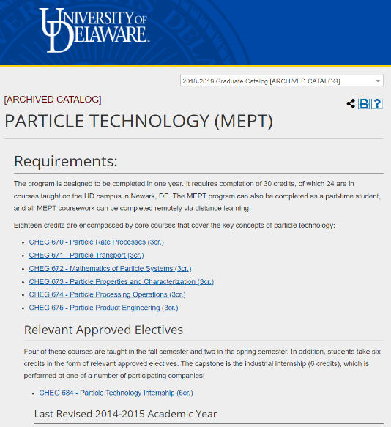

Native content
Particulate | MSE512 Powder Processing
 | Making particles | Making products
Particulate = finely-divided solid Colloid Powder Granule Dry flow (powder, granules) Suspension rheology (colloid, fine particles) | Production from raw material (ore, gas, oil…) Extraction Refining Synthesis Crystallization/ precipitation: Growth Aggregation Comminution, size reduction Granulation: Roll-compaction Mixer Fluid bed Spray drying | A mixture of particles Dry granular mixture Fine powder or colloidal dispersion Making a useful shape with controlled composition & structure (micro, meso) Shape, composition (macro) Properties (micro, meso) Particle Local ensemble, “fabric” Particles used in processing: Catalysis (packed or fluid bed) Peening (surface treatment)
Characterization | Systems integration: flowsheet modeling, control, optimization

Slide 8
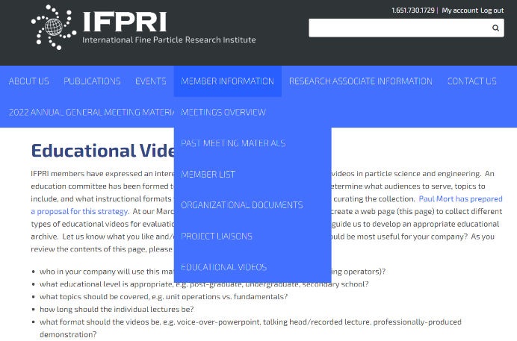
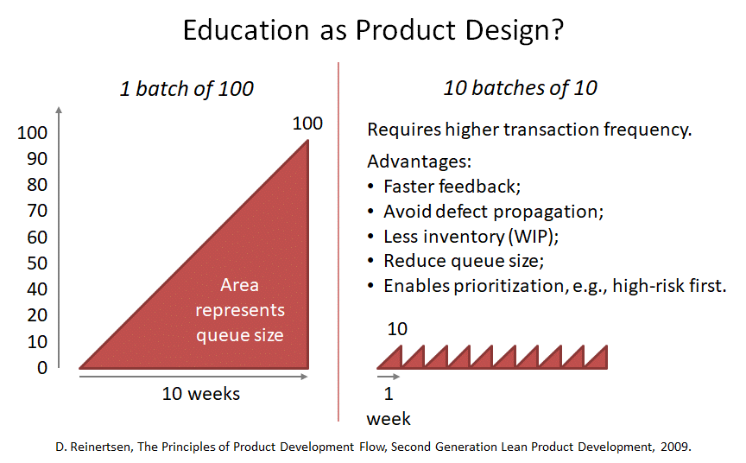
Feedback!
Opportunity to refine production of content.
A PhD student in Education doing concurrent Masters in MSE is available at Purdue.
Narrated video (module priority)
Knowledge check
Data analysis tools
…
What else?

