Slide 1
“Prediction of the Effect of Solvents and Impurities/Additives on Crystal Shape and Growth Kinetics” ADDICT Advanced Design and Development of Industrial Crystallization Technology
Michael Doherty
UCSB Chemical Engineering
10 January 2019
Additional notes by John Hone

Slide 2
Abstract
“The goal of this research is to develop a practical engineering tool
for predicting the relative growth rates (growth kinetics) and
morphology of solution-grown faceted crystals, including the effects
of solvent (Phase 1 of the research), and impurities/ additives (Phase 2).”
Solvent model exists and validated → now needs incorporation into ADDICT code.
Supersaturation model exists, needs validation then incorporation into ADDICT code.
Impurity model exists (validated on 2 case studies)
deficient at high density facet coverages and needs improvement for some lower coverage scenarios. In the IFPRI 2019 work plan.

Slide 3
The Team
Mike Doherty, PI – manage and oversee project
Dr. Yongsheng Zhao, postdoc – solvent effects & ADDICT growth rate engine
Steven Landis, Computer Science undergraduate – in charge of software and chief software developer
Toby Mazal – newly recruited doctoral student – impurity effects
(Toby was a top undergraduate in ChE from the University of Delaware. He joined
UCSB in September, 2018 as a first year doctoral student and comes with a partial
Fellowship that combined with IFPRI funds will provide him with a full doctoral stipend)

Slide 4
ADDICT executes a multiscale mechanistic framework
Models at each scale feed info back and forth
Face growth rates
Crystal Shape
Spiral rotation times
~ mm³
Crystal Face
Step velocities
~ mm²
What faces?
Spiral /
2D Nuclei
Kink densities
~ μm²
Net incorporation
rates
What mechanisms?
Crystal Step
~100s nm
What step edges?
Kink Site
~ nm
Kink Attachment / Detachment event
What step surface structures?
What kink cycles?

Slide 5
ADDICT is a shape prediction tool
Computational screening can target experiments
Inputs
Crystallography +
Growth conditions
- Solvent & Impurity
- Supersaturation
- Temperature
ADDICT
Question:
How can we engineer the morphology by changing growth conditions?
ADDICT:
Fast computational screening + mechanistic insight into modifications can aid selection of growth conditions
Interpret crystal
Describe growth units
Energetic calculations
Organize interactions
Mechanistic models
Spiral growth
Crystal shape
Lattice energy
Spiral & 2D nucleation and growth shapes
Mechanistic info (faces, steps, kinks etc.)
Morphology map
Outputs

Slide 6
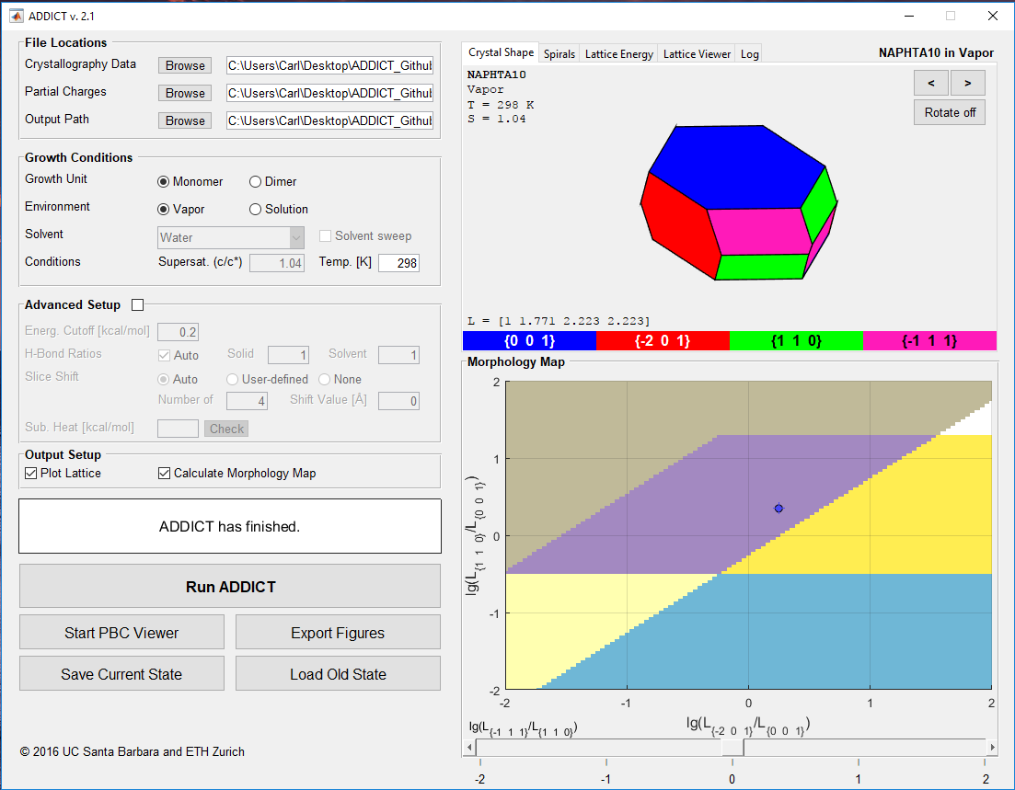
Then use solvent sweep to shortlist solvents
Investigate shortlisted solvents experimentally
Crystallography
Specific polymorph
Pure organic molecule
Future: cocrystals/ solvates, organic salts
Output = predicted morphology
Growth conditions
47 solvents
Supersaturation
Temperature
Morphology map plots results of solvent sweep
Plot of 2nd vs. 3rd slowest growing face families relative to the slowest growing face family

Slide 7
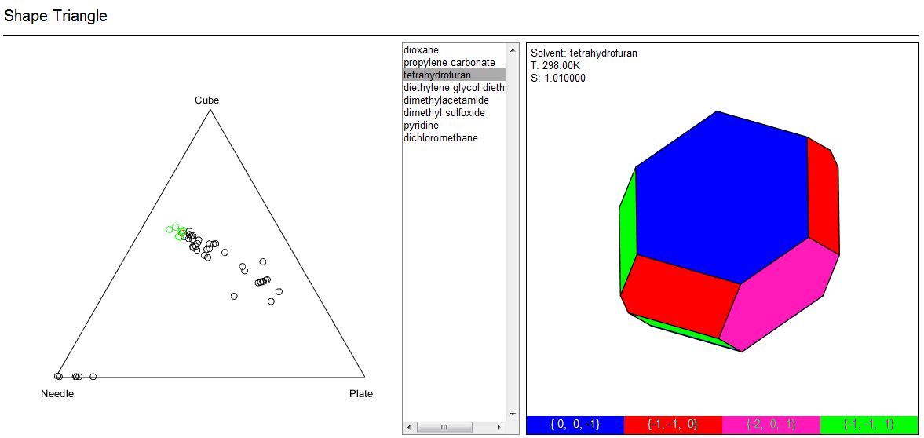
Shape Triangle
Organizes crystals by shape
Each circle is a crystal
Each vertex of the triangle is some ideal shape (Needle, Plate, Cube)
Quickly find growth conditions for specific shapes
Predicted morphology placed in a bounding cuboid; l, w, h analysed

Slide 8
Next Steps For 2019
Test ADDICT for complex crystalline solutes (Z’ = 2 or greater)
Test for supersaturation-dependent shapes
Develop morphology models that incorporate impurity effects
Sensitivity analysis
Create detailed output and log files (shapes of spirals & 2D nuclei, …)

Slide 9
JH Notes
Effect | Initial Model | Final Model | Validation | Coded in ADDICT
Temperature | ü | ü | ü | ü
Solvent | ü | ü | ü | 2019
Supersaturation | ü | ü | 2019 | 2019
Impurities (IFPRI) | ü | 2019 | 2020 | 2020

