Slide 1



Flowability Assessment of Weakly Consolidated Powders
Colin Hare, Ali Hassanpour, Azza Aly-Mahmoud
June 2020
Supervisors
Dr Colin Hare
Prof Chaun-Yu Wu
Dr Ali Hassanpour

Slide 2
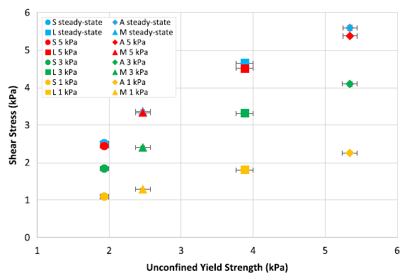
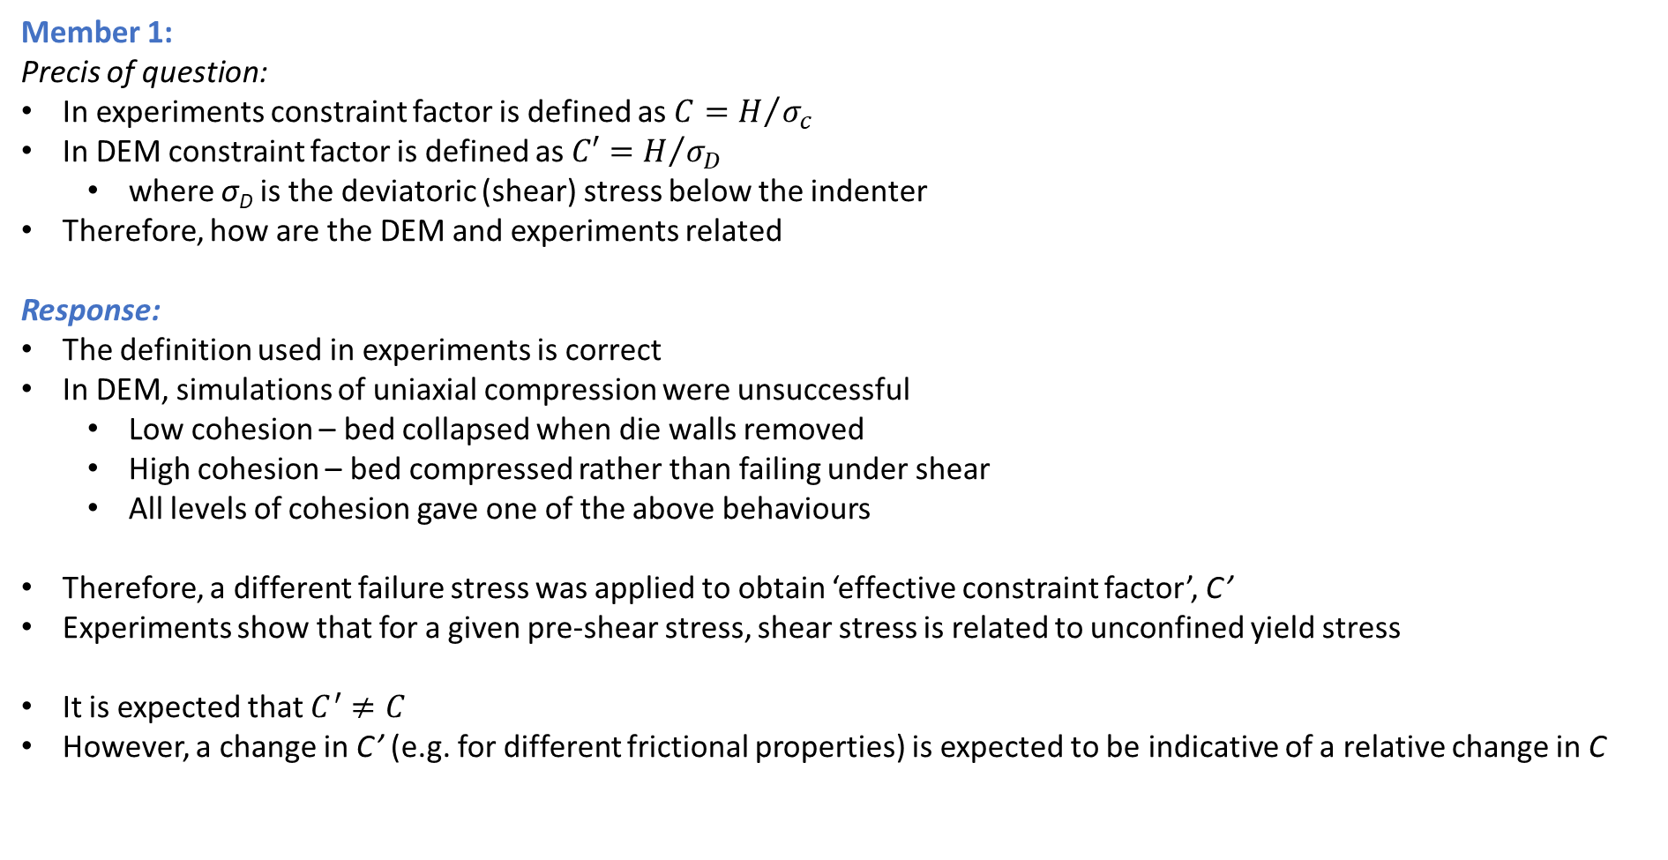
Responses to IFPRI member questions
Member 1:
Precis of question:
In experiments constraint factor is defined as $C=H/{σ_{c}}$
In DEM constraint factor is defined as $C′=H/{σ_{D}}$
  where σ_{D} is the deviatoric (shear) stress below the indenter
Therefore, how are the DEM and experiments related
Response:
The definition used in experiments is correct
In DEM, simulations of uniaxial compression were unsuccessful
  Low cohesion – bed collapsed when die walls removed
  High cohesion – bed compressed rather than failing under shear
  All levels of cohesion gave one of the above behaviours
Therefore, a different failure stress was applied to obtain ‘effective constraint factor’, C’
Experiments show that for a given pre-shear stress, shear stress is related to unconfined yield stress
It is expected that $C^{′}≠C$
However, a change in C’ (e.g. for different frictional properties) is expected to be indicative of a relative change in C
From: Stavrou et al. (2020)
https://doi.org/10.1016/j.ces.2019.115307

Slide 3
Responses to IFPRI member questions
Member 2:
Does powder compressibility have an influence on penetration depth or is preconditioning and pre-shearing enough to eliminate this influence even at low stresses?
Have you considered to look for time dependencies – does it matter when the measurement is done after preconsitioning and pre-shearing?
Have all the measurements been done at controlled humidity? If so, at which level og humidity?, If not, have the humidity been recorded?
How many repeats are you normally doing?
Response:
Penetration depth is controlled, during indentation the bed should be sheared but not consolidated
  The stable penetration depth range does vary with material
  It is not known whether compressibility influences this
Delay in flow testing means the material may respond to the environment, e.g. moisture pick-up/loss
  This may change surface properties and/or packing state, so is not indicative of the consolidation state
  Investigating this is out of scope
Humidity has not been controlled but has been measured.
  The range is 30 – 65 %RH, typically 35 – 55 %RH
Typically 3 repeats for shear cell tests, 5 repeats for ball indentation

Slide 4
Future Work

Slide 5

Part 1: Accuracy of flow measurement techniques
Flowability measurement techniques
Uniaxial compression
Shear cell
Ball indentation
σ_{c} at low to high stresses
σ_{c} at high stresses
Hardness tests at high stress
Reproducible
Infer σ_{c} at low stresses
Reproducible
Hopper flow testing
Future work:
Fabricate two separate hoppers with the determined outlet sizes (25 and 10 cm for SC and BI, respectively) – for testing Titania DT51
Or
Fabricate one hopper with a good inclination (hopper angle) allowing different outlet sizes to be tested.

Slide 6
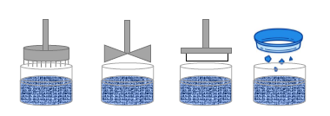
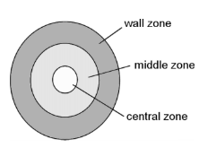
Part 2: Ball indentation conditions and bed packing
Ball Indentation technique
Using sieve-filling method
Bed preparation
Indentation conditions
Indentation conditions influence on C and on the inferred σ_{c}
Penetration depth (% of indenter radius)
  Identifying stable hardness range, if it exists
  Applying two different depths (20, and 50%)
Indentation position (central, radial)
Indenter size (4, 6, and 10 mm indenter diameters)
Findings:
Stable hardness range is not always found
Bed hardness in centre is always greater than at radial position
Larger indenter size provides more reliable hardness measurements
Future work:
Complete the required measurements for the study
X-Ray tomography for two materials (ff_{c} ~ 1-2, 4)
  Packing state before and after compression
  Indentation zone after indentation
  Indentation zone at different penetration depths (20, 50%)
  Indentation zone at 0 and 1 kPa
Pre-shearing
Blade conditioning
Wire conditioning
Sieve-filling
Reproducible

Slide 7
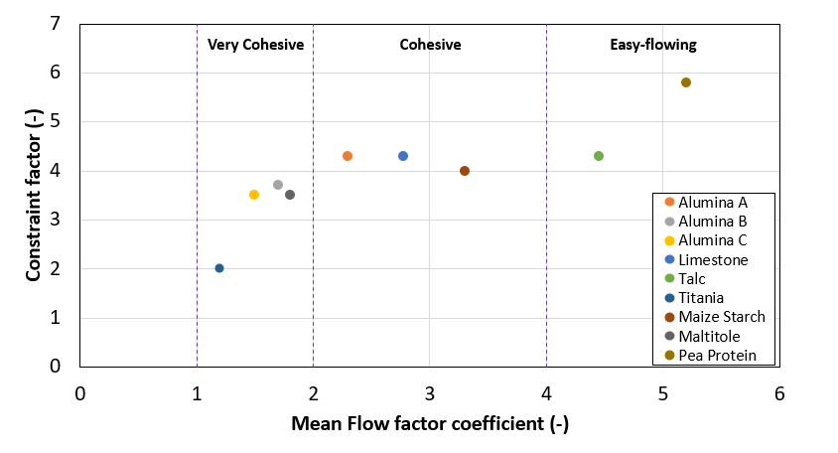
Part 3: Constrain factor correlations
Future work:
Correlating C to flow behaviour determined by uniaxial compression tests
Investigating correlations for C against loose & compressed bulk density and compressibility
Investigate wider range of materials
  Including Titania A1, Limestone, and Talc at same penetration depth (50%, previously 20%)
FF_{c} data Alumina B & C: at σ_{pre} of 8, 10, 12 & 14 kPa
FF_{c} data for all other materials : at σ_{pre} of 2, 4, 6 & 8kPa

Slide 8
Future experimental work - summary
Accuracy of techniques - Hopper flow testing:
Fabricate two separate hoppers with the determined outlet sizes (25 and 10 cm for SC and BI, respectively)
Or
Fabricate one hopper with a good inclination (hopper angle) allowing different outlet sizes to be tested
Constraint factor correlations:
Correlating C to flow behaviour determined by uniaxial compression tests
Investigating the influence of materials loosely bulk density and compressibility on the determined C
Investigate wider range of materials
  Applying Uniaxial, BI and SC
  Repeating indentation tests for the previously tested materials (Titania A1, Limestone and Talc) but at 50% dimensionless penetration depth
Ball indentation – indentation conditions and bed packing:
Complete the required measurements for the study (repeats)
X-Ray tomography for one or two materials
  Packing state of sieved loosely and compressed packed beds
  Indentation zone after indentation
  Indentation zone at different penetration depths (20, 50%)
  Indentation zone at 0 and 1 kPa

