Slide 1
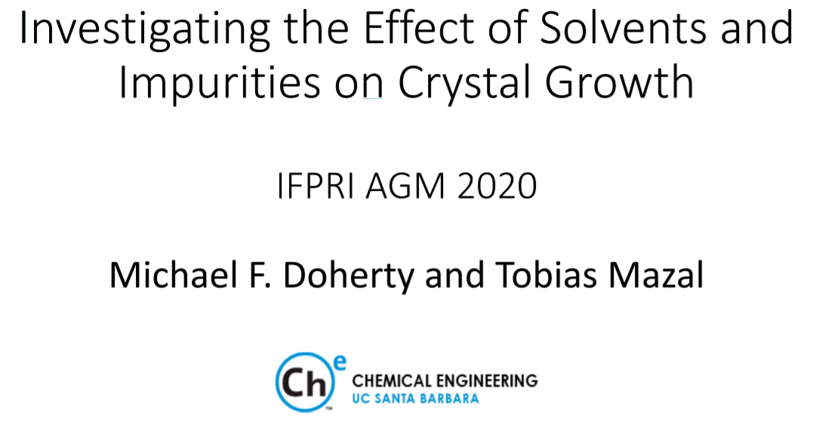

Slide 2
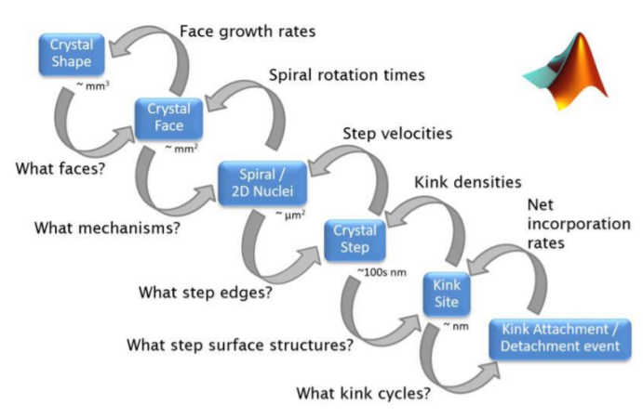
Before getting technical…
Is the model (ADDICT) available for industrial members? If so – how?
ANSWER: We are currently debugging the latest version, ADDICT 3.11. I am hoping that we can distribute it later this year.
I have a proposal for IFPRI members to consider. Once we have finished developing a really robust version of ADDICT 3.11 we can make a distribution and follow up with a live webinar on getting started and using ADDICT as part of your work flow.

Slide 3
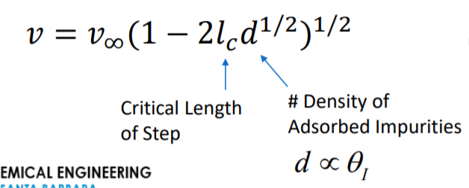
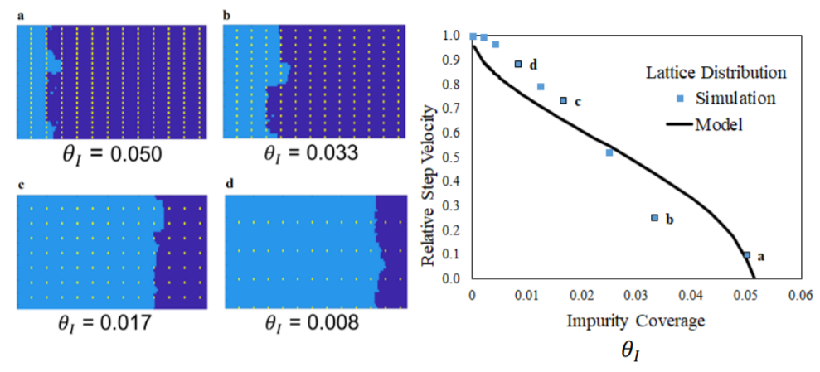
Testing Step Pinning Theory of Cabrera & Vermilyea with Kinetic Monte Carlo Simulations
Good agreement with regular impurity spacing

Slide 4
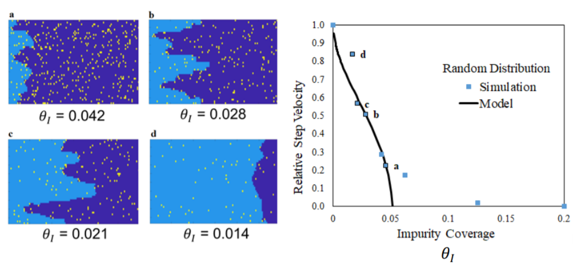
Testing Step Pinning Theory of Cabrera & Vermilyea with Kinetic Monte Carlo Simulations
Discrepancy with random impurity spacing at high impurity levels on terrace – checking the error

Slide 5
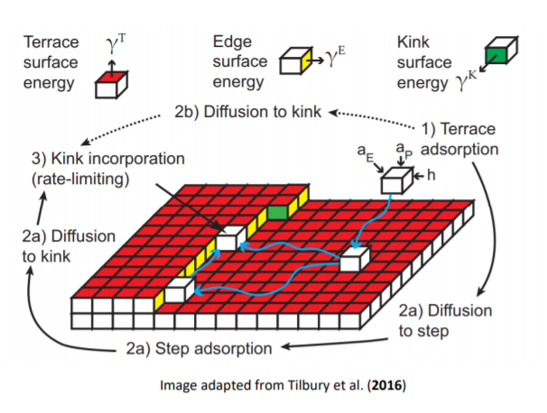
1. How does the model determine the bond energy between the surface and molecule? Is it calculated specifically for each system and face or different bond energies are used to create a map?
ANSWER: We calculate the kink, edge, and terrace energies (between growth unit (GU) and crystal surface) directly from the solid-state force field model (e.g., Amber-GAFF). They are calculated separately for every GU at every kink site, edge site and terrace site at every edge, on every face.

Slide 6
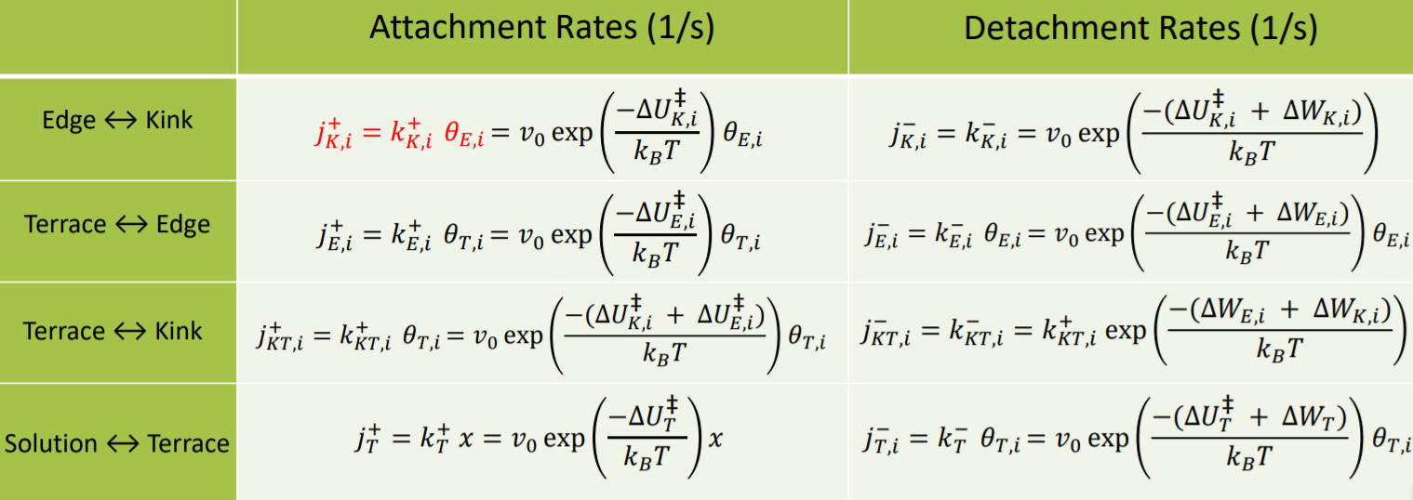
How are the ΔU and ΔW calculated (slide 10, attachment/detachment rate expressions)?
ANSWER: ΔW is calculated as in the previous answer, from the force field. ΔU is primarily determined by the nature of the solvent (desolvation energy) and is believed to be approximately the same at every site. Therefore, it cancels from the relative growth rates – which are the ones that matter for morphology modeling.

Slide 7
Is Addict using forcefield, DFT or COSMOtherm model?
ANSWER: Force field. For solution-grown crystals the kink energies need to be modified to account for solvent interactions, and this is where COSMO or another solution-solid interface model is needed.
Does the model consider only the growth of a step on a face? How are new steps created?
ANSWER: Yes, the growth models are driven by the growth rate of steps, appropriately embedded into a spiral growth or 2D nucleation & growth mechanism. The steps are created by either screw dislocations (spiral growth) or 2D surface nuclei.

Slide 8
How does the Kinetic Monte Carlo model incorporate the critical length of a step (l_{c}).
ANSWER: The KMC model has absolutely no knowledge of critical length – it is not part of the simulation method in any way. KMC only knows about attachment and detachment of growth units at surface sites. This is also true of experiments – an experiment only knows about attachment and detachment of growth units at surface sites. Only the mechanistic models, such as Cabrera & Vermilyea, use such concepts as critical length. We are using KMC simulation to test the mechanistic models for the very reason that it does not know about critical length, etc. You can think of KMC simulations as a “highly controlled experiment.”

