Slide 1
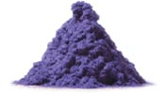

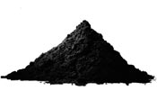

International Fine Particle Research Institute
Methods and Specifications for Particle Properties
At Schenck Process we need to evaluate particle properties to design and configure our systems to achieve customer requirements.
Some properties are important regardless of the process or technology such as Bulk Density, Slide Angle, Moisture Level, Explosibility, Flow Characteristics, etc.
Different processes / technologies require more detailed knowledge of the material properties:
Pneumatic Conveying and Filtration require consideration of Particle Size Distribution (PSD), Abrasiveness, Friability, Horizontal & Vertical Velocities
Milling requires information about the size of the feed material, the required PSD of the milled product to determine the optimal milling solution
We rely on customer datasheets and specifications as well as internal testing/PSD Analysis when designing a process.

Slide 2
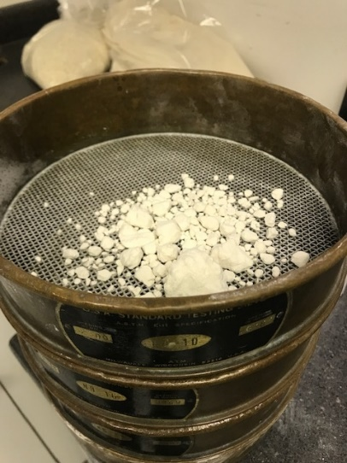
International Fine Particle Research Institute
Methods and Specifications for Particle Properties
In the Milling, Sifting and Mixing lab, when analyzing materials, the same characteristics listed earlier need to be known, however there is an added emphasis on the materials‘ PSD:
The processes include reducing particle sizes (mills), separating dissimilar size particles into two (2) or more fractions (sifters & screeners) and blending materials to produce homogeneous, non-segregating mixes.
Although conventional analytical techniques are still used where appropriate to determine the % of coarse agglomerated product in a client‘s material (e.g., below sieve pans)
More often today, finer particle size analyses is required employing Laser Defraction techniques (e.g. Malvern, Microtrac particle size analyser)

Slide 3
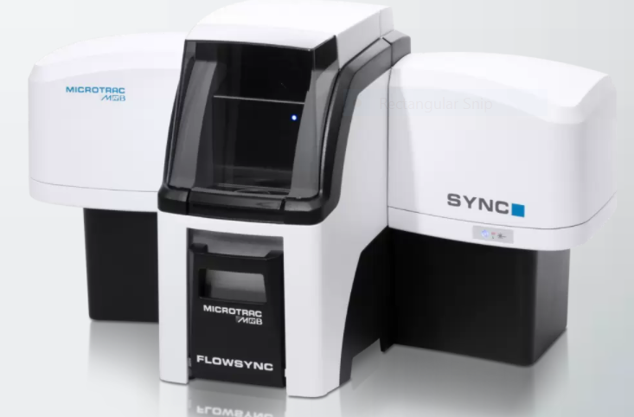
International Fine Particle Research Institute
Methods and Specifications for Particle Properties
Shown above is the latest analytical equipment at Schenck‘s Bristol Lab, the compact Microtrac Sync which facilitates:
Laser Diffraction Measurement ranges from 0.24-2,000 µm (dry materials only)
Dry imaging module range of 4.6-2,000 µm
Powerful digital/graphical reporting that integrates particle size and shape data

Slide 4
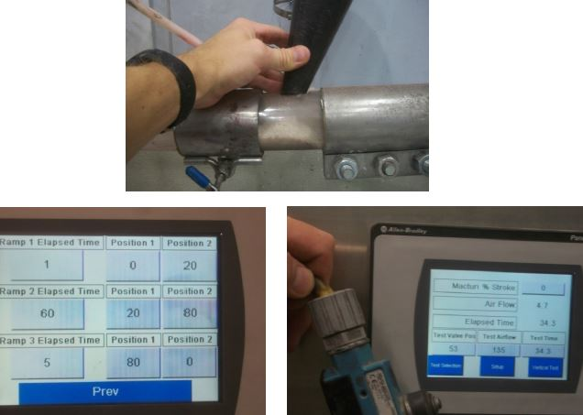
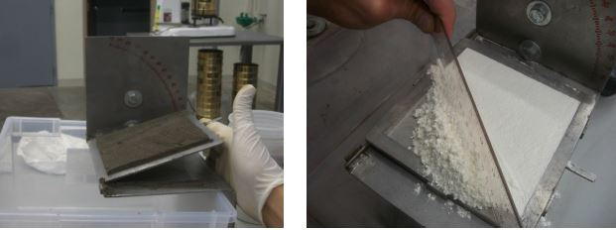
International Fine Particle Research Institute
Methods and Specifications for Particle Properties
In our Pneumatic & Filtration Test Lab we have custom test rigs to find the material information that is usually not in specifications:
Horizontal Velocity Slide Angle
While performing these tests we follow the same procedures from test to test and take at least three measurements to improve the accuracy of the data.

