Slide 1
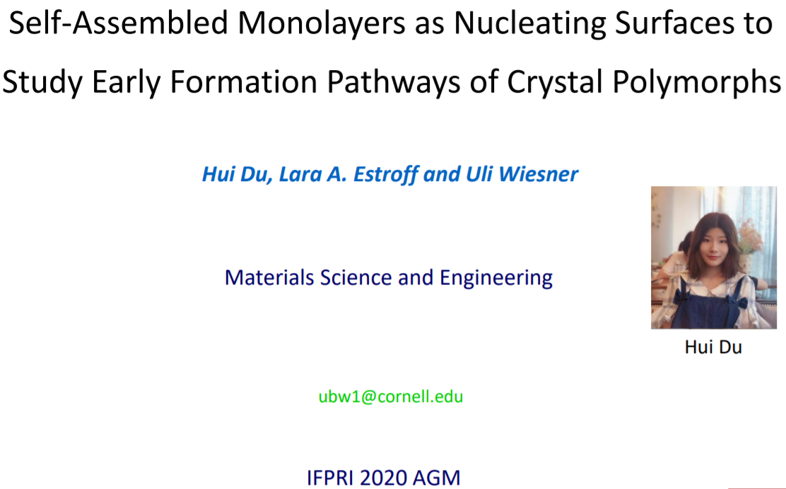

Slide 2
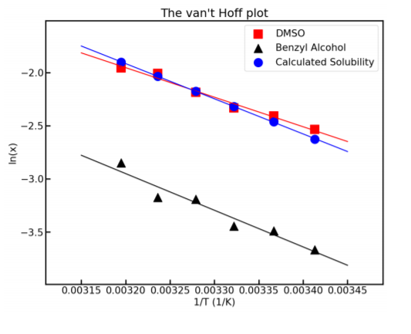
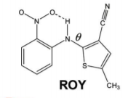
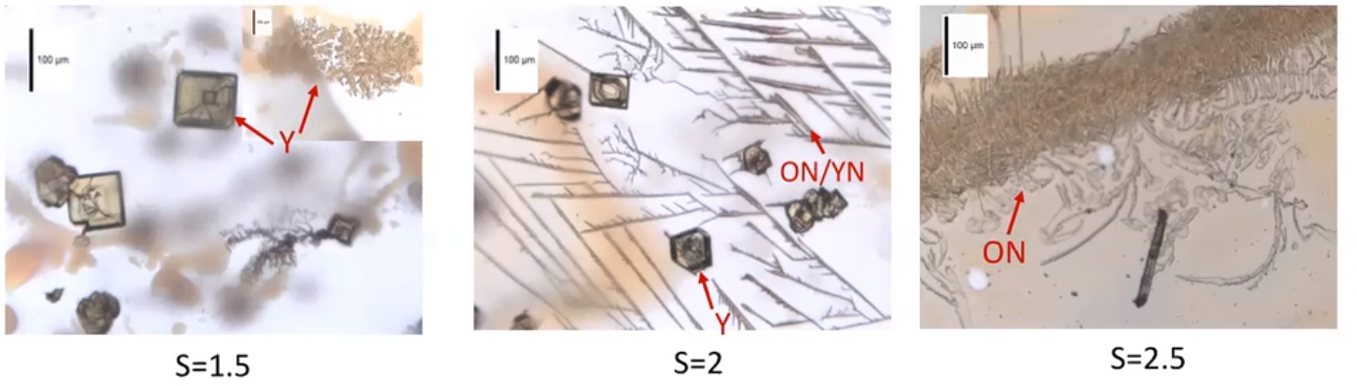
Switch to ROY (9 forms) and Supersaturation Control
Solubility measured for supersaturation knowledge & control
CCDC: QAXMEHxx
Multiple forms seen on glass slides from benzyl alcohol

Slide 3
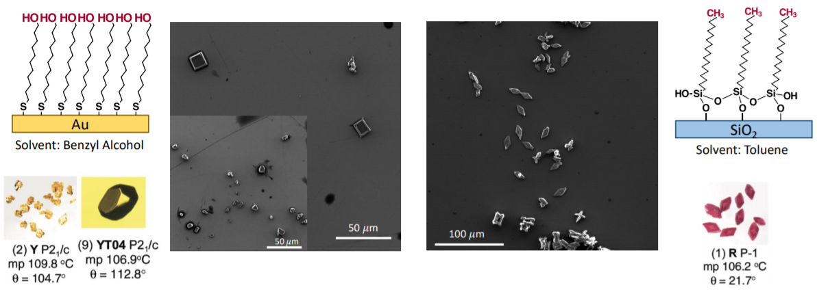
SAMs
No crystals seen on –CH₃ SAM in benzyl alcohol

Slide 4
Comment 1:
Would be interested in seeing more surface characterization SAM (i.e maybe contact angle or hydrophobicity, or AFM for surface feature)
At the very beginning of this IFPRI project, we checked whether our SAMs are high quality by reproducing earlier results of how specific SAMs lead to nucleation and growth of inorganic crystals with particular orientations. In particular, we showed that calcite (CaCO₃) crystallized on –COOH terminated SAMs is oriented along the (012) facet, exactly how is has been described in the literature (JACS 129 (2007), 5480). But we can certainly generate some additional AFM images to further demonstrate our SAM quality.

Slide 5
Comment 2:
How easy is it to put different functional group on SAM, that way we can have access to more energy level. I think in the video there were only 4 different Sam, how easy/difficult to make other types
We definitively want to study more different SAMs. As pointed out in the video, the results we got were first proof-of-principle results that we got in just before the Covid-19 pandemic shut all labs down at Cornell. Now that we are reopened again (since last week, at 1/3 of the usual occupancy only, however), we will continue to look at other SAMs and their effects on the polymorph selectivity of ROY. Their preparation is straight forward, so not a major time-limiting step.

Slide 6
I think it would be great to start to link the data to the chemistry. Do you have any plans later to do that, perhaps with MD simulations or similar?
The current continuation plan is to basically get the details straightened out, as discussed/described in the talk. We need to do the x-ray in order to assign the polymorphs and will also do Raman on the samples. Once we have a couple of clear “winners”, my thought was to then try to go the synchrotron again in order to look at the early formation stages, which is what the IPFRI brief really was charging us with. Do you think this is the right way to think about it?
Mike Doherty’s work has clear links here (not so much the IFPRI project) but the work on understanding morphology – if he’s willing you could understand which faces are attached to the surface.
Concerning Mike Doherty: It would indeed be nice to get him to look at this. But for one, maybe that should wait until we have some synchrotron data on early formation stages? Also, I am not sure whether I can talk him into this, as someone needs to pay for the student on his end seriously looking into this. In academia, that is always a bit of a problem…

