Slide 1
Particle and Powder Characterization Tools and Methods

Slide 2
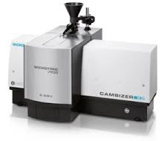
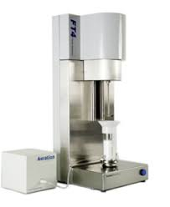
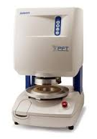
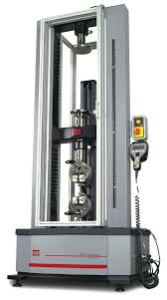
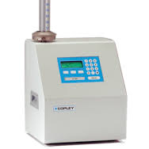
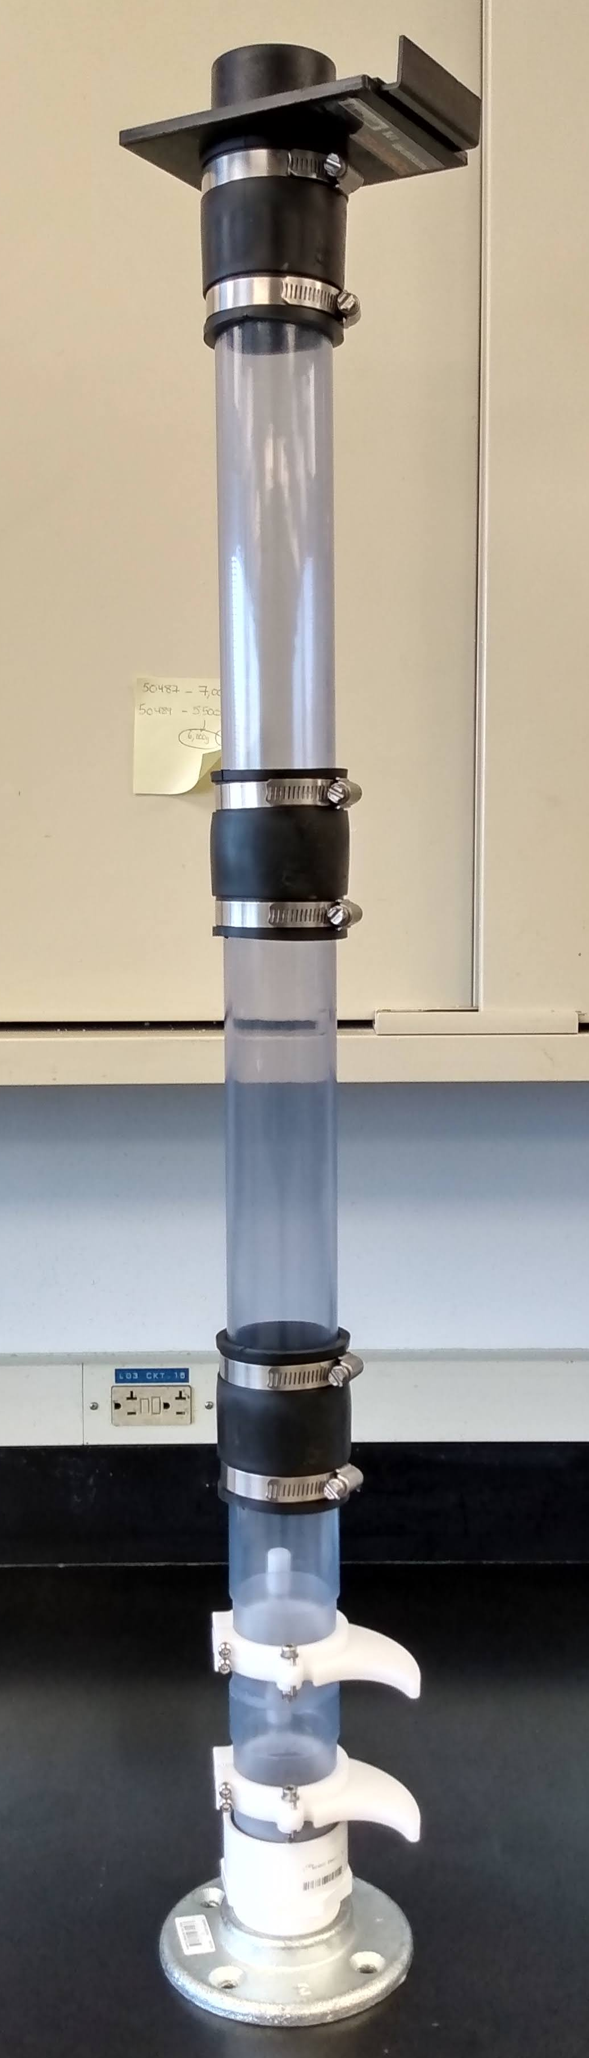
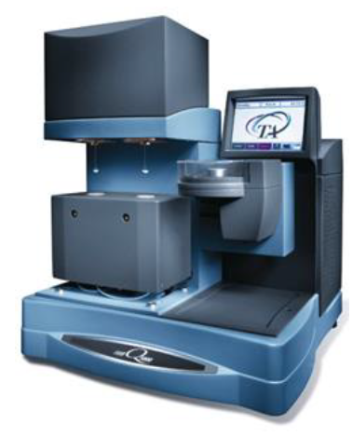
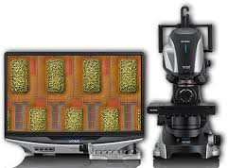
Characterization Tools and Methods
Tools | Characterization Methods
Camsizer X2 | Size, Shape
FT4 Powder Rheometer | Dynamic Powder Flow, Attrition, Conditioned Bulk Density, Permeability, Aeration
Powder Flow Tester | Static Powder Flow, Bulk Density, Compressibility
MTS Force Gauge | True Density, Elasticity, Tensile Strength
Tapped Density Tester | Bulk / Tapped Density Ratios
Segregation Tube | Flow-induced Segregation potential
Vapor Sorption | Moisture uptake
Microscopy | Color, Shape, Structure, Porosity

Slide 3
Processes Affected by Particle/Powder Characteristics
Powder flow
Powder compression (densification)
Powder compaction (solidification)
Powder segregation
Powder handling (dustiness, loss of containment during transfer)
Powder and liquid mixing
Powder/Compact dissolution

