Slide 1

Recent Advances in the Textural Characterization of Porous Materials and Powders – Selected Aspects
Prof. Dr. Matthias Thommes
Institute of Separation Science and Technology
Department of Chemical and Biological Engineering (CBI)
University Erlangen – Nürnberg, Germany

Slide 2

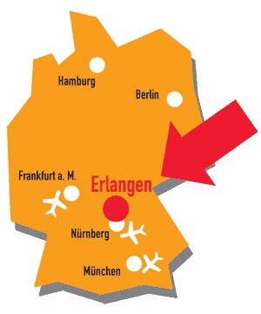
Founded in 1743, the Friedrich-Alexander University Erlangen-Nuremberg is today one of Germany's top comprehensive research universities with approximately 40,000 students.
.

Slide 3

Selected Experimental Techniques
Nanoporous Materials Characterisation
Physical Adsorption (Micro/Mesopore Analysis)
Liquid Intrusion/Mercury Porosimetry (Meso/Macropore Analysis)
Thermoporometry
Scattering Techniques (x-ray and neutron scattering techniques such as SAXS, SANS, XRD)
Spectroscopy (e.g., NMR based techniques)
Microscopy, (e.g.SEM, TEM), Digital Image Analysis etc..
Combining gas adsorption with mercury porosimetry allows to assess a pore size range from ca. 0.3 nm up to > 400 μm!

Slide 4
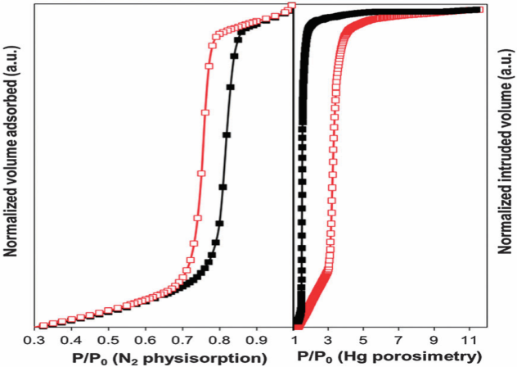
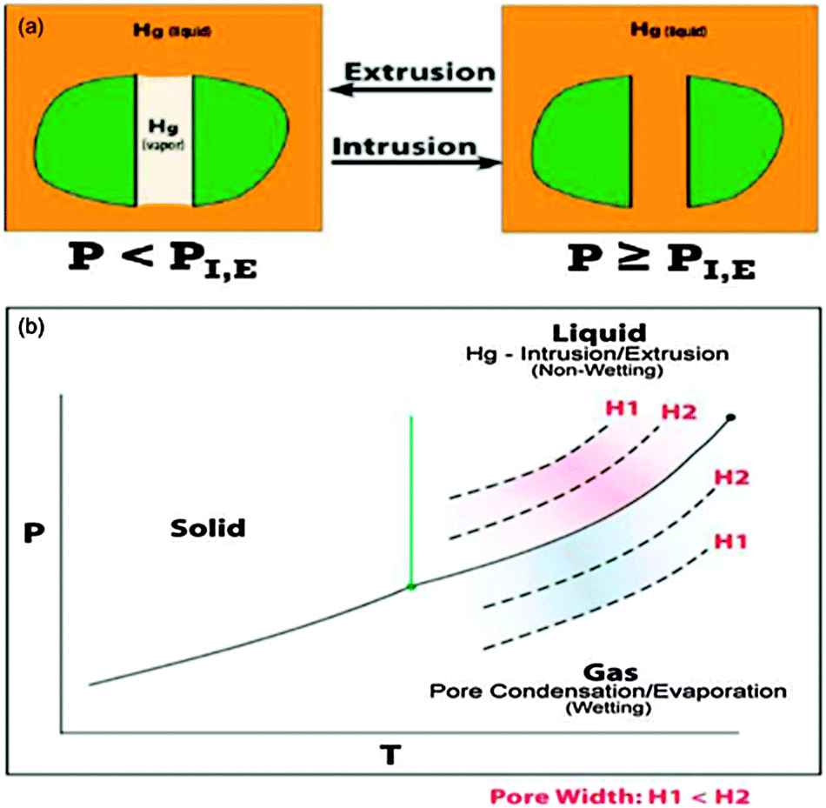
Macropore Analysis:
Analogy between mercury intrusion/extrusion
and gas adsorption (pore condensation/evaporation)
Ads/Des iostherms of N2 and Hg in
ordered mesoporous silica KIT-6
KIT-6 silica
N₂/77K
Hg/293 K)
Wetting
Non-wetting
Mechanism of mercury intrusion/extrusion can be considered thermodynamically equivalent to pore evaporation/condensation in gas adsorption → potential for advancing macropore size/pore network analysis by Hg Poroismetry, i.e. transfer of methodologies such as hysteresis scanning to mercury porosimetry
R. Guillet-Nicolas, K.A. Cychosz, F. Kleitz, M. Thommes, New. J. Chem. 40 (2016) 4251
F. Porcheron, P. Monson, M. Thommes, Langmuir 20 (2004) 64
F. Porcheron, M. Thommes, R. Ahman, P. Monson, Langmuir 23 (2007) 3372.

Slide 5
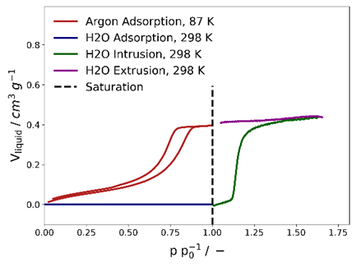
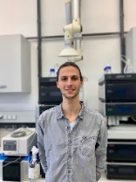
Adsorption isotherms of Argon (87 K) and Water (298 K) into
fully hydrophobized mesoporous silica (pore size: 9.1 nm)
Jakob Söllner
Ar (87K)
H₂0 (296K)
●Water adsorption isotherms obtained from thermodynamic analysis
of water intrusion
H₂0
J. Söllner and M. Thommes, to by published,

Slide 6
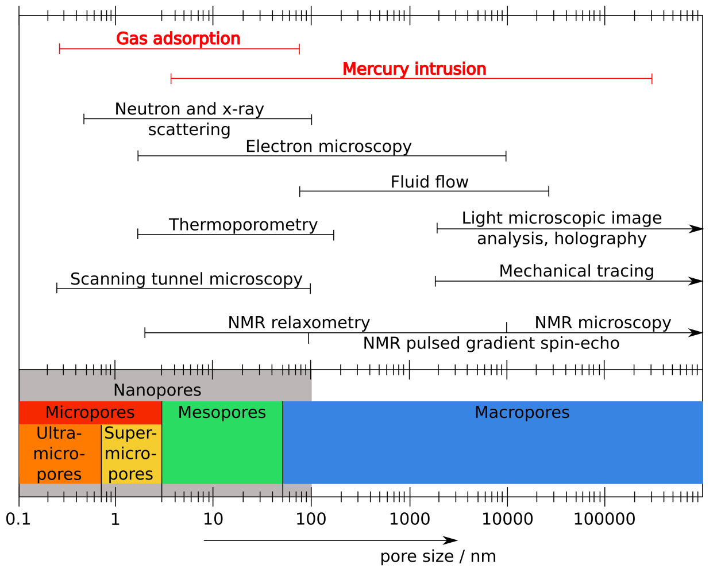
Textural Characterization Techniques
C. Schlumberger, M. Thommes, Advanced Materials Interfaces (2021), 5. 2002181
P. Klobes, K. Meyer, G. Munro, NIST, Gaithersburg, MD 2006, p.960

Slide 7
Characterization of Porous Materials and Powders
● Physical Adsorption – Micro- Mesopore Analysis
- Major progress during the last two decades in understanding
the adsorption and phase behaviour of fluids in pores
● Liquid Intrusion (e.g. Mercury Porosimetry) – Macropore Analysis
- Recent advances in the understanding of phase behavior of
nonwetting fluids under confinement
Some Challenges:
● Assessment of Surface Chemistry: i.e. only possible by combining
complimentary techniques such as adsorption, liquid intrusion,
and spectroscopy
● Textural characterization of materials immersed in liquid phase
- Development of novel methdologies based on:
- NMR Relaxometry
- High frequency conductivity measurements
- Electroacoustics

Slide 8
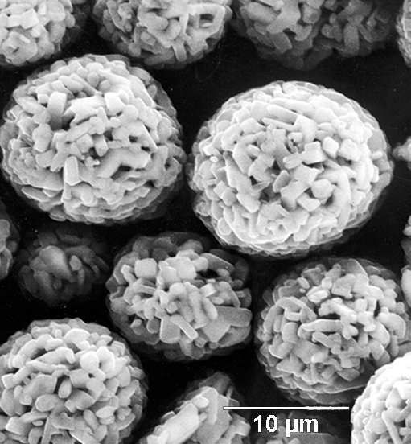
Physical Adsorption Characterization of Nanoporous Materials
Surface Area
Pore Size/Volume Distribution/Porosity
Pore Geometry, Structure of Pore Network
Surface Properties

Slide 9
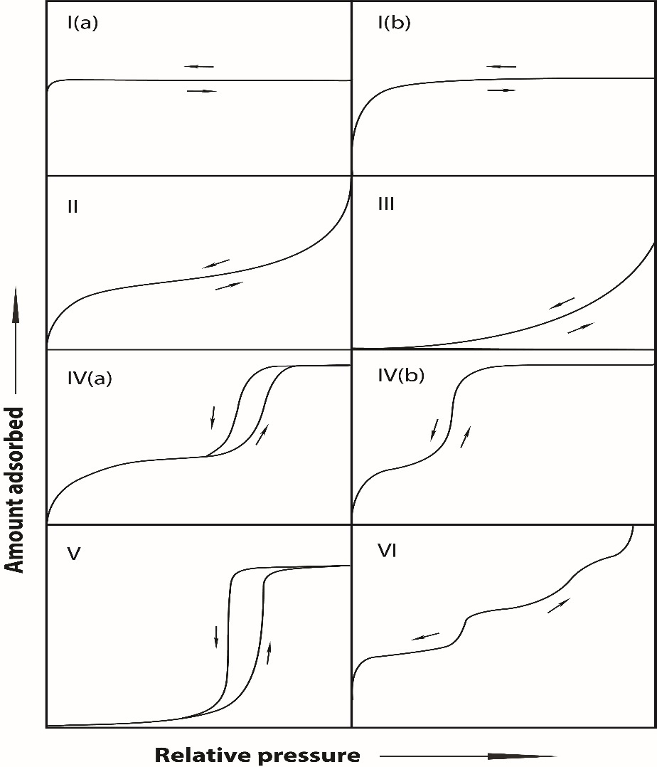
New IUPAC Recommendations (2015) Updated Classification of Physisorption Isotherms
M. Thommes, K. Kaneko, A.V. Neimark, J.P. Olivier, F. Rodriguez-Reinoso J. Rouquerol, K.S.W. Sing, Pure Appl. Chem., 2015, 87, 1051.
New
ultramicropore
supermicropore
Nanopores: pore widths ≤ 100 nm
Within the range of nanopores:
Micropores < 2 nm
Ultramicropore < 0.7 nm
Supermicropore 0.7 – 2nm
Mesopore: 2- 50 nm
Macropores: > 50nm
non-porous, het surf.
non-porous; het.surf
New
mesoporous
mesoporous
,
microporous
or–mesoporous
nonporous-homog.
surface
Classification represents subcritical adsorption isotherms on rigid adsorbents

Slide 10
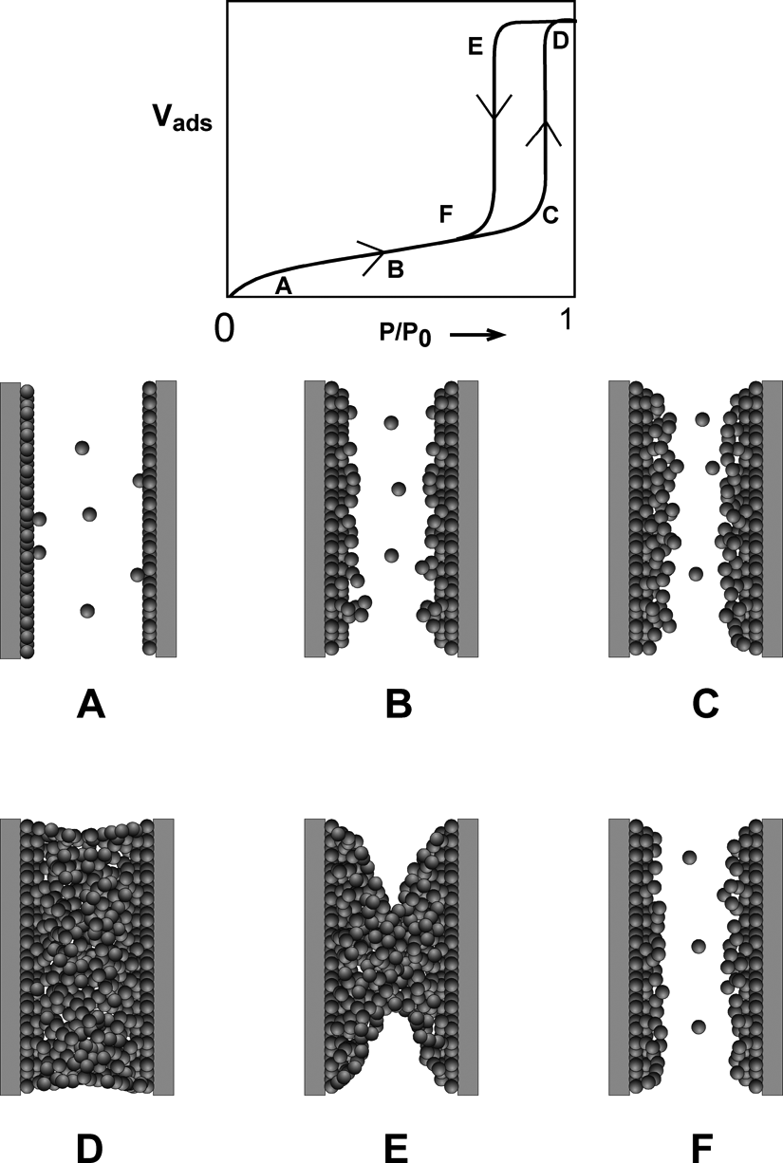

Mesopores (Type IV isotherm): MultilayerAdsorption, Phase Behavior, and Hysteresis
adsorption branch: delayed condensation due to metastable pore fluid
desorption branch: equilibrium
M. Thommes , In: Nanoporous Materials, Science & Engineering
(Lu G.Q. & Zhao X.S., eds), Chapter 11, Imperial College Press, 2004

Slide 11
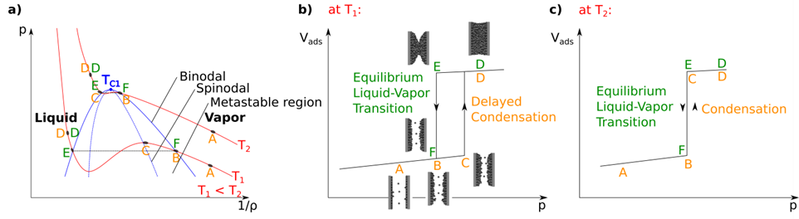
Adsorption and desorption of a fluid in a mesopore
at temperature T₁ and T₂ (T₁ < T₂)
Vapour-Liquid Phase Transition can be understood as homogeneous
nucleation process
C. Schlumberger, M. Thommes, “Characterization of hierarchically ordered porous materials
by physisorption and mercury porosimetry- (invited) A Tutorial Review”,
Advanced Materials Interfaces (2021), 6, 2002181

Slide 12
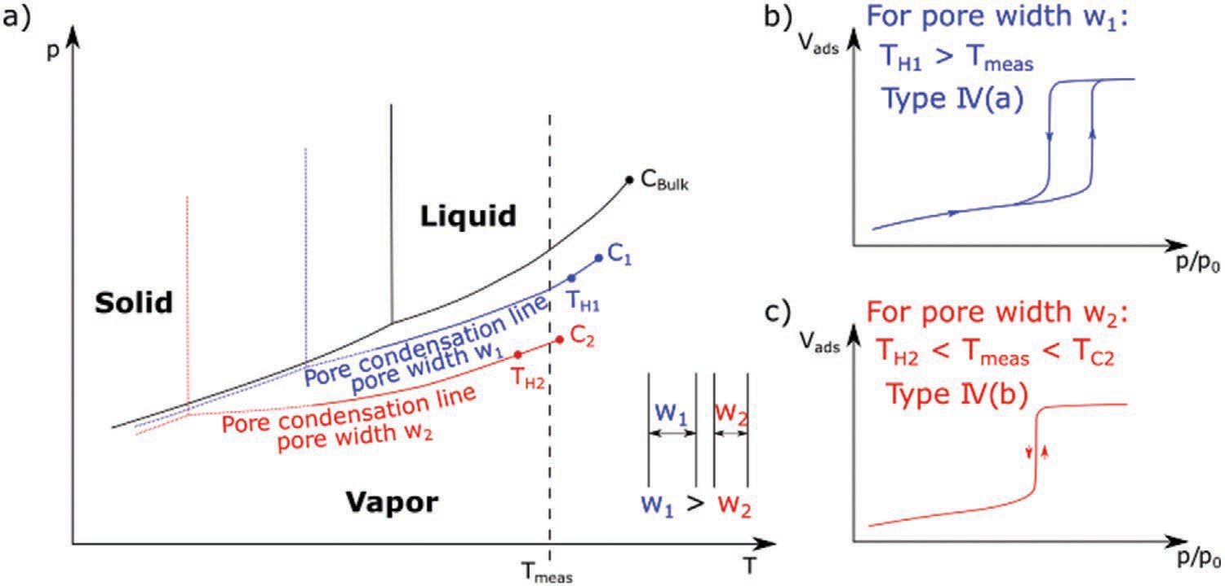
Effect of confinement on pore condensation
and hysteresis
Schematic phase diagram of pore and bulk fluid applicable to fluids such as Ar and N₂
confined in mesoporous oxides and carbons,
M. Thommes, Physical adsorption characterization of ordered and amorphous mesoporous
materials. In Nanoporous Materials: Science and Engineering, vol. Volume 4 of Series on
Chemical Engineering (2004) 317–364;
M. Thommes, C. Schlumberger, Annual Review of Chemical and Biomolecular Engineering (2021) 12, 137

Slide 13
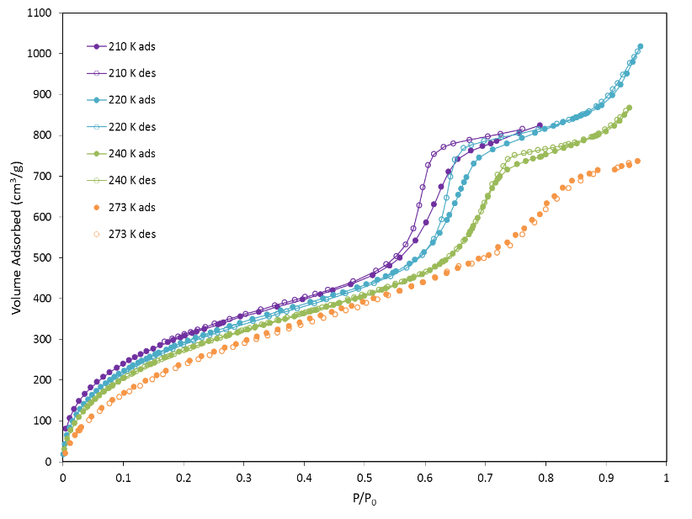
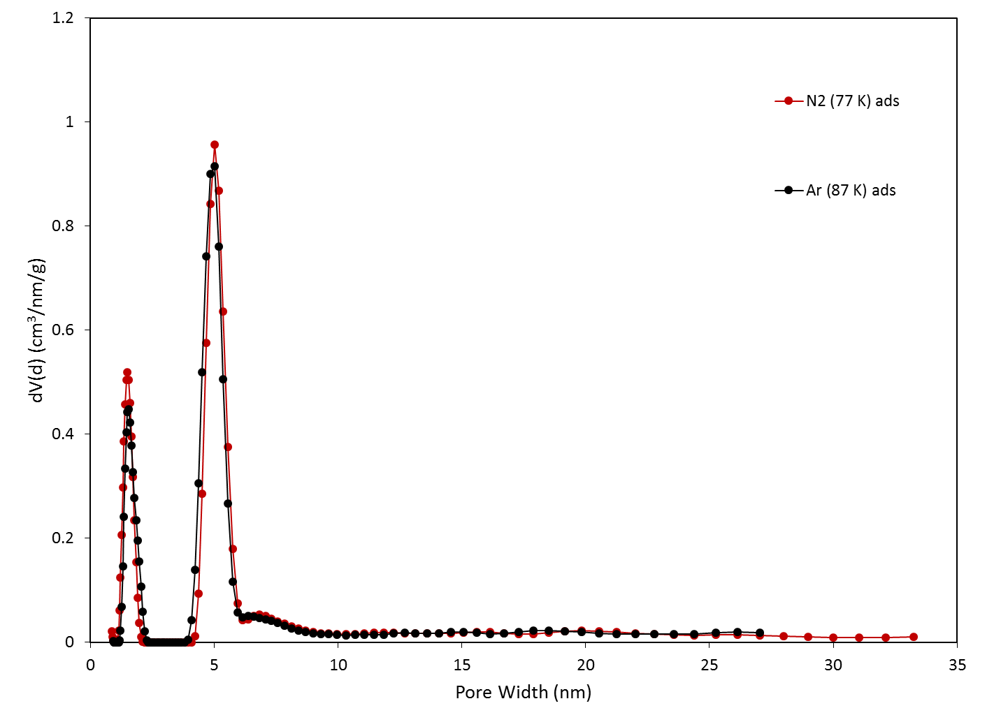
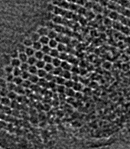
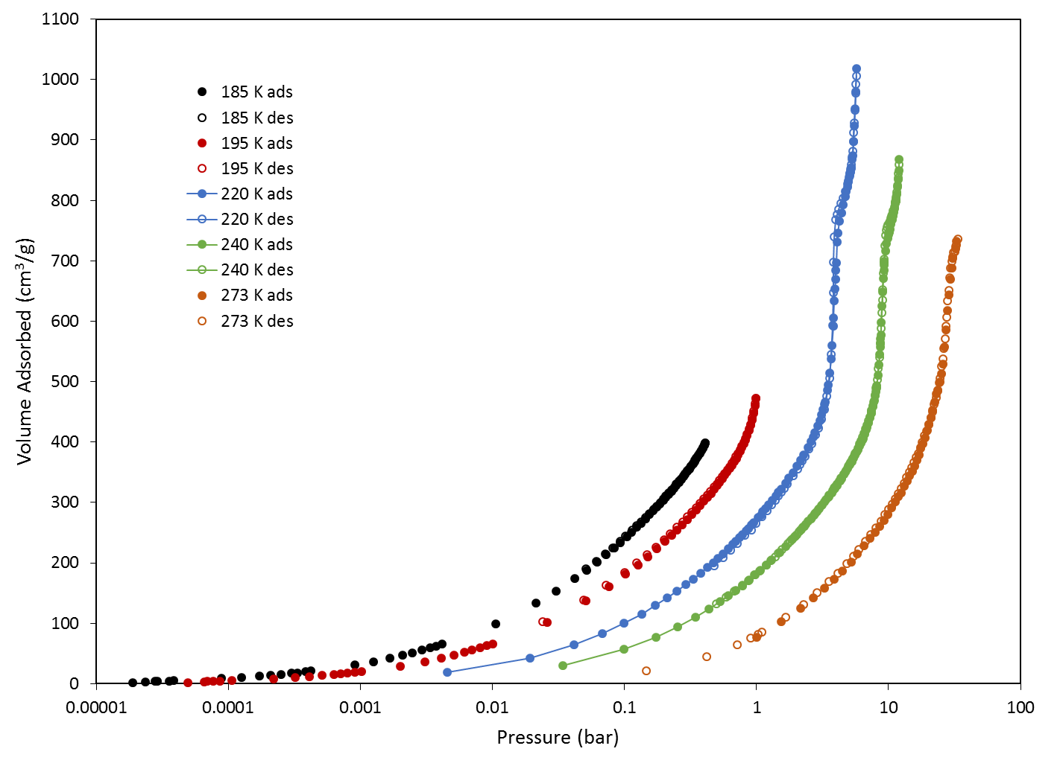
CO₂ adsorption and phase behavior in ordered micro- mesoporous CMK 3 carbon – Experiments over a wide range of temperatures and pressures
5 nm
210 K
220K
240 K
273K
1nm
QSDFT Pore Size Analysis
from N₂ (77K) and Ar (87K) isotherms
T_{tr}, CO₂ : 216.58 K
T_{c}, CO₂ : 304.18 K
● No hysteresis is observed over a wide range of temperatures
→ shift of the hysteresis/pore critical temoerature in the order of ∼ 65K!!!!
220
240 K
Vapor-solid
273K
● Capillary condensation with hysteresis occurs below CO₂ bulk triple point but not at 195 K (dry ice/aceton temperature)
→ shift of pore triple point region to lower temperaures, i.e. the downward shift is > 6 K but < 20 K
195
185 K
Dantas, Cychosz, Thommes*, Neimark* Langmuir, 2019, 35, 11291

Slide 14
Surface Area Analysis:
BET Area Determination

Slide 15
New IUPAC Recommendations (2015) Updated Classification of Physisorption Isotherms
M. Thommes, K. Kaneko, A.V. Neimark, J.P. Olivier, F. Rodriguez-Reinoso J. Rouquerol, K.S.W. Sing,
Pure Appl. Chem., 2015, 87, 1051.
ultramicropore
supermicropore
Nanopores: pore widths ≤ 100 nm
Within the range of nanopores:
Micropores < 2 nm
Ultramicropore < 0.7 nm
Supermicropore 0.7 – 2nm
Mesopore: 2- 50 nm
Macropores: > 50nm
non-porous, het surf.
non-porous; het.surf
mesoporous
mesoporous
,
microporous
or–mesoporous
nonporous-homog.
surface
Classification represents subcritical adsorption isotherms on rigid adsorbents

Slide 16
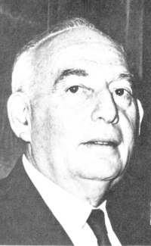
Determination of the specific surface area of solids by gas adsorption – BET (Brunauer, Emmett and Teller method)
●The Brunauer-Emmett-Teller (BET) method continues to be the most widely used procedure for evaluating the surface area of porous and finely-divided materials from physical adsorption isotherms
●Analysis of adsorption isotherm in a defined range of pressures (i.e. “classical “ relative pressures range : P/P₀:
0.05 – 0.3)) with the BET equation allows one to determine the (statistical ) monolayer of adsorbate
coupled with the known cross-sectional area of an adsorbate atom/molecule the surface area can be determined
Published in 1938
BET Equation

Slide 17
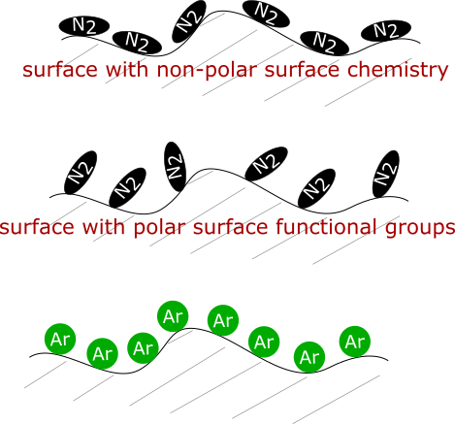
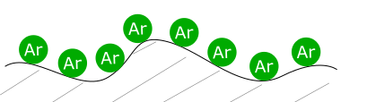
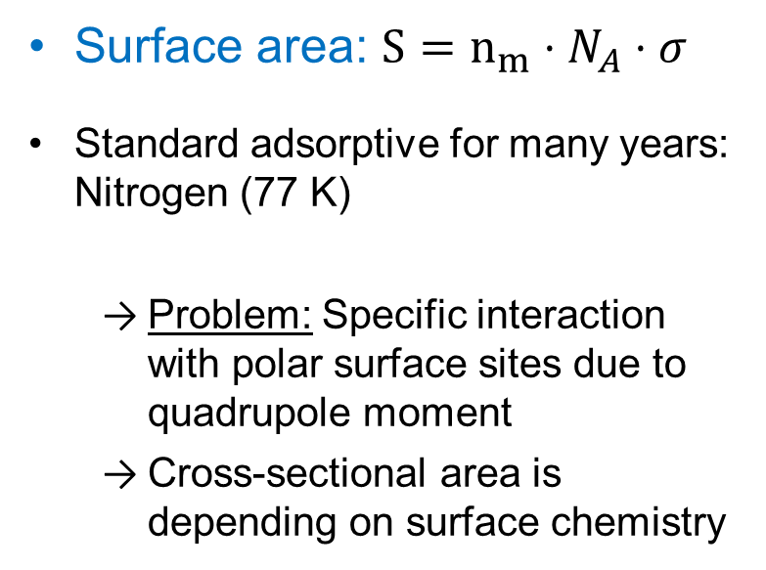
Reference method: Gas adsorption
Reliable Surface Area Assessment by Adsorption (BET method)
Surface area: $S=n_{m}⋅N_{A}⋅σ$
Standard adsorptive for many years: Nitrogen (77 K)
Problem: Specific interaction with polar surface sites due to quadrupole moment
Cross-sectional area is depending on surface chemistry
Overestimation of surface area possible with nitrogen (approx. 20-25 %) ^{[1,2]}
Solution: Argon (87 K) adsorption ^{[1-3]}
References
[1] C. Schlumberger, …G Reichenauer, M. Thommes et al., Reliable surface area determination of powders and meso/macroporous materials: Small-angle X-ray scattering and gas physisorption, Microporous and Mesoporous Materials. (2022) 111554.
[2] M. Thommes, C. Schlumberger, Characterization of Nanoporous Materials, Annual Review of Chemical and Biomolecular Engineering. 12:137-162 (2021) 137–162 and references therein
[3] Thommes M et al. 2015. Physisorption of gases, with special reference to the evaluation of surface area and pore size distribution (IUPAC Technical Report). Pure and Applied Chemistry. 87(9–10):

Slide 18
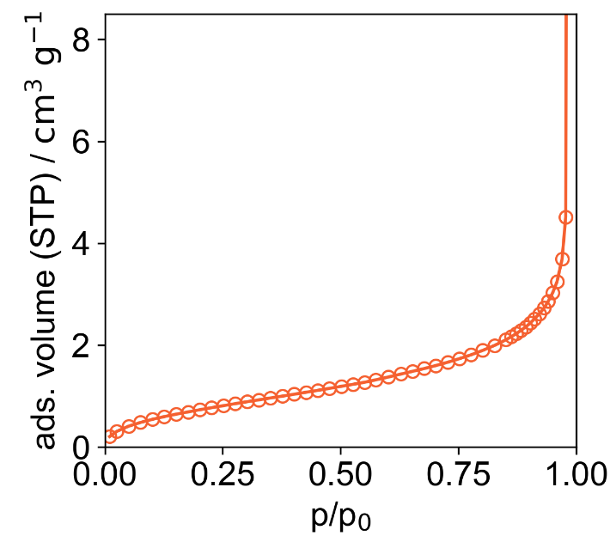
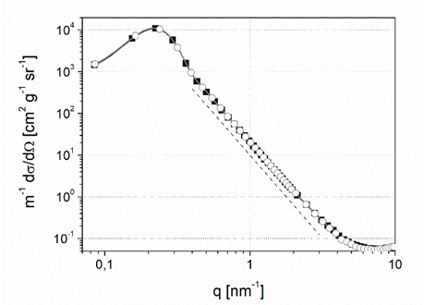
Surface Area Analysis
Benchmark and surface area data on silica model materials
without micro-and narrow mesopores
 | S (Ar, 87 K) / m² g⁻¹ | S (N₂, 77 K) / m² g⁻¹
CPG ERM-FD-121 | 98.6 | 118.6
Silica, 12 nm | 162.6 | 202.5
Silica, 200 nm | 15.6 | 18.9
Silica, 80 nm | 47.1 | 57.5
Silica, 120 nm | 23.6 | -
Silica, 1 µm | 2.6 | -
Argon 87 K
on nonporous Silica
Systematic SAXS measurements independenly confirm accurate surface area determination with
Ar (87 K), while N2 (77K) is unreliable for assessing
of surface with polar surface functionality
(errors up to 25- 30 %)^{1,2}
SAXS
[1] Schlumberger C , Reichenauer, M Thommes et al. 2021. Reliable Surface Area Determination of of powders and meso/macroporous materials : Small Angle X-ray Scattering and Gas Physisorption, Microporous and Mesoporous Materials. (2022) 111554
[2] Thommes, M. et al. 2015. Physisorption of gases, with special reference to the evaluation of surface area and pore size distribution (IUPAC Technical Report), Pure and Applied Chemistry. 87
Notes:
Cooperation with Anton Paar and ZAE Würzburg, validation of surface area with SAXS

Slide 19
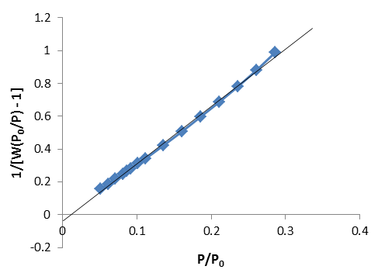
Problem: Application of the BET Method for Determination of the BET Area of Microporous Materials
Problem: BET equation is in a strict sense not applicable to microporous materials → BET Area (apparent surface area)
Application of BET equation in “classical range”, i.e. relative pressure range 0.05 to 0.3:
Negative y-intercept
Negative C constant
Less than optimal correlation coefficient
BET area: 1008 m²/g,

Slide 20
Determination of the BET Area of Microporous Materials
Find the linear range of the BET plot for microporous materials in a way that reduces any subjectivity
J. Rouquerol et al. (Stud. Surf. Sci. Catal. 2007, 160, 49-56) suggested the following
main criteria:
(1) The quantity of C must be positive. Any negative intercept on the ordinate of the BET plot is an indication that one is outside the valid range of the BET equation.
(2) The application of the BET equation should be limited to the pressure range where the term n(P₀-P) or n(1-P/P₀) continuously increases with P/P₀. All data points above the maximum of the plot should be eliminated.
(3)The pressure finally corresponding to the monolayer capacity, n_{m}, should enter the pressure range for the calculation.

Slide 21
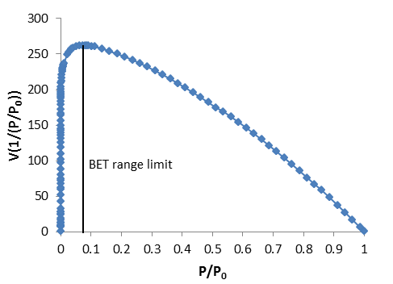
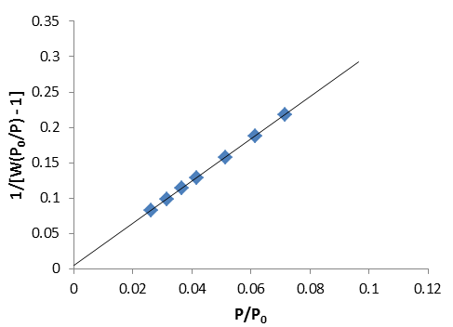
Procedure to Find the Linear BET Range for Microporous Materials
microporous material
BET area = 1167 m²/g
maximum at P/P₀ = 0.07, apply BET equation to data points below that
positive C constant, good correlation coefficient
Improves reproducibility of BET area determination of microporous materials
Improves the comparison of BET area data between labs-

Slide 22
IUPAC Report 2015 Surface Area Determination
● ●The Brunauer-Emmett-Teller (BET) method continues to be the most widely used procedure for evaluating the surface area of porous and finely-divided materials
●Under certain carefully controlled conditions, the BET-area of a non-porous, macroporous or a mesoporous solid (i.e. giving a well-defined Type II or a Type IVa isotherm) can be regarded as the probe accessible surface area
● In the presence of micropores (ie. Type I isotherms and combinations of Types I and II or Types I and IV isotherms) the application of the BET method
only leads to an apparent surface area (i.e BET Area) which serves as a useful “fingerprint” of the adsorbent.
In this case the linear range of the BET plot may be difficult to locate. A useful procedure suggested by Rouquerol et. al permits to overcome this difficulty and improves the reproducibility of the method.

Slide 23
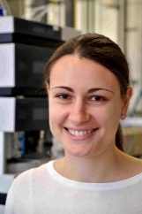
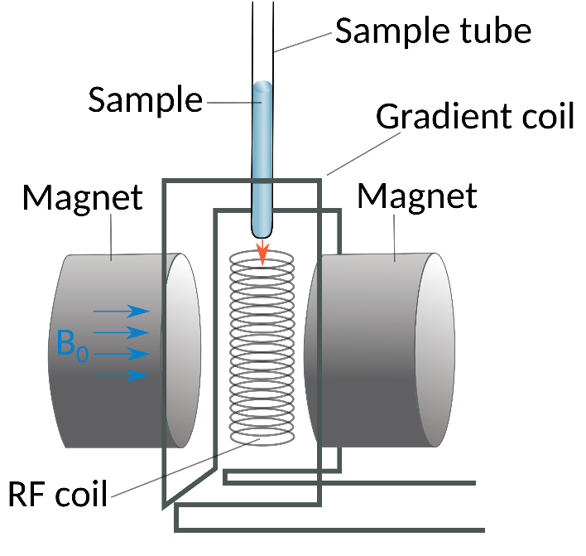
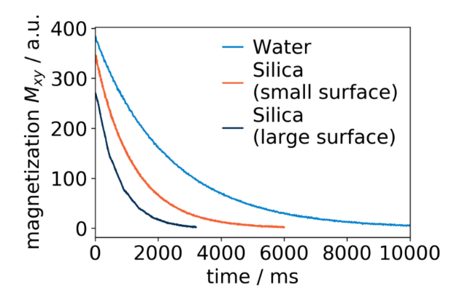

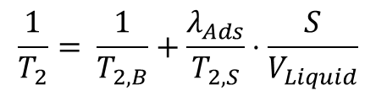
Development of methodology for a reliable textural characterization of materials immersed in the liquid phase by NMR relaxamotry
→ Relaxation of liquid on the particle surface is
much faster than in the bulk liquid
C. Schlumberger
Spin-spin relaxation (T₂):
$$\frac{1}{T_{2}}= \frac{1}{T_{2,B}}+\frac{λ_{Ads}}{T_{2,S}}⋅\frac{S}{V_{Liquid}}$$
Particle
Notes:
Surface area assessment is based on the fact that liquid near the particle surface shows a shorter relaxation time compared to the bulk liquid.

Slide 24
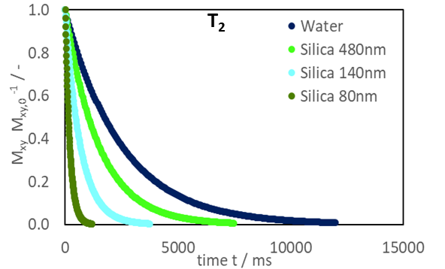
Surface Area Assessment by NMR Relaxometry
NMR relaxation of nonporous silica materials in water
Good correlation between T₂ relaxation time and surface area
Increase in surface area
Surface area of silica model
materials (nonporous silica / water)
 | Silica 1 µm | Silica 480 | Silica 200 | Silica 140 | Silica 80 | Silica 12
S (BET, Ar) / m² g⁻¹ | 2.6 | 6.9 | 13.7 | 24.2 | 40.7 | 162.6
S (NMR, T₂) / m² g⁻¹ | 2.2 | 7.1 | 13.6 | 29.2 | 47.3 | 161.4
Good agreement between NMR T₂ surface area and BET surface area
M. Thommes, C. Schlumberger, Characterization of Nanoporous Materials, Annual Review of Chemical and Biomolecular Engineering. 12:137-162 (2021) 137–162
Schlumberger, C., Sandner, L., Michalowski, A., Thommes, M. Reliable surface area assessment of wet and dry nonporous and nanoporous particles: Nuclear magnetic resonance relaxometry and gas physisorption, under review

Slide 25
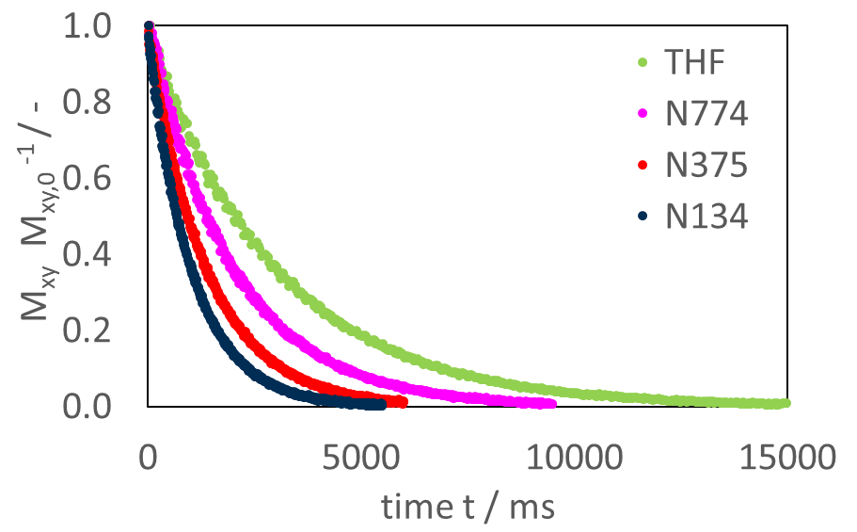
Surface Area Assessment by NMR Relaxometry
Spin-spin relaxation of carbon blacks
in tetrahydrofuran (THF) ^{[1]}
Increase in surface area
Good correlation between T₂ relaxation time and surface area
Surface area of carbon blacks (Carbon Black N134/THF)
 | Carbon Black N774 | Carbon Black N375
S (BET, Ar) / m² g⁻¹ | 26.1 | 82.2
S (NMR, T₂) / m² g⁻¹ | 27.7 | 69.9
[1] D. Fairhurst et al., Relaxation NMR as a tool to study the dispersion and formulation behavior of nanostructured carbon materials, Magnetic Resonance in Chemistry. 54 (2016) 521–526.
[2] Schlumberger, C., Sandner, L., Michalowski, A., Thommes, M. Reliable surface area assessment of wet and dry nonporous and nanoporous particles: Nuclear magnetic resonance relaxometry and gas physisorption, under review
Good agreement between NMR T₂ surface area and BET surface area for carbon blacks

Slide 26
Pore Size Analysis

Slide 27
New IUPAC Recommendations (2015) Updated Classification of Physisorption Isotherms
M. Thommes, K. Kaneko, A.V. Neimark, J.P. Olivier, F. Rodriguez-Reinoso J. Rouquerol, K.S.W. Sing, Pure Appl. Chem., 2015, 87, 1051.
New
ultramicropore
supermicropore
Nanopores: pore widths ≤ 100 nm
Within the range of nanopores:
Micropores < 2 nm
Ultramicropore < 0.7 nm
Supermicropore 0.7 – 2nm
Mesopore: 2- 50 nm
Macropores: > 50nm
non-porous, het surf.
non-porous; het.surf
New
mesoporous
mesoporous
,
microporous
or–mesoporous
nonporous-homog.
surface
Classification represents subcritical adsorption isotherms on rigid adsorbents

Slide 28
IUPAC (2015): Key Recommendations
for Characterization of Porous Materials
Choice of Adsorptive:
● Pore Size/Volume Characterization of microporous materials with polar surface functionality, e.g. zeolites, MOFs
⇒ Argon 87 K adsorption
● Characterization of ultramicroporous carbons
⇒ CO₂ adsorption at 273K
● Low surface area materials
⇒ Krypton adsorption at 77 K for BET analysis

Slide 29
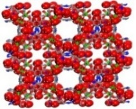
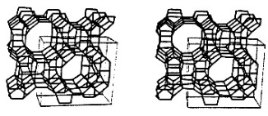

High Resolution Argon (87 K) Adsorption
soc-MOF
soc-MOF
mordenite
Mordenite
ZSM-5
Thommes, M. Textural Characterization of Zeolites and Ordered Mesoporous Materials by Physical Adsorption in: Introduction to Zeolite Science and Practice, 2007, p. 495-523
Thommes, M.; Cychosz, K.A. Adsorption 2014, 20, 233-250
→ Argon 87 K adsorption allows to resolve pore width differences on a 0.1 nm level

Slide 30
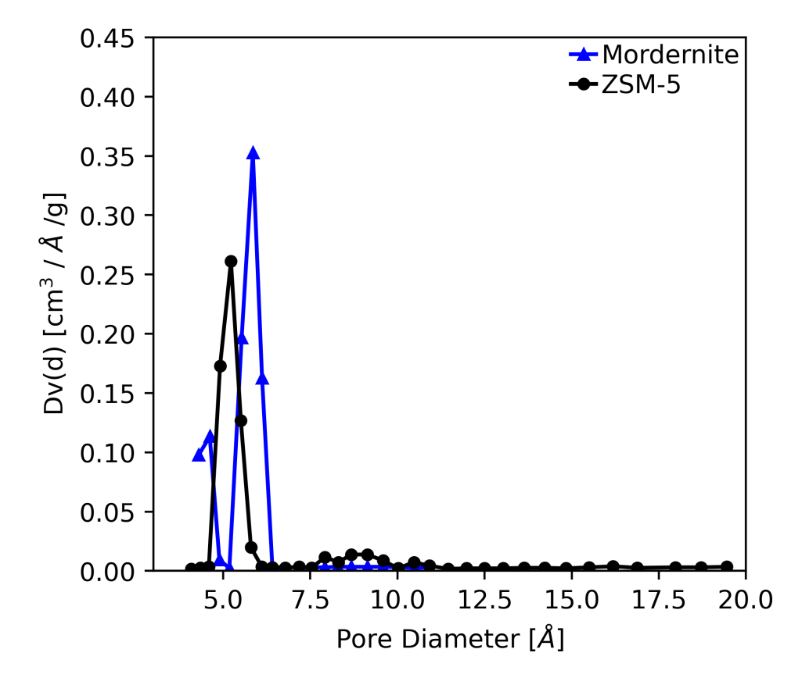
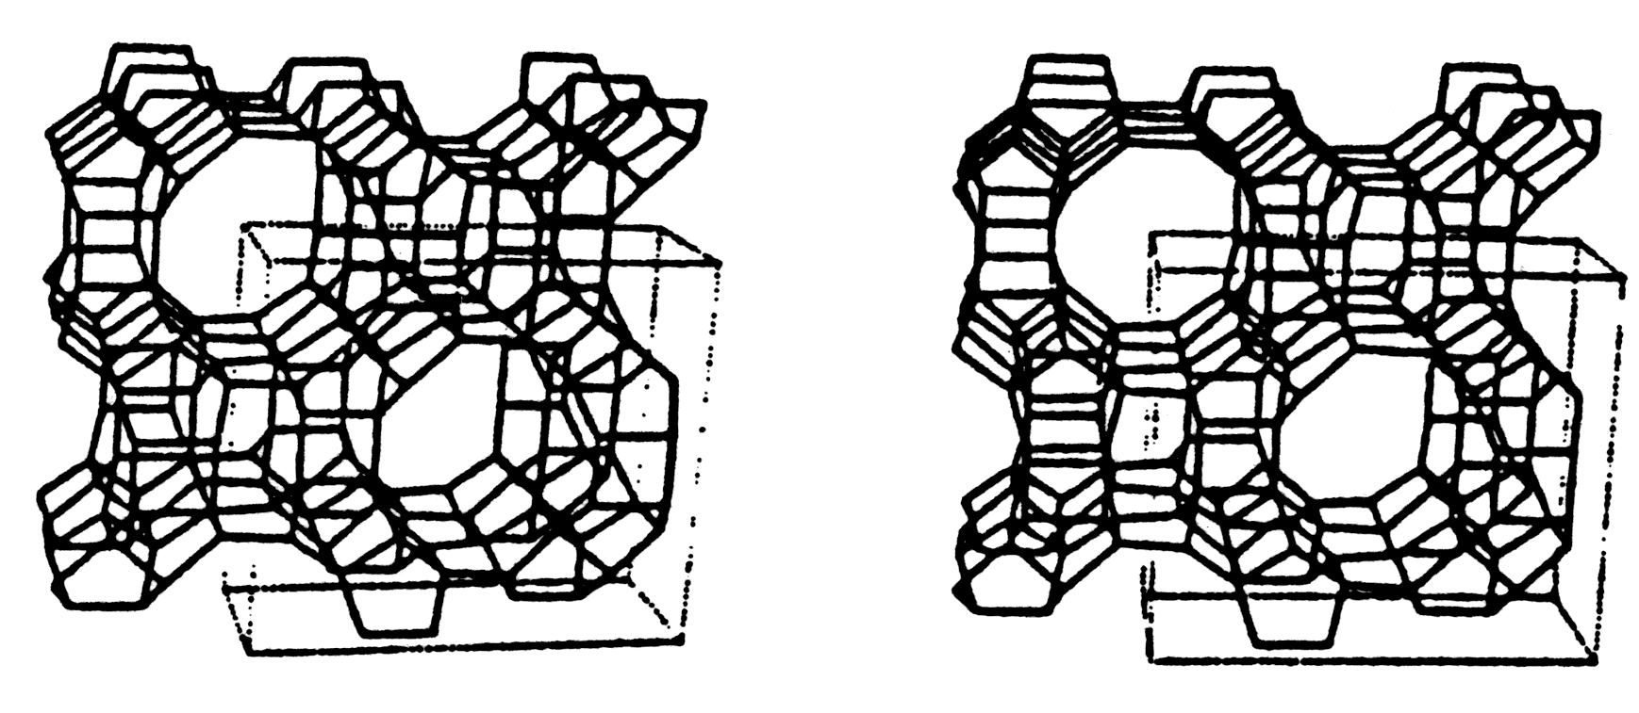
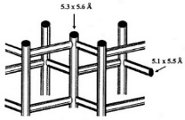
Argon (87 K) Adsorption in Zeolites and MOFs
Argon 87 K Adsorption
NLDFT Pore Size Analysis
Mordenite
ZSM-5
→ Argon 87 K adsorption allows to resolve pore width
differences on a 0.1 nm level

Slide 31
Pore Size/Volume Analysis of Nanoporous Materials
Classical, macroscopic methods
Micropores (< 2 nm): e.g. Dubinin-Radushkevitch, Horvath-Kawazoe (HK), Saito-Foley (SF), comparison plot methods (t-method, alpha-s method)
Note: Application of conventional t-method and other comparison plot methods is not straightforward for Micro-mesoporous materials with narrow mesopores
Meso- and Macropores (> 2 nm): e.g. Kelvin equation based methods such as Barrett, Joyner, Halenda (BJH) or Broeckhoff-de Boer (BDB), KJS (Kruk,Jaroniec, Sayari), VBS (Villarroel-Rocha, Barrera, Sapag)
Note: Classical methods (if not corrected) understimate pore sizes of pore width < 10 nm up to 25-30%
Modern, microscopic methods based on statistical mechanics describe configuration of adsorbed molecules on a molecular level (IUPAC 2015)
Both Micro- and Mesopore size range: e.g. Density Functional Theory (DFT), Molecular Simulation
An accurate pore size analysis over the complete pore size range can be
⇒ performed by a single method.

Slide 32
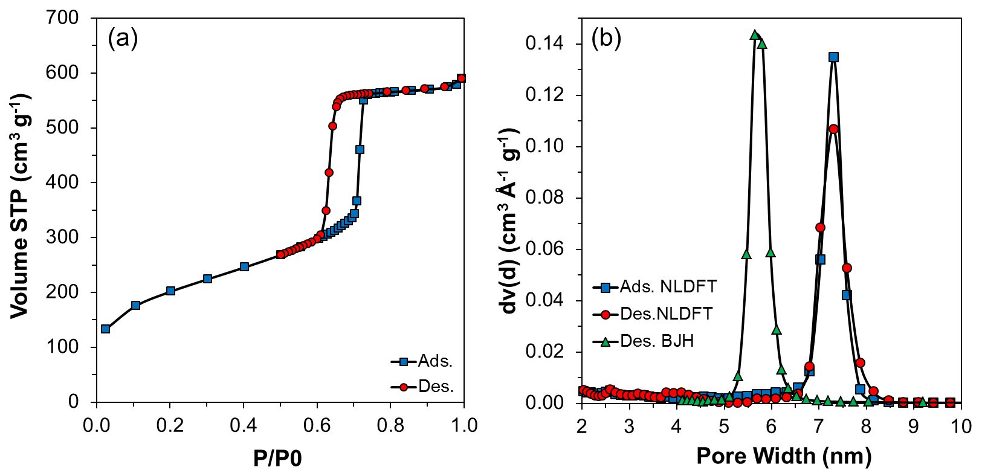
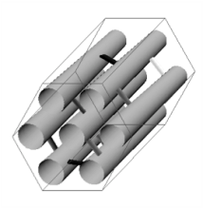
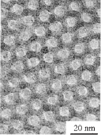
Pore Size Analysis of SBA-15 Silica
NLDFT
Equilib. transition
Kelvin/BJH
delayed
condens..
M.Thommes, R. Guillet-Nicolas, K.A Cychosz, Physical Adsorption Characterization of Mesoporous Zeolites. In: Mesoporous Zeolites: Preparation, Characterization and Applications, Ed. J. Garcia-Martinez, K. (Eds) 2015, Wiley, p.
Landers, G. Gor, A.V. Neimark, Application of Density Functional Theory Methods for Characterization of Porous Materials., Colloids Surfaces A, 2013

Slide 33
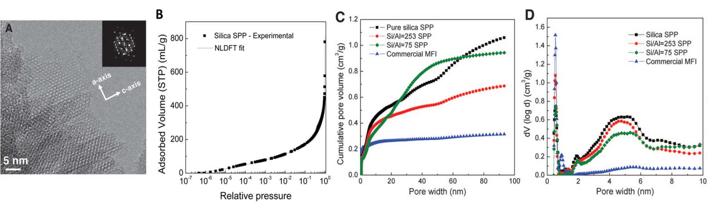
Characterization of Hierarchically Structured ZSM-5 Zeolite by Argon (87 K) Adsorption and NLDFT Analysis
Unique house-of-cards arrangement of nanosheets provides a hierarchical pore net
work.
Zhang, X.; Liu, D.; Xu, D.; Asahina, S.; Cychosz, K.A.; Agrawal, K.V.; Al Wahedi, Y.; Bhan, A.; Al Hashimi, S.; Terasaki, O.; Thommes, M.; Tsapatsis, M,. Science 2012, 336, 1684-1687

Slide 34
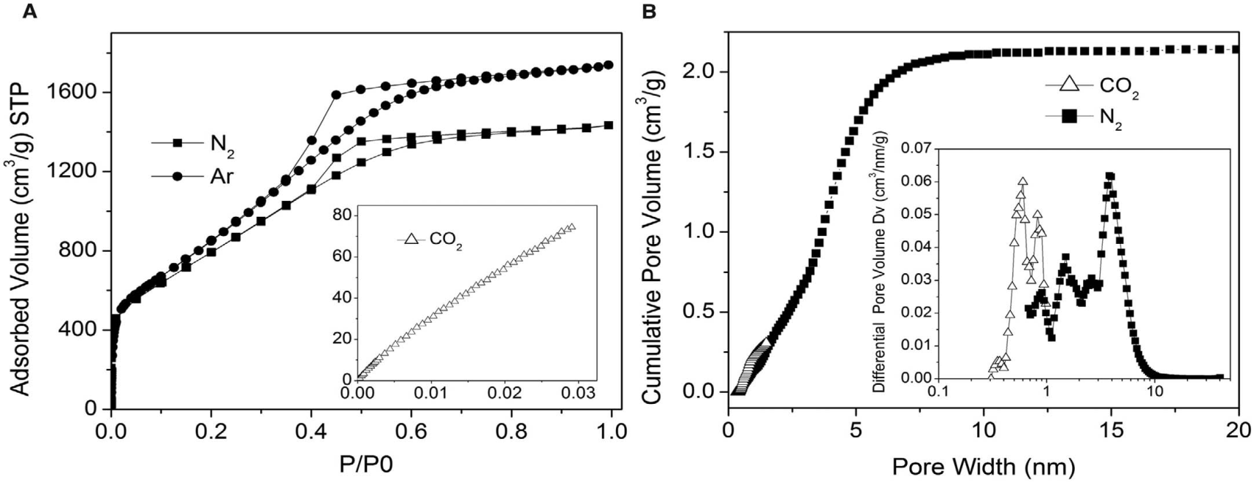
Characterization of Hierarchically Structured Nanoporous Carbon for Supercapacitor Applications by combining N₂, Ar and (77, 87K) and CO₂ (273K) Adsorption
NLDFT Analysis : slit/cylinder mod.
,
X.Zhu., S. Murali, M. D. Stoller, K. J. Ganesh, W. Cai, P.J. Ferreira, A.Pirkle, R.M. Wallace, K. A. Cychosz, M.Thommes, D.Su, E.A. Stach and R. S. Ruoff.
Science 2011, 332, 1537-1541

Slide 35
Assessing Pore Network Characteristics
by Advanced Adsorption Methodologies
Key:
● Understanding of Adsorption and Phase Behavior
of Fluids in Pores (confined geometry effects)
● Understanding contributions to Hysteresis

Slide 36
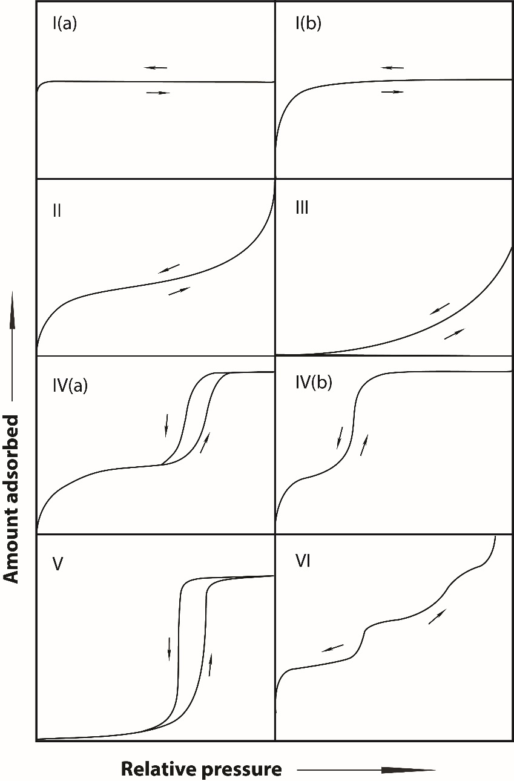
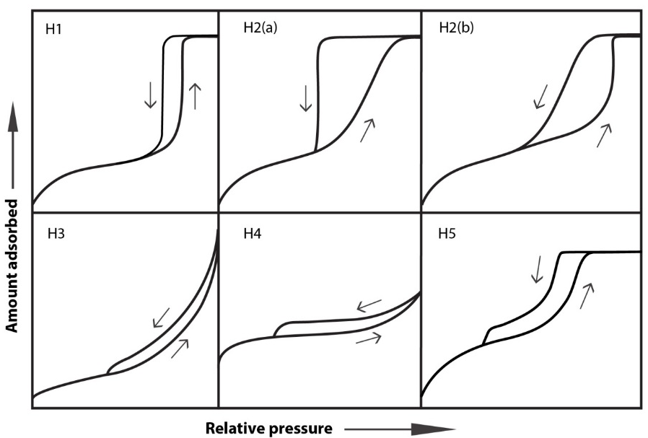
IUPAC (2015) Classification of Hysteresis Loops
M. Thommes, K. Kaneko, A.V. Neimark, J.P. Olivier, F. Rodriguez-Reinoso
J. Rouquerol, K.S.W. Sing, Pure Appl. Chem., 2015, 87, 1051.
Ultramicropores
Supermicropores
Heterogeneous Planar Surfaces
Heterogeneous Planar Surfaces
Cylindrical Pores
Pore Networks and Ink Bottle Pores
Large Mesopores
Narrow Mesopores
Mesopores and Micropores
Disordered pore structures
Micro- and mesoporous adsorbents
Open and restricted mesopores
“Ideal” Planar Surfaces

Slide 37
Adsorption Hysteresis
Pore Network Analysis by Physisorption:
Requires understanding
of hysteresis
Correlation between
pore structure and
underlying adsorption
mechanism
Thommes, M.; Cychosz, K.A. Adsorption 2014, 20, 233-2
Thommes, M. Schlumberger C,Annu. Rev. Chem. Biomol. Eng. 2021. 12:137–62

Slide 38
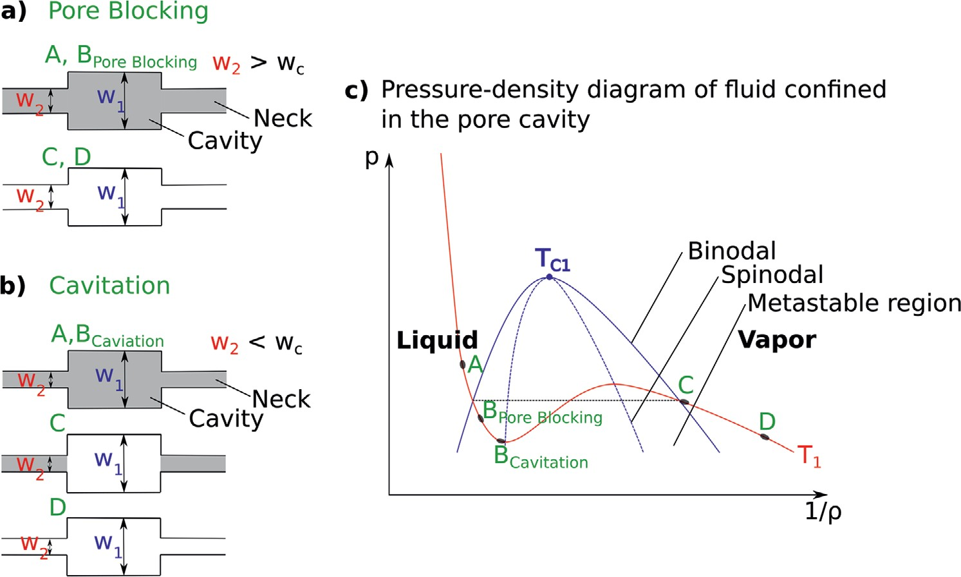
Desorption/Evaporation Mechanisms:
Pore Blocking vs Cavitation
C. Schlumberger, M. Thommes, “Characterization of hierarchically ordered porous materials
by physisorption and mercury porosimetry- (invited) A Tutorial Review”, Advanced Materials Interface (2021), 6, 2002181

Slide 39
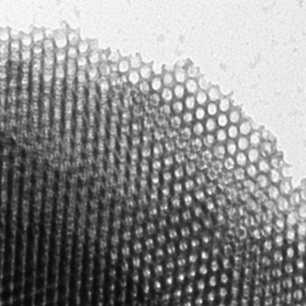
Combined Micro- and Mesopore Size Analysis of Hierarchically Structured KLE Silica
1.3 nm
13.9 nm
Cavitation →
KLE
N₂ (77 K) adsorption isotherm
N₂/ 77 K
Pore diameter (Angström)
Mesopore size:
N₂ adsorption = 13.9 nm
TEM = ~13 nm
SAXS = 13.8 nm
NLDFT pore size distribution (spherical mesopores, cylindrical micropores from adsorption branch
Excellent agreement between SAXS, TEM, and NLDFT approach
Thommes, M.; Smarsly, B.; Groenewolt, M.; Ravikovitch, P.I.; Neimark, A.V. Langmuir 2006, 22, 756

Slide 40
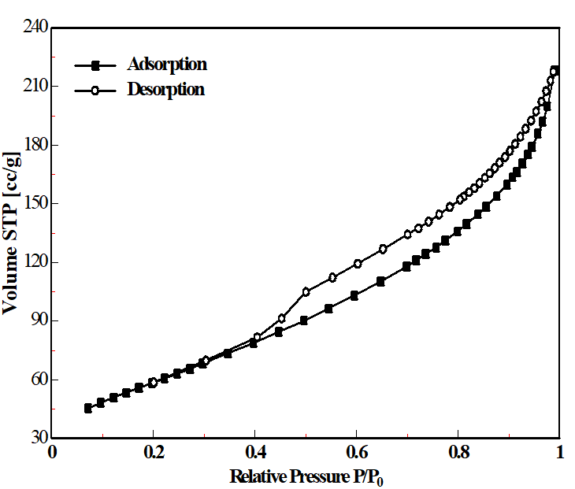
Pitfall: Effect of Cavitation on Nitrogen Sorption in Disordered Alumina Catalyst Support
Desorption PSD
Artifact
Cavitation→
→ The typical “step-down” of the desorption branch at ca. 0.4 for nitrogen adsorption is indicative of cavitation , i.e. which occurs because large mesopores are only accessible through narrow mesopores (pore withd < ca. 6 nm) or micropores.

Slide 41
“Physisorption Toolkit “: Pore Network Analysis
(1) Application of advanced DFT methods for analysis of hysteresis loop
- checking consistency of PSD’s from Adsorption and Desorption Branches
→ can detect whether pore/pore network is open(unrestricted) or if restricted
pores exist which could give rise to either pore blocking or cavitation
controlled evaporation(desorption)
(2) Adsorption measurements with different adsorptives (e.g. argon, nitrogen)
→ Differentiating between pore blocking and cavitation in restricted pore
systems
(3) (Scanning of hysteresis loop
→ Differentiating between pore blocking and cavitation in restricted pore
systems
(4) Adsorption measurements with a given adsorptive at different temperatures
→ changing thermodynamics of confined pore phase
For details: C. Schlumberger, M. Thommes, “Characterization of hierarchically ordered porous materials
by physisorption and mercury porosimetry- (invited) A Tutorial Review”,
Advanced Materials Interface (2021), 6, 2002181

Slide 42
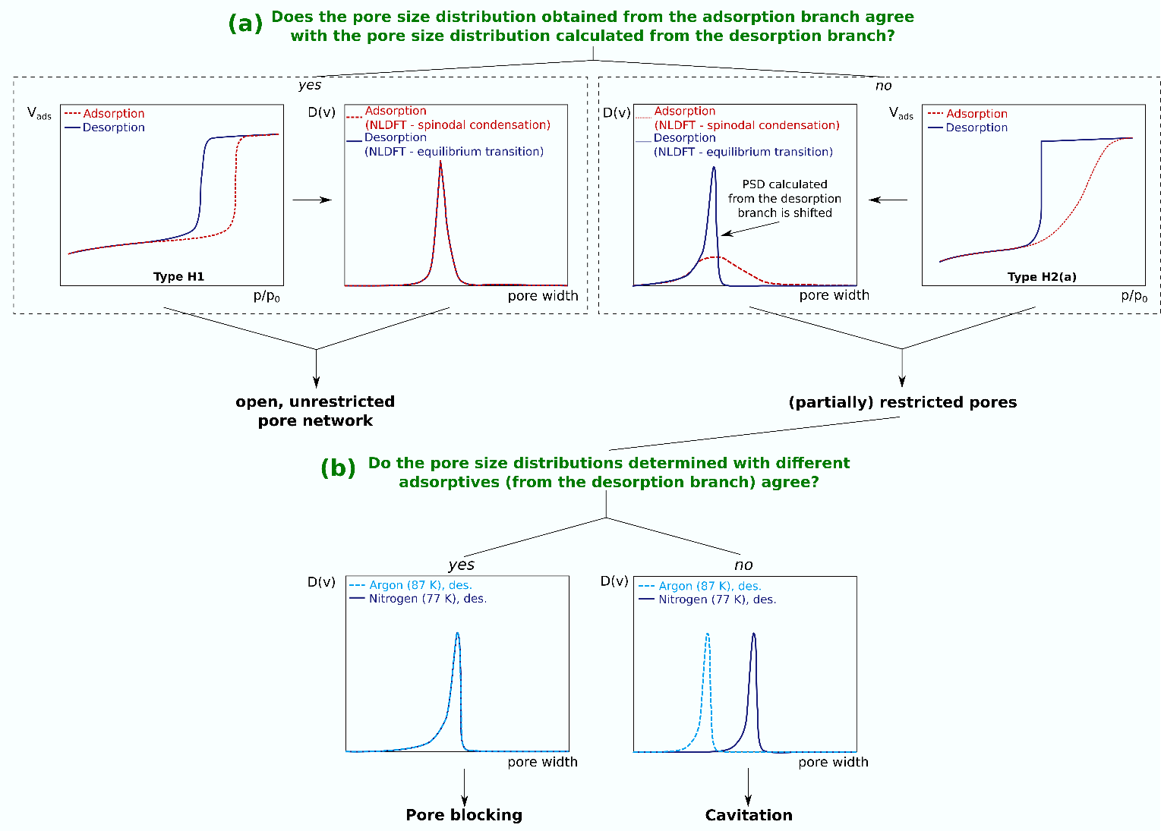
Advanced Pore Network Analysis Approach
C. Schlumberger, M. Thommea”, Advanced Materials Interface (2021), 6, 2002181

Slide 43
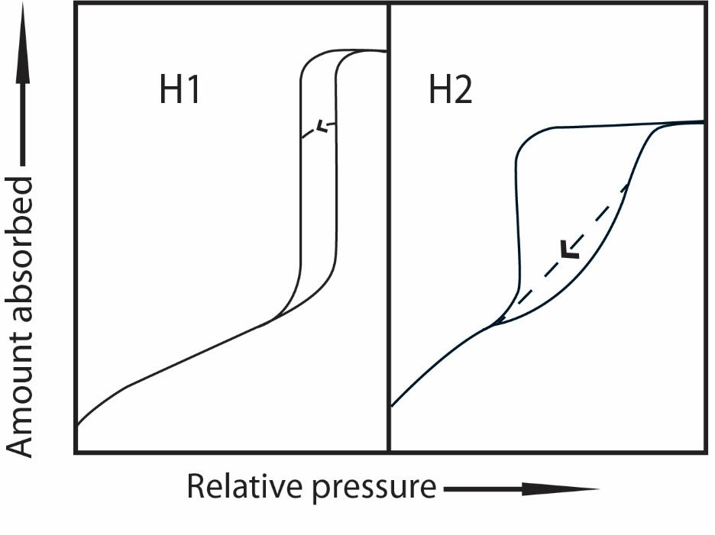
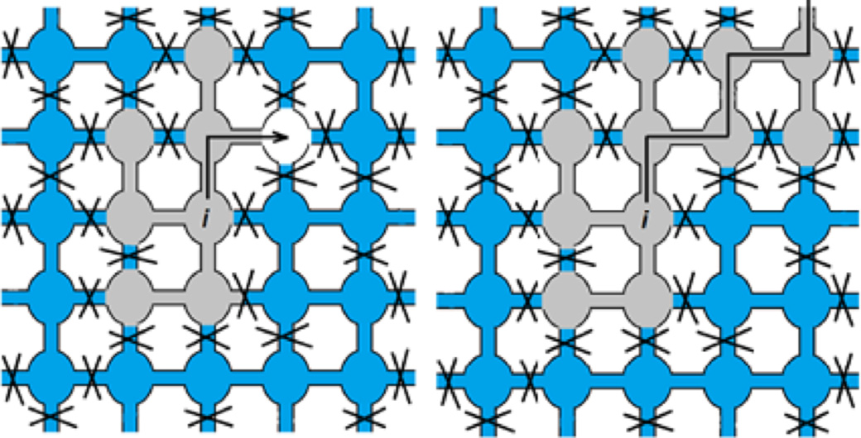
Advanced Pore Network Analysis by “Scanning” of the Hysteresis Loop
Pore Network - Type H2 hysteresis
Quantitative analysis of scanning curves allows one to obtain information about pore connectivity
Pioneered by Everett - 1967, De Boer - 1958
Type H1 Hysteresis: Pores evaporate independently from one another (e.g. SBA-15 silica)
Type H2 Hysteresis: Evaporation of certain pores depends on the state of neighboring pores → Network effects/percolation
Cimino, R.; Cychosz, K.A.; Thommes, M.; Neimark, A.V. Colloids Surfaces A 2013, 437, 76-89

Slide 44
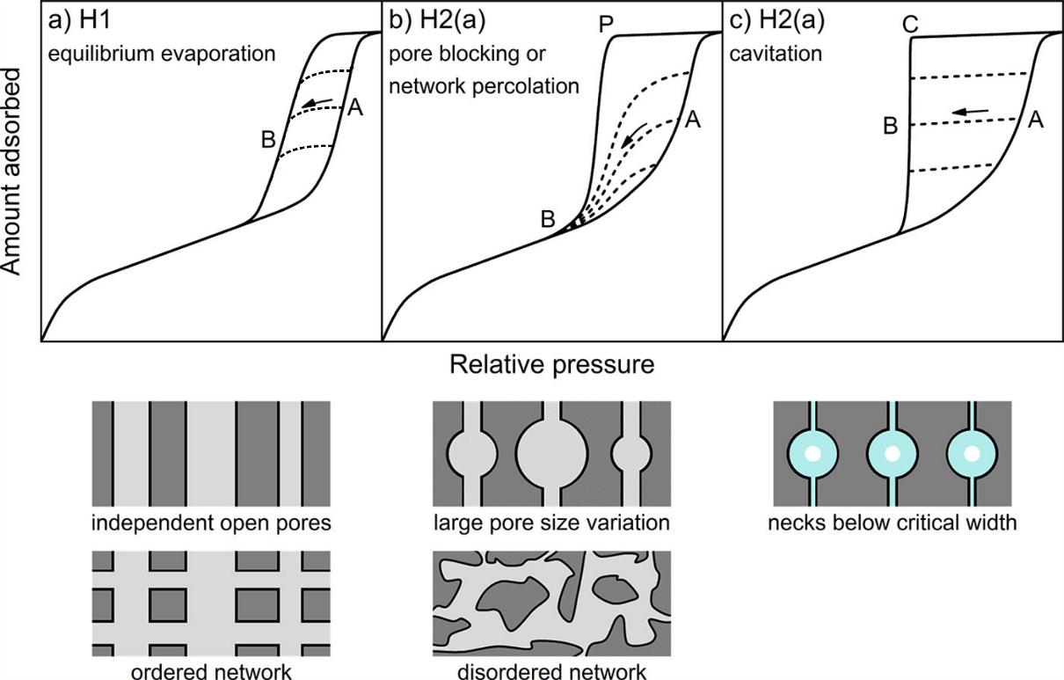
Hysteresis Loop Scans and Pore Network Structure
From: S. A. Kube, K. Turke, R. Ellinghaus, D. Wallacher, M. Thommes,B. M. Smarsly, Langmuir 2020, 36, 11996.
R. Cimino; K.A. Cychosz, M.Thommes, A.V. Neimark, A.V. Colloids Surfaces A 2013, 437, 76-89

Slide 45
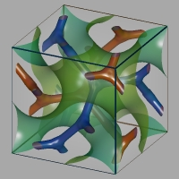


Scanning and Pore Network Analysis
Cavitation
KIT-6 silica
KLE-silica
Information:
-Pore Neck
-Pore Cavities
- Pore connecticity
Rasmussen, C.J.; Vishnyakov, A.; Thommes, M.; Smarsly, B.M.; Kleitz, F.; Neimark, A.V. Langmuir (2010)
Cimino, R.; Cychosz, K.A.; Thommes, M.; Neimark, A.V. Colloids Surfaces A (2013)(, 437, 76-89
J. Söllner, M. Thommes, manuscript in preparation, (2023)

Slide 46


Assessing pore network structure/connectivity
Example: hierarchical micro-mesoporous zeolites
K.A. Cychosz, K.A., R.Guillet-Nicolas, J. Garcia-Martinez and M. Thommes*, “Recent advances in the textural characterization of hierarchically structured nanoporous materials“ (invited) Chem. Soc. Rev. 46 ,389 (2017)

Slide 47






Argon (87 K) Adsorption and NLDFT Pore Size Analysis of Mesoporous Y Zeolites
A)
B)
C)
D)
Garcia-Martinez, J.; Xiao, C.; Cychosz, K.A.; Li, K.; Wan, W.; Zou, X.; Thommes, M. ChemCatChem 2014, 6, 3110-3115

Slide 48


Advanced Characterization Hierarchically Structured Mesoporous Y-Zeolite (C16)
Collaboration with University of Stockholm, X. Zhou
(1) Advanced image analysis: transmission electron microscopy (TEM), including high-resolution imaging and electron tomography (ET); three-dimensional rotation electron diffraction
Directly revealed the connectivity of micro- and mesopores in the mesostructured zeolite
(2) Advanced gas adsorption: high resolution argon adsorption at various temperatures;hysteresis scanning; application of advanced NLDFT methods
Quantitative determination of intracrystalline micro- and mesopores volumes and differentiation between truly accessible (open) mesopores and those that are constricted
Garcia-Martinez, J.; Xiao, C.; Cychosz, K.A.; Li, K.; Wan, W.; Zhou, X.; Thommes, M. ChemCatChem 2014, 6, 3110-3115
Highlight: Thomas, J.M.; Leary, R.K. Angew. Chemie. Int. Ed. 2014, 53, 2-4

Slide 49






Application of “Physisorption Toolkit” : Changing of state of pore fluid to visualize pore network connectivity
A)
B)
1.2 nm
NLDFT PSD
4.2 nm
N₂ (77 K) and Ar (87 K)
C)
Ar (65 K)
D)
open -->
Ar (77 K)
Ar (77 K)
restricted -->
Detailed structural information from hysteresis scanning
Tr(Ar): 83.8 K
⇒ More than 65% of pores lead to micropores
Garcia-Martinez, J.; Xiao, C W.; Zou, X.; Thommes, M. ChemCatChem 2014, 6, 3110-3115

Slide 50




Confined Geometry Effects: Adsorption and Phase Behavior of Fluids in Mesopores
Morishige et al.,1997
Ar/MCM-41
IV(a)
IV(b)
pore W₁ > pore W₂
pore W₁ > pore W₂
Schematic phase diagram of pore and bulk fluid,
applicable to Ar and N₂confined in
mesoporous oxides and carbons ,
Ar 87K/
MCM-41
Kruk et al, 2000
M. Thommes et, al, Applied, Surface Science, 2002)

Slide 51
Summary
● Physical adsorption and mercury porosimetry are powerful tool s for the
characterization of porous materials
● Advanced, high resolution physical adsorption experiments (e.g,
scanning of hysteresis etc) coupled with state-of-the-art data
reduction (DFT and molecular simulation based methods
⇒ allows one to obain reliable surface and pore size/porosity information
and explore important aspects of pore connectivity
What is needed for a comphensive and accurate textural characterization of porous materials and powders with complex and hierarchical pore structures:
● Development of new procesures/methodologies based on the combination of adsorption and mercury porosimetry with complimentary experimental techniques such as in-situ scattering (e.g., SAXS,SANS) electron tomography and reconstruction, spectroscopy (such as NMR-based methods)
● Further work needed for deriving of a unified framework for textural characterisation of functionalised, porous materials and particles in the wet and dry state.

Slide 52



Acknowledgement
CRC 1411
CRC 1452
Federal Ministry for
Economic Affairs and Energy
Institute of Separation Science and Technology (University Erlangen-Nuremberg)

Slide 53
Macropore Analysis

Slide 54

Limitation of Adsorption Characterization Nitrogen Sorption at 77 K into Mesoporous TiO₂
6 nm
10 nm
Gas Adsorption: reliable pore size analysis only for pores with diameter < 50 nm
30 nm
200nm
100 nm
H. Kueppers, B. Hirthe, M.Thommes, G.I.T, 3 (2001) 110

Slide 55

Macropore Analysis: Mercury Porosimetry
Pore size/volume analysis over a wide range from 4 nm up to 400 μm
• “Fast” and highly reproducible measurements
Texture (Pore structure,Tortuisity, Permeability)
Surface area
Particle size distribution
Skeletal and Bulk Density
Washburn Equation:
P_{h} r = - 2γcos
non-wetting
θ

Slide 56

Macro-Mesopore Size Distributon of Hierarchical Macro-Mesopore Silica Monolith for Chromatographic Applications
M. Thommes , R. Skudas,K.K. Unger, et al.J. Chromatogr. A, 2008,1191, 57

Slide 57


Pore Network Analysis of Pore Systems with Hierarchical Macro-Mesopore Porenetwork
Studies of Hg intrusion/extrusion into porous glasses (Vycor and CPG)
by combining experiments and advanced molecular simulation confirm:
Hysteresis in gas adsorption and Hg porosimetry has the same origin
Entrapment is of kinetic origin, i.e., due to fragmentation (snap-off) of liquid during extrusion
Further confirmed by Hg porosimetry on silica monoliths
No entrapment
Extrusion → cavitation
F. Porcheron , P. Monson,, M. Thommes
et al., Langmuir 2004,20, 64
F. Porcheron, R. Ahmad, M. Thommes,
P. Monson. Lanngmuir, 2007, 23, 3372
M. Thommes , R. Skudas,K.K. Unger, et al.
J. Chromatogr. A, 2008,1191, 57

Slide 58


Mercury Porosimetry into MCM-41 and SBA-15 Silica
Some selected examples:
- A. Lind, C. du Fresne Von Hoenesche, J.H. Smått, .; M. Linden;
K.K. Unger, Microporous Mesoporous Mater. 2003, 66, 219.
- M. Hartmann, A. Vinu, A. Langmuir 2002, 18, 8010.
- A. Vinu, V. Murugesan, W. Bohlmann, M. Hartmann, . J. Phys.Chem. B 2004
108, 11496.
- A. Galarneau, B. Lefèvre,† H. Cambon,† B. Coasne,† S. Valange, Z. Gabelica, J.-P. Bellat,
and F. Di Renzo*, J. Phys. Chem. C 2008, 112, 12921–12927
⇒ These studies highlighted the effects of mechanical stability of
mesoporous molecular sieves (mainly with MCM-41, SBA-15 silica )
combined with surface roughness effects on mercury intrusion/extrusion

Slide 59

Mercury Intrusion/Extrusion in ordered mesoporous silica (KIT-6)
First reversible mercury intrusion/extrusion experiments into ordered mesoporous 3D silica ( KIT-6 ) NO fracture
For more details: R. Guillet-Nicolas, R. Ahmad, K.A. Cychosz, F. Kleitz, M. Thommes, New J. Chem. 2016,

Slide 60
Equivalency of Gas Sorption (pore condensation /evaporation) and Hg Porosimetry (extrusion/intrusion)
(1) Symmetry in Experiments:
Lowell and Shields (1981), Seaton and Murray (1999).
Correlation between the hydraulic pressure P_{h} (required to force mercury into pores) to the relative pressure P/P₀, exerted by the liquid Hg with radius of curvature r:
P_{h} = (RT/V_{M}) ln(P/P₀)
(2) Symmetry in Theory:
Lattice gas model (Porcheron, Monson, Thommes ) exhibits a symmetry that provides a direct relationship between I intrusion/extrusion of non wetting fluid with adsorption/desorption isotherms for a wetting fluid
F. Porcheron , P. Monson,, M. Thommes
et al., Langmuir 2004,20, 64
F. Porcheron, R. Ahmad, M. Thommes,
P. Monson. Lanngmuir, 2007, 23, 3372

Slide 61
Macropore Analysis:
Analogy between mercury intrusion/extrusion
and gas adsorption (pore condensation/evaporation)
Ads/Des iostherms of N2 and Hg in
ordered mesoporous silica KIT-6
KIT-6 silica
N₂/77K
Hg/293 K)
Wetting
Non-wetting
Mechanism of mercury intrusion/extrusion can be considered thermodynamically equivalent to pore evaporation/condensation in gas adsorption → potential for advancing macropore size/pore network analysis by Hg Poroismetry, i.e. transfer of methodologies such as hysteresis scanning to mercury porosimetry
R. Guillet-Nicolas, K.A. Cychosz, F. Kleitz, M. Thommes, New. J. Chem. 40 (2016) 4251
F. Porcheron, P. Monson, M. Thommes, Langmuir 20 (2004) 64
F. Porcheron, M. Thommes, R. Ahman, P. Monson, Langmuir 23 (2007) 3372.

Slide 62
Summary
● Physical adsorption and mercury porosimetry are powerful tool s for the
characterization of porous materials
● Advanced, high resolution physical adsorption experiments (e.g,
scanning of hysteresis etc) coupled with state-of-the-art data
reduction (DFT and molecular simulation based methods
⇒ allows one to obain reliable surface and pore size/porosity information
and explore important aspects of pore connectivity
What is needed for a comphensive and accurate textural characterization of porous materials and powders with complex and hierarchical pore structures:
● Development of new procesures/methodologies based on the combination of adsorption and mercury porosimetry with complimentary experimental techniques such as in-situ scattering (e.g., SAXS,SANS) electron tomography and reconstruction, spectroscopy (such as NMR-based methods)
● Further work needed for deriving of a unified framework for textural characterisation of functionalised, porous materials and particles in the wet and dry state.

Slide 63
Acknowledgement
CRC 1411
CRC 1452
Federal Ministry for
Economic Affairs and Energy
Institute of Separation Science and Technology (University Erlangen-Nuremberg)

Slide 64





Institute of Separation Science and Technology (TVT)
Adsorption and Characterisation of Porous Materials
Advanced Separation Processes
Adsorption fundamentals
Gas/energy storage and separation applications
Novel approaches for characterisation of surface and pore structure
Breakthrough measurements
Preparative chromatography
Membrane processes
Gas adsorption
Modelling and optimisation-based process design
Prof. Thommes
(Head of Institute )
Prof. Kaspereit
Structure-
Property-Performance-Relationship
Porous materials
Process
10
Resolution
6
2
300
Hierarchical mesoporous zeolite Y
MW₁
3000
3000
300
MW₂
High-resolution chromatography
Chromatography
Hysteresis scanning
R
R, S
R↔S
S
NMR relaxation
Hybrid SSR/racemisation process

